Slide 1

Claim 1
Smarter Balanced Sample Items
Grade 7 - Target D
Solve real-life and mathematical problems using numerical and algebraic expressions and equations.
Questions courtesy of the Smarter Balanced Assessment Consortium Item Specifications – Version 3.0
Slideshow organized by SMc Curriculum – www.ccssmathactivities.com
Notes:
‹#›

Slide 2

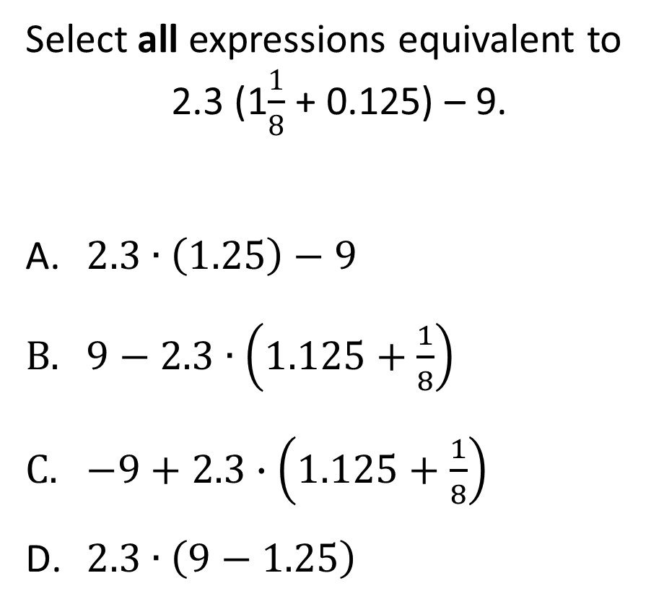
#1
7.EE.3 DOK 1
Notes:
‹#›

Slide 3

#1 Answer
Rubric:
(1 point) The student selects all the appropriate expressions.
Answer: A and C
Notes:
‹#›

Slide 4

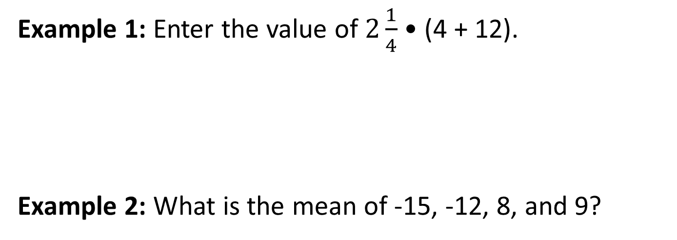
#2
7.EE.3 DOK 1

Slide 5
#2 Answer
Rubric:
(1 point) The student accurately calculates the value.
Answer:
Example 1: 36
Example 2: -2.5

Slide 6
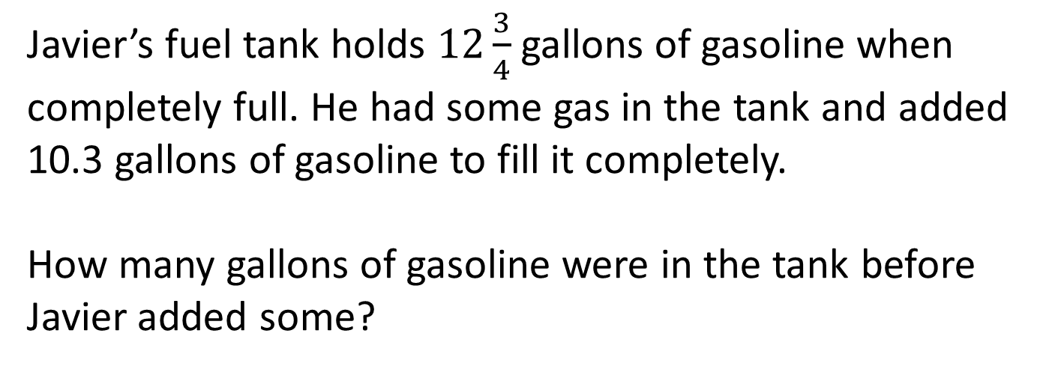
#3
7.EE.4a DOK 2

Slide 7
#3 Answer
Rubric:
(1 point each) Student enters a correct value.
Answer: 2.45 or equivalent

Slide 8
#4
A coach buys a uniform (u) and a basketball for each of the 15 players on the team. Each basketball costs $9.40. The coach spends a total of $420 for uniforms (u) and basketballs.
Part A: Enter an equation that models the situation with u, the cost of 1 uniform.
Part B: Enter the cost, in dollars, of 1 uniform
7.EE.4b DOK 2
Notes:
‹#›

Slide 9
#4 Answer
Rubric:
(1 point each) Student enters a correct equation/solution.
Answers:
Part A: 15u + 15 • 9.4 = 420
Part B: 19
Notes:
‹#›

Slide 10
#5
Linda has $26. She earns $6 for 1 hour (h) of babysitting. She wants to buy a ski pass for $80.
Part A: Enter an inequality that shows the number of hours (h) Linda could babysit to be able to buy the ski pass.
Part B: Enter the minimum number of hours Linda must babysit to be able to buy the ski pass.
7.EE.4b DOK 2
Notes:
‹#›

Slide 11
#5 Answer
Rubric:
(1 point each) The student enters a correct inequality/solution.
Answers:
Part A: 6h + 26 ≥ 80
Part B: 9
Notes:
‹#›

Slide 12
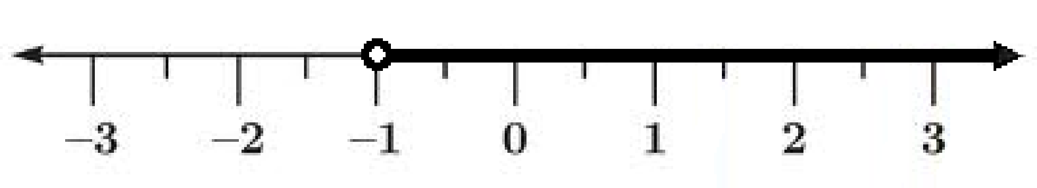
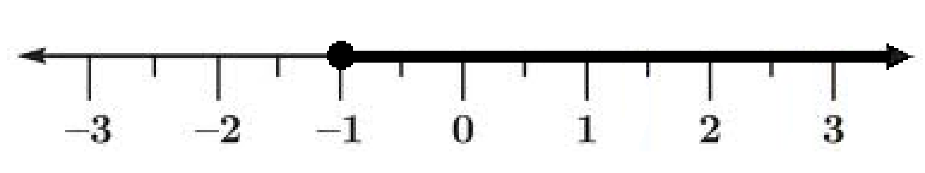
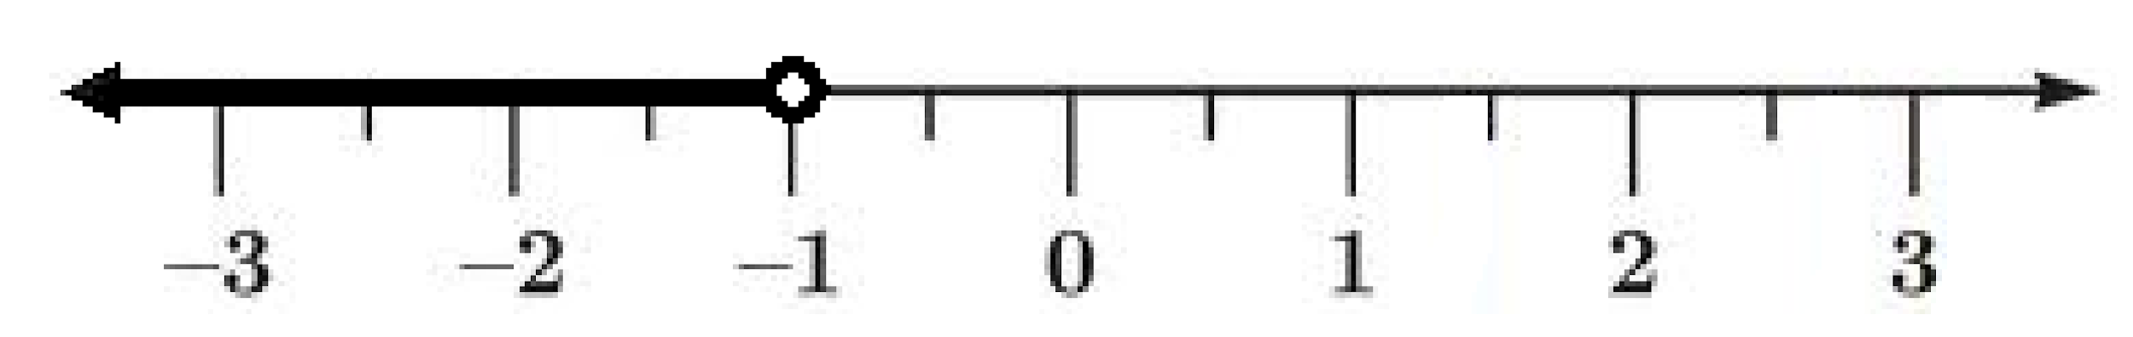
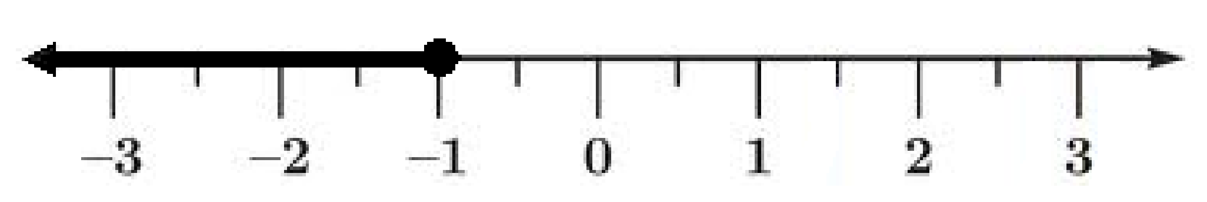
#6
Which number line shows the solution to the inequality
–3x – 5 < –2?
A.
B.
C.
D.
7.EE.4b DOK 2

Slide 13
#6 Answer
Rubric:
(1 point) The student selects the correct number line.
Answer: A

Slide 14
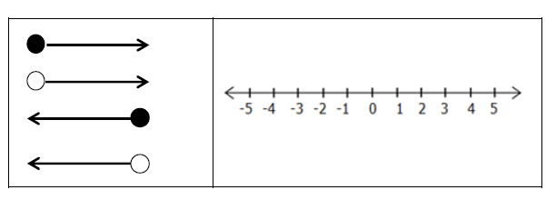
#7
Drag the correct arrow to the number line to represent the solution of the inequality 3x + 7 > 13.

Slide 15
#7 Answer
Rubric:
(1 point) The student graphs the inequality by placing an arrow on the number line.

