Slide 1

Claim 1
Smarter Balanced Sample Items
Grade 7 - Target C
Use properties of operations to generate equivalent expressions.
Questions courtesy of the Smarter Balanced Assessment Consortium Item Specifications – Version 3.0
Slideshow organized by SMc Curriculum – www.ccssmathactivities.com
Notes:
‹#›

Slide 2

#1
Example 1: Select the expression equivalent to
(3x + 2) + (–6x + 3).
A. –3x + 5
B. 3x + 5
C. 9x + 5
D. –9x + 5
Example 2: Select the expression equivalent to
(2.1x + 4.3) – (–3x – 7).
A. –0.9x – 2.7
B. –0.9x + 11.3
C. 5.1x – 2.7
D. 5.1x + 11.3
7.EE.1 DOK 1
Notes:
‹#›

Slide 3

#1 Answer
Rubric:
(1 point each) The student identifies the equivalent expression.
Answers:
Example 1: A
Example 2: D
Notes:
‹#›

Slide 4
#2
Example 1: Enter the value of n so that the expression (–y + 5) + (7y – 9) is equivalent to (ny – 4).
Example 2: Enter the value of n so that the expression (–y + 5.3) + (7.2y – 9) is equivalent to 6.2y + n.
7.EE.1 DOK 1
Notes:
‹#›

Slide 5
#2 Answer
Rubric:
(1 point each) The student enters the correct value for the variable.
Answers:
Example 1: 6
Example 2: –3.7
Notes:
‹#›

Slide 6
#3
Select all expressions equivalent to –72x + 60.
A. –12(6x – 5)
B. –12(–6x – 5)
C. 6(–12x + 10)
D. –6(–12x – 10)
7.EE.1 DOK 1
Notes:
‹#›

Slide 7
#3 Answer
Rubric:
(1 point) The student selects all of the equivalent expressions.
Answer: A and C
Notes:
‹#›

Slide 8
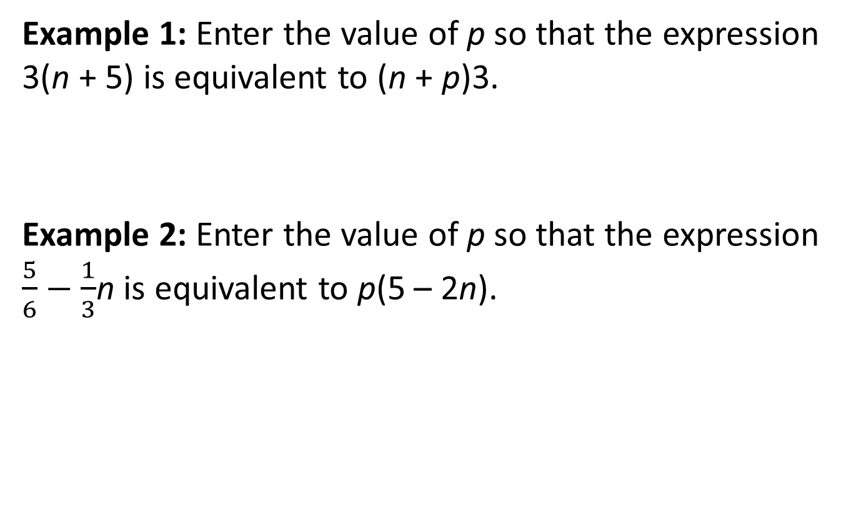
#4
7.EE.1 DOK 1
Notes:
‹#›

Slide 9

#4 Answer
Rubric:
(1 point each) The student enters the correct value for p.
Answers:
Example 1: 5
Example 2:
Notes:
‹#›

Slide 10
#5
Example 1: Which expression is equivalent to –15x + 6?
A. (–3)x – (–3)2 + (–3)4x
B. –3(–5x + 6)
C. (3)x – (–3)2 – (–3)4x
D. 3(5x + 6)
Example 2: Which expression is equivalent to
–0.8(10.8x – 20 + 3.2x)?
A. –11.2x + 16
B. –11.2x – 16
C. –8.64x – 16.8
D. –8.64x + 16.8
7.EE.1 DOK 1
Notes:
‹#›

Slide 11
#5 Answer
Rubric:
(1 point each) The student selects the equivalent expression.
Answers:
Example 1: A
Example 2: A
Notes:
‹#›

Slide 12
#6
Enter the value of b when the expression 14.1x + b is equivalent to 4.7(3x – 3.5).
7.EE.1 DOK 1

Slide 13
#6 Answer
Rubric:
(1 point) The student enters the correct value for b.
Answer: –16.45

Slide 14
#7
Select all expressions that are equivalent to
3x + 5(–4x + 12) – (x – 3).
A. –18x + 63
B. 18x – 63
C. 3x – 20x + 60 – x + 3
D. 3x + 20x + 60 – x – 3
7.EE.1 DOK 1

Slide 15
#7 Answer
Rubric:
(1 point) The student selects all the appropriate expressions.
Answers: A and C

Slide 16
#8
Select all expressions that are equivalent to
0.75x + 0.25(x + 12.4) + (x – 2.1).
A. 2x + 1
B. x + 1
C. x + 3.1 + x + 2.1
D. x + 3.1 + x – 2.1
7.EE.1 DOK 2

Slide 17
#8 Answer
Rubric:
(1 point) The student selects all the appropriate expressions.
Answers: A and D

