Slide 1

Claim 1
Smarter Balanced Sample Items
Grade 7 - Target B
Apply and extend previous understandings of operations with fractions to add, subtract, multiply, and divide rational numbers.
Questions courtesy of the Smarter Balanced Assessment Consortium Item Specifications – Version 3.0
Slideshow organized by SMc Curriculum – www.ccssmathactivities.com
Notes:
‹#›

Slide 2

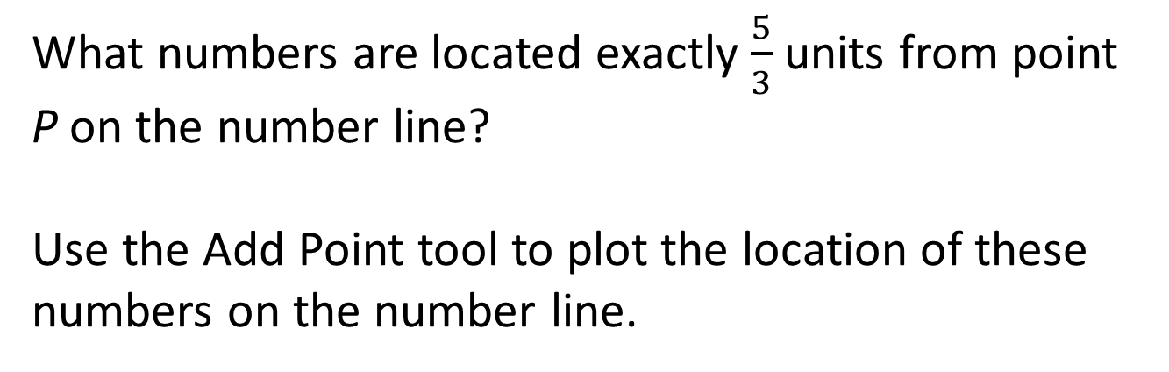
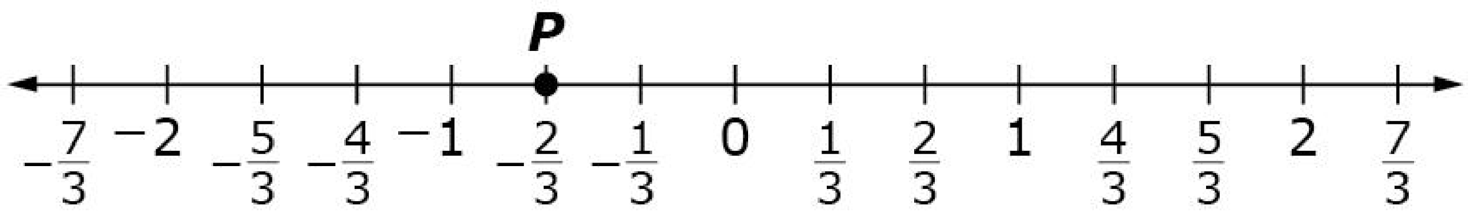
#1
Notes:
‹#›

Slide 3

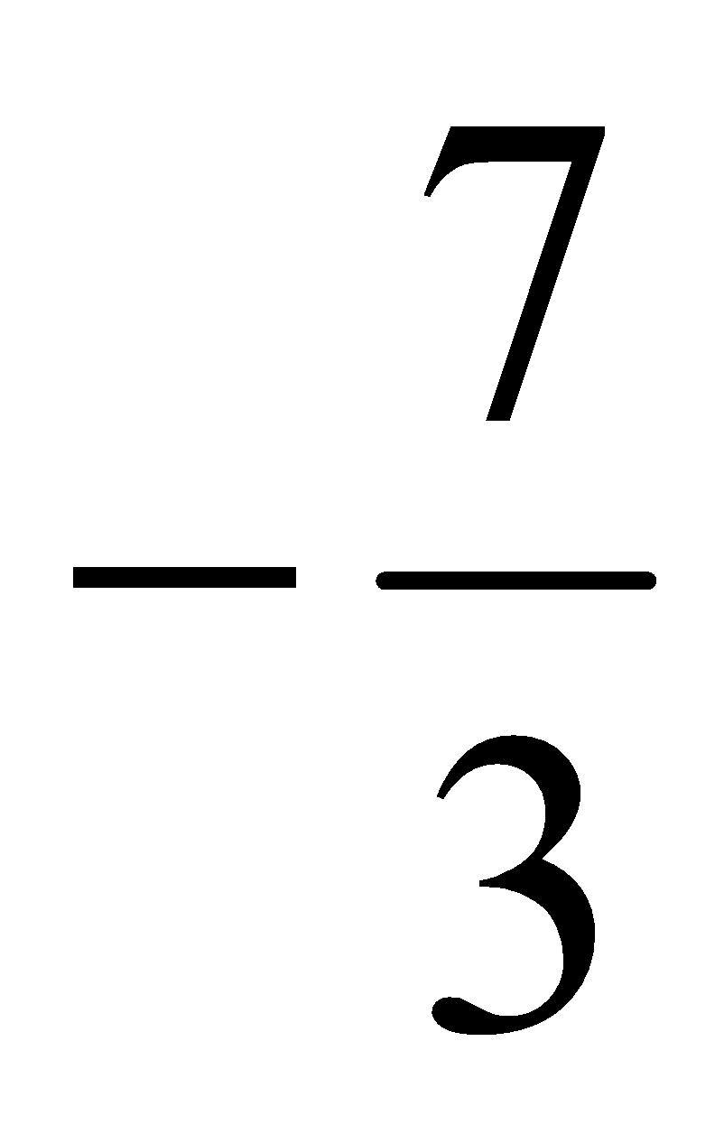
#1 Answer
Rubric:
(1 point) The student plots the exact location of both points.
Answer: and 1
Notes:
‹#›

Slide 4
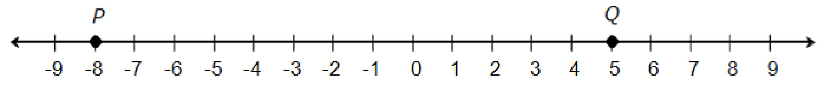
#2
Select all expressions that show the distance between P and Q.
A. 5 – (−8)
B. 5 + |−8|
C. |−8 + 5|
D. 5 + (−8)
Notes:
‹#›

Slide 5
#2 Answer
Rubric:
(1 point) Student selects all correct expressions and no incorrect expressions.
Answer: A and B
Notes:
‹#›

Slide 6
#3
Select all expressions that equal -7 – (-12).
7 + (-12)
-7 + (-12)
-7 + 12
7 = 12

Slide 7
#3 Answer
Rubric:
(1 point) Student selects all correct expressions and no incorrect expressions.
Answer: C

Slide 8
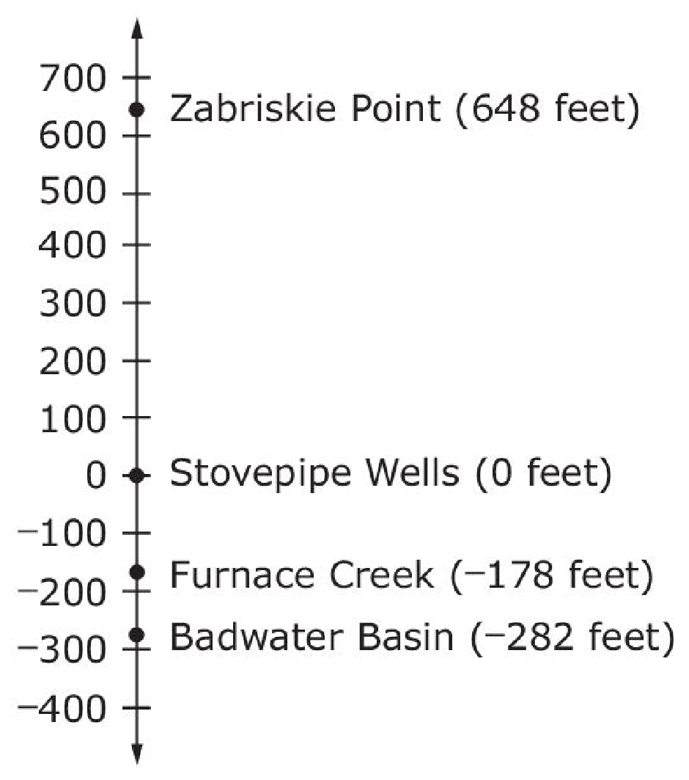
#4
The number line shows four elevations in Death Valley National Park. Enter the difference, in feet, between the elevation at Zabriskie Point and Furnace Creek.

Slide 9
#4 Answer
Rubric:
(1 point) Correct answer will be a rational number.
Answer: 826

Slide 10
#5
Example 1: Enter the value of 14 + (-22) – 14 – 22.
Example 2: Enter the value of 2.1 + (-3) – (-0.9)
Notes:
‹#›

Slide 11
#5 Answer
Rubric:
(1 point) Student accurately computes the value of the expression, which is a rational number.
Answer:
Example 1: -44
Example 2: 0
Notes:
‹#›

Slide 12
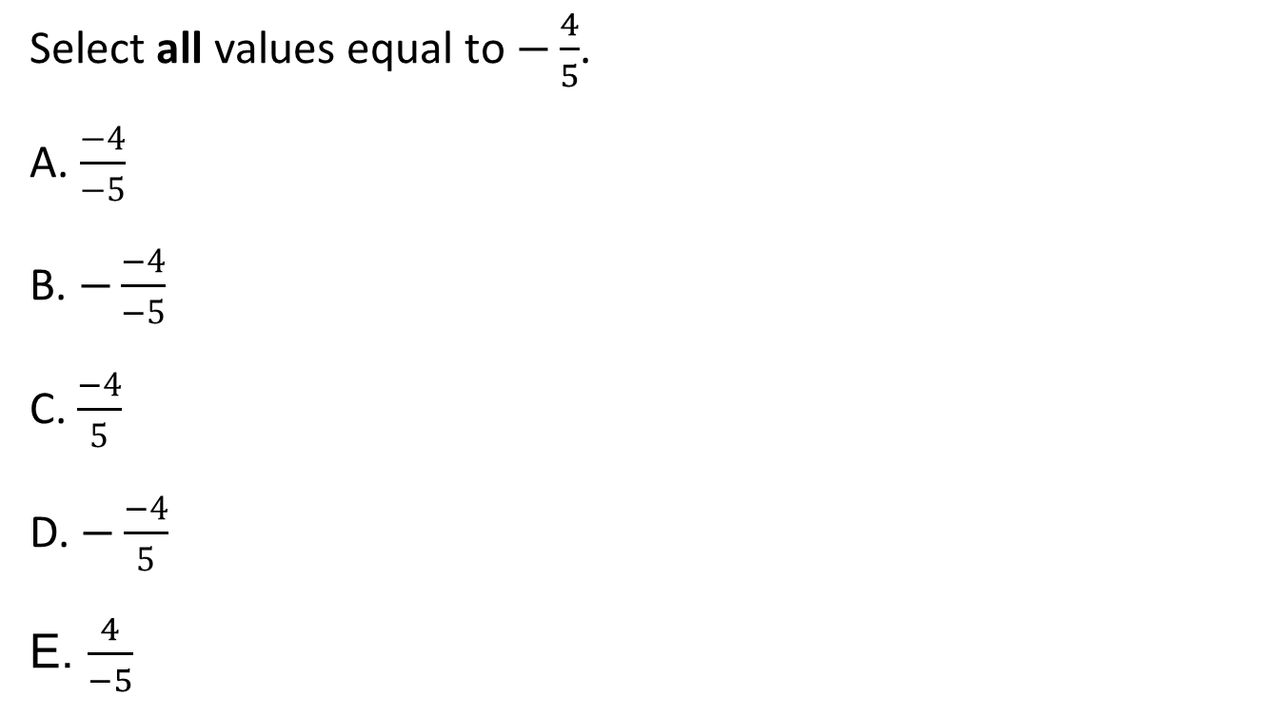
#6

Slide 13
#6 Answer
Rubric:
(1 point) Student selects all the correct expressions.
Answer: B, C, and E

Slide 14
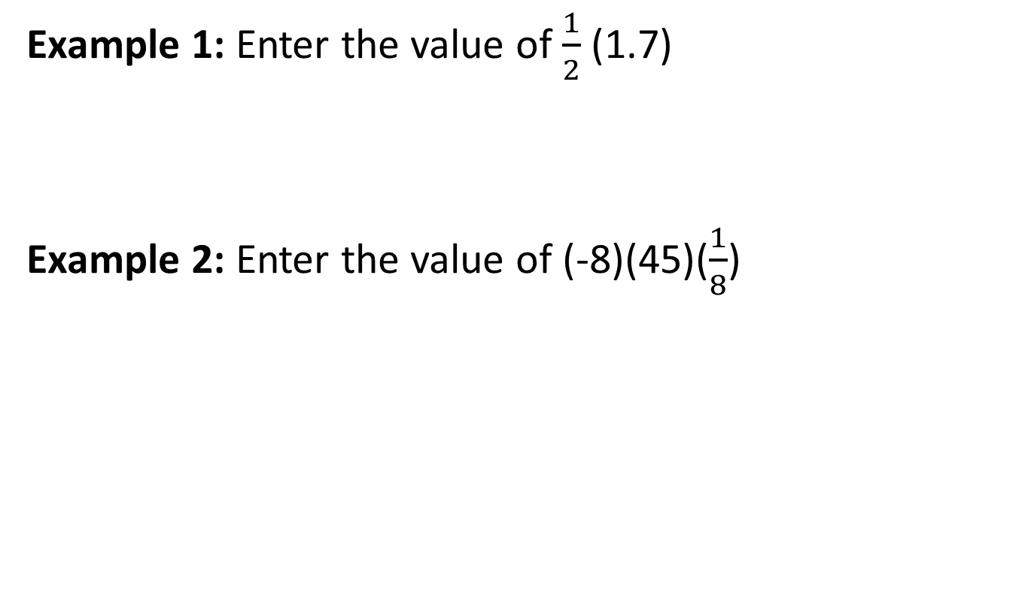
#7

Slide 15
#7 Answer
Rubric:
(1 point) Student accurately calculates the product, which is a rational number.
Answer:
Example 1: 0.85
Example 2: -45

Slide 16
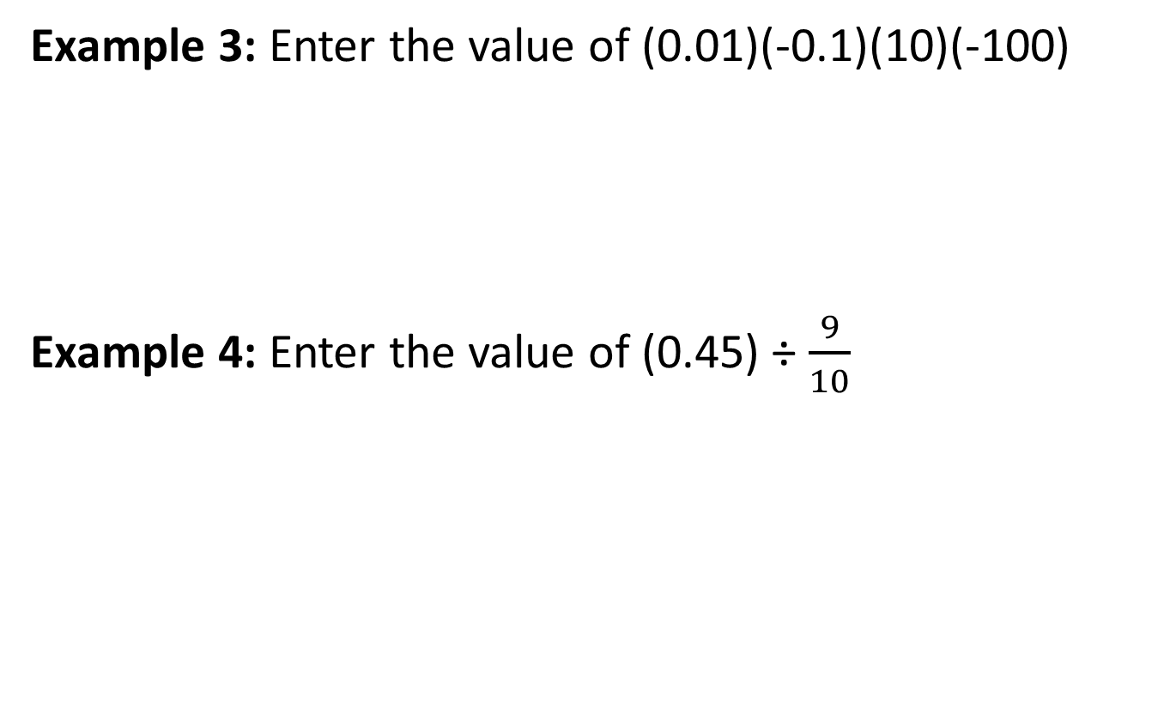
#8

Slide 17
#8 Answer
Rubric:
(1 point) Student accurately calculates the product or quotient, which is a rational number.
Answer:
Example 1: 1
Example 2: 0.5

Slide 18
#9
If a bank represents deposits with positive numbers and withdrawals as negative numbers, what could
5•(-20) represent?
Five deposits of $20.
Five withdrawals of $20.
A $5 deposit followed by a $20 withdrawal.
A $5 withdrawal followed by a $20 deposit.

Slide 19
#9 Answer
Rubric:
(1 point) The student selects the correct response.
Answer: B

Slide 20

#10

Slide 21

#10 Answer
Rubric:
(1 point) Student gives the correct decimal equivalent.
Answer: 0.625

Slide 22

#11

Slide 23
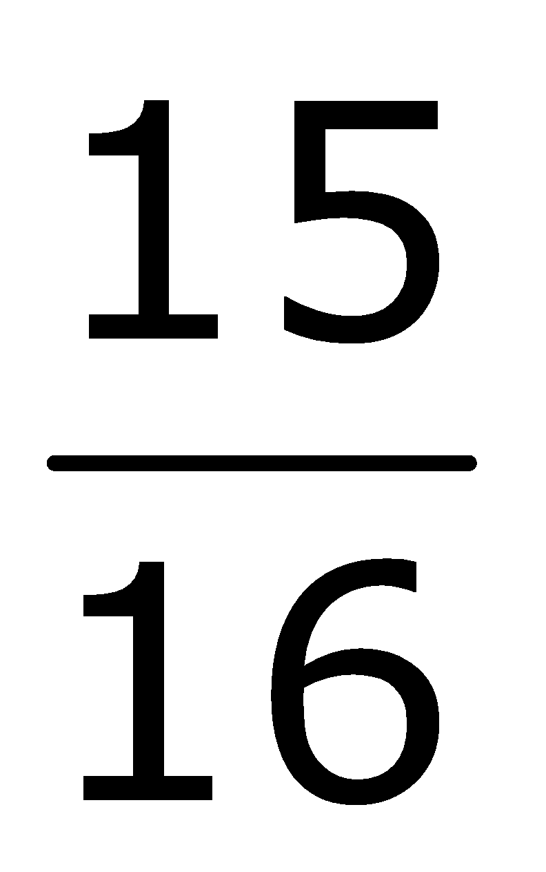
#11 Answer
Rubric:
(1 point) The student accurately calculates the value, which is a rational number.
Answer: 3.9375 or 3

Slide 24
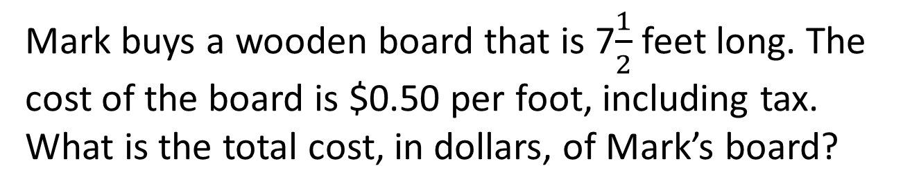
#12

Slide 25
#12 Answer
Rubric:
(1 point) Correct answer will be a single numeric value.
Answer: 3.75

