Slide 1

Claim 1
Smarter Balanced Sample Items
Grade 7 - Target A
Analyze proportional relationships and use them to solve real-world and mathematical problems.
Questions courtesy of the Smarter Balanced Assessment Consortium Item Specifications – Version 3.0
Slideshow organized by SMc Curriculum – www.ccssmathactivities.com
Notes:
‹#›

Slide 2

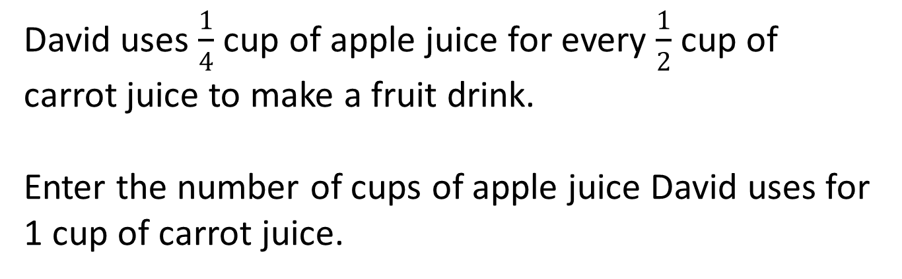
#1
Notes:
‹#›

Slide 3

#1 Answer
Rubric:
(1 point) Student enters the correct number.
Answer:
Notes:
‹#›

Slide 4
#2
This table shows a proportional relationship between the number of cups of sugar and flour used for a recipe.
Enter the number of cups of sugar used for 1 cup of flour.
Cups of Sugar | Cups of Flour
2 | 5
6 | 15
8 | 20
Notes:
‹#›

Slide 5

#2 Answer
Rubric:
(1 point) Student enters the correct number.
Answer:
Notes:
‹#›

Slide 6
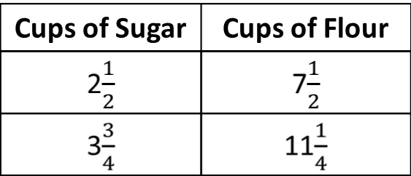
#3
This table shows a proportional relationship between the number of cups of sugar and flour used for a recipe.
Enter the number of cups of sugar used for 1 cup of flour.
Notes:
‹#›

Slide 7

#3 Answer
Rubric:
(1 point) Student enters the correct number.
Answer:
Notes:
‹#›

Slide 8
#4
Notes:
‹#›

Slide 9

#4 Answer
Rubric:
(1 point each) Student enters the correct number.
Answers:
Example 1: 4
Example 2:
Notes:
‹#›

Slide 10
#5
Select all tables that represent a proportional relationship between x and y.
A.
B.
C.
D.
x | 0 | 1 | 2 | 3
y | 0 | 2 | 4 | 6
x | 0 | 2 | 4 | 6
y | 0 | 4 | 16 | 36
x | 0 | 3 | 6 | 9
y | 0 | 15 | 30 | 45
x | 0 | 4 | 6 | 8
y | 0 | 16 | 36 | 64
Notes:
‹#›

Slide 11
#5 Answer
Rubric:
(1 point) Student selects all the correct tables.
Answer: A and C
Notes:
‹#›

Slide 12
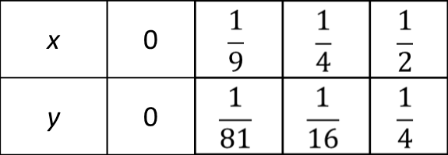
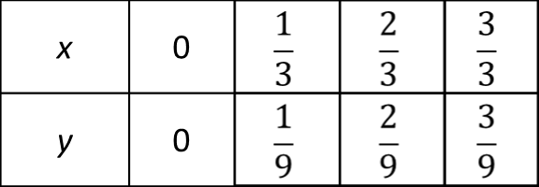
#6
Select all tables that represent a proportional relationship between x and y.
A. B.
C. D.
x | 0 | 1 | 2 | 3
y | 0 | 2 | 4 | 6
x | 0 | 2 | 4 | 6
y | 0 | 4 | 16 | 36
Notes:
‹#›

Slide 13
#6 Answer
Rubric:
(1 point) Student selects all the correct tables.
Answer: A and D
Notes:
‹#›

Slide 14
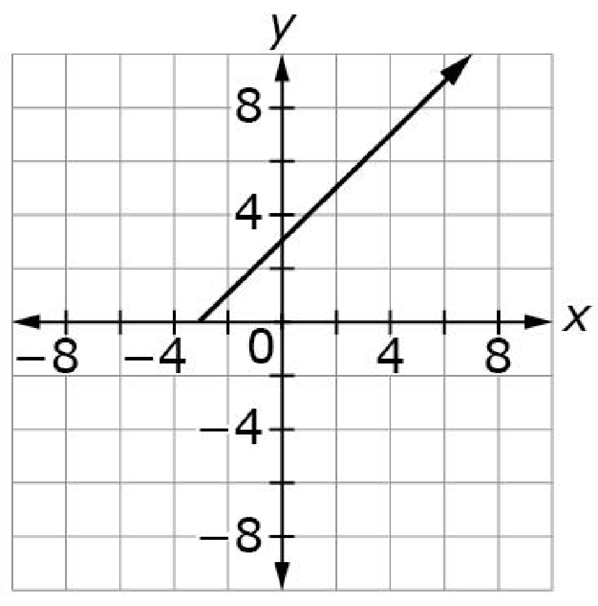
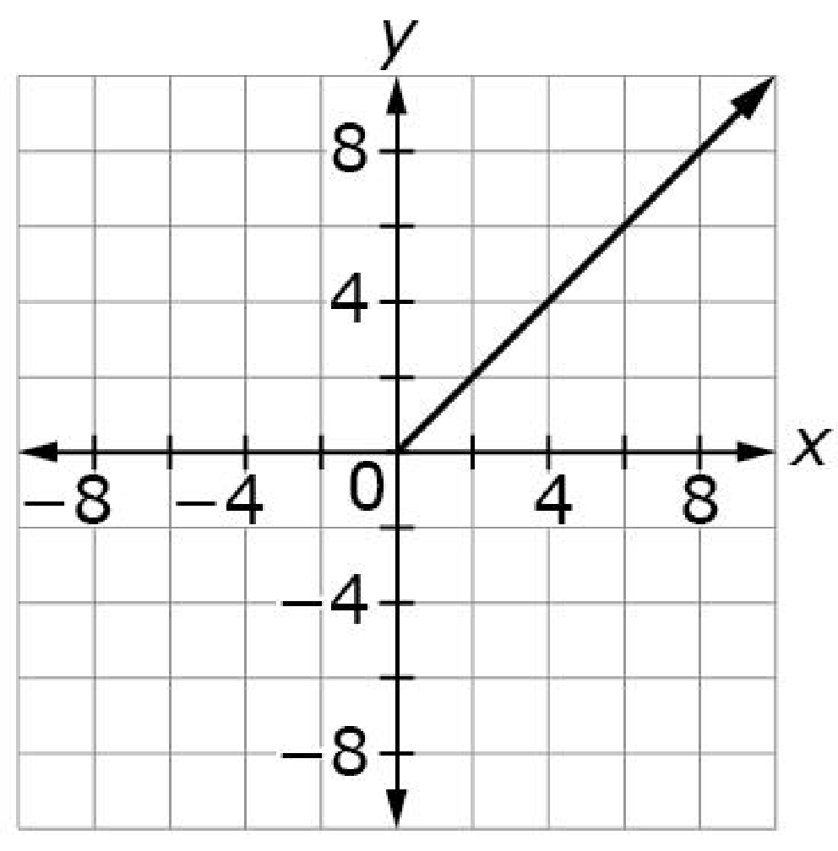
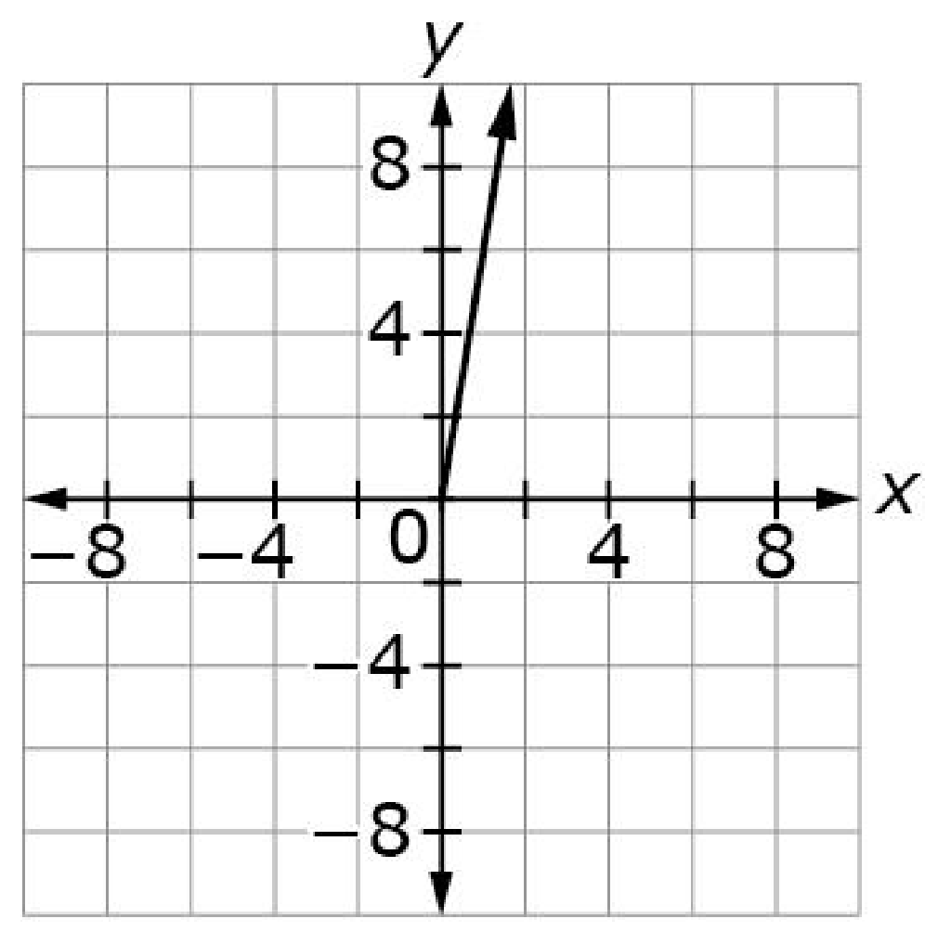
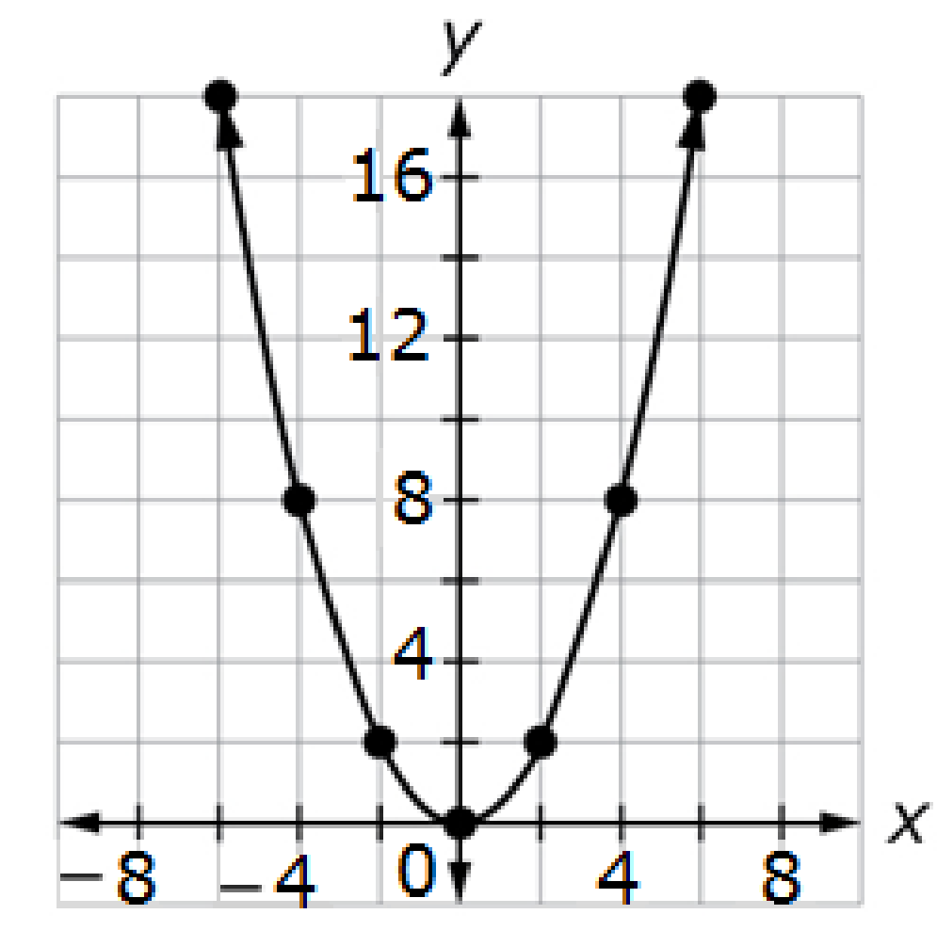
#7
Select all the graphs that show a proportional relationship.
A. B.
C. D.
Notes:
‹#›

Slide 15
#7 Answer
Rubric:
(1 point) Student selects all the correct graphs.
Answer: B and C
Notes:
‹#›

Slide 16
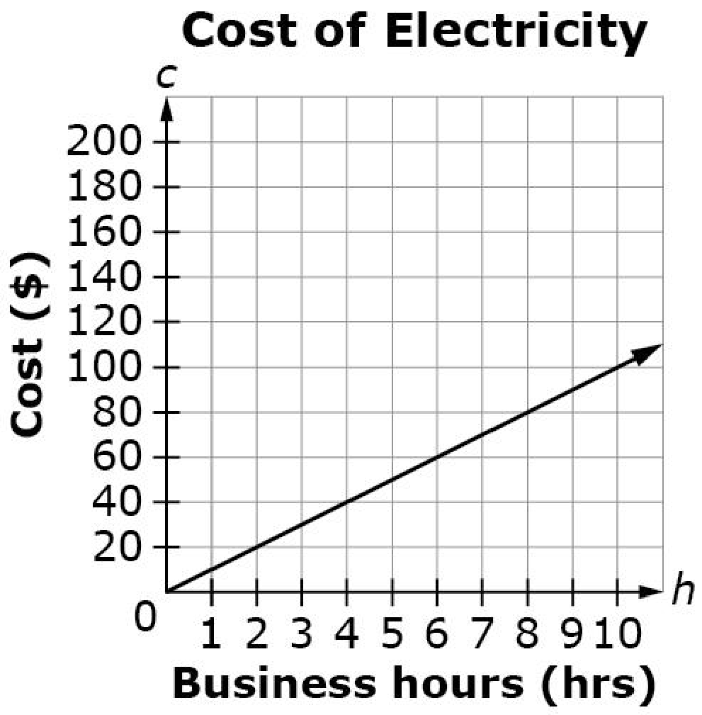
#8
This graph shows a proportional
relationship between the number
of hours (h) a business operates
and the total cost of electricity (c).
Find the constant of proportionality (r). Using the value for r, enter an equation in the form of c = rh that represents the relationship between the number of hours (h) and the total cost (c).
Notes:
‹#›

Slide 17
#8 Answer
Rubric:
(1 point) Student enters the correct equation.
Answer: c = 10h
Notes:
‹#›

Slide 18
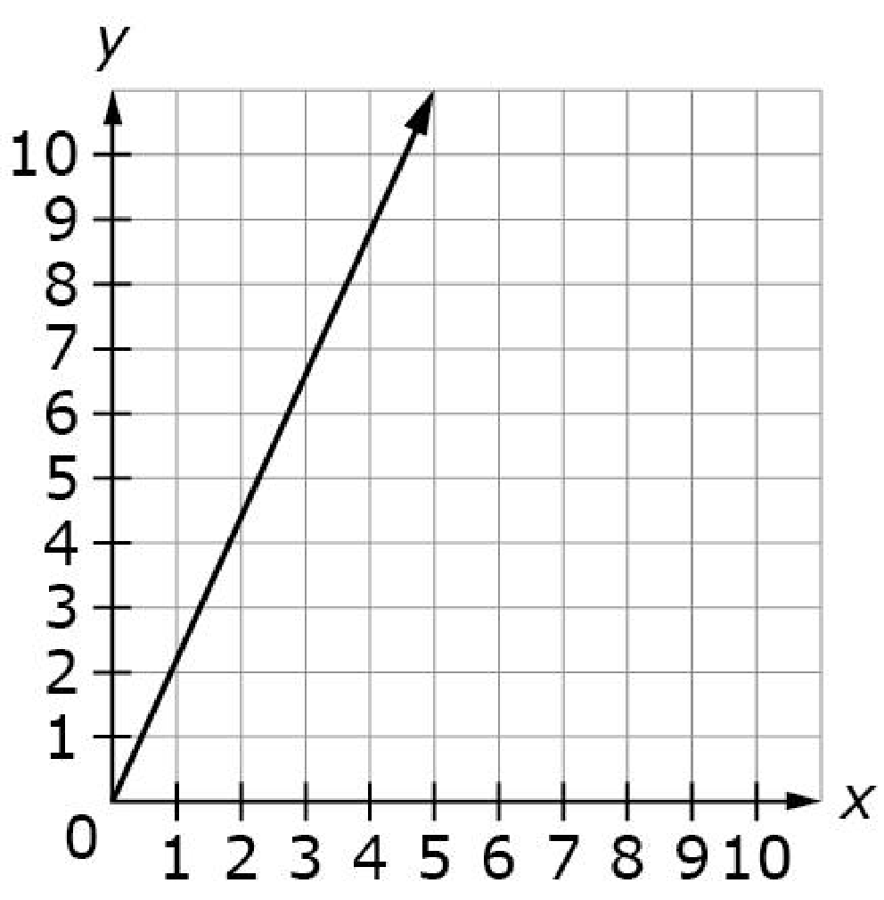
#9
This graph shows a proportional
relationship between x and y.
Find the constant of proportionality (r). Using the value for r, enter an equation in the form of y = rx.
Notes:
‹#›

Slide 19
#9 Answer
Rubric:
(1 point) Student enters the correct equation.
Answer: y = 2x
Notes:
‹#›

Slide 20
#10
This table shows a proportional relationship between x and y.
Find the constant of proportionality (r). Using the value for r, enter an equation in the form of y = rx.
X | Y
4 | 48
5 | 60
8 | 96
Notes:
‹#›

Slide 21
#10 Answer
Rubric:
(1 point) Student enters the correct equation.
Answer: y = 12x
Notes:
‹#›

Slide 22
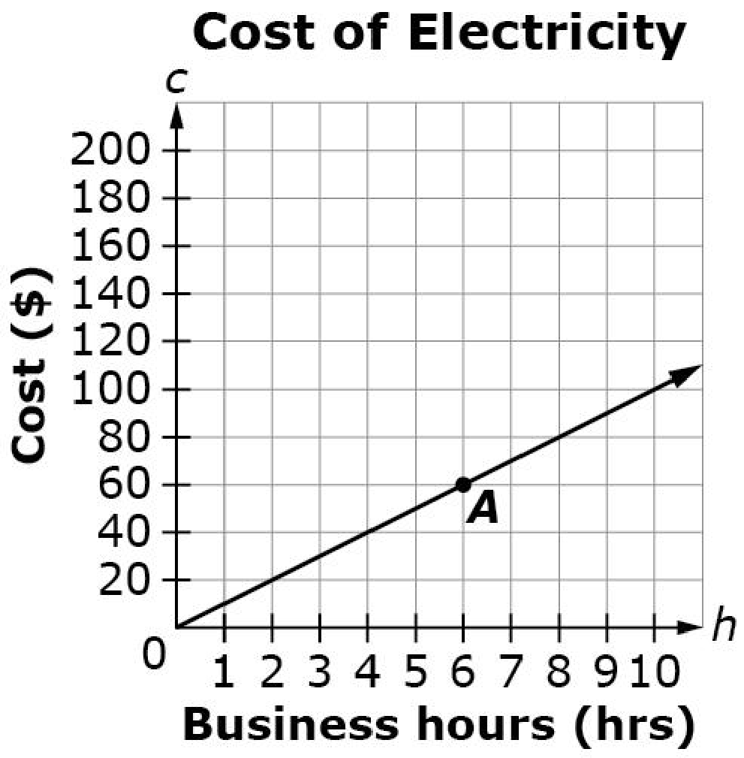
#11
This graph shows a proportional relationship between the number of hours (h) a business operates and the total cost (c) of electricity. Select True or False for each statement about the graph.
Statement | True | False
Point A represents the total cost of electricity when operating the business for 6 hours.
The total cost of electricity is $8 when operating the business for 80 hours.
The total cost of electricity is $10 when operating the business for 1 hour.
Notes:
‹#›

Slide 23
#11 Answer
Rubric:
(1 point) Student determines each statement as being either true or false. Each statement is a sentence describing one of the points in the context. False statements should be statements that use the wrong values or switch the values when interpreting the graph. More difficult statements are about points beyond the visible portion of the graph.
Answer: T, F, T
Notes:
‹#›

Slide 24
#12
Dave buys a baseball for $15 plus an 8% tax. Mel buys a football for $20 plus an 8% tax. Enter the difference in the amount Dave and Mel paid, including tax. Round your answer to the nearest cent.
Notes:
‹#›

Slide 25
#12 Answer
Rubric:
(1 point) Student gives the correct difference in the amount between David and Mel.
Answer: 540
Notes:
‹#›

Slide 26
#13
A bicycle is originally priced at $80. The store owner gives a discount and the bicycle is now priced at $60. Enter the percentage discount for the cost of the bicycle.
Notes:
‹#›

Slide 27
#13 Answer
Rubric:
(1 point) Student gives the correct percentage discount.
Answer: 25
Notes:
‹#›

Slide 28
#14
Dave has a 32 ounce energy drink. He drinks 10 ounces. Enter the percentage of ounces Dave has left from his energy drink. Round your answer to the nearest hundredth.
Notes:
‹#›

Slide 29
#14 Answer
Rubric:
(1 point) Student gives the correct percentage.
Answer: 68.75
Notes:
‹#›

