Slide 1

Claim 4
Smarter Balanced Sample Items
Grade 6
Modeling and Data Analysis
Questions courtesy of the Smarter Balanced Assessment Consortium Item Specifications – Version 3.0
Slideshow organized by SMc Curriculum – www.ccssmathactivities.com

Slide 2
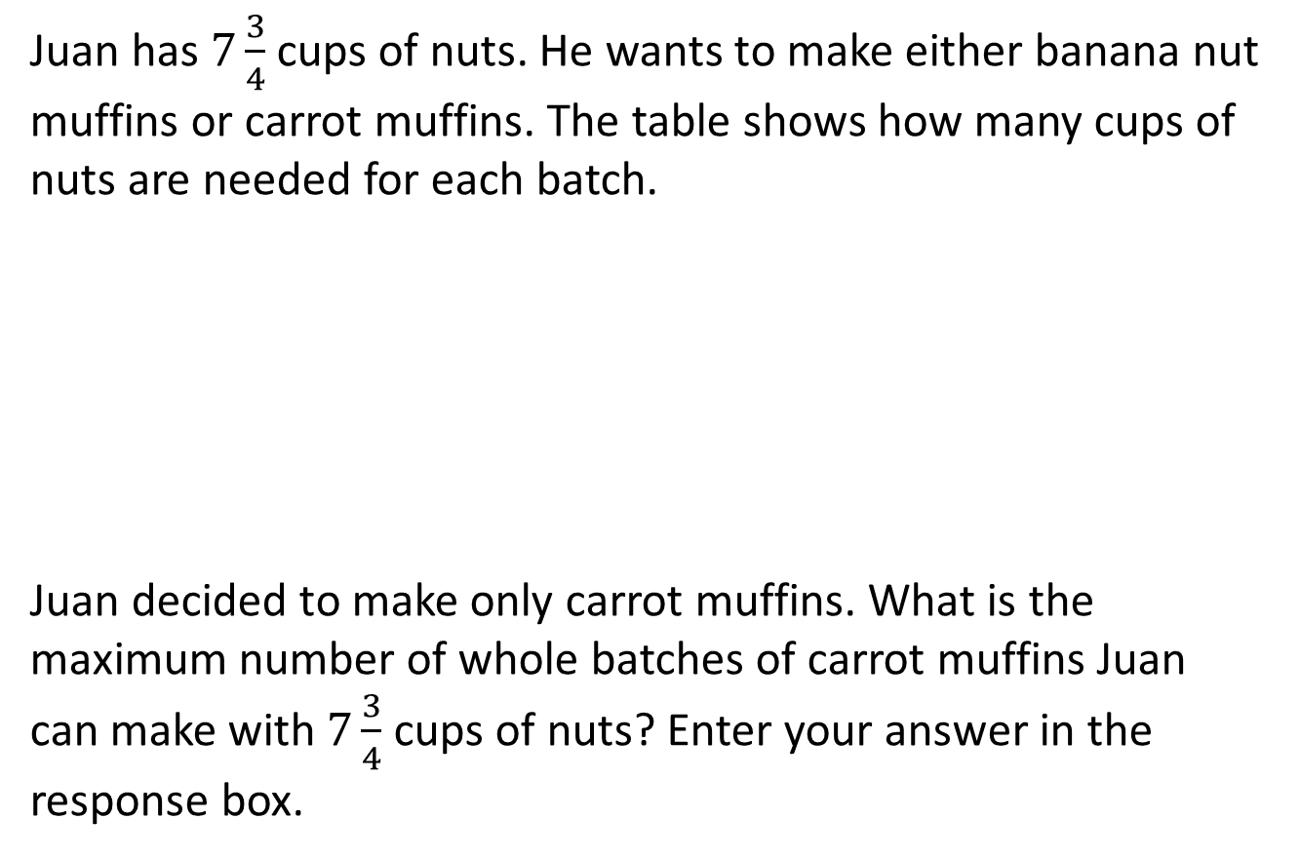
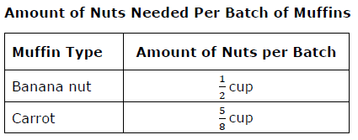
#1

Slide 3
#1 Answer
Rubric:
(1 point) Student enters the correct number.
Answer: 12

Slide 4
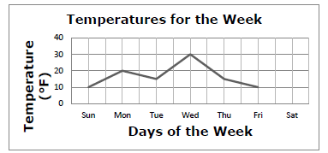
#2
Justin predicts that the temperature change from Friday to Saturday will be twice as much as it was from Thursday to Friday.
Use the Add Point tool to plot a point on the graph that could represent Justin’s predication for Saturday’s temperature.

Slide 5
#2 Answer
Rubric:
(1 point) The student graphs a point on Saturday that represents the temperature that represents a change of 10 degrees either direction.
Answer: 0 or 20

Slide 6
#3
A boat takes 3 hours to reach an island 15 miles away.
The boat travels:
at least 1 mile but no more than 6 miles during the first hour
at least 2 miles during the second hour
exactly 5 miles during the third hour
Use the Connect Line tool to show the range of miles the boat could have traveled during the second hour, given the conditions above.
Number of Miles

Slide 7
#3 Answer
Rubric:
(1 point) The student graphs the correct solution set.
Answer: a line segment from 4 to 9

Slide 8
#4
Hummingbirds drink nectar from flowers and sugar water from bird feeders.
Sugar water is made by mixing 50 grams of sugar with 200 grams of water.
A hummingbird’s favorite flower nectar is 21% sugar by mass.
The amount of food a hummingbird eats at one time is always the same whether it eats sugar water or flower nectar.
Part A
Will the hummingbird get more sugar from a meal of sugar water made according to the recipe, or from an equal-sized meal of flower nectar? Choose one: Sugar water, flower nectar
Part B
How much more sugar, in grams, would a hummingbird get from 4 grams of the more sugary food type than from 4 grams of the less sugary food type?

Slide 9
#4 Answer
Rubric:
(2 points) The student selects the more sugary food and identifies the additional amount of sugar correctly.
(1 point) The student identifies the food made by the recipe and enters the difference as 0.16, which corresponds to assuming the recipe is 25% sugar by weight (a likely mistake) but then correctly computing the difference.
Answer: More sugary food: flower nectar; amount of sugar: 0.04

Slide 10
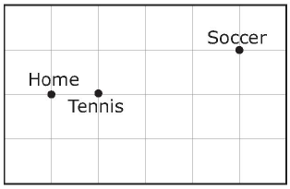
#5
Mrs. Jonas, her son Cody, and her daughter, Laura
drove from home to Cody’s tennis practice.
Mrs. Jonas then drove Laura to her soccer game
and stayed to watch.
After the game, mother and daughter picked up
Cody from the tennis courts on the way home.
Once home, Mrs. Jonas saw that they had driven 15 miles that day.
Mrs. Jonas took the shortest routes to and from each destination. The figure shows the location of the Jonas family home, the tennis courts, and the soccer field. The gridlines in the figure represent the streets, and all distances between cross streets are approximately the same.
Part A
Write an equation that can be used to find the distance, d, between the tennis courts and home. Enter your answer in the first response box.
Part B
What is the distance, in miles, between home and the tennis courts? Enter your answer in the second response box.

Slide 11
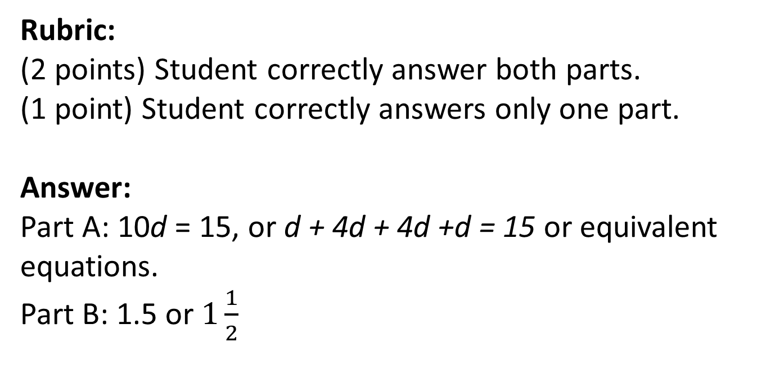
#5 Answer

Slide 12
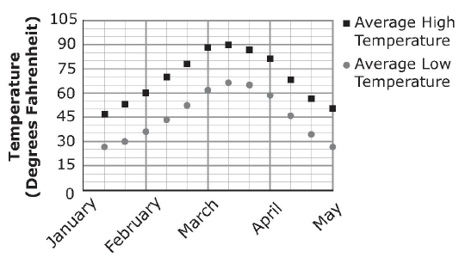
#6
Part A
If you were going to plan a picnic, what temperature would you hope to have for the picnic? Enter the temperature, in degrees Fahrenheit, you think would be best in the first response box. You may change your answer later if you wish.
Part B
The average monthly high and low temperatures for a town are shown in the graph. Select a month from the drop
down menu where the
temperature you chose would
fall between the high and low
temperatures for that month.

Slide 13
#6 Answer
Rubric:
(1 point) The student selects a month where the temperature he or she chose falls between the high and low temperatures for that.

