Slide 1

Claim 3
Smarter Balanced Sample Items
Grade 6
Communicating Reasoning
Questions courtesy of the Smarter Balanced Assessment Consortium Item Specifications – Version 3.0
Slideshow organized by SMc Curriculum – www.ccssmathactivities.com

Slide 2
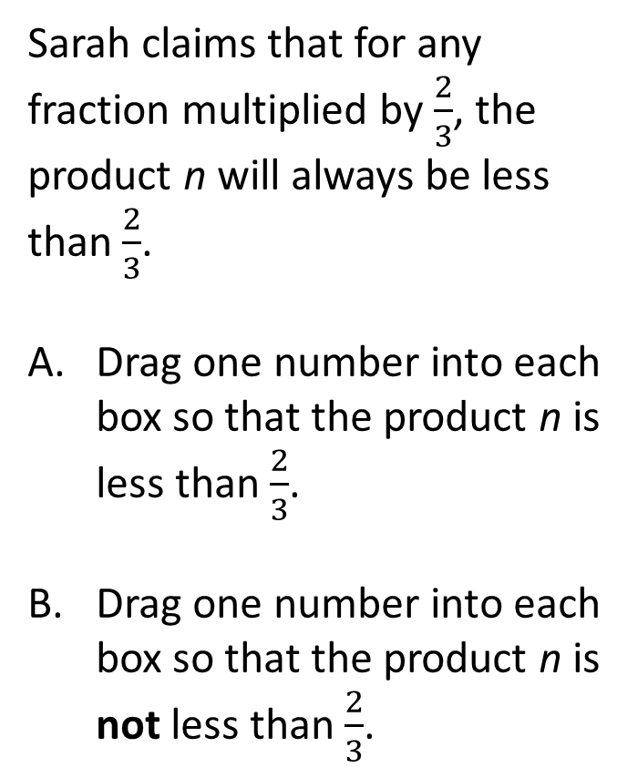
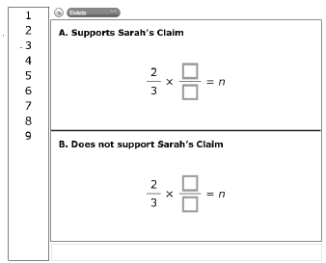
#1

Slide 3
#1 Answer
Rubric:
(1 point) The student drags one number into each box to create an equation where n is less than in Part A, and drags one number into each box to create an equation to show that Sarah’s claim is incorrect in Part B.

Slide 4
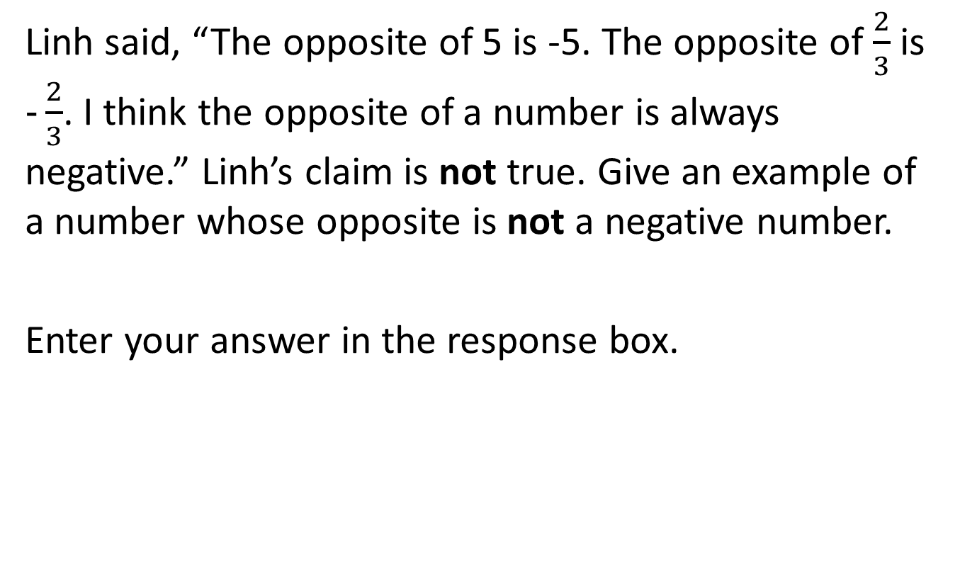
#2

Slide 5
#2 Answer
Rubric:
(1 point) The student gives a negative number.
Answer: Any negative number.

Slide 6
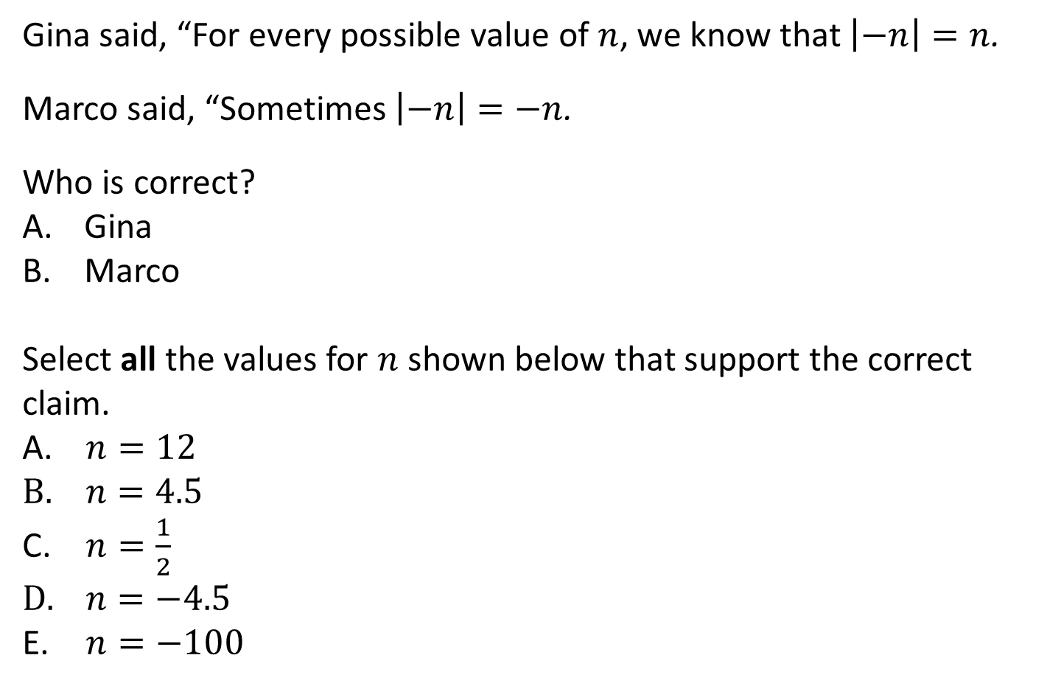
#3

Slide 7
#3 Answer
Rubric:
(1 point) The student selects the correct student and all of the correct values that supports Marco’s claim.
Answer: B (Marco); D and E

Slide 8
#4
Lola said, “If n is a positive number, then the points P = (n, n),
Q = (-n, n), R = (-n, -n), and S = (n, -n) are the vertices of a square in the coordinate plane.”
Select all of the statements that support Lola’s claim that the figure is a square.
The number n is a whole number.
The angles at P, Q, R and S are all 90 degrees.
The distances between P and Q, Q and R, R and S, and S and P are n units.
The distances between P and Q, Q and R, R and S, and S and P are 2n units.

Slide 9
#4 Answer
Rubric:
(1 point) The student selects all of the statements that support Lola’s claim.
Answer: B and D

Slide 10
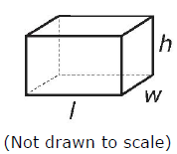
#5
A right rectangular prism has a height of 5 centimeters. Is it possible that the volume of the prism is 42 cubic centimeters?
If it is possible:
Enter a possible length and width, in cm, of a prism with a height of 5 cm in two response boxes.
If it is not possible:
Enter a possible volume (in cubic centimeters) and the corresponding length and width (in centimeters) in the response boxes.

Slide 11
#5 Answer
Rubric:
(1 point) The student enters dimensions that are possible.
Answer: Any two numbers whose product is 8.4.

Slide 12

#6
Clark biked 4 miles in 20 minutes. How far can he go in 2 hours if he bikes at this rate? Enter your answer in the first response box.
Show how you would solve this problem with a table or an equation (choose one option).
Option 1: Table
Enter values in the table so that it shows the number of miles, m, Clark can bike in 2 hours at this rate.
Option 2: Equation
Enter an equation that can be solved to find the number of miles, m, Clark can bike in 2 hours at this rate in the second response box.

Slide 13

#6 Answer
Rubric:
(2 points) The student enters the correct number of miles (24) and fills in the table with at least two columns, one of which contains the correct answer, or enters an equation that can be solved to find the answer.
(1 point) The student does one of these parts correctly.
Answer: Examples:
2 x 3 x 4 = m or 4/20 m/20 or equivalent equation.

Slide 14
#7
Lyla flew her radio-controlled airplane 500 feet in 20 seconds. She claims that the speed of her airplane was 25 feet per second during the flight. What assumption must Lyla make for her claim to be true?
The airplane flew in a circle.
The airplane flew in a straight line.
The airplane flew at a constant speed.
The airplane flew faster at the end of the flight than at the beginning.

Slide 15
#7 Answer
Rubric:
(1 point) The student selects the correct statement.
Answer: C

Slide 16
#8
Emma was solving the equation t – 4 = 16. She said, “I’m looking for a number t that is 4 less than 16. So t = 12.”
Which statement best describes the flaw in Emma’s reasoning?
Emma’s answer is right but she should just subtract 4 from both sides of the equation.
Emma’s answer is wrong but she thought about the equation correctly.
Emma is confused about which number the 4 is being subtracted from.
Emma should subtract the 16 from the 4 instead of 4 from the 16.

Slide 17
#8 Answer
Rubric:
(1 point) The student selects the correct analysis of the flaw in reasoning.
Answer: C

