Slide 1

Claim 2
Smarter Balanced Sample Items
Grade 6
Problem Solving
Questions courtesy of the Smarter Balanced Assessment Consortium Item Specifications – Version 3.0
Slideshow organized by SMc Curriculum – www.ccssmathactivities.com

Slide 2
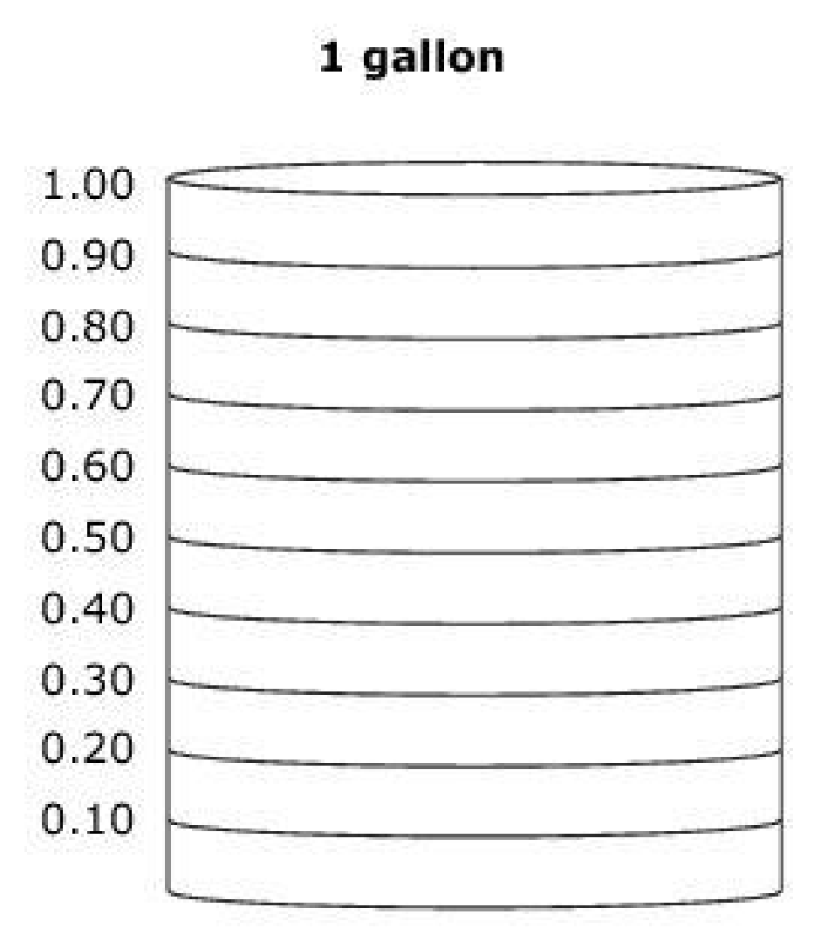
#1
Tim makes 80 gallons of paint by mixing 48 gallons of green paint with 32 gallons of blue paint.
What part of every gallon is from green paint?
The model represents 1 gallon of mixed paint.
Select the bars to show how much of the gallon is from green paint.

Slide 3
#1 Answer
Rubric:
(1 point) The student clicks on the model up to 0.6 gallon.

Slide 4
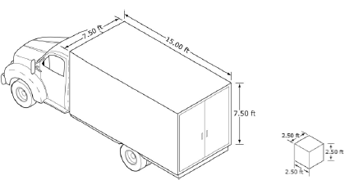
#2
Cube-shaped boxes will be loaded into the cargo hold
of a truck.
The edges of each box measure 2.5 feet.
The cargo hold of the truck is in the shape of a rectangular prism.
The dimensions of the
cargo hold are 7.5 feet by
15.0 feet by 7.5 feet.
What is the volume, in cubic feet, of the cargo hold of the truck? Enter your answer in the first response box.
How many boxes will it take to completely fill the cargo hold of the truck? Enter your answer in the second response box.

Slide 5
#2 Answer
Rubric:
(2 points) The student correctly determines the volume and the number of 2.5 x 2.5 x 2.5 boxes the truck can hold. Two response boxes are needed.
(1 point) The student correctly answers either the volume or the number of boxes, but not both.
Answer: 843.75, 54

Slide 6
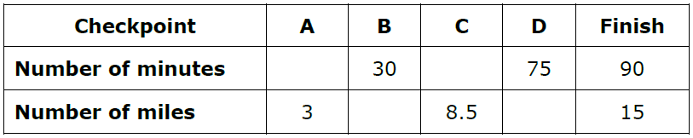
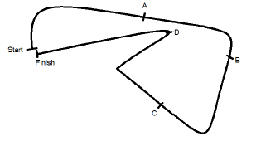
#3
It takes Shaun 90 minutes to complete a 15 mile race. The route, with four checkpoints (labeled A, B, C, and D), is shown. Assume Shaun runs at a constant rate during the race. Complete the table to show Shaun’s time, in minutes, and distance, in miles, at each checkpoint.

Slide 7
#3 Answer
Rubric:
(2 points) The student correctly enters all four missing values in the table.
(1 point) The student correctly determines both minutes or both miles or three out of four values correct.
Answer:
Minutes: 18, 51
Miles: 5, 12.5

Slide 8
#4
Katie and Becca each bought a new book for $50.
Katie sold her book to the used bookstore for 25% less than the original price.
Becca sold her book to the used bookstore for 40% less than the original price.
Enter how much more money, in dollars, Katie received for her book than Becca received for her book.

Slide 9
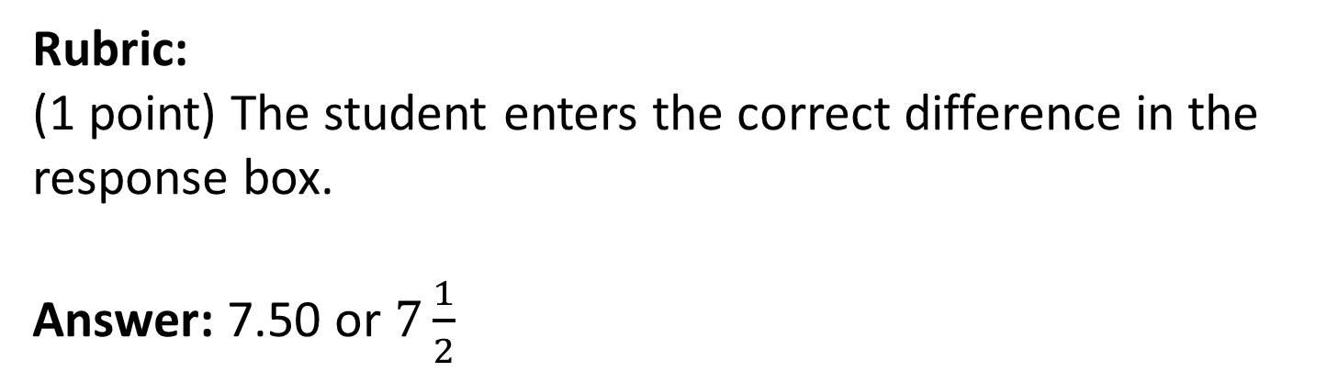
#4 Answer

Slide 10
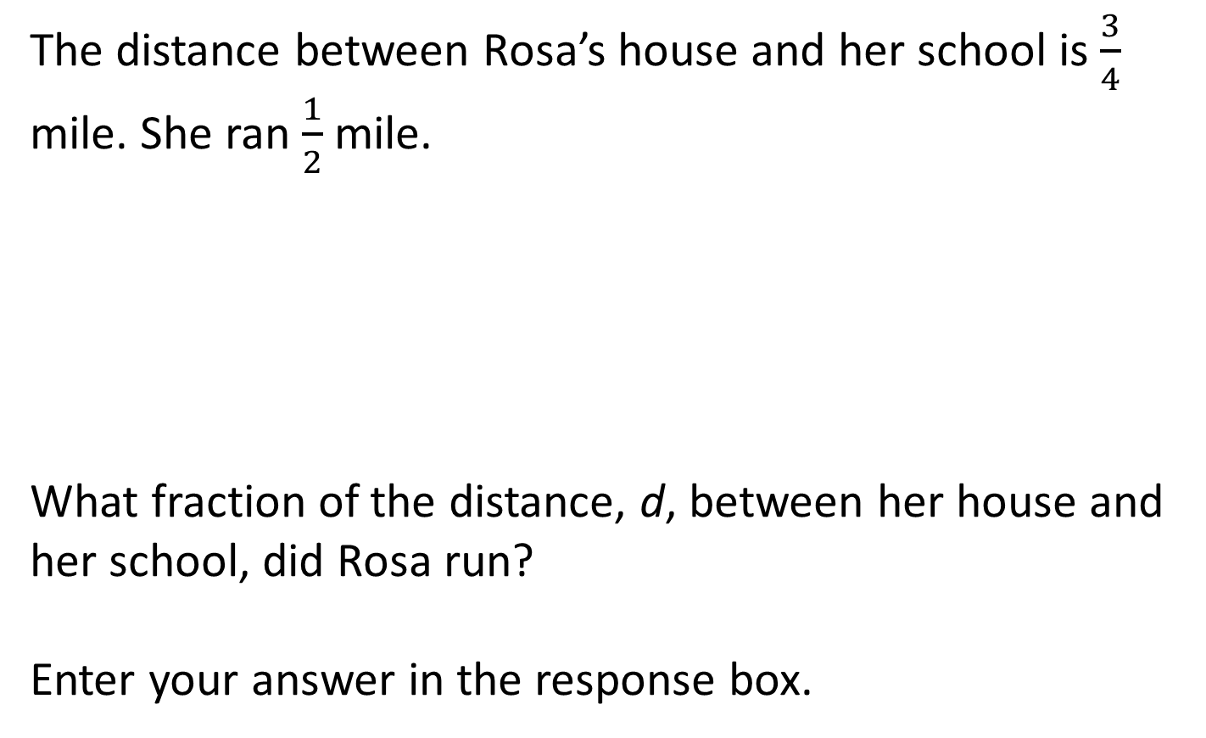
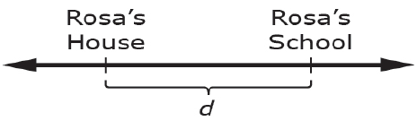
#5

Slide 11
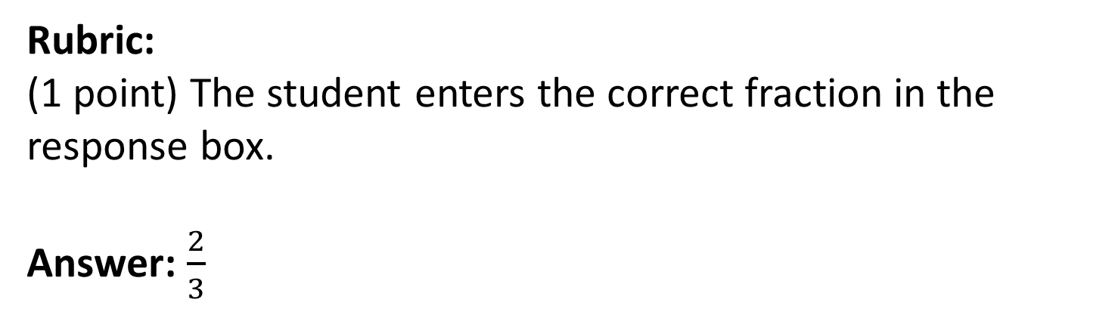
#5 Answer

Slide 12
#6
A factory makes 2,200 bottles every 5.5 hours. The factory makes bottles for 8 hours each work day.
Enter a whole number to represent the fewest number of work days the factory will need to make 28,000 bottles.

Slide 13
#6 Answer
Rubric:
(1 point) The student solves for the least number of days.
Answer: 9

Slide 14
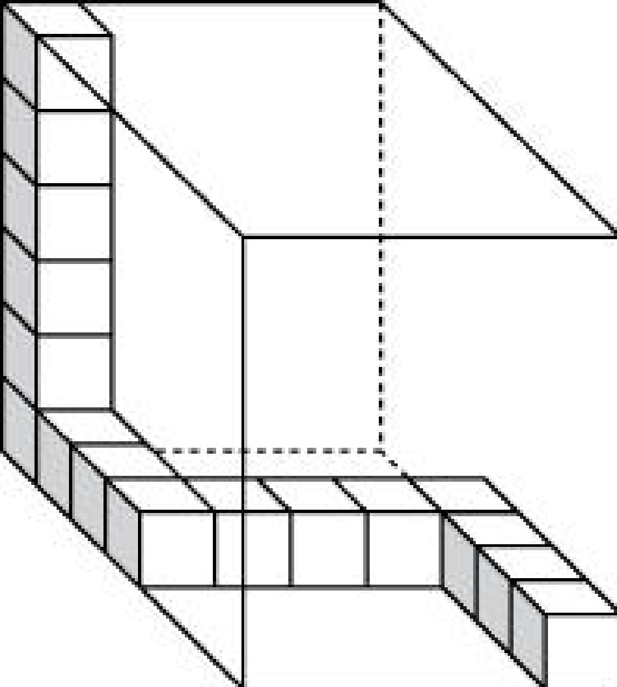
#7
Brady started to fill the box shown with some unit cubes. Including the cubes that are already in the box, what is the total number of unit cubes needed to completely fill the box?

Slide 15
#7 Answer
Rubric:
(1 point) The student enters the number of unit cubes.
Answer: 210

Slide 16
#8
Bill wants to run a total of 4000 meters in 5 days. The table shows how far he runs each day for 4 days. Each lap is 400 meters.
Enter the number of laps Bill should run on Friday so his total for the 5 days is exactly 4000 meters.
Day of Week | Laps Run
Monday
Tuesday
Wednesday
Thursday

Slide 17
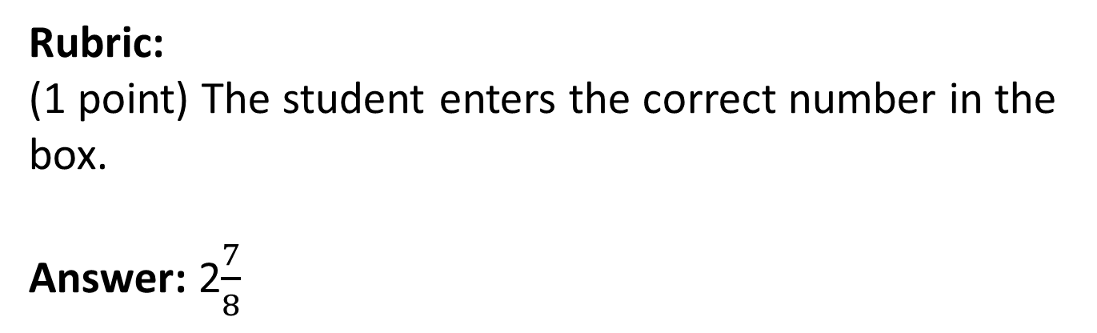
#8 Answer

Slide 18
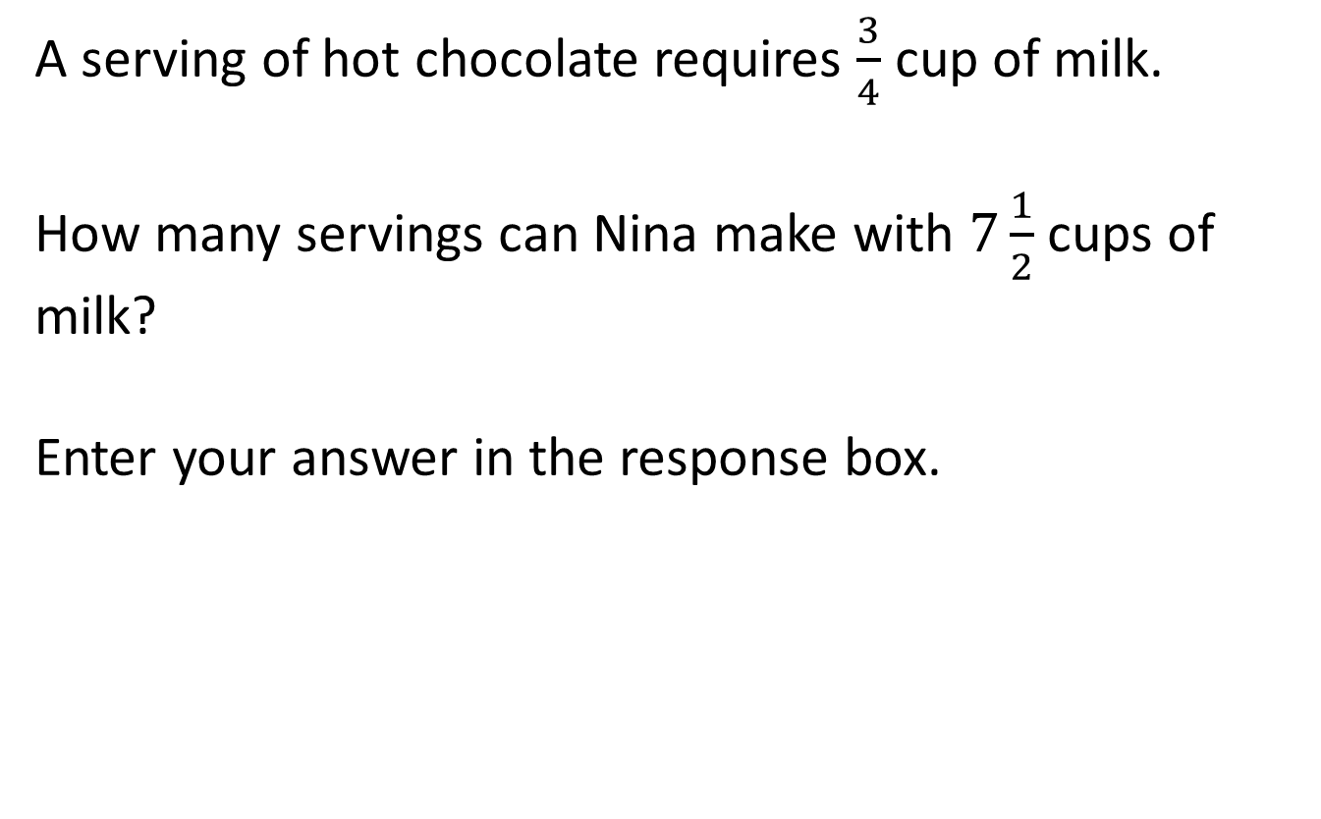
#9

Slide 19
#9 Answer
Rubric:
(1 point) The student enters the correct number of servings in the response box.
Answer: 10

Slide 20
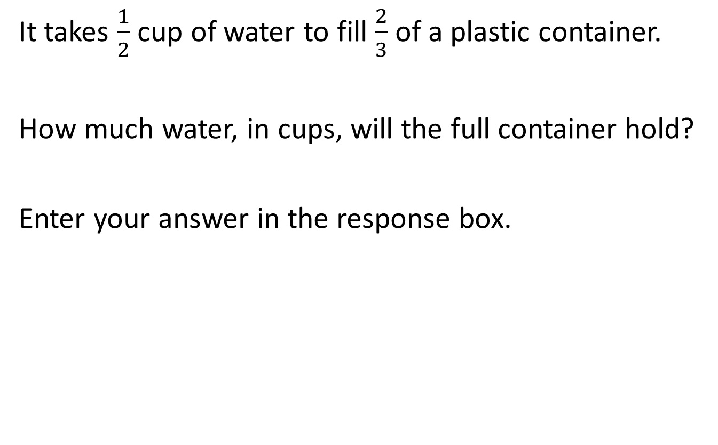
#10

Slide 21
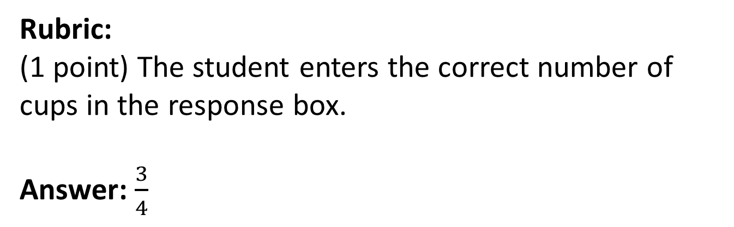
#10 Answer

Slide 22
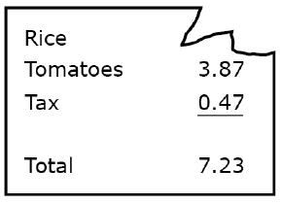
#11
Sierra bought a bag of rice and some tomatoes. The corner of her receipt got torn. The torn receipt is shown.
Write an equation that can be solved to determine the cost, x, of the bag of rice.
Enter your equation in the response box.

Slide 23
#11 Answer
Rubric:
(1 point) The student enters a correct equation in the response box.
Answer: x + 3.87 + 0.47 = 7.23

Slide 24
#12
Perform the following calculations. You may use a calculator, but in some cases, mental calculations might be faster and more reliable.
Part A:
(1 – 1) + (2 – 2) + (3 – 3) + (4 – 4) + (5 – 5) + (6 – 6) + (7 – 7) + (8 – 8) + (9 – 9) + 10 = ?
Enter your answer in the first response box.
Part B:
987 x 654 = ?
Enter your answer in the second response box.

Slide 25
#12 Answer
Rubric:
(1 point) The student correctly enters the correct values for both parts in the response boxes.
Answer: 10; 645,498

Slide 26
#13
A factory makes 12 bottles every 2 minutes. The factory makes bottles for 8 hours each work day.
Enter a whole number to represent the fewest number of work days the factory will need to make 28,000 bottles.

Slide 27
#13 Answer
Rubric:
(1 point) The student enters the correct least number of days in the response box.
Answer: 10

