Slide 1

Claim 1
Smarter Balanced Sample Items
Grade 6 - Target J
Summarize and describe distributions.
Questions courtesy of the Smarter Balanced Assessment Consortium Item Specifications – Version 3.0
Slideshow organized by SMc Curriculum – www.ccssmathactivities.com
Notes:
‹#›

Slide 2
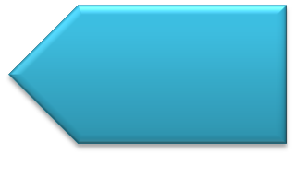

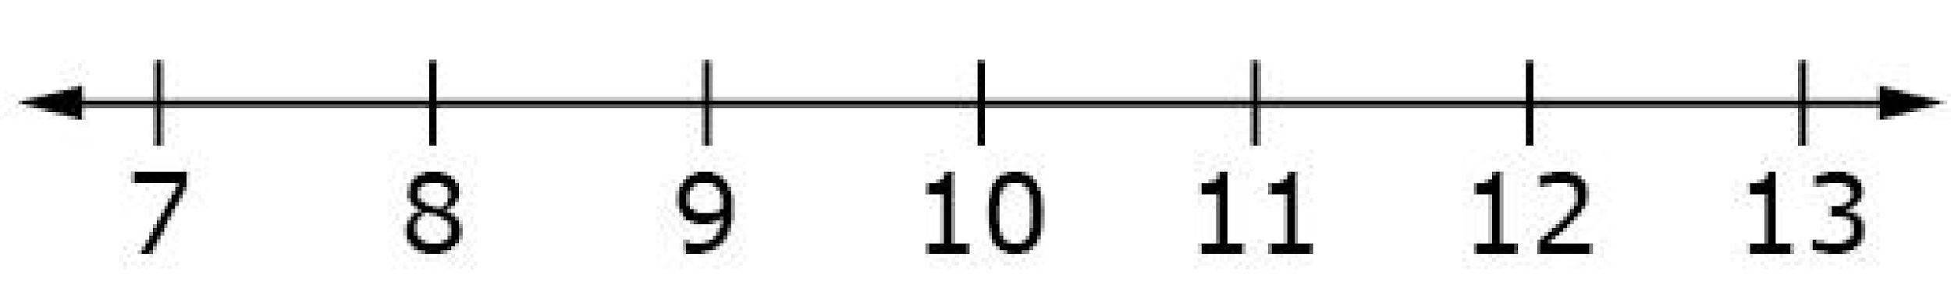
#1
Consider this data set.
Click above the number line to create a dot plot for the data set.
10 | 11 | 12
9 | 8 | 9
11 | 9 | 8
Notes:
‹#›

Slide 3

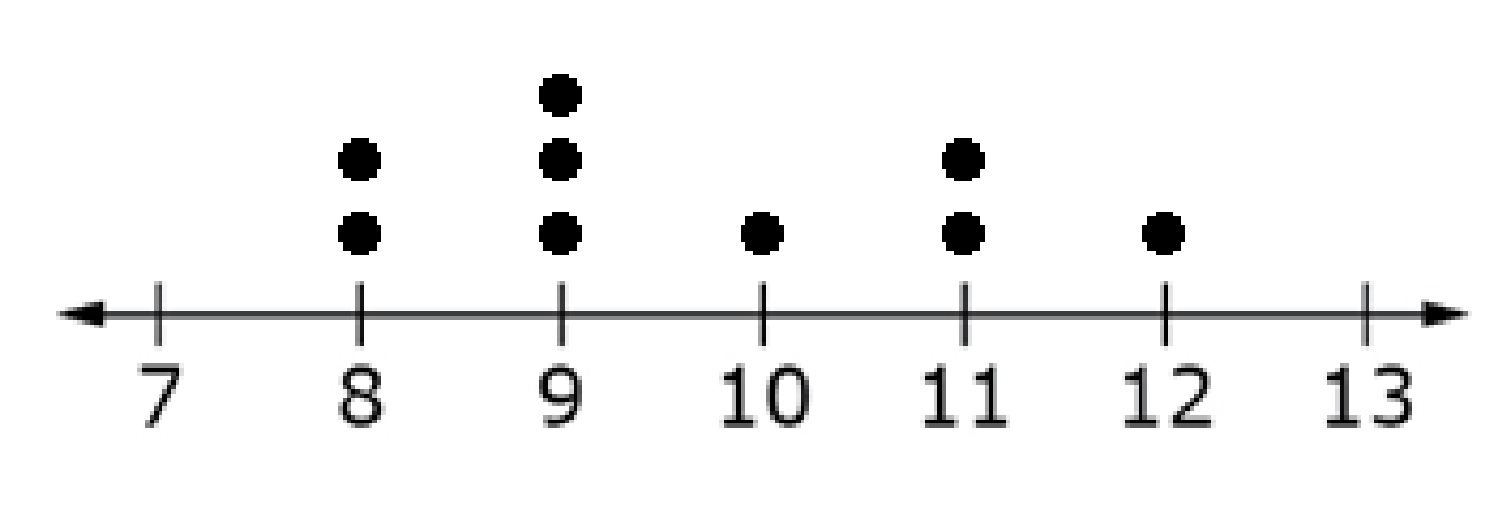
#1 Answer
Rubric:
(1 point) Student correctly creates a dot plot to represent the data.
Answer:
Notes:
‹#›

Slide 4
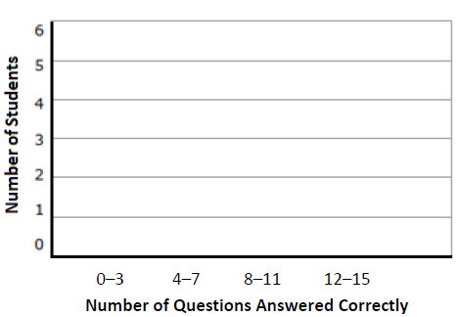
#2
Consider this data set.
Click within the graph area to create a histogram for the data set.
10 | 11 | 12
9 | 15 | 9
7 | 4 | 8
Notes:
‹#›

Slide 5
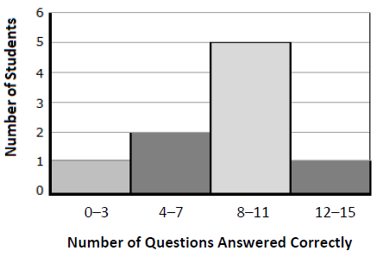
#2 Answer
Rubric:
(1 point) Student correctly creates a histogram to represent the data.
Answer:
Notes:
‹#›

Slide 6
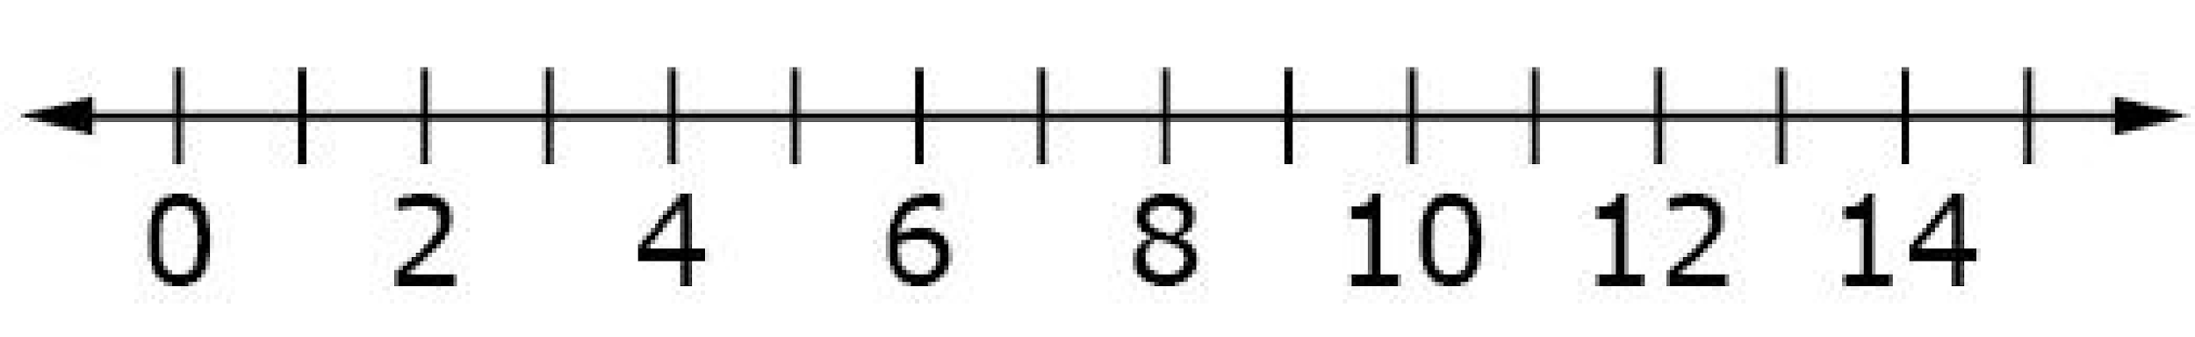
#3
Consider this data set.
The vertical line segments represent the 1st quartile (1st Q), median and the 3rd quartile (3rd Q) of the data set. Drag each line segment to the correct location on the number line.
1st Q Median 3rd Q
10 | 11 | 12
9 | 15 | 9
7 | 4 | 8
Notes:
‹#›

Slide 7
#3 Answer
Rubric:
(1 point) Student places the three line segments in the correct locations on the number line.
Answer:
1st Q = 7.5
Median = 9
3rd Q = 11.5
Notes:
‹#›

Slide 8
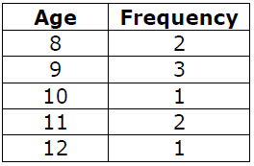
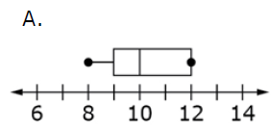
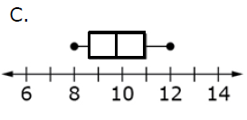
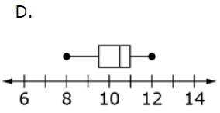
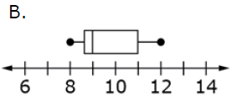
#4
The ages of 9 students in a summer camp are shown in this frequency table.
Which box plot correctly displays the
data shown in the table?
Notes:
‹#›

Slide 9
#4 Answer
Rubric:
(1 point) The student selects the correct box plot.
Answer: B
Notes:
‹#›

Slide 10
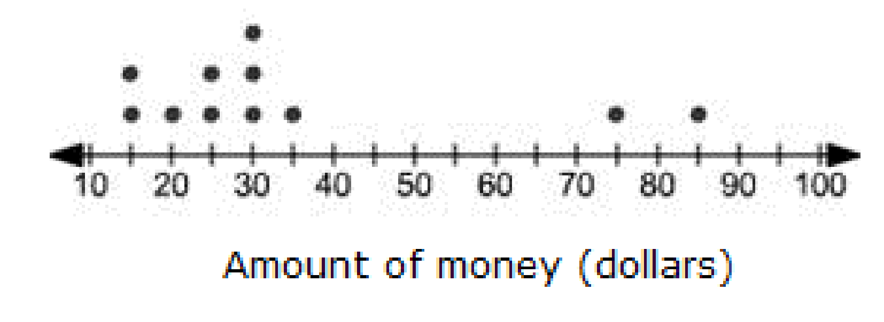
#5
Ted surveyed his neighbors to see how much money they spent on gasoline each week. The results are shown in the dot plot. Enter the total number of people Ted surveyed.
Notes:
‹#›

Slide 11
#5 Answer
Rubric:
(1 point) Student enters correct value.
Answer: 11
Notes:
‹#›

Slide 12
#6
Judy surveyed her friends to see how many minutes they studied for their math test last evening. The results are in this list.
10, 15, 20, 15, 35, 25, 20, 30, 25
Enter the mean of the data.
Notes:
‹#›

Slide 13
#6 Answer
Rubric:
(1 point) Student gives the correct mean of the data. Students answers should be within an acceptable range.
Answer: 21.6– 22
Notes:
‹#›

Slide 14
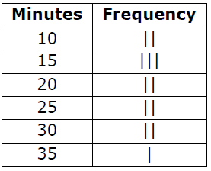
#7
Avery surveyed her friends to see how many minutes they studied for their math test last evening. The results are shown in the frequency table.
Enter the median of the data.
Notes:
‹#›

Slide 15
#7 Answer
Rubric:
(1 point) Student gives the correct median of the data.
Answer: 20
Notes:
‹#›

Slide 16
#8
Avery surveyed her friends to see how many minutes they studied for their math test last evening. The results are shown in the frequency table.
Enter the interquartile range of the data.
Notes:
‹#›

Slide 17
#7 Answer
Rubric:
(1 point) Student gives the correct interquartile range of the data.
Answer: 15
Notes:
‹#›

