Slide 1

Claim 1
Smarter Balanced Sample Items
Grade 6 - Target H
Solve real-world and mathematical problems involving area, surface area, and volume.
Questions courtesy of the Smarter Balanced Assessment Consortium Item Specifications – Version 3.0
Slideshow organized by SMc Curriculum – www.ccssmathactivities.com
Notes:
‹#›

Slide 2
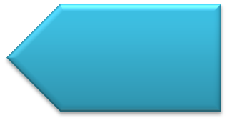

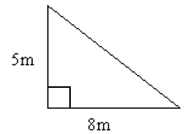
#1
Consider this figure.
Enter the area of the right triangle in square meters.
Notes:
‹#›

Slide 3

#1 Answer
Rubric:
(1 point) Student enters the correct area of the figure. Correct answer should be a single numerical value and units should be assumed from the stem.
Answer: 20
Notes:
‹#›

Slide 4
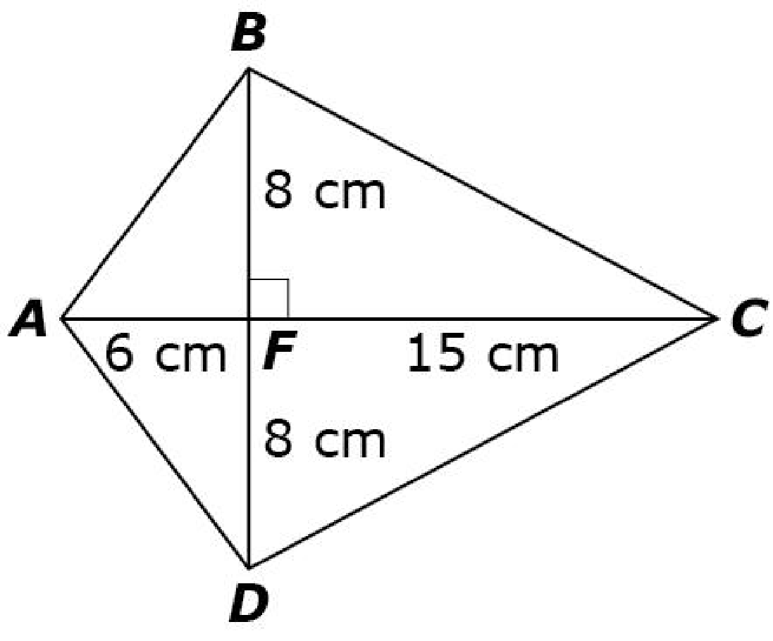
#2
Consider this figure.
Enter the total area, in square centimeters, of kite ABCD.
Notes:
‹#›

Slide 5
#2 Answer
Rubric:
(1 point) Student enters the correct area of the figure. Correct answer should be a single numerical value and units should be assumed from the stem.
Answer: 168
Notes:
‹#›

Slide 6
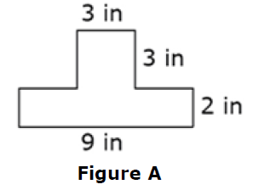
#3
Figure A is composed of two shapes.
A rectangle with length 9 inches and width 2 inches.
A square with side lengths 3 inches.
Enter the total area, in square inches, of Figure A.
Notes:
‹#›

Slide 7
#3 Answer
Rubric:
(1 point) Student enters the correct area of the figure. Correct answer should be a single numerical value and units should be assumed from the stem.
Answer: 27
Notes:
‹#›

Slide 8
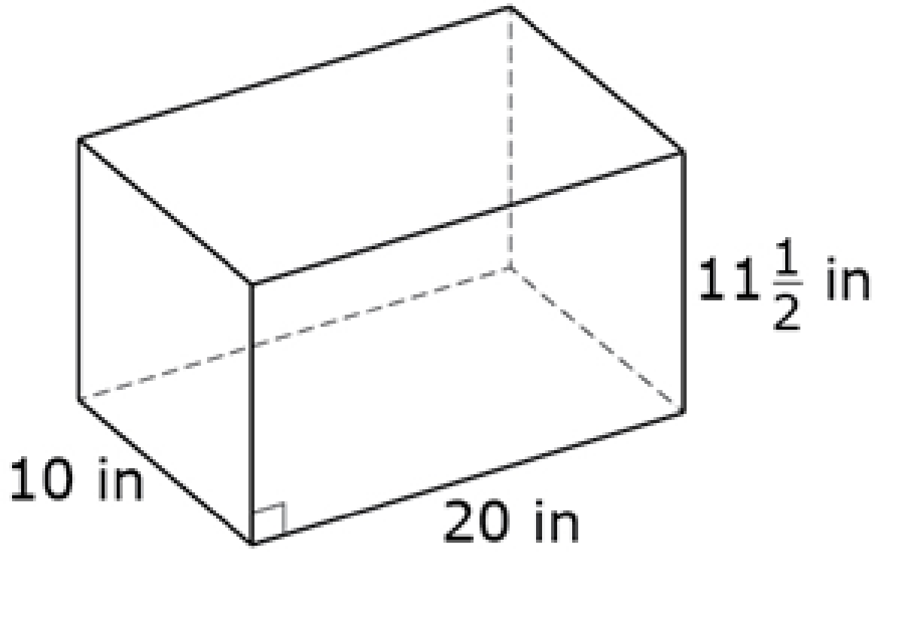
#4
Consider this figure.
Enter the volume, in cubic inches, of the right rectangular prism.
Notes:
‹#›

Slide 9
#4 Answer
Rubric:
(1 point) Student enters the correct volume. Correct answer should be a single numerical value and units should be assumed from the stem.
Answer: 2,300
Notes:
‹#›

Slide 10
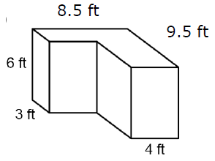
#5
This figure was created by joining two right rectangular prisms.
Enter the volume, in cubic feet, of the figure.
Notes:
‹#›

Slide 11
#5 Answer
Rubric:
(1 point) Student enters the correct volume. Correct answer should be a single numerical value and units should be assumed from the stem.
Answer: 309
Notes:
‹#›

Slide 12
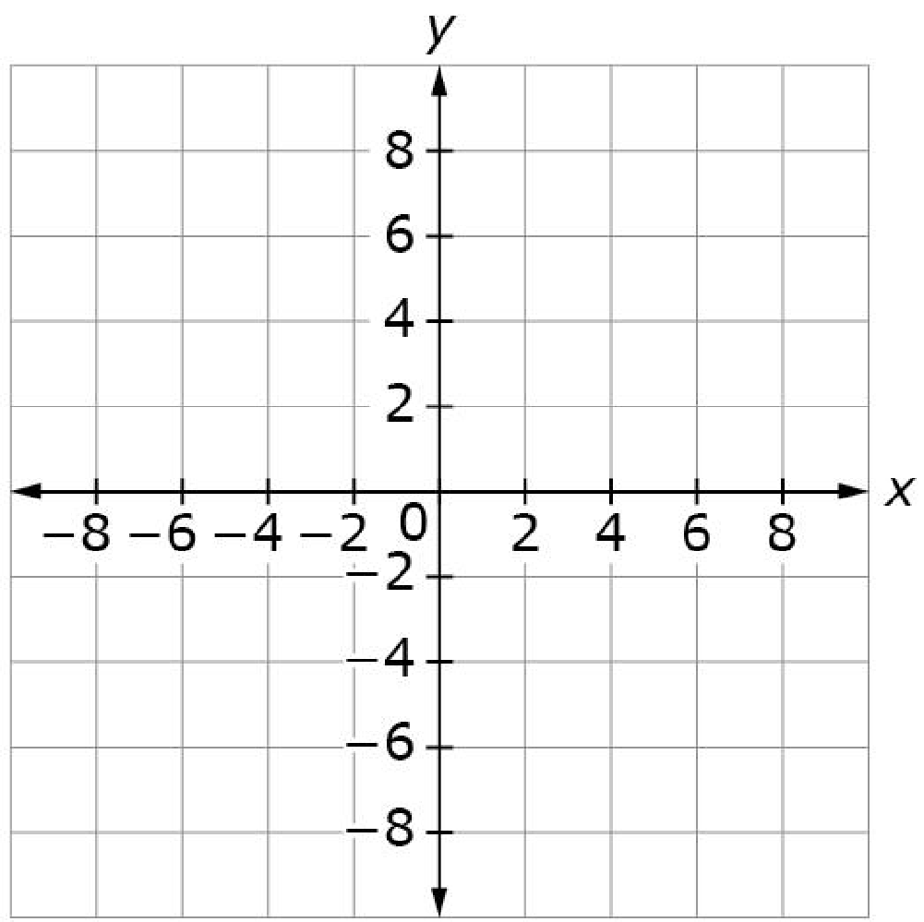
#6
Consider these ordered pairs.
Point A: (3, 2)
Point B: (–3, 2)
Point C: (3, –2)
Use the Add Point and Connect Line tools to connect the three points to form triangle ABC.

Slide 13
#6 Answer
Rubric:
(1 point) The student plots all given points and connects the lines correctly.

Slide 14
#7
A triangle has these coordinates:
Point A: (–5, 2)
Point B: (–5, 6)
Point C: (7, 2)
Enter the length of side AC.

Slide 15
#7 Answer
Rubric:
(1 point) Student enters the correct length. Correct answer should be a single numerical value and units should be assumed from the stem.
Answer: 12

Slide 16
#8
Refer to the map as a coordinate grid. On the map, the library is located at (–5, 2), the bus station is located at (–5, 6), and the courthouse is located at
(7, 2). Each square unit in the grid represents 1 square kilometer. Enter the distance, in kilometers, from the courthouse to the library.

Slide 17
#8 Answer
Rubric:
(1 point) Student enters the correct length. Correct answer should be a single numerical value and units should be assumed from the stem.
Answer: 12

Slide 18
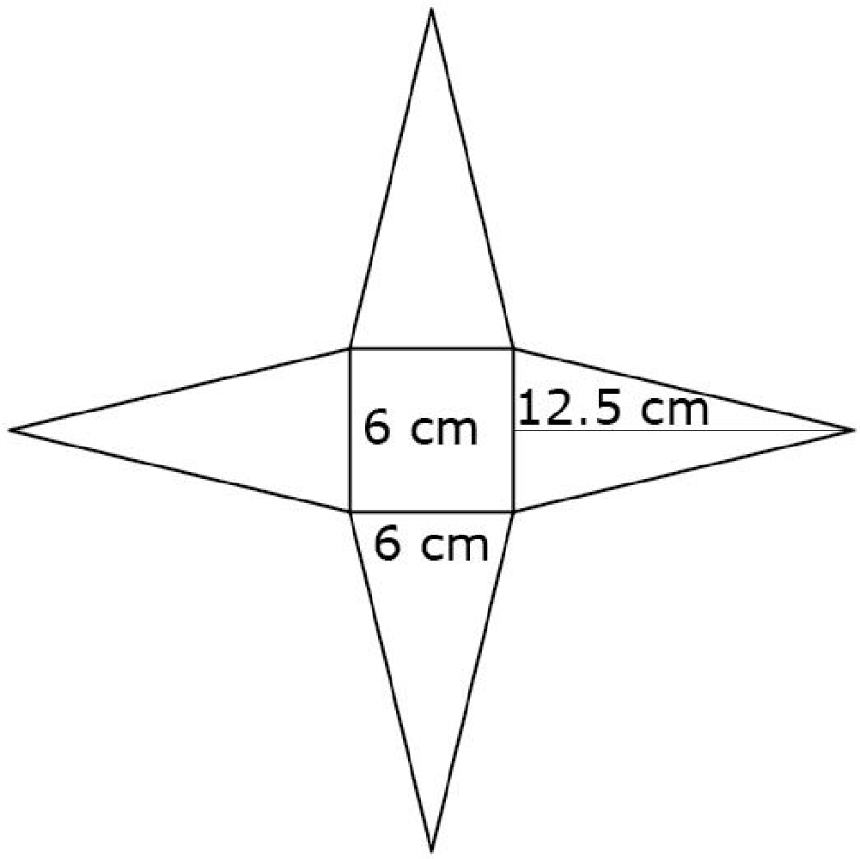
#9
Susan is painting the outside of a square pyramid. The net for the pyramid is shown.
Enter the total surface area, in square centimeters, of the pyramid that Susan will paint.

Slide 19
#9 Answer
Rubric:
(1 point) Student enters the correct surface area. Correct answer should be a single numerical value and units should be assumed from the stem.
Answer: 186

