Slide 1

Claim 1
Smarter Balanced Sample Items
Grade 6 - Target G
Represent and analyze quantitative relationships between dependent and independent variables.
Questions courtesy of the Smarter Balanced Assessment Consortium Item Specifications – Version 3.0
Slideshow organized by SMc Curriculum – www.ccssmathactivities.com
Notes:
‹#›

Slide 2


#1
Emily studies 40 minutes after lunch for a science exam. She studies x more minutes that evening.
Enter an equation that represents the total number of minutes, y, Emily studies for the science exam.
Notes:
‹#›

Slide 3

#1 Answer
Rubric:
(1 point) Student gives a correct equation.
Answer: 40 + x = y
Notes:
‹#›

Slide 4
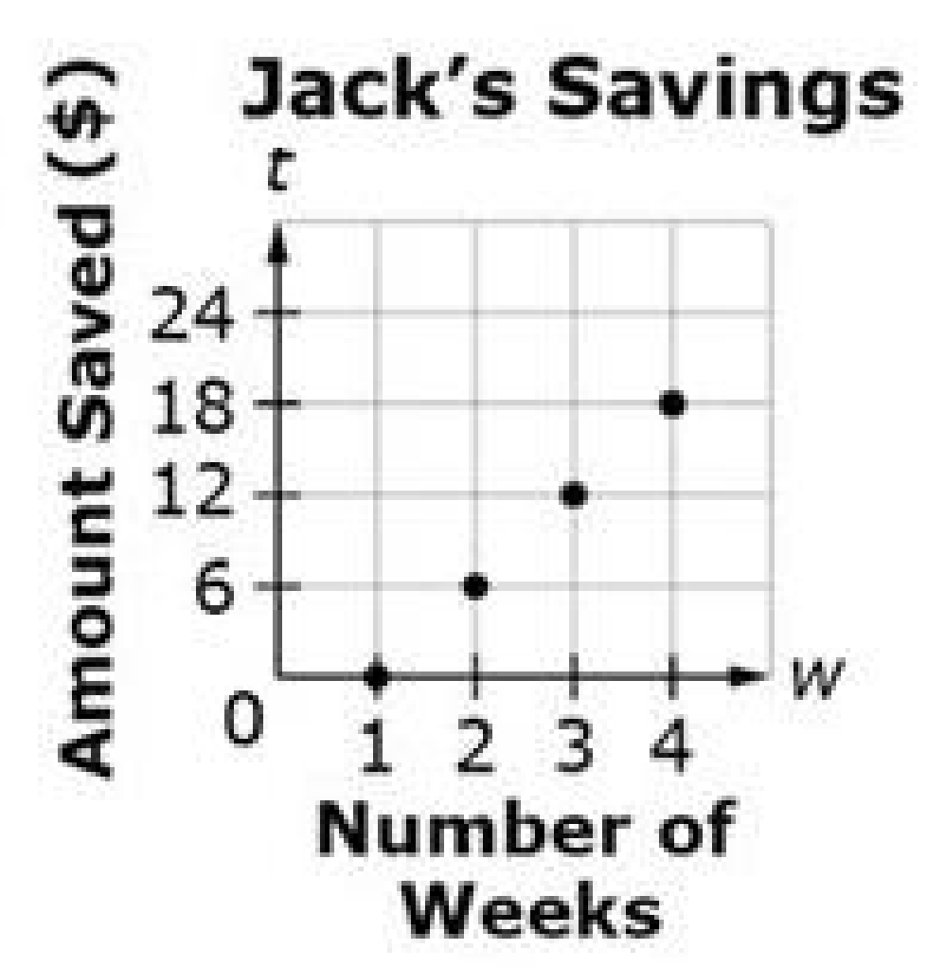
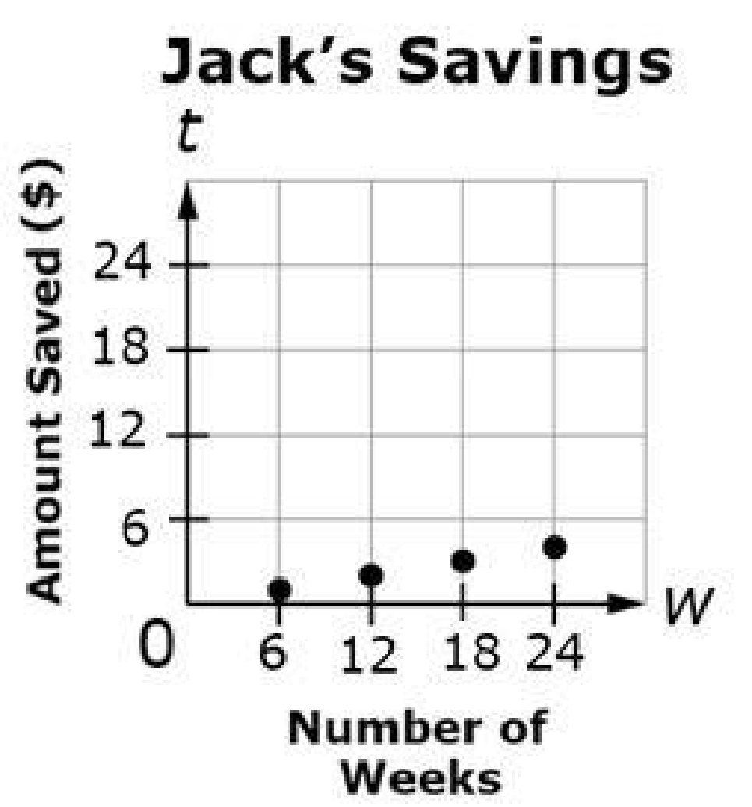
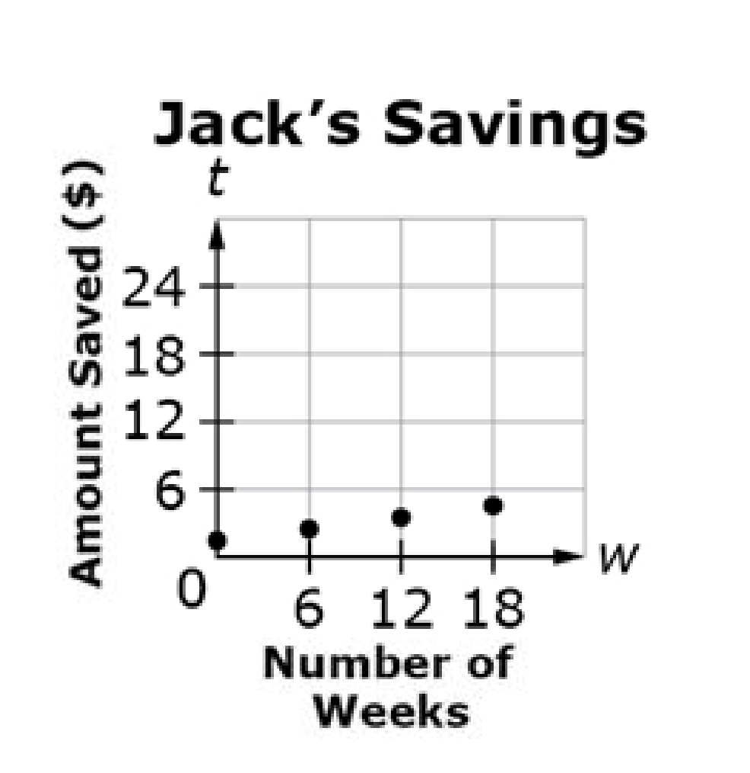
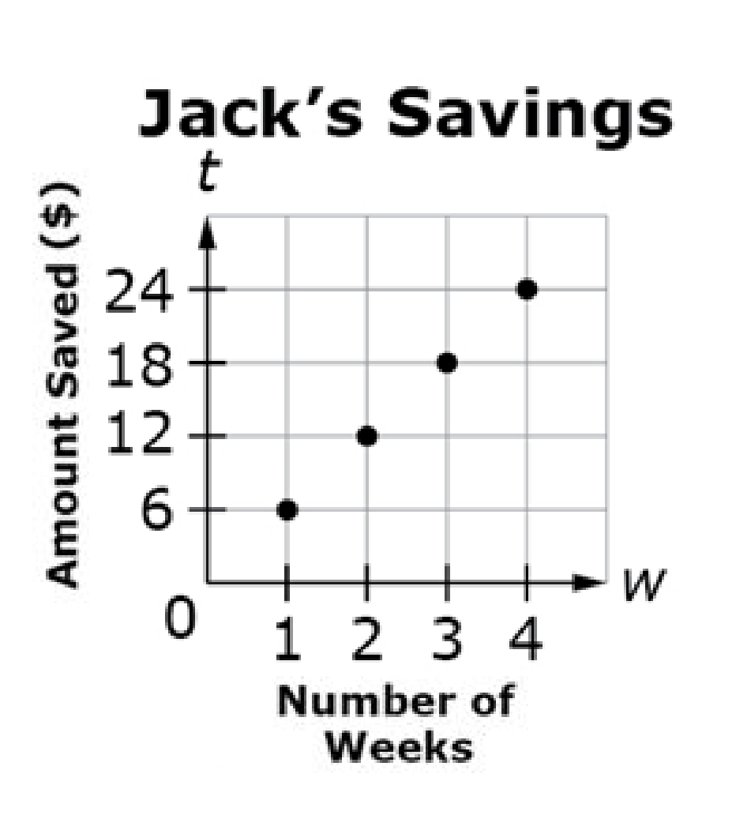
#2
Jack saves $6.00 each week. He started saving beginning with Week 1.
Let w represent the number of weeks that Jack saves.
Let t represent the total amount saved, in dollars.
Which graph shows the amount of money Jack saves over four weeks?
A. B.
C. D.
Notes:
‹#›

Slide 5
#2 Answer
Rubric:
(1 point) Student selects the correct graph.
Answer: D
Notes:
‹#›

Slide 6
#3
Jack saves the same amount of money each week as shown in the table.
Let w represent the number of weeks that Jack saves
Let t represent the total amount saved, in dollars.
Number of Weeks w | Total Amount Saved t
1 | $ 6
2 | $12
3 | $18
4 | $24
Determine whether each statement is true. Select True or False for each statement.
Statement | True | False
The equation t = 6 + w represents the relationship between the number of weeks and the total amount saved.
The total amount saved is 6 times the number of weeks.
The number of weeks that Jack saves depends on the total amount of money Jack saves.
Notes:
‹#›

Slide 7
#3 Answer
Rubric:
(1 point) Student correctly identifies each statement as being either true or false.
Answer: F, T, F

Slide 8
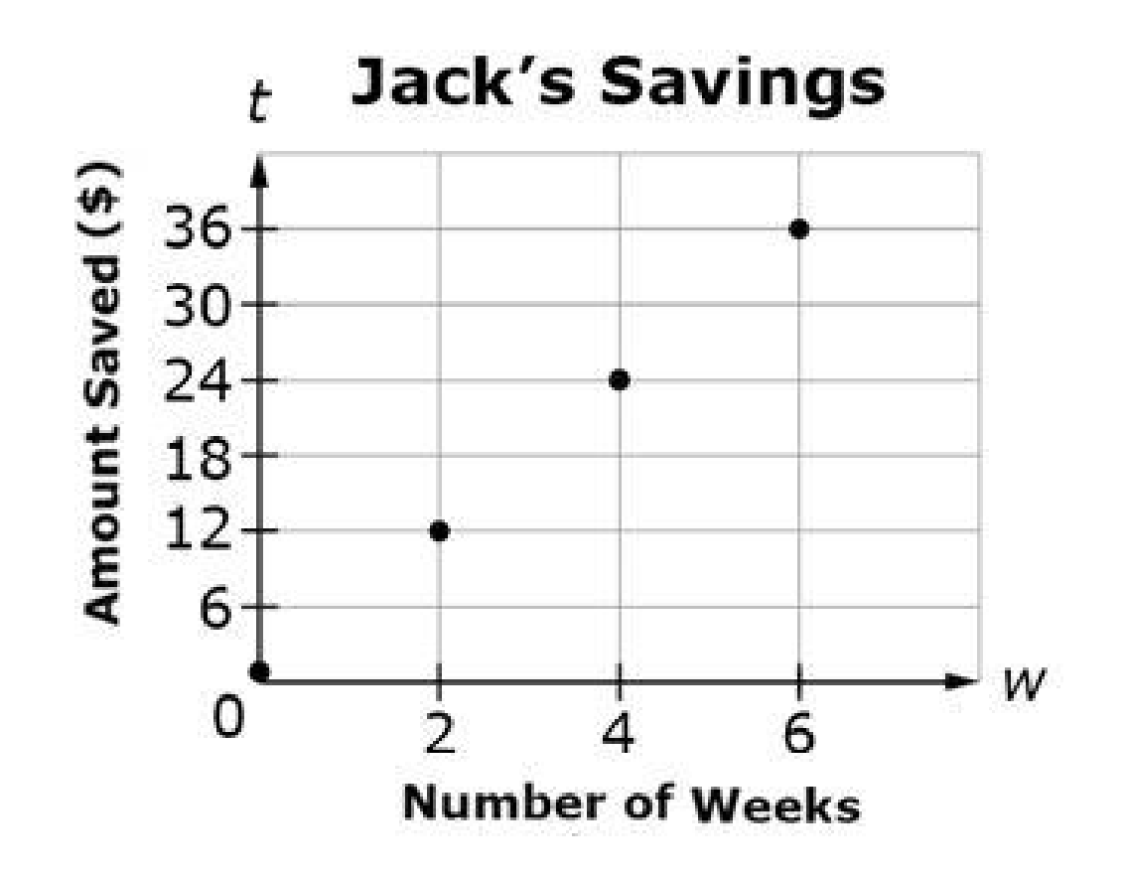
#4
Jack saves the same amount
of money each week as shown in the graph.
w represents the number of weeks that Jack
saves.
t represents the total amount saved,
in dollars.
Determine whether each statement is true. Select True or False for each statement.
Statement | True | False
Jack saved a total of $12 at the end of week 2.
The equation t = 6w represents the relationship between the number weeks and the total amount saved.
The total amount of money Jack saves depends on the number weeks that Jack saves.
Notes:
‹#›

Slide 9
#4 Answer
Rubric:
(1 point) Student correctly identifies each statement as being either true or false.
Answer: T, T, T

Slide 10
#5
Jack saves the same amount of money each week as shown in the table.
Let w represent the number of weeks that Jack saves
Let t represent the total amount saved, in dollars.
Enter the total amount of money, in dollars, that Jack saves after 6 weeks.
Number of Weeks w | Total Amount Saved t
1 | $ 6
2 | $12
3 | $18
4 | $24
Notes:
‹#›

Slide 11
#5 Answer
Rubric: (1 point) Student enters the correct value.
Answer: 36
Notes:
‹#›

Slide 12
#6
Jack saves the same amount of money each week as shown in the graph.
Let w represent the number of weeks that Jack saves.
Let s represents the total amount saved, in dollars.
Enter the total amount of money, in dollars, that Jack saves after 6 weeks.

Slide 13
#6 Answer
Rubric: (1 point) Student enters the correct value.
Answer: 36

Slide 14
#7
The band members are selling chocolate bars for a fundraiser. The amount of money collected for each box of bars sold is the same.
Let n represent the number of boxes sold.
Let d represent the amount of money collected, in dollars.
Fill in the table for all missing values of n and d.
Number of Boxes Sold w | Amount of Money Collected, in Dollars d
 | 30
2
3 | 90
4 | 120
6

Slide 15
#7 Answer
Rubric:
(1 point) Student correctly enters all missing values in the table.
Answer: 1, 60, and 180

Slide 16
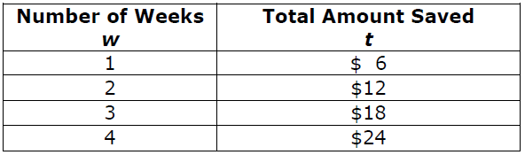
#8
Jack saves the same amount of money each week as shown in the table.
Let w represent the number of weeks that Jack saves.
Let t represent the total amount saved, in dollars.
Enter an equation that represents the relationship between the number of weeks Jack saves and the total amount of money saved.

Slide 17
#8 Answer
Rubric:
(1 point) Student enters the correct equation.
Answer: t = 6w

Slide 18
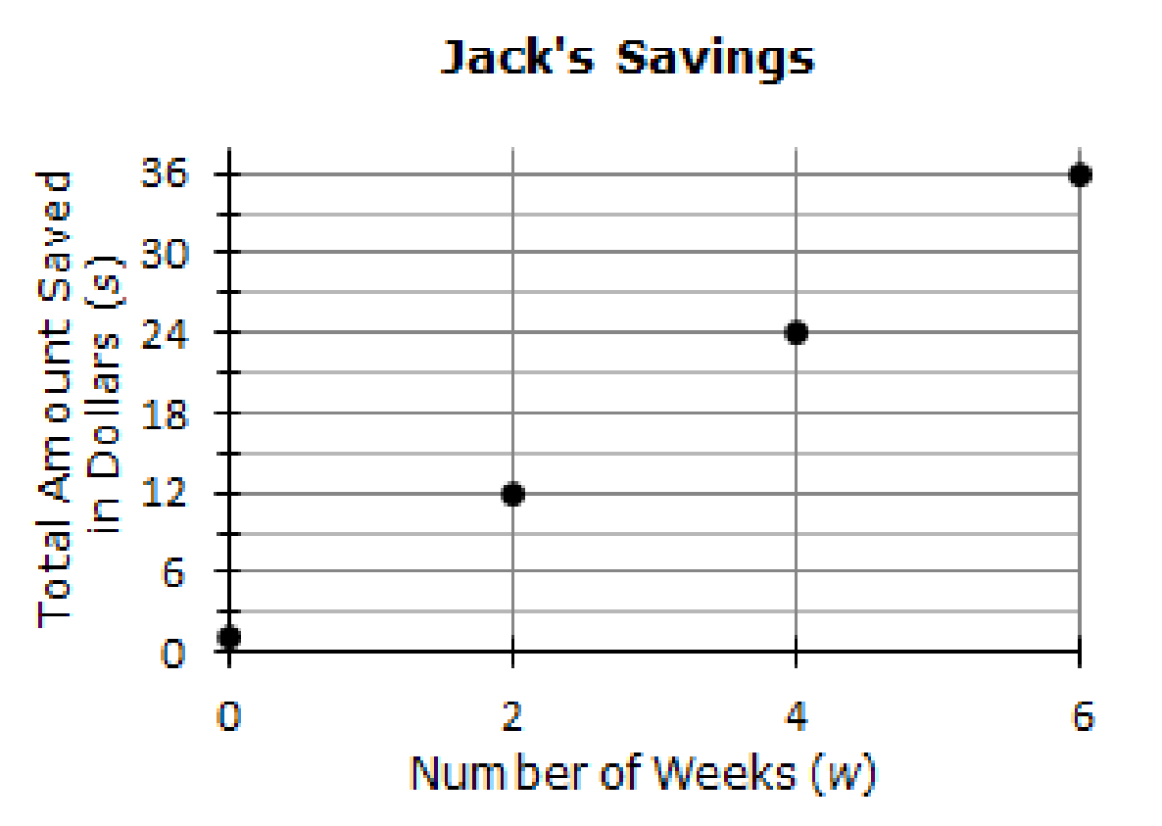
#9
Jack saves the same amount of money each week as shown in the graph.
Let w represent the number of weeks that Jack saves.
Let s represent the total amount saved, in dollars.
Enter an equation that represents
the relationship between the
number of weeks Jack saves and
the total amount of money saved.

Slide 19
#9 Answer
Rubric:
(1 point) Student enters the correct equation.
Answer: s = 6w

