Slide 1

Claim 1
Smarter Balanced Sample Items
Grade 6 - Target F
Reason about and solve one-variable equations and inequalities.
Questions courtesy of the Smarter Balanced Assessment Consortium Item Specifications – Version 3.0
Slideshow organized by SMc Curriculum – www.ccssmathactivities.com
Notes:
‹#›

Slide 2

#1
Select all equations that have x = 3 as a solution.
A. x + 7 = 10
B. 3 + x = 3
C. x ⋅ 3 = 1
D. 4 ⋅ x = 12
Notes:
‹#›

Slide 3

#1 Answer
Rubric:
(1 point) Student selects all the correct equations.
Answer: A and D
Notes:
‹#›

Slide 4
#2
Example 1: Select all inequalities that include 0 in the solution set.
x > –4.24
x < –5.5
x > –5.13
x < 4.5
Example 2: Select all inequalities that include all numbers less than –6 in the solution set.
x > –4.24
x < –5.5
x > –5.13
x < 4.5

Slide 5
#2 Answer
Rubric:
(1 point) Student selects all the correct inequalities.
Answer:
Example 1: A, C, D
Example 2: B, D

Slide 6
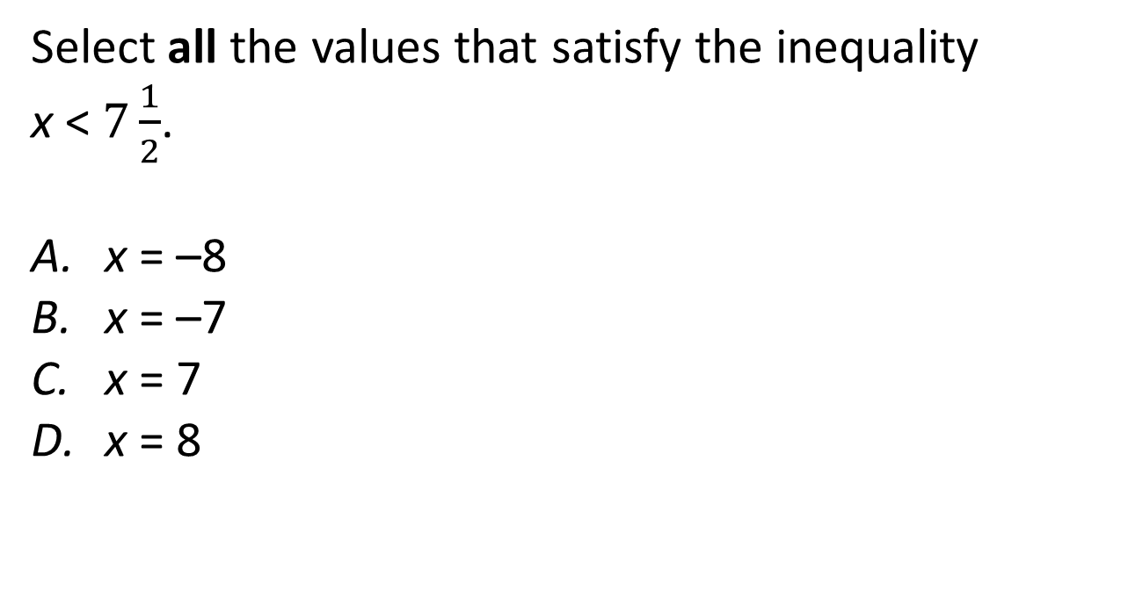
#3

Slide 7
#3 Answer
Rubric:
(1 point) Student selects all the correct set of numbers.
Answer: A, B, C

Slide 8
#4
Consider the inequality x > 7.
Determine whether each value of x makes this inequality true. Select Yes or No for each value.
x | Yes | No
22
−7
13
5
−39
Notes:
‹#›

Slide 9
#4 Answer
Rubric:
(1 point) Student correctly determines whether all five values make the inequality true.
Answer: Y, N, Y, N, N
Notes:
‹#›

Slide 10
#5
John is planning to put a rectangular pool in his backyard. The length (l) of the pool must be greater than 24 feet and the width (w) must be less than 14 feet.
Select the pair of inequalities that models the possible measurements for each dimension.
A. l > 14 and w < 24
B. l > 24 and w < 14
C. 24 > l and 14 > w
D. 24 < l and 14 < w
Notes:
‹#›

Slide 11
#5 Answer
Rubric: (1 point) Student selects the correct inequality pair.
Answer: B
Notes:
‹#›

Slide 12
#6
Julia has some peaches. She gathers 6 more peaches. She now has 58 peaches.
Part A: In the first box, enter an equation to represent the total number of peaches, p, that Julia has after she gathers 6 more peaches.
Part B: In the second box, enter the number of peaches represented by p in this situation.

Slide 13
#6 Answer
Rubric: (2 points) Student enters the correct equation and the correct solution.
(1 point) Student enters the correct equation or the correct solution.
Answer: p + 6 = 58; 52

Slide 14
#7
The sum of 32 and n is equal to 59.13.
Enter the equation described in the sentence.

Slide 15
#7 Answer
Rubric: (1 point) Student enters the correct equation.
Answer: 32 + n = 59.13

Slide 16
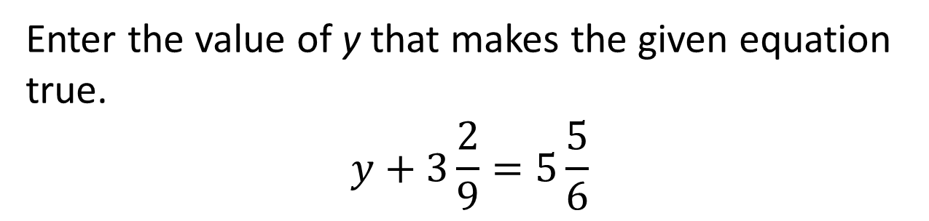
#8

Slide 17

#8 Answer
Rubric: (1 point) Student enters the correct value.
Answer: 2

Slide 18
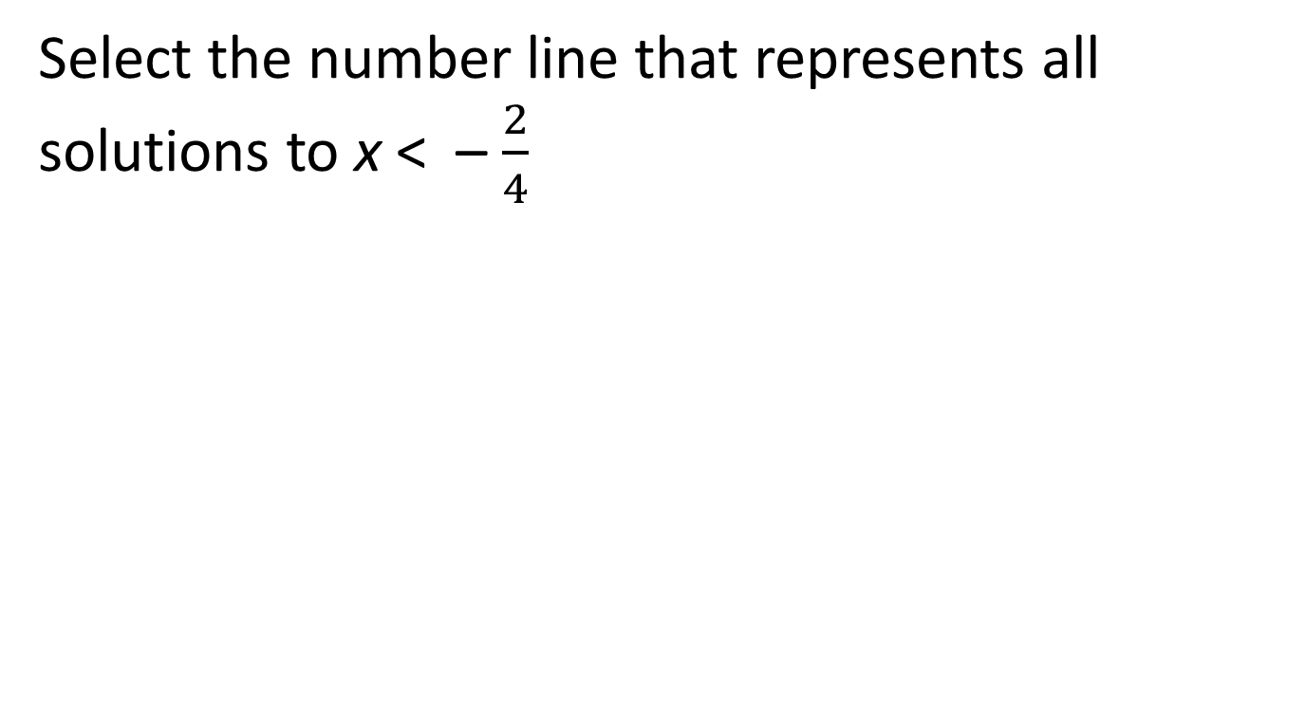
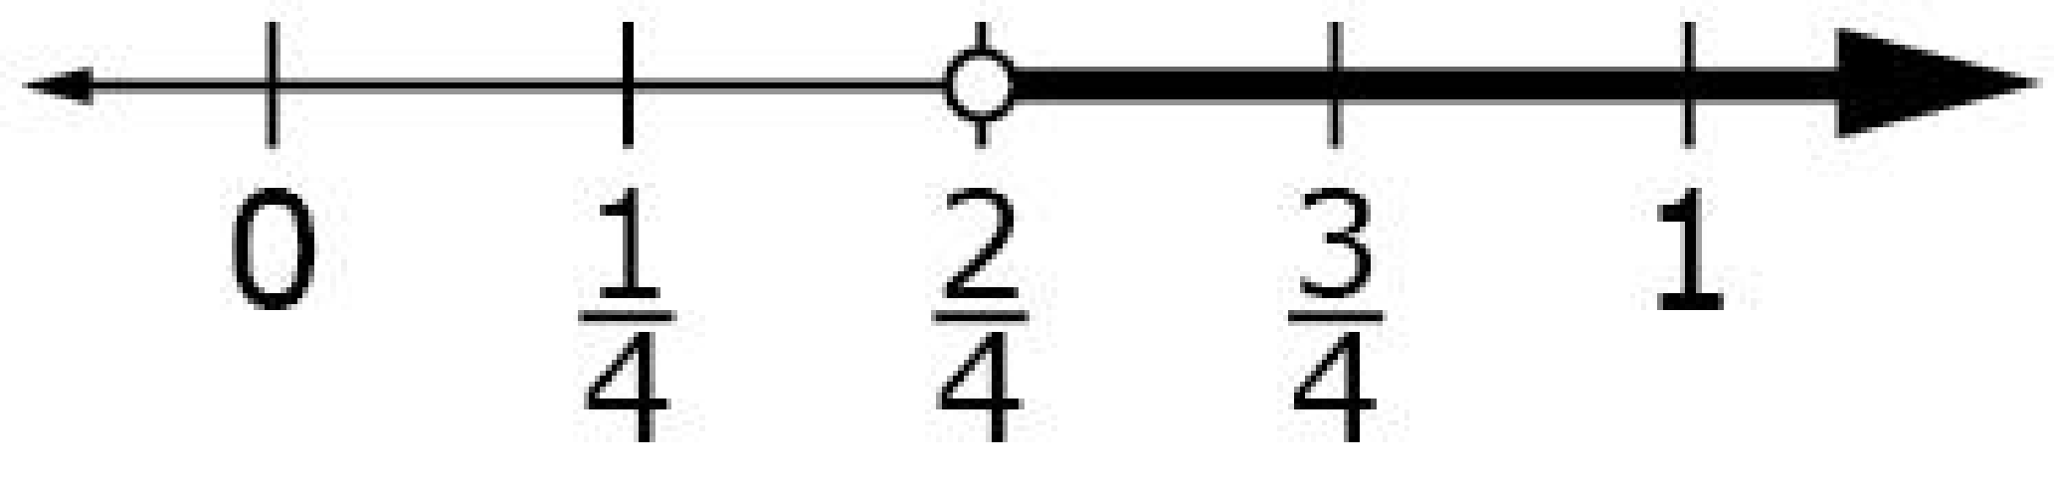
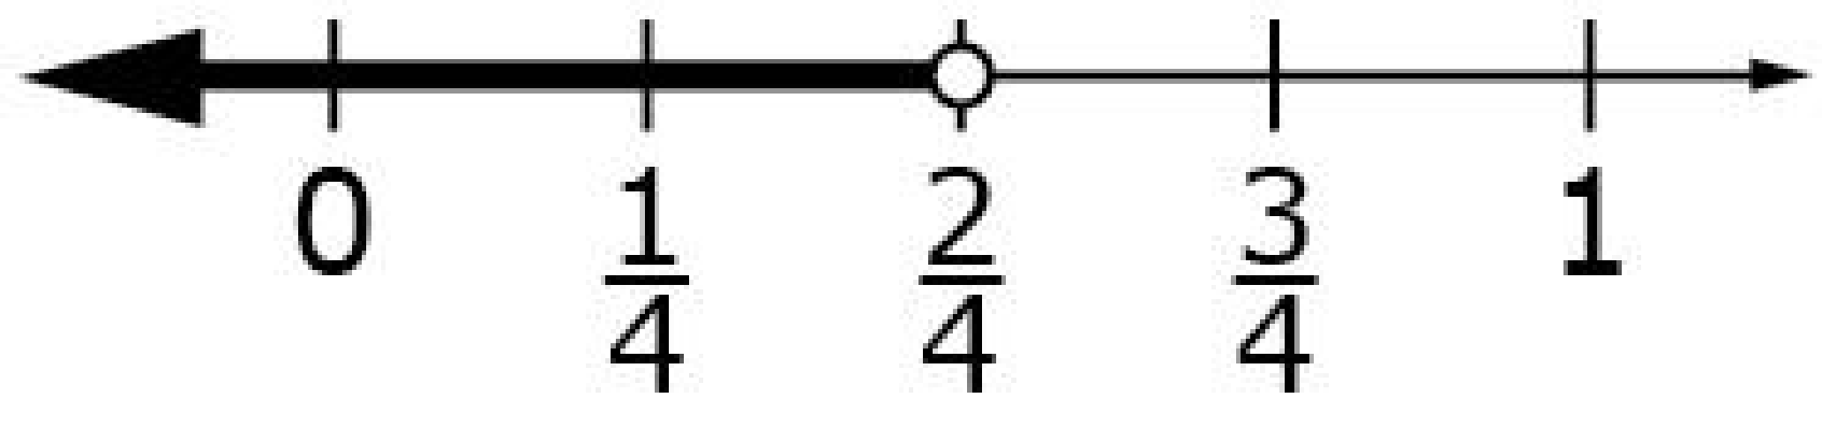
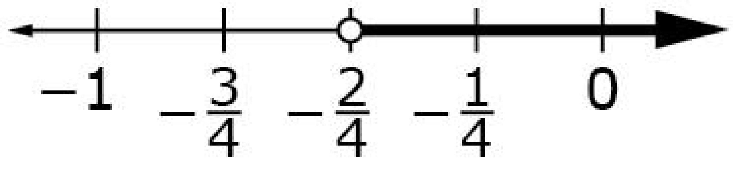
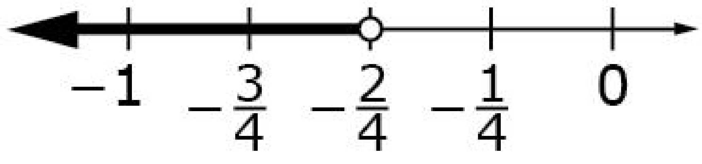
#9

Slide 19
#9 Answer
Rubric:
(1 point) Student selects the correct number line.
Answer: D

Slide 20
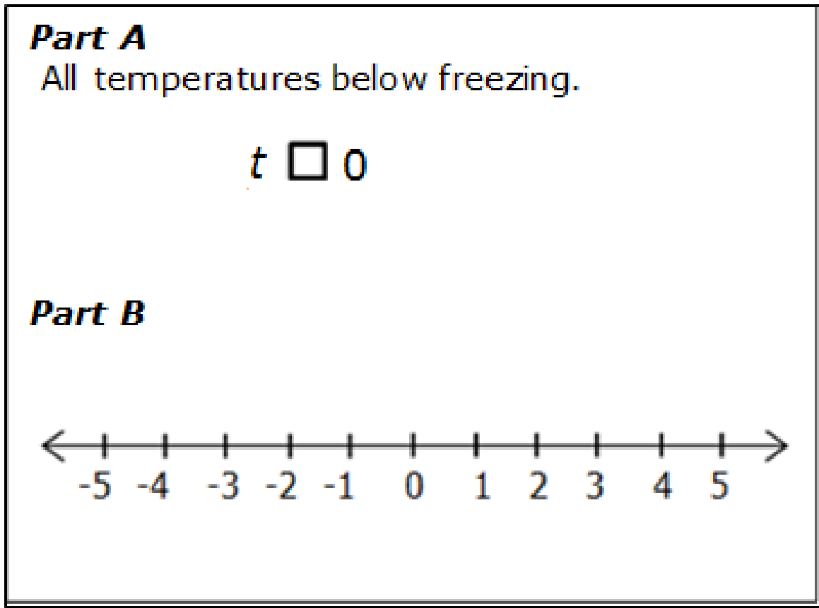
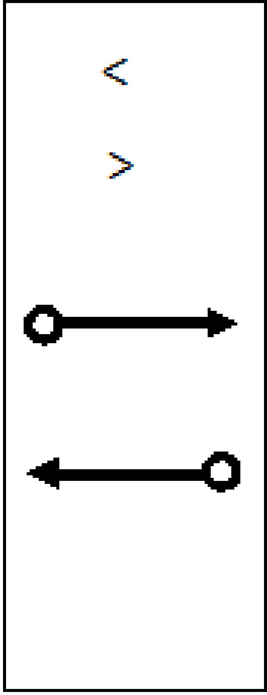
#10
The freezing point of water is 0 degrees Celsius.
Part A: Drag the correct symbol into the box to create an inequality that describes all temperatures (t) below freezing.
Part B: Drag the correct ray to the number line to represent all temperatures, t, that are below freezing, in degrees Celsius.

Slide 21

#10 Answer
Rubric:
(1 point) Student places the correct inequality symbol in the box and places the correct ray at the proper location on the number line.

