Slide 1

Claim 1
Smarter Balanced Sample Items
Grade 6 - Target E
Apply and extend previous understandings of arithmetic to algebraic expressions.
Questions courtesy of the Smarter Balanced Assessment Consortium Item Specifications – Version 3.0
Slideshow organized by SMc Curriculum – www.ccssmathactivities.com
Notes:
‹#›

Slide 2

#1
Enter the value of 3³ ⋅ 7² − 8 ÷ 4.
Notes:
‹#›

Slide 3

#1 Answer
Rubric:
(1 point) Student enters the correct value for the expression.
Answer: 1321
Notes:
‹#›

Slide 4
#2
Example 1: Enter a numerical expression that represents the sum of eight squared and thirty-two.
Example 2: Enter an algebraic expression that represents eight times the sum of y squared and twenty-eight.
Notes:
‹#›

Slide 5
#2 Answer
Rubric:
(1 point each) Student enters the correct numerical/algebraic expression for the given verbal expression.
Answers:
Example 1: 8² + 32
Example 2: 8(y² + 28)
Notes:
‹#›

Slide 6
#3
Select all the statements that correctly describe
4³ ⋅ (8w − 7).
3 is a factor of the expression.
The difference of 8w and 7 is a factor in the expression.
The expression represents the product of 4³ and 8w – 7.
The expression represents the difference of
4³ • 8w and 7.

Slide 7
#3 Answer
Rubric:
(1 point) Student selects all the correct statements.
Answer: B and C
Notes:
‹#›

Slide 8
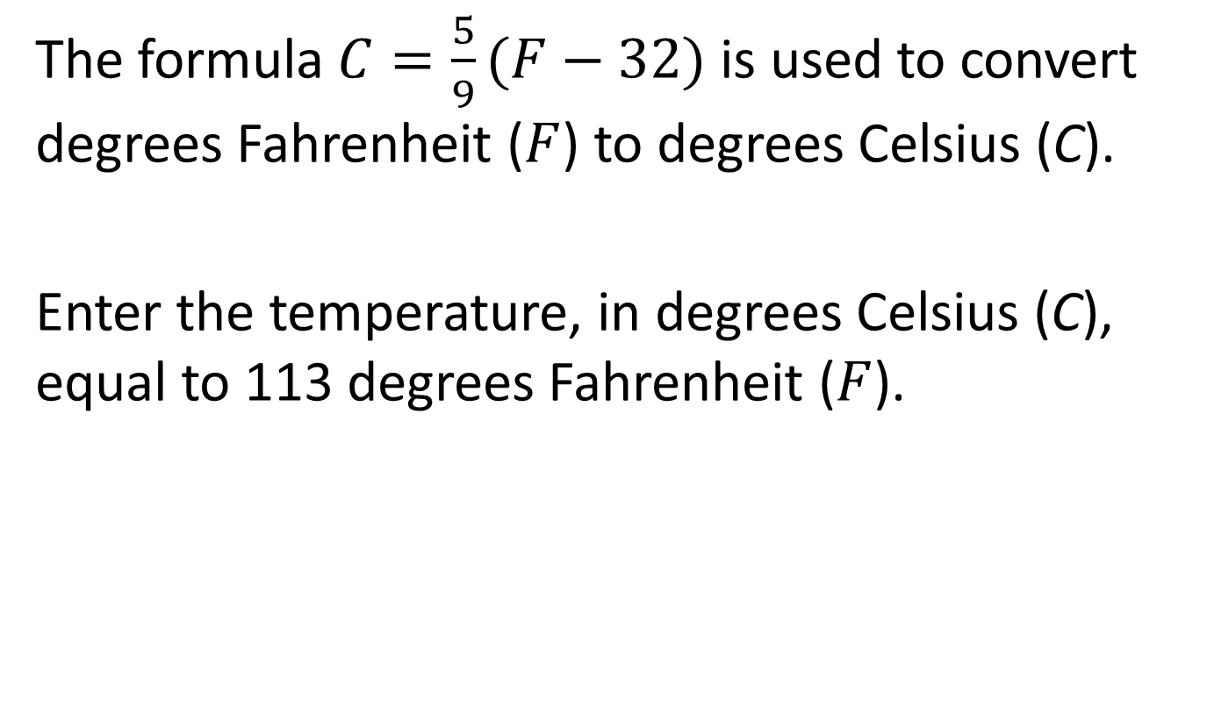
#4
Notes:
‹#›

Slide 9
#4 Answer
Rubric:
(1 point each) Student enters the correct value for the formula. Units should be assumed from the problem.
Answer: 45
Notes:
‹#›

Slide 10
#5
Example 1: Enter the value of 2 • y – 8 ÷ 4 when y = 7.
Example 2: Enter the value of 3³ • y² – 8 ÷ 4 when y = 7.
Notes:
‹#›

Slide 11
#5 Answer
Rubric:
(1 point each) Student enters the correct value for the expression. Units should be assumed from the problem.
Answer:
Example 1: 12
Example 2: 1321
Notes:
‹#›

Slide 12
#6
A baker uses the expression 5.75c + 3.45p to calculate his profit when he sells c cakes and p pies.
What is the baker’s profit, in dollars, when he sells 33 cakes and 42 pies?

Slide 13
#6 Answer
Rubric:
(1 point each) Student enters the correct value for the expression. Units should be assumed from the problem.
Answer: 334.65

Slide 14
#7
Example 1: Consider this expression: 3(2x + 5y). Enter an expression that shows the sum of exactly two terms that is equivalent to 3(2x + 5y).
Example 2: An equivalent expression to 6x + 15y can be written as the product of two factors. One of the factors is 3. Enter the second factor that will result in 6x + 15y when the two factors are multiplied.

Slide 15
#7 Answer
Rubric:
(1 point each) Student enters the correct algebraic expression.
Answers:
Example 1: 6x + 15y
Example 2: 2x + 5y

Slide 16
#8
Example 1: Consider this equation
3(2x + 5y) = +
Drag a term into each box to create an expression equivalent to 3(2x + 5y)
Example 2: Consider this equation
6x + = 3( + 5)
Drag a term into each box to create a true equation.

Slide 17
#8 Answer
Rubric:
(1 point each) Student correctly creates an equivalent expression.
Answers:
Example 1: 6x and 15y
Example 2: 15 and 2x

Slide 18
#9
Example 1: Select all expressions that are equivalent to
4(3x + 6y)
12x + 6y
12x + 24y
2(6x + 12y)
4(12x + 24y)
Example 2: Select all expressions that are equivalent to
3 + w + w + w
3(1 + w)
3 + 3w
3 + w³
3w³

Slide 19
#9 Answer
Rubric:
(1 point each) Student selects all of the correct expressions.
Answers:
Example 1: B and C
Example 2: A and B

