Slide 1

Claim 1
Smarter Balanced Sample Items
Grade 6 - Target C
Compute fluently with multi-digit numbers and find common factors and multiples.
Questions courtesy of the Smarter Balanced Assessment Consortium Item Specifications – Version 3.0
Slideshow organized by SMc Curriculum – www.ccssmathactivities.com
Notes:
‹#›

Slide 2

#1
Example 1: Divide.
16,536 ÷ 24
Enter the exact quotient.
Example 2: Divide.
35,702 ÷ 25
Enter the exact quotient.
Notes:
‹#›

Slide 3

#1 Answer
Rubric:
(1 point each) Student enters the correct quotient.
Answers:
Example 1: 689
Example 2: 1428.08
Notes:
‹#›

Slide 4
#2
Add.
34.381 + 8.2
Enter the exact sum.
Notes:
‹#›

Slide 5
#2 Answer
Rubric:
(1 point) Student enters the correct sum.
Answer: 42.581
Notes:
‹#›

Slide 6
#3
Subtract.
48.235 – 29.67
Enter the exact difference.
Notes:
‹#›

Slide 7
#3 Answer
Rubric:
(1 point) Student enters the correct difference.
Answer: 18.565
Notes:
‹#›

Slide 8
#4
Multiply.
8.296 ⋅ 0.8
Enter the exact product.
Notes:
‹#›

Slide 9
#4 Answer
Rubric:
(1 point) Student enters the correct product.
Answer: 6.6368
Notes:
‹#›

Slide 10
#5
Divide.
0.912 ÷ 0.24
Enter the exact quotient.
Notes:
‹#›

Slide 11
#5 Answer
Rubric:
(1 point) Student enters the correct quotient.
Answer: 3.8
Notes:
‹#›

Slide 12
#6
Use the fact that 12 ⋅ 218 = 2616.
Enter the exact product of 1.2 ⋅ 2.18.

Slide 13
#6 Answer
Rubric:
(1 point) Student enters the correct product.
Answer: 2.616

Slide 14
#7
Enter the greatest common factor of 24 and 36.

Slide 15
#7 Answer
Rubric:
(1 point) Student enters the correct greatest common factor.
Answer: 12

Slide 16
#8
Enter the least common multiple of 6 and 8.

Slide 17
#8 Answer
Rubric:
(1 point) Student enters the correct least common multiple.
Answer: 24

Slide 18
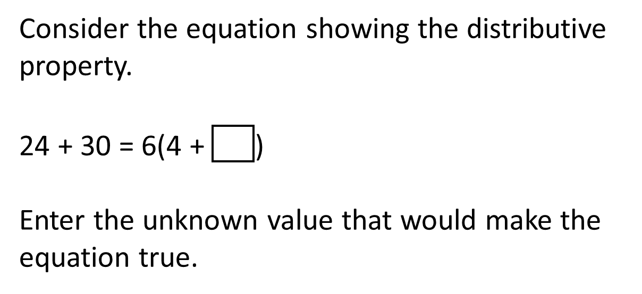
#9

Slide 19
#9 Answer
Rubric:
(1 point) Student enters the correct value.
Answer: 5

