Slide 1

Claim 1
Smarter Balanced Sample Items
Grade 6 - Target B
Apply and extend previous understandings of multiplication and division to divide fractions by fractions.
Questions courtesy of the Smarter Balanced Assessment Consortium Item Specifications – Version 3.0
Slideshow organized by SMc Curriculum – www.ccssmathactivities.com
Notes:
‹#›

Slide 2

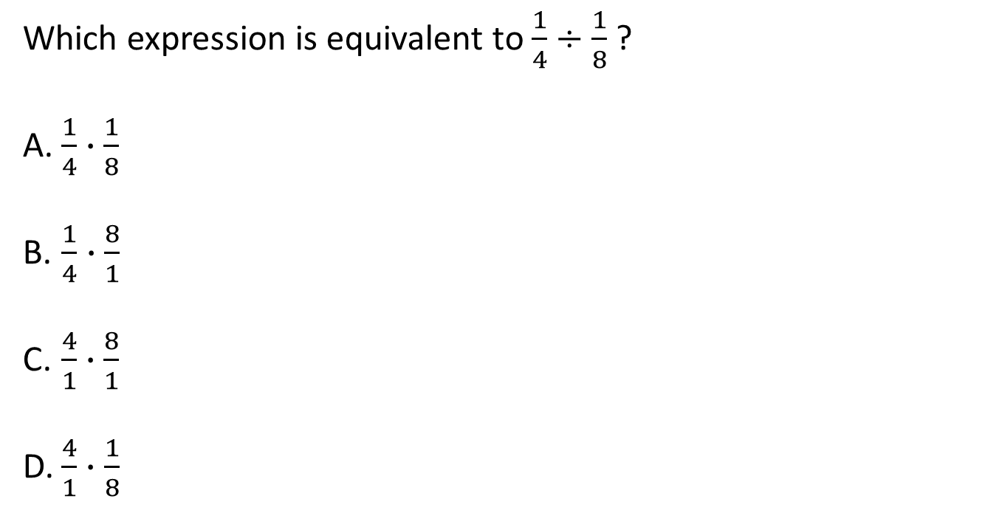
#1
Notes:
‹#›

Slide 3

#1 Answer
Rubric:
(1 point) Student selects the correct answer.
Answer: B
Notes:
‹#›

Slide 4
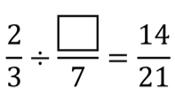
#2
What number makes the equation true?

Slide 5
#2 Answer
Rubric:
(1 point) The student drags the correct quotient to the box so that the divisor equals 1.
Answer: 7

Slide 6
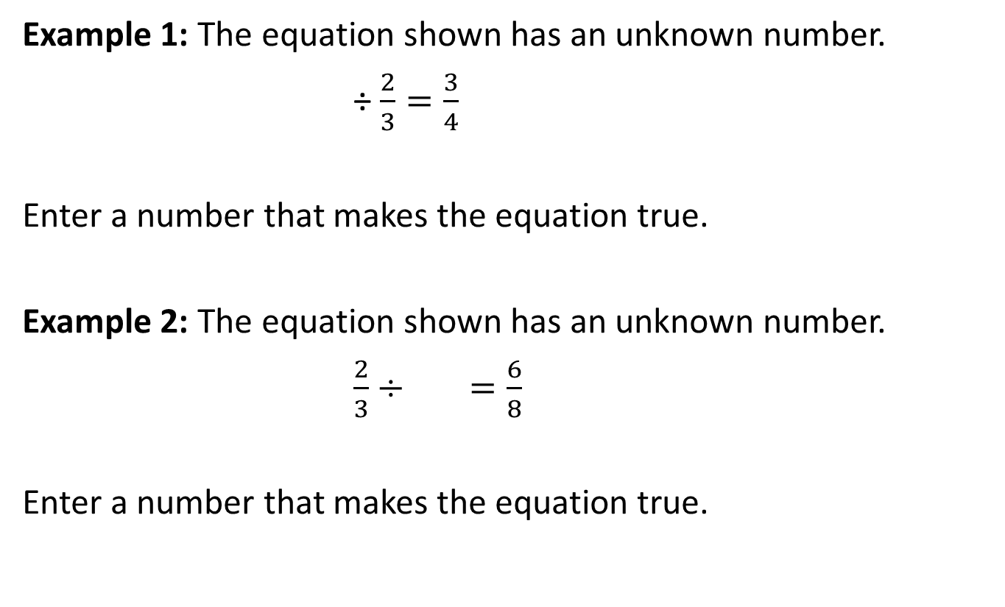
#3

Slide 7
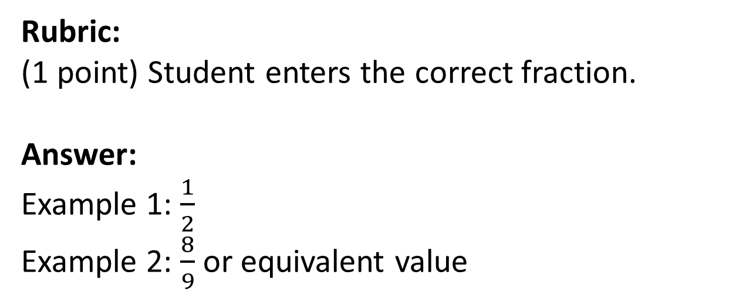
#3 Answer

Slide 8
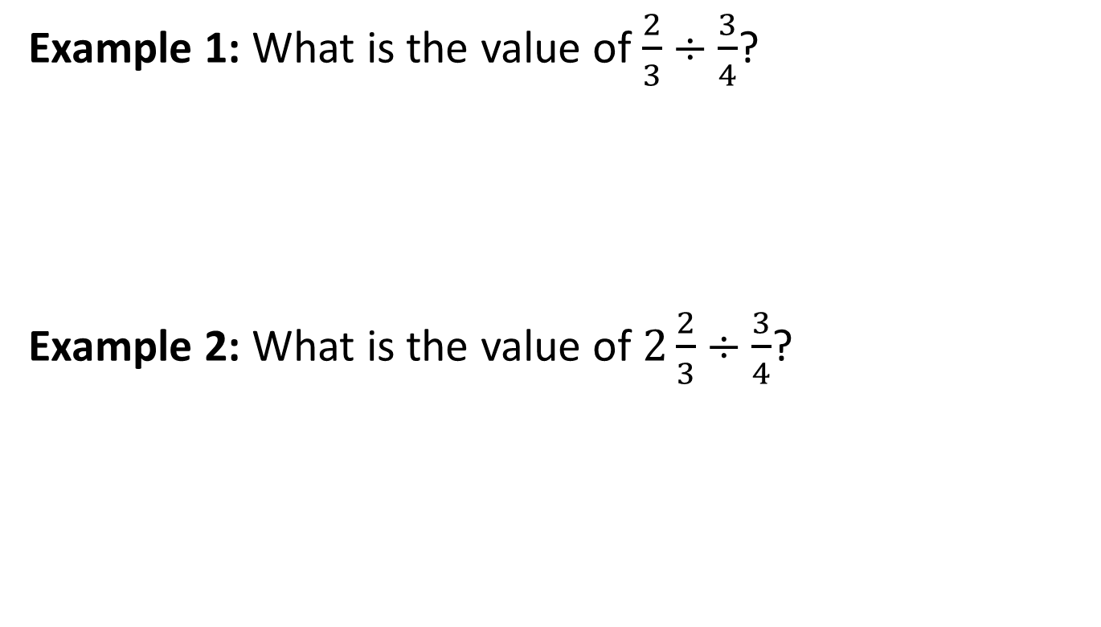
#4

Slide 9


#4 Answer
Rubric:
(1 point each) The student enters a whole number, mixed number, or fraction equivalent to the correct quotient.
Answers:
Example 1:
Example 2: 3

Slide 10
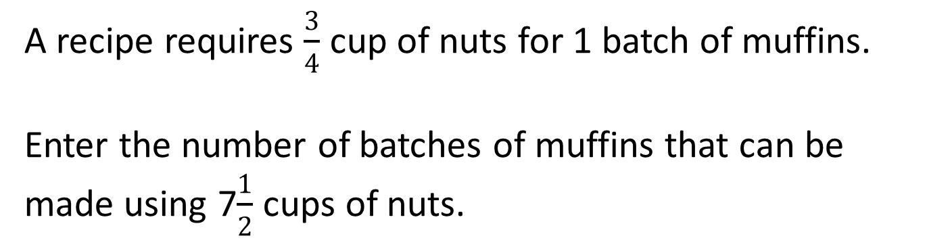
#5
Notes:
‹#›

Slide 11
#5 Answer
Rubric:
(1 point) Student enters the correct quotient.
Answer: 10
Notes:
‹#›

Slide 12
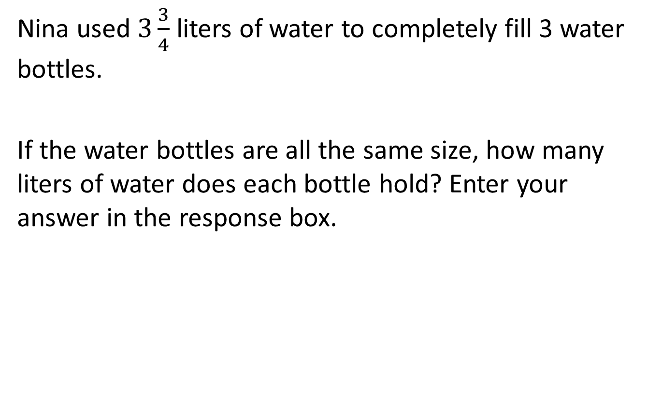
#6

Slide 13
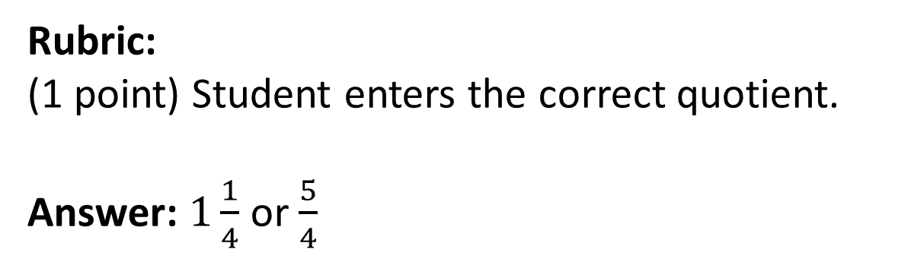
#6 Answer

Slide 14
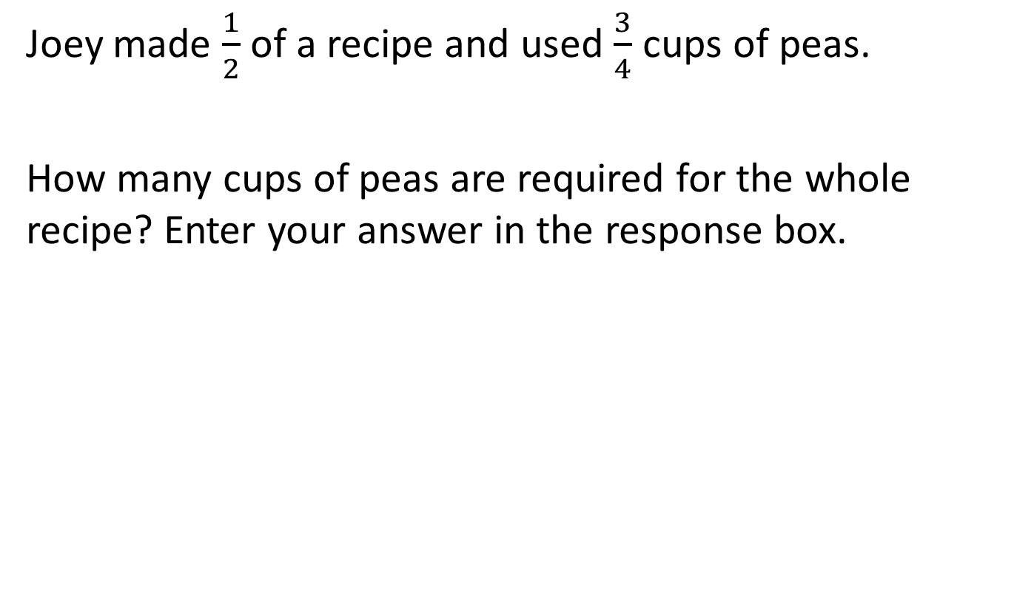
#7

Slide 15
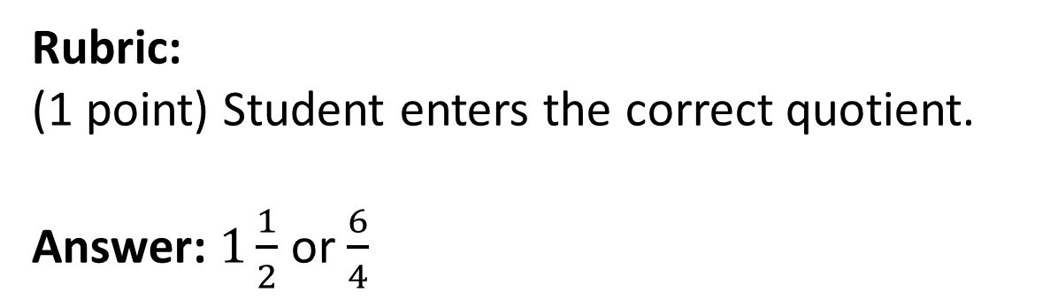
#7 Answer

Slide 16
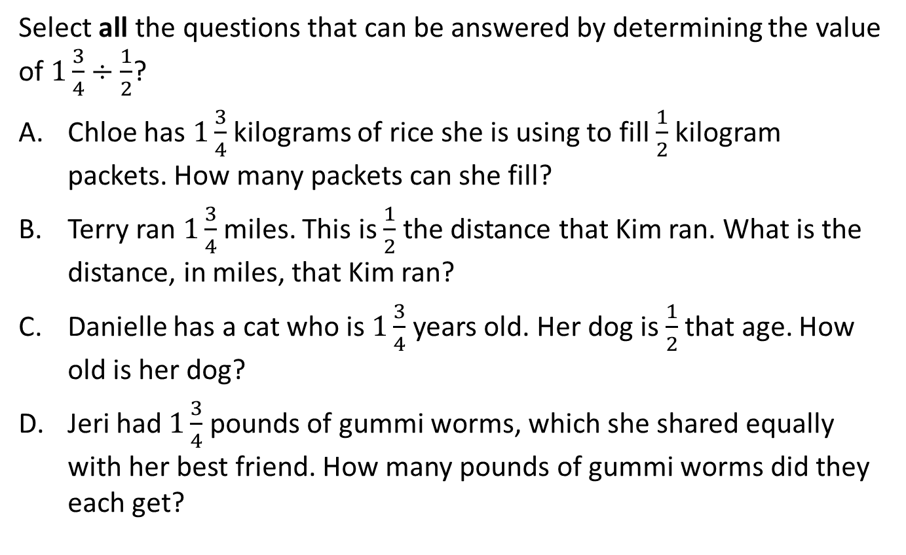
#8

Slide 17
#7 Answer
Rubric:
(1 point) The student selects all of the contexts that can be represented by the given quotient.
Answers: A and B

