Slide 1

Claim 1
Smarter Balanced Sample Items
Grade 6 - Target A
Understand ratio concepts and use ratio reasoning to solve problems.
Questions courtesy of the Smarter Balanced Assessment Consortium Item Specifications – Version 3.0
Slideshow organized by SMc Curriculum – www.ccssmathactivities.com
Notes:
‹#›

Slide 2

#1
A game has green and blue pieces. The ratio of green game pieces to total pieces is 5:12.
Select all the statements that are correct about the game pieces.
The ratio of green pieces to blue pieces is 7:5.
The ratio of total pieces to blue pieces is 12:7.
There must be 7 more blue pieces than green pieces.
The ratio of total pieces to green pieces is 12:5.
Notes:
‹#›

Slide 3

#1 Answer
Rubric:
(1 point) Student selects all the correct statements.
Answer: B and D
Notes:
‹#›

Slide 4
#2
A punch recipe calls for 3 cups of orange juice for every 2 cups of cranberry juice.
Select all of the statements about the recipe that are correct.
There are 3 cups of orange juice for every 5 cups of punch.
The ratio of cranberry juice to orange juice is 2 to 3.
The ratio of orange juice to cranberry juice is 2:1.
The ratio of cranberry juice to punch is 2:5.
Notes:
‹#›

Slide 5
#2 Answer
Rubric:
(1 point) Student selects all the correct statements.
Answer: A, B and D
Notes:
‹#›

Slide 6

#3
Carl can type 180 words in 2 minutes.
How many words can Carl type in 1 minute?
Notes:
‹#›

Slide 7
#3 Answer
Rubric:
(1 point) Student enters correct value. Units should be assumed from the problem.
Answer: 90
Notes:
‹#›

Slide 8
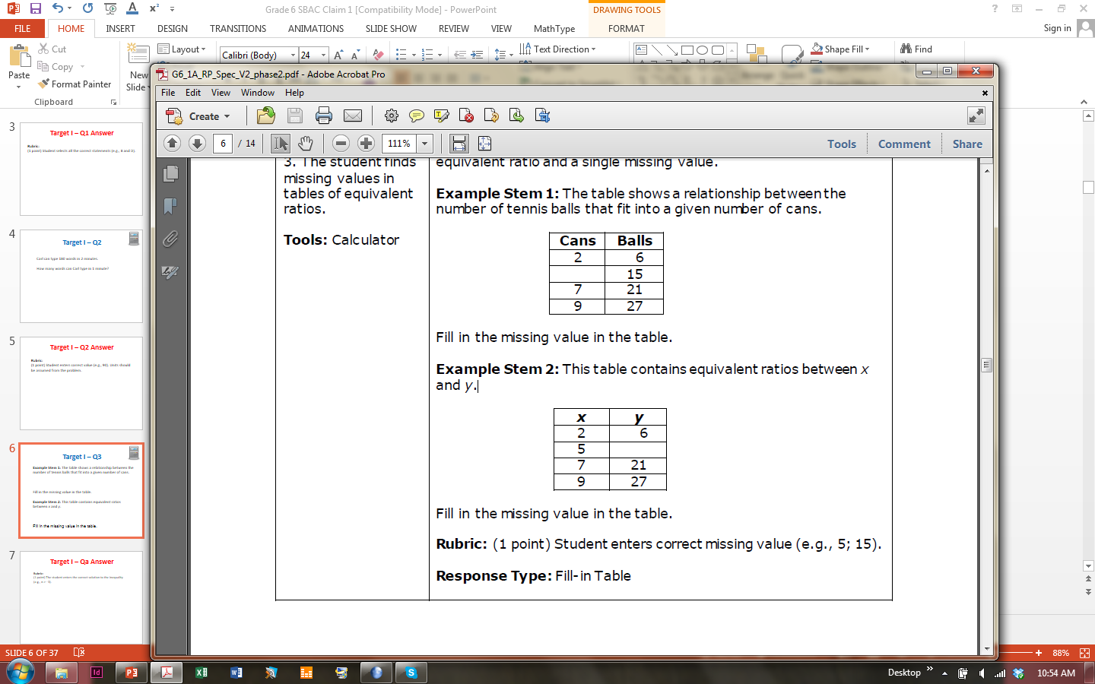
#4
Example 1: The table shows a relationship between the number of tennis balls that fit into a given number of cans.
Fill in the missing value in the table.
Example 2: This table contains equivalent ratios between
x and y.
Fill in the missing value in the table.
Notes:
‹#›

Slide 9
#4 Answer
Rubric:
(1 point each) Student enters correct missing value.
Answers:
Example 1: 5
Example 2: 15
Notes:
‹#›

Slide 10
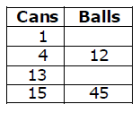
#5
The table shows a relationship between the number of tennis balls that fit into a given number of cans.
Fill in the missing values to complete the table.

Slide 11
#5 Answer
Rubric:
(1 point) Student enters the two correct values into the table.
Answer: 3 and 39

Slide 12
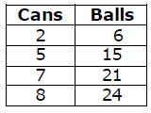
#6
The table shows a relationship between the number of tennis balls that fit into a given number of cans.
Use the Add Point tool to plot the coordinate pairs on the graph.
Notes:
‹#›

Slide 13
#6 Answer
Rubric:
(1 point) Student correctly plots all coordinate pairs on the graph.
Notes:
‹#›

Slide 14
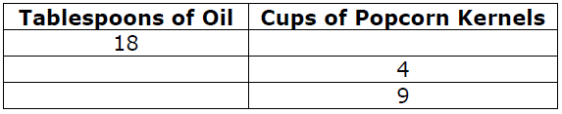
#7
To make popcorn, a movie theater uses 9 tablespoons of oil for each cup of popcorn kernels.
Using this information, complete the table for the missing amounts of oil and popcorn kernels.
Notes:
‹#›

Slide 15
#7 Answer
Rubric:
(1 point) Student enters correct missing values in the table.
Answer: 2, 36, 81
Notes:
‹#›

Slide 16
#8
Carl types 180 words in 2 minutes.
Enter the number of words Carl types in 5 minutes at this rate.
Notes:
‹#›

Slide 17
#8 Answer
Rubric:
(1 point) Student enters correct numeric value.
Answer: 450
Notes:
‹#›

Slide 18
#9
The student is presented with a part and a percent.
Enter the unknown value that makes this statement true: 30% of is 60.
Notes:
‹#›

Slide 19
#9 Answer
Rubric:
(1 point) Student enters the correct numeric value representing the total amount.
Answer: 100
Notes:
‹#›

Slide 20

#10
Example 1: Janet correctly answers 45 questions on her science test. There are 50 questions on the test.
Enter the percent of the questions Janet answers incorrectly.
Example 2: Enter the unknown value that makes this statement true: 30 is % of 50.

Slide 21

#10 Answer
Rubric:
(1 point) Student enters the correct numeric value representing the percent and 0.90 is not an acceptable answer. Percent symbol (%) is not required for a correct response.
Answers:
Example 1: 90
Example 2: 60

Slide 22

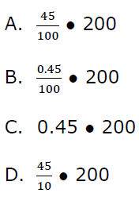
#11
In a school with 200 students, 45% are males. Select all expressions that demonstrate a correct method to calculate the total number of male students.

Slide 23
#11 Answer
Rubric:
(1 point) Student selects all the correct mathematical expressions.
Answers: A and C

Slide 24
#12
Aaron needs 24 inches of copper wire for an experiment. The wire is sold by the centimeter.
Given that 1 inch = 2.54 centimeters, how many centimeters of wire does Aaron need?

Slide 25
#12 Answer
Rubric:
(1 point) Students enters the correct numeric value for the converted unit of measurement.
Answer: 60.96 (accept 61 because of the real-world context.

