Slide 1

Claim 4
Smarter Balanced Sample Items
Grade 5
Modeling and Data Analysis
Questions courtesy of the Smarter Balanced Assessment Consortium Item Specifications – Version 3.0
Slideshow organized by SMc Curriculum – www.ccssmathactivities.com

Slide 2
#1
Gina is making cookies. The last three steps used to make the cookies are shown.
Gina wants to give cookies to 9 people. She wants to give each person 3 cookies. She does not want extra cookies. Which action will help Gina get closest to the exact number of cookies she needs?
A. Place the cookies 3 inches apart.
B. Bake the cookies for only 10 minutes.
C. Roll the cookies slightly bigger than ½ inch.
D. Roll the cookies slightly smaller than ½ inch.
Step 5: Roll the cookies into ½-inch balls.
Step 6: Place the cookies on a baking tray 2 inches apart.
Step 7: Bake for 12 minutes.
This recipe makes 18 to 24 cookies.

Slide 3
#1 Answer
Rubric:
(1 point) The student correctly determines which action will help Gina get closest to the exact number of cookies.
Answer: D

Slide 4
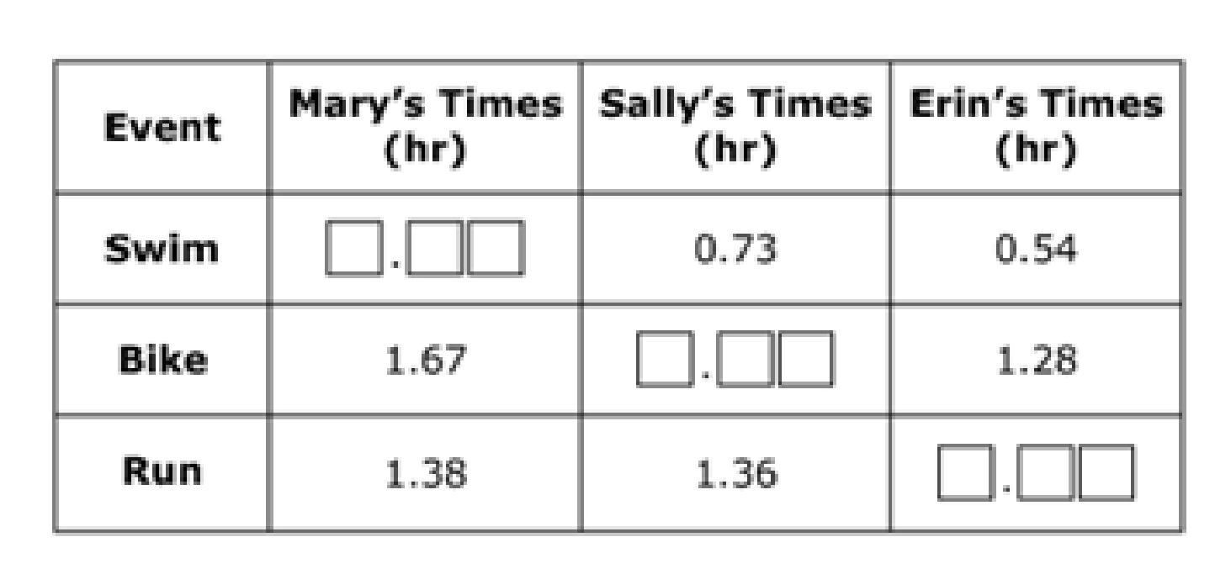
#2
Mary, Sally, and Erin competed in a three-part race. A “finish time” for each person is the total amount of time to finish all three events.
Mary’s swim time was 0.10 hour faster than Erin’s run time.
Sally’s finish time was 0.12 hour faster than Mary’s finish time.
Erin finished the race in 2.72 hours.
Drag numbers into the boxes to complete the missing times for each girl.

Slide 5
#2 Answer
Rubric:
(3 points) The student is able to complete all parts of the table correctly. Each part is independently scored as 1 point.
Answer: Mary’s swim time: 0.80; Sally’s bike time: 1.64; Erin’s run time: 0.90

Slide 6
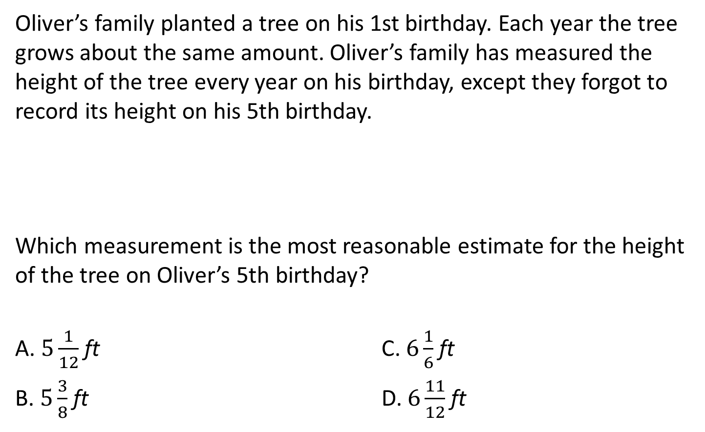
#3
Oliver’s Birthday | 1st | 2nd | 3rd | 4th | 5th | 6th
Height of Tree (ft) |  |  |  |  | ?

Slide 7
#3 Answer
Rubric:
(1 point) The student selects the most reasonable height.
Answer: C

Slide 8
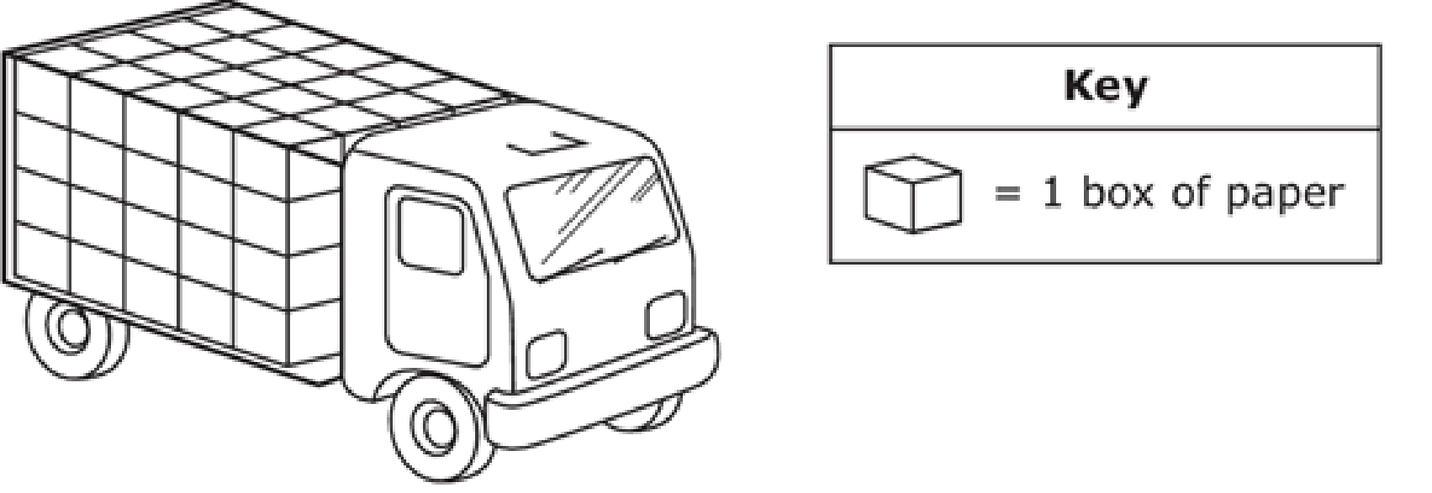
#4
The trailer of a truck is packed with boxes of paper. The boxes are packed 5 boxes deep by 4 boxes high by 4 boxes across, as shown in the picture.
When the driver is in the truck and the trailer is empty, the mass of the truck is 2948.35 kilograms.
The mass of 1 box of paper is 22.5 kilograms.
The driver delivers some of the boxes of paper at his first stop.
The truck has to drive over a bridge on the way to the next stop.
Trucks with a mass greater than 4700 kilograms are not allowed to drive over the bridge.
Enter the minimum number of boxes of paper the driver must deliver at the first stop to be allowed to drive over the bridge.

Slide 9
#4 Answer
Rubric:
(2 points) The student enters the correct whole number of boxes that must be delivered.
(1 point) Partial credit is possible for correctly determining the exact number of boxes and entering any value from 2.1-2.148 or for mistakenly rounding down to 2 instead of up to 3 boxes as needed.
Answer: 3

Slide 10
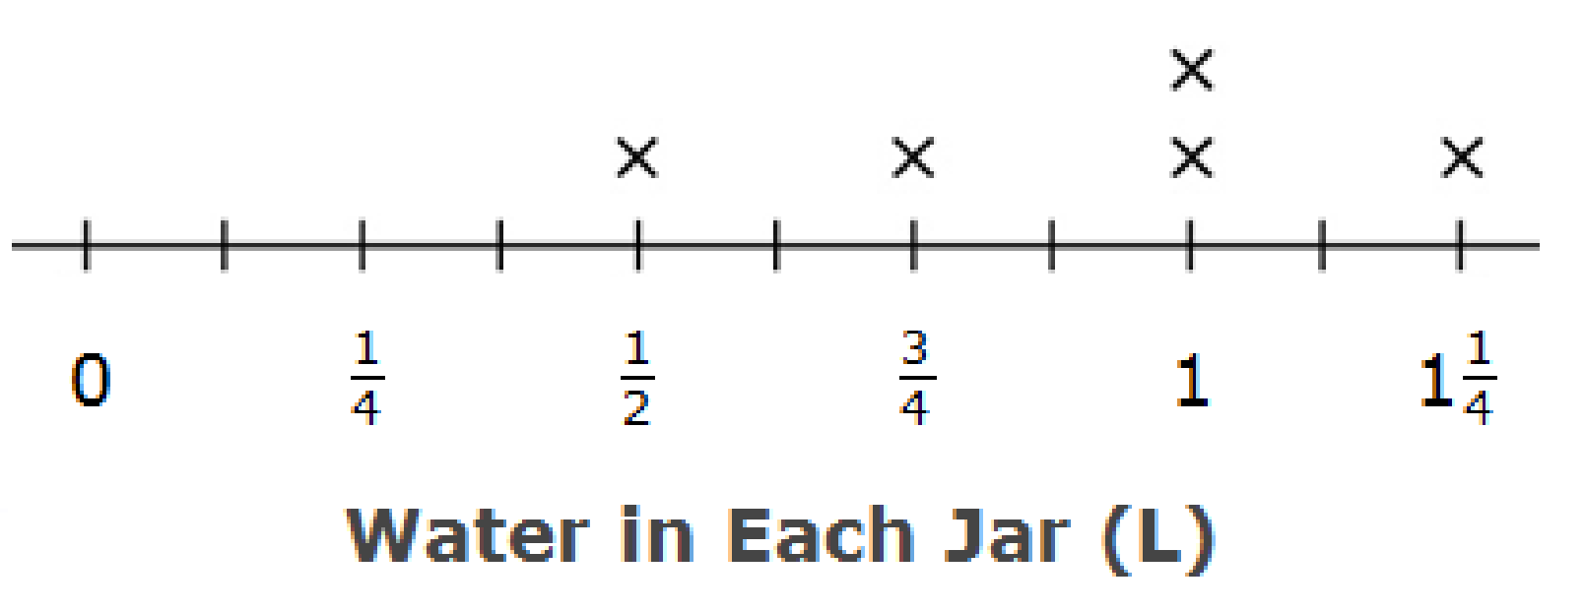
#5
Gabi measures the amount of water, in liters, in
5 identical jars.
Gabi combines all of the water and then divides it equally into the 5 jars. How much water, in liters, does she put in each jar? Enter your answer in the response box.

Slide 11
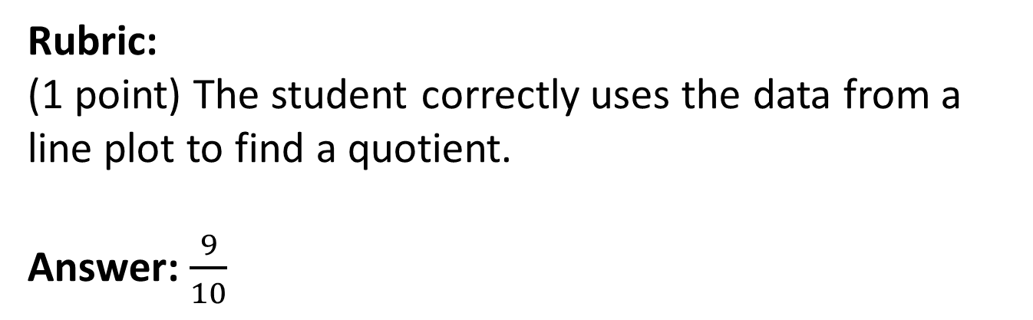
#5 Answer

Slide 12
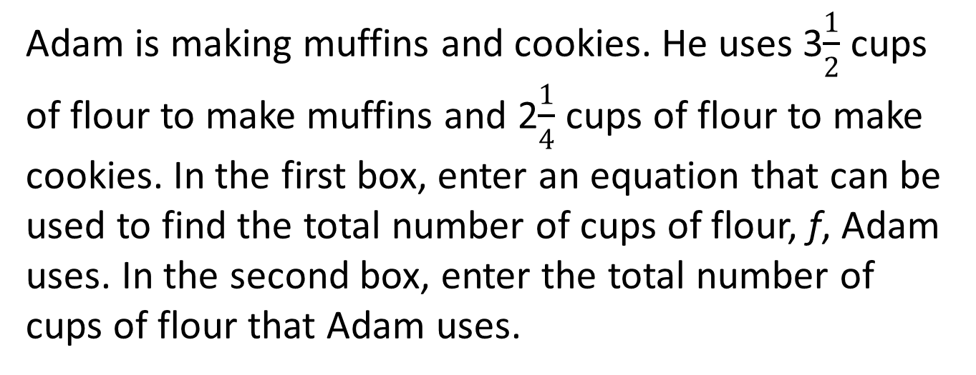
#6

Slide 13
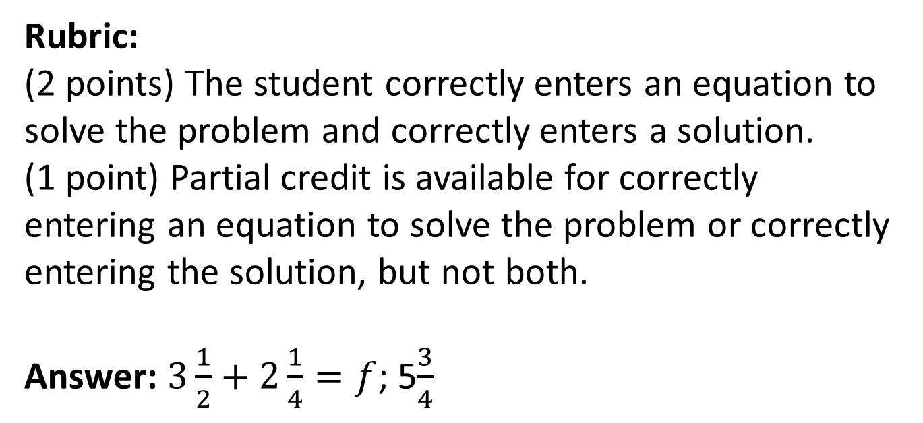
#6 Answer

Slide 14
#7
How many minutes are in 1 day?
More information (if needed)
There are 60 seconds in a minute.
There are 60 minutes in 1 hour.
There are 24 hours in 1 day.
There are 7 days in 1 week.
There are 52 weeks in 1 year.

Slide 15
#7 Answer
Rubric:
(1 point) The student enters the correct number of minutes.
Answer: 1440

Slide 16
#8
A parking meter accepts nickels, dimes, and quarters. It holds up to 1500 coins.
Estimate the value of the coins, in dollars, in the meter when it is full.

Slide 17
#8 Answer
Rubric:
(1 point) The students enters a reasonable estimate.
Answer: A multiple of 5 between 75 and 375.

Slide 18
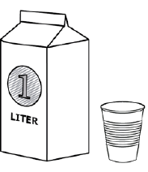
#9
Part A
A liter is more than a cup. Estimate the number of liters in a cup. You can use the picture to help you make an estimate.
Enter your estimate, in liters, in the response box.
Part B
There are about 0.24 liters in one cup. How much greater or less than your estimate is the real amount?
Enter the difference in the response box.

Slide 19
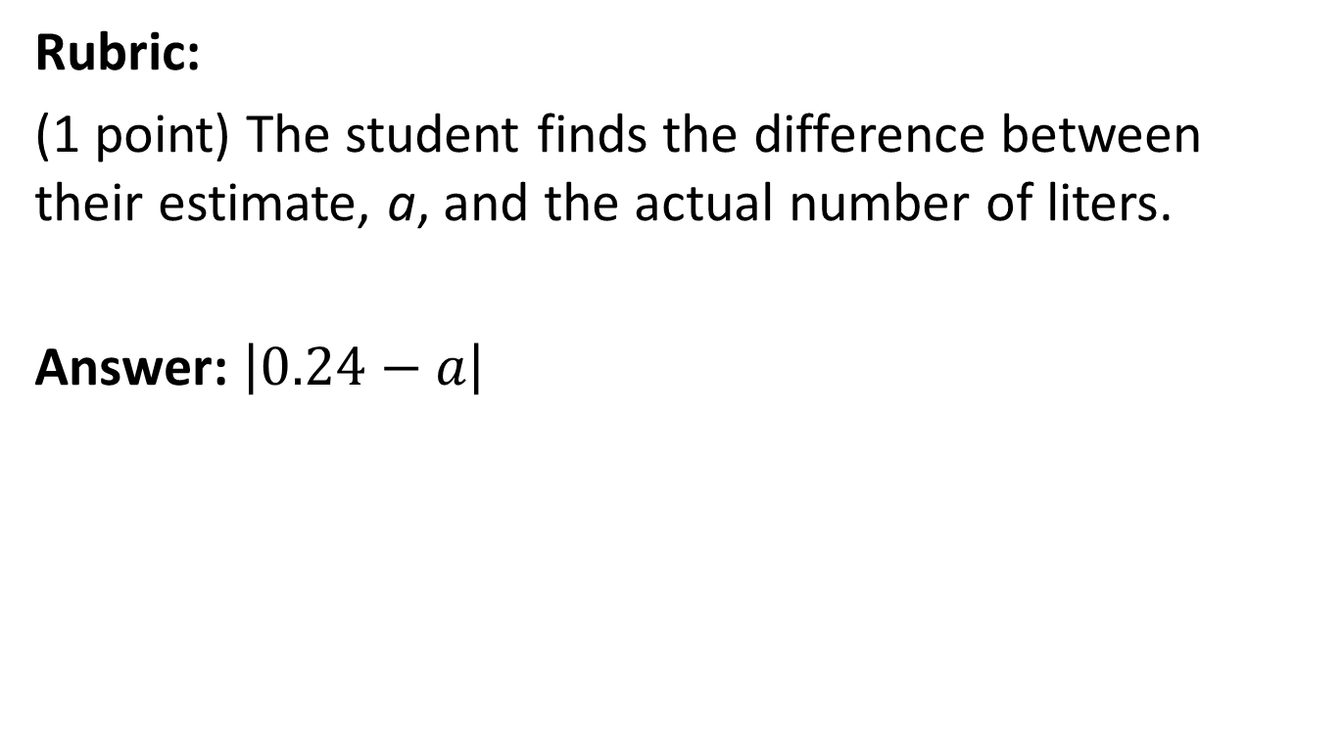
#9 Answer

Slide 20
#10
A school spends $2.40 on every lunch it serves in the cafeteria and $0.30 for each carton of milk.
250 people at the school get a lunch each day
120 take a carton of milk
Create an expression using this information that shows how much the school spends altogether on lunches and milk each day.

Slide 21
#10 Answer
Rubric:
(1 point) Student constructs a correct numerical expression.
Answer: 250 x 2.40 + 120 x 0.30 or its equivalent

Slide 22
#11
A school spends $2.40 on every lunch it serves in the cafeteria and $0.30 for each carton of milk.
250 people at the school get a lunch each day
120 take a carton of milk
Which expression represents the amount of money the school spends altogether on lunches and milk each day?
250 x 2.40 + 120 x 0.30
250 x 0.30 + 120 x 2.40
250 x (2.40 + 0.30)
120 x (2.40 + 0.30)

Slide 23
#11 Answer
Rubric:
(1 point) Student selects the correct numerical expression.
Answer: A

Slide 24
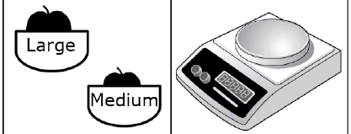
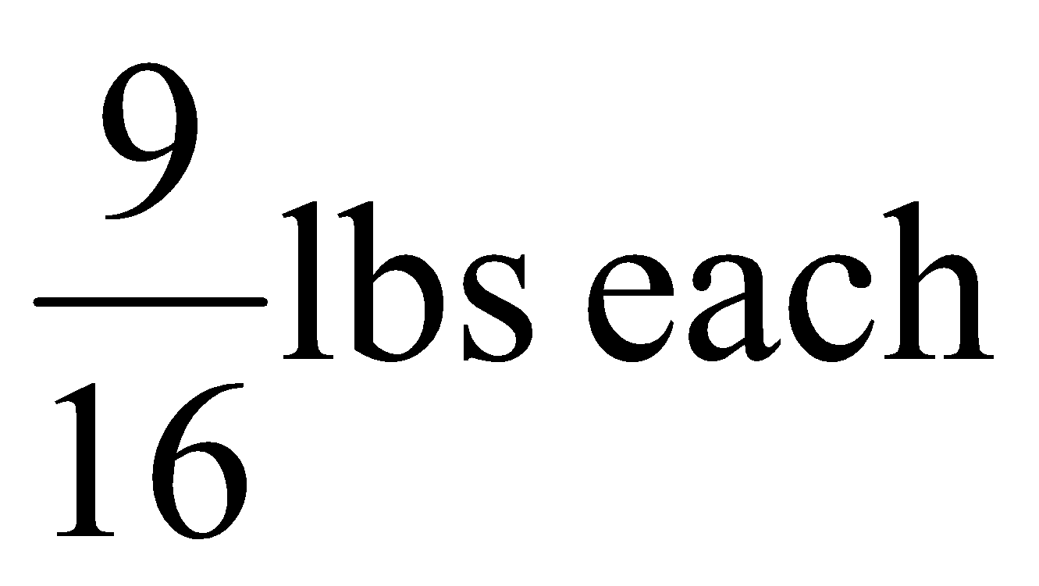
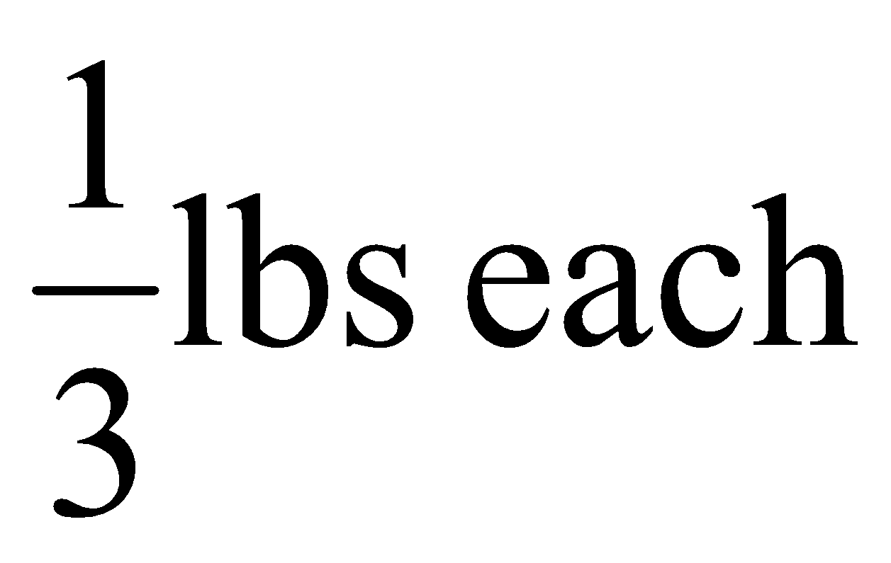
#12
Molly and Sam need about 2 pounds of apples for a pie. Medium apples cost $0.45 each. Large apples cost $0.65 each.
Molly says: “Let’s buy the medium apples, they are less expensive.”
Sam says: “I think it’s less expensive to buy large apples. They are more expensive but we won’t have to buy as many of them.”
Analyze both approaches. You can use the scale to weigh the apples.
Use the choices to complete each statement.
Statement A:
Molly and Sam would need __ medium apples or __ large apples for the pie. (Choose 1, 2, 3, 4, 5, 6, 7, or 8)
Statement B:
The number of medium apples that would be needed cost __ (Choose more or less) than the
number of large apples that would be needed. So ___ (Choose Molly or Sam) is correct.

Slide 25
#12 Answer
Rubric:
(2 points) The student selects the correct numbers and words in all of the drop-down menus.
Answer: 6, 4, more, Sam

Slide 26
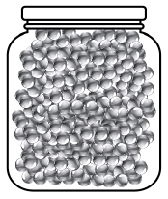
#13
Lilian wants to estimate the number of marbles in a glass jar that has a mass of 2.3 kilograms when it is full.
Part A
Make an estimate for the mass of a single marble, in grams. Enter your estimate in the response box.
Make an estimate for the mass of the jar, in grams. Enter your estimate in the response box.
Estimate the number of marbles in the jar based on the assumptions you made. Enter your estimate in the response box.
Part B
The jar has a mass of about 500 grams and there are about 600 marbles in the jar. Which of the following estimates is closest to the actual mass of a single marble?
2 grams
20 grams
200 grams
1200 grams

Slide 27
#13 Answer
Rubric:
(2 points) The student estimates the mass of a single marble m and the mass of a jar b, and makes an estimate of the number of marbles in the jar that is consistent with the initial estimates and then selects the best estimate from the given choices.
(1 point) The student makes an estimate for the number of marbles that is consistent with his/her estimated masses in Part A or selects the best estimate from the choices given in Part B.
Answer: (2300 – b)/m +/- 50; A

