Slide 1

Claim 3
Smarter Balanced Sample Items
Grade 5
Communicating Reasoning
Questions courtesy of the Smarter Balanced Assessment Consortium Item Specifications – Version 3.0
Slideshow organized by SMc Curriculum – www.ccssmathactivities.com

Slide 2
#1
The dimensions of a right rectangular prism are:
length = 6 inches
width = 3 inches
height = 4 inches.
What will happen to the volume of the right rectangular prism if the width is doubled?
A. The new volume will be half the original volume.
B. The new volume will be twice the original volume.
C. The new volume will be 3 times the original volume.
D. The new volume will be 6 times the original volume.

Slide 3
#1 Answer
Rubric:
(1 point) The student selects the correct response.
Answer: B

Slide 4
#2
At Maria’s school, 6 classes are going on a field trip. Each class has 26 students and 1 teacher. Each bus holds a maximum of 48 people. The school requests 3 buses for the field trip.
Carefully read Maria’s argument:
Click to select the statement in Maria’s argument that has incorrect reasoning or incorrect calculations.
Drag the numbers from the palette into boxes to create the number that will correct the statement you choose.
A. Maria says that the 3 buses are not enough.
B. She argues that 3 buses will hold a maximum of 144 people.
C. The classes need space for 156 people.
D. The school needs to order 1 more bus.

Slide 5
#2 Answer
Rubric:
(1 point) The student selects the correct statement and enters the number that corrects it.
Answer: C, 162

Slide 6
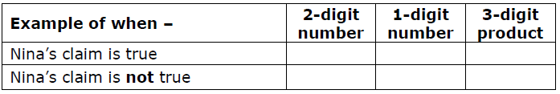
#3
Nina says, “If you multiply a 2-digit number and a 1-digit number, you get a 3-digit number.”
Enter numbers in the table to give one example of when Nina’s claim is true, and another example that shows her claim is not always true.

Slide 7
#3 Answer
Rubric:
(2 points) The student gives an example where the product is a three-digit number and an example where it is not.
(1 point) The student gives an example where the product is a three-digit number or an example where it is not.
Answer: Examples: 90 x 2 = 180; 10 x 2 = 20

Slide 8
#4
Gil and Nina are comparing the numbers 3 and 12.
Gil says, “12 is 9 more than 3.”
Nina says, “12 is 4 times more than 3.”
What is true about Gil and Nina’s statements?
Nina is correct and Gil is not. You should multiply to compare the numbers.
Gil is correct and Nina is not. You should add to compare numbers.
They are both correct. They just compared using different operations.
Neither one is correct. You have to compare like this: 12 > 3.

Slide 9
#4 Answer
Rubric:
(1 point) The student selects the correct statement.
Answer: C

Slide 10
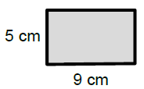
#5
Carrie saw the figure below and said that its area is
5 x 9 = 45 square centimeters.
Which statement best supports Carrie’s claim?
It is true if the opposite sides have the same length.
It is true if the figure is a rectangle.
It is false if the opposite sides have the same length.
It is false if the figure is a rectangle.

Slide 11
#5 Answer
Rubric:
(1 point) The student selects the correct statement.
Answer: B

Slide 12
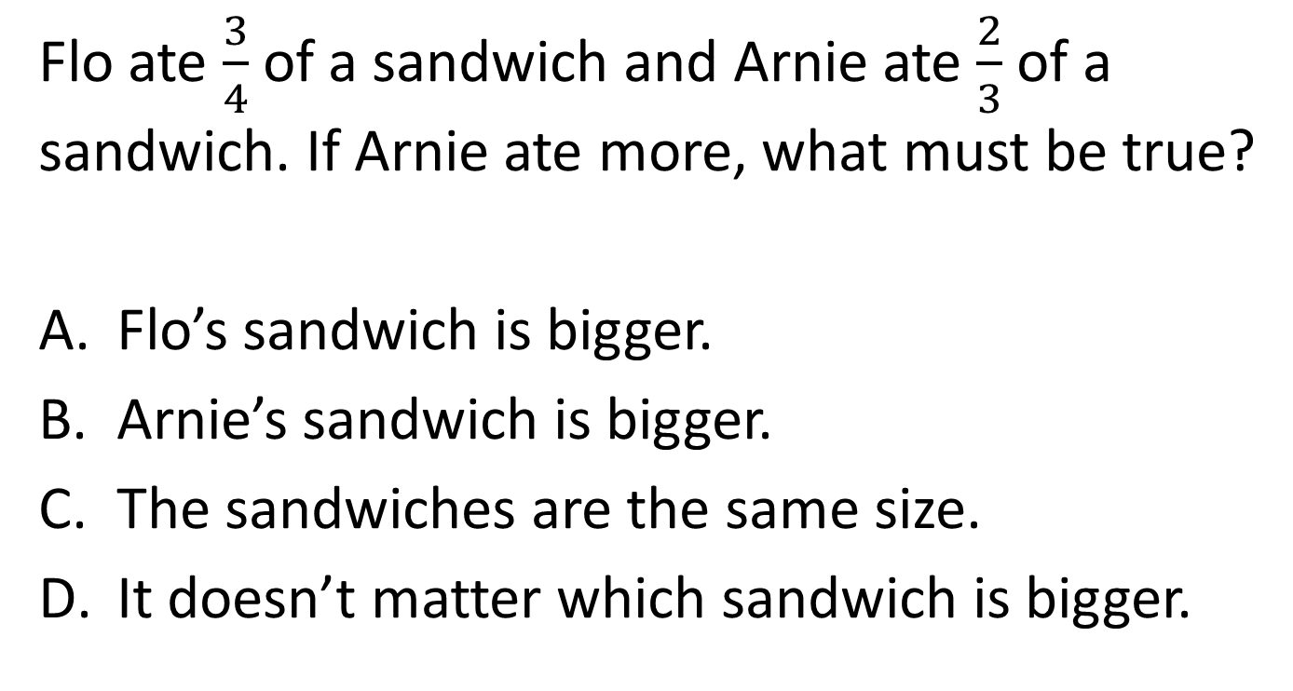
#6

Slide 13
#6 Answer
Rubric:
(1 point) The student selects the correct assumption.
Answer: B

Slide 14
#7
Patrick is learning about quadrilaterals. He was given the following true statements.
Opposite sides of all parallelograms have the same length.
Opposite sides of all rectangles have the same length.
All sides of a square have the same length.
All rectangles are parallelograms.
All rectangles have right angles.
All squares have right angles.
Based on this information, Patrick assumes the following statements are always true. Which statement is not supported by the given information?
All squares are rectangles.
All squares are parallelograms.
All parallelograms are rectangles.
All parallelograms are quadrilaterals.

Slide 15
#7 Answer
Rubric:
(1 point) The student selects the correct response.
Answer: C

Slide 16
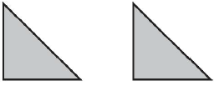
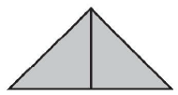
#8
Nora has drawn two identical isosceles right triangles.
Here is a way to put them together so that they share a side and make another triangle.
Select all the quadrilaterals Nora can make with these triangles if she puts them together so that they share a side.
A square
A rectangle that is not a square
A rhombus that is not a square
A parallelogram that is not a rectangle

Slide 17
#8 Answer
Rubric:
(1 point) The student selects the possible cases.
Answer: A and D

Slide 18
#9
32 x 45 is greater than both 32 and 45. When is a x b between a and b?
Select all that apply.
When a > 1 and b > 1
When a < 1 and b > 1
When b < 1 and a > 1
When a < 1 and b < 1

Slide 19
#9 Answer
Rubric:
(1 point) The student selects the correct answer.
Answer: B and C

Slide 20

#10
Jenny says, “To round a decimal d between 3.2 and 3.3 to the nearest tenth, you just see which tenth it is closest to on the number line. For example, 3.28 is closer to 3.3 than 3.2, so it rounds to 3.3.”
In which cases will Jenny’s method work? (Select all that apply.)
Case 1: 3.25 < d ≤ 3.3
Case 2: d = 3.25
Case 3: 3.2 ≤ d < 3.25
Jenny’s method doesn’t usually work—it just worked for this example.

Slide 21
#10 Answer
Rubric:
(1 point) The student selects the correct cases.
Answer: A and C

Slide 22
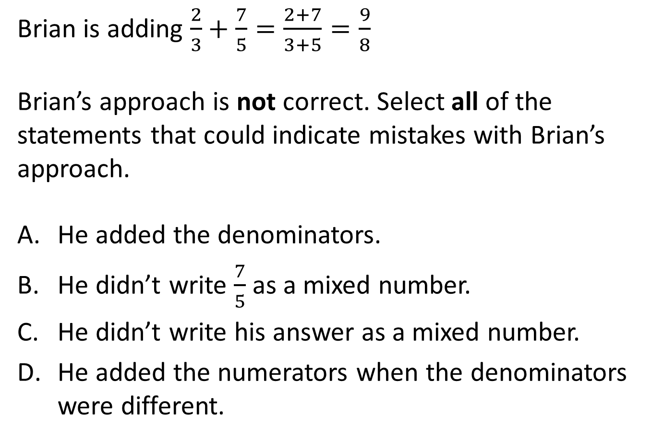
#11

Slide 23
#11 Answer
Rubric:
(1 point) The student clicks on the mistakes in the algorithm.
Answer: A and D

Slide 24
#12
Mr. Spivak’s class was finding the volume of a right rectangular prism
with dimensions 20 cm, 45 cm, and 80 cm.
Brigit said, “I tried two ways of multiplying the dimensions and got different answers. I can’t figure out what went wrong.”
She explained her two ways to Mr. Spivak.
First method: Second method:
Step 1: I distributed. Step 1: I broke apart the numbers.
20 x (45 x 80) = (20 x 45) + (20 x 80) 20 x 45 x 80 = (2 x 10) x (5 x 9) x (8 x 10)
Step 2: I multiplied 20 by 45 and 20 by 80. Step 2: I rearranged the numbers.
= 900 + 1600 = (8 x 9) x (2 x 5) x (10 x 10)
Step 3: Then I added. Step 3: I multiplied everything.
=2500 = 72 x (10 x 100) = 72,000
Which method has an error? Which step has the first error in the method?

Slide 25
#12 Answer
Rubric:
(1 point) The student selects the incorrect method and identifies the step in which the error occurred.
Answer: First method is incorrect; step 1

Slide 26
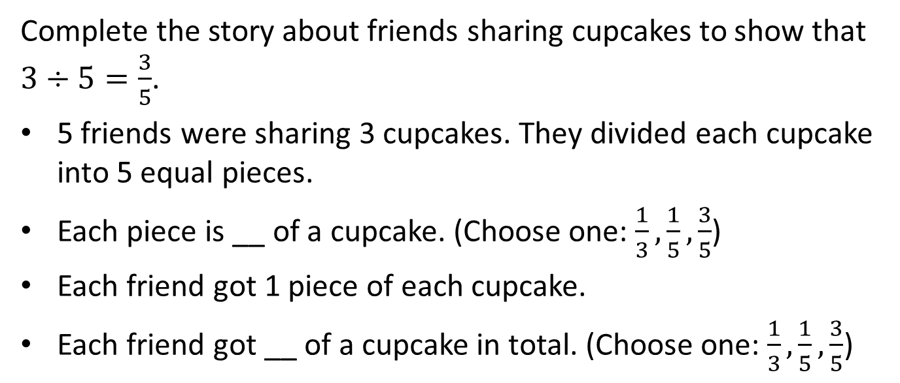
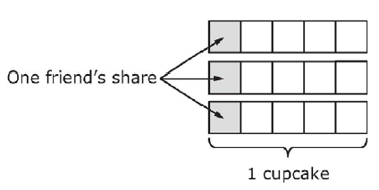
#13

Slide 27
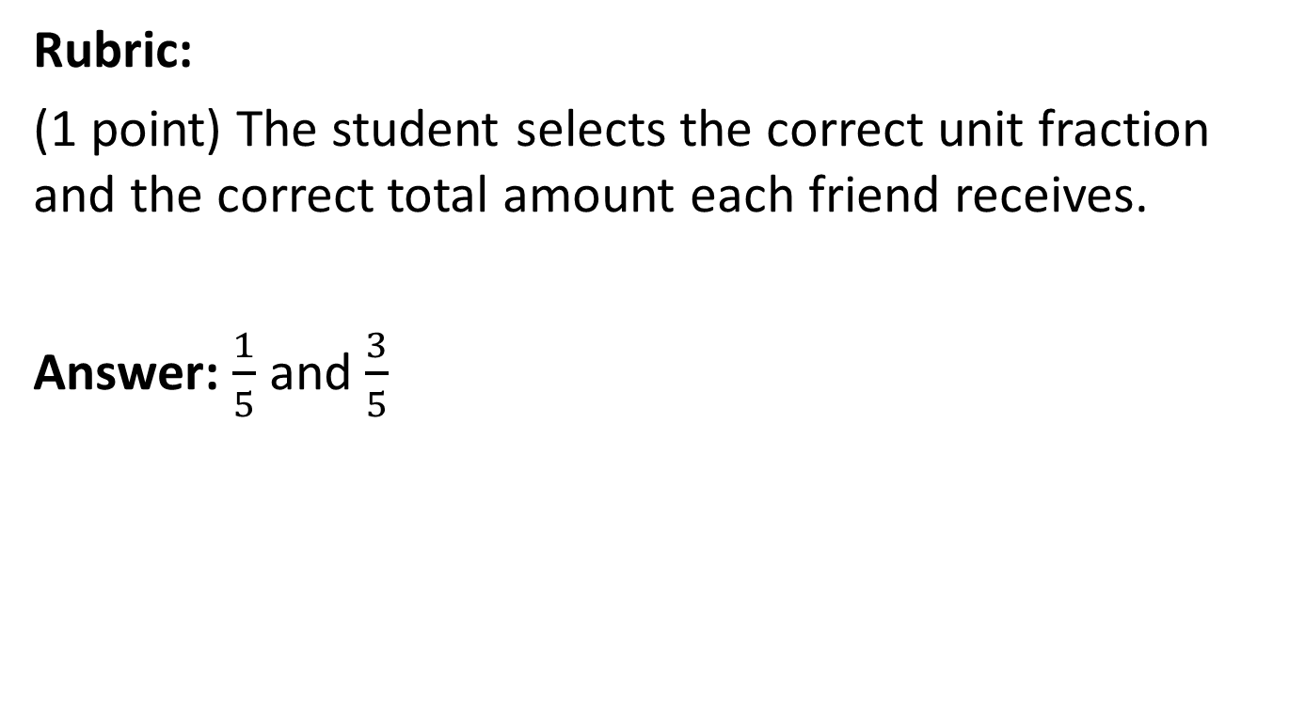
#13 Answer

