Slide 1

Claim 2
Smarter Balanced Sample Items
Grade 5
Problem Solving
Questions courtesy of the Smarter Balanced Assessment Consortium Item Specifications – Version 3.0
Slideshow organized by SMc Curriculum – www.ccssmathactivities.com

Slide 2
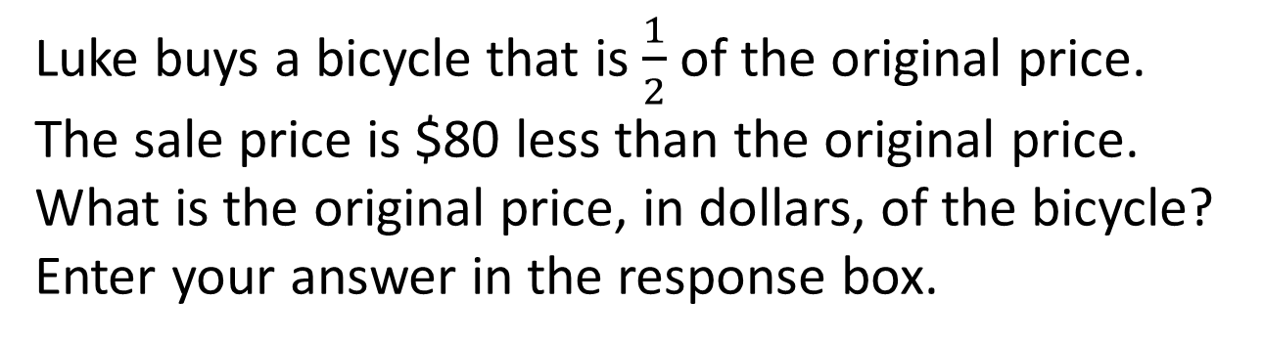
#1

Slide 3
#1 Answer
Rubric:
(1 point) The student enters the correct original price.
Answer: 160

Slide 4
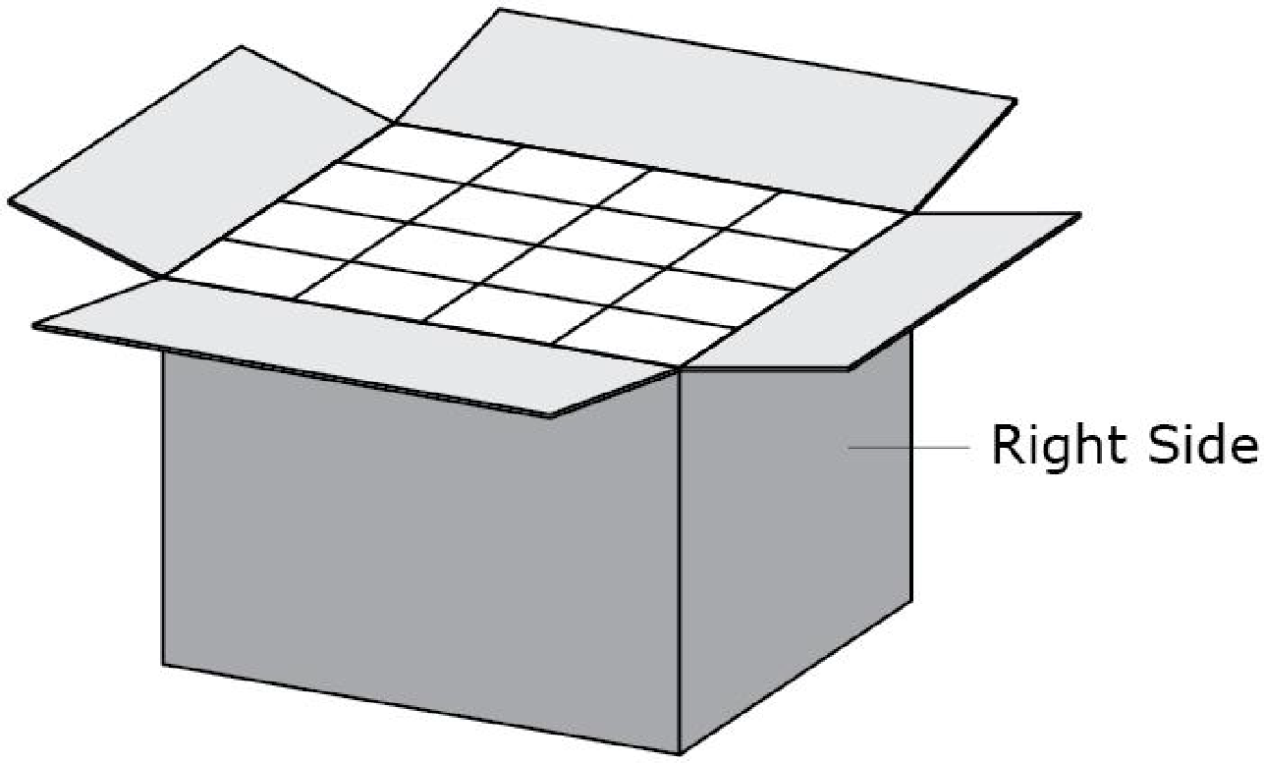
#2
A rectangular box is filled with 48 same-sized cubes. Julie opens the top of the box and sees 16 cubes.
Julie closes the top and then opens the right side of the box. How many cubes should she see?
Enter your answer in the response box.

Slide 5
#2 Answer
Rubric:
(1 point) The student provides the correct number of cubes for the right side of the box.
Answer: 12

Slide 6
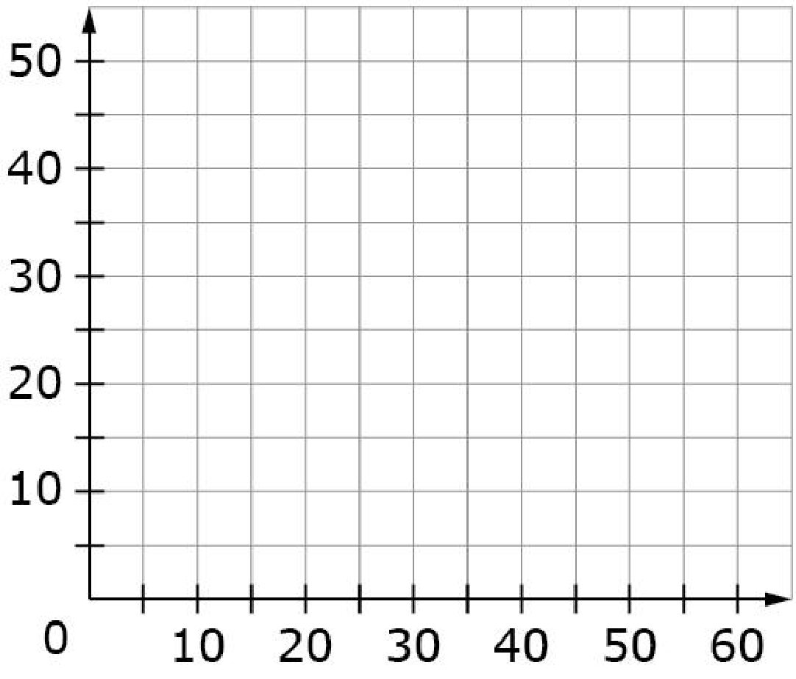
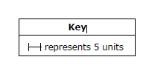
#3
Use the Connect Line tool to draw a rectangle with area 1575 square units and one side with length 45 units.

Slide 7
#3 Answer
Rubric:
(1 point) The student draws a rectangle with correct dimensions.
Answer: 45 by 35

Slide 8
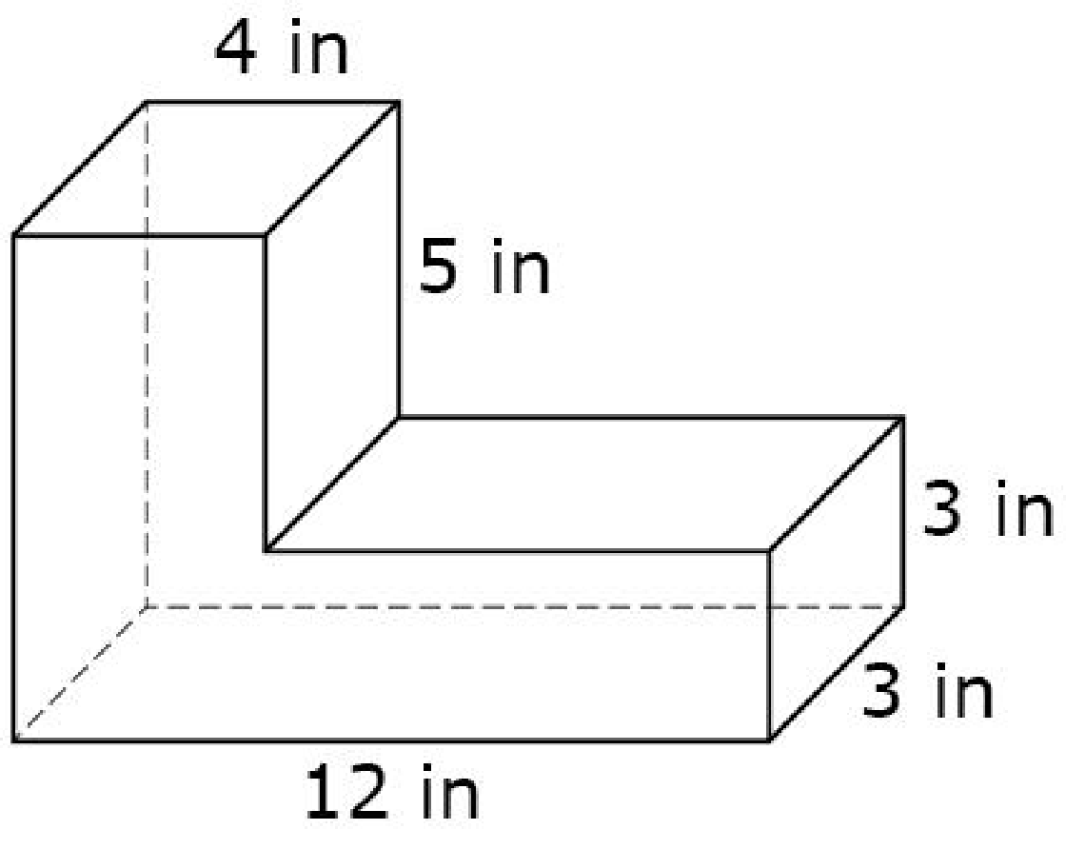
#4
The figure shown was created by joining two rectangular prisms. What is the total volume, in cubic inches, of the figure? Enter your answer in the response box.

Slide 9
#4 Answer
Rubric:
(1 point) The student correctly enters the total volume of the figure in cubic inches.
Answer: 168

Slide 10
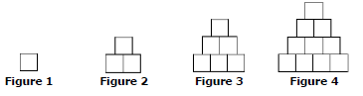
#5
The four figures shown represent a sequence.
Enter your answer for Figure 5 in the first response box.
Figure 40 in this sequence contains
820 squares. How many squares are
needed to make Figure 41? Enter
your answer for Figure 41 in the
second response box.
Figure | Number of Squares
1 | 1
2 | 3
3 | 6
4 | 10
5 | ?

Slide 11
#5 Answer
Rubric:
(2 points) The student is able to correctly determine the number of squares in both figures.
(1 point) The student is able to correctly determine the number of squares in one figure, but not both.
Answer: 15; 861

Slide 12
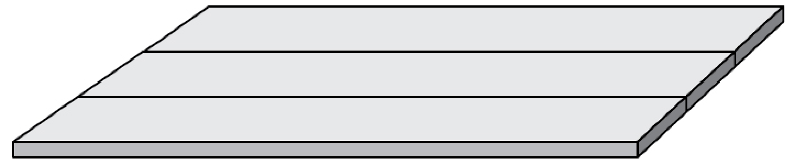
#6
Shelbi builds a platform with wooden boards. Each board is 100 millimeters wide.
Shelbi places the boards side by side to build the platform.
The platform has a total width of 12 meters. What is the fewest number of boards that Shelbi needs to build the platform?
Enter your answer in the response box.

Slide 13
#6 Answer
Rubric:
(1 point) Student enters the correct number.
Answer: 120

Slide 14
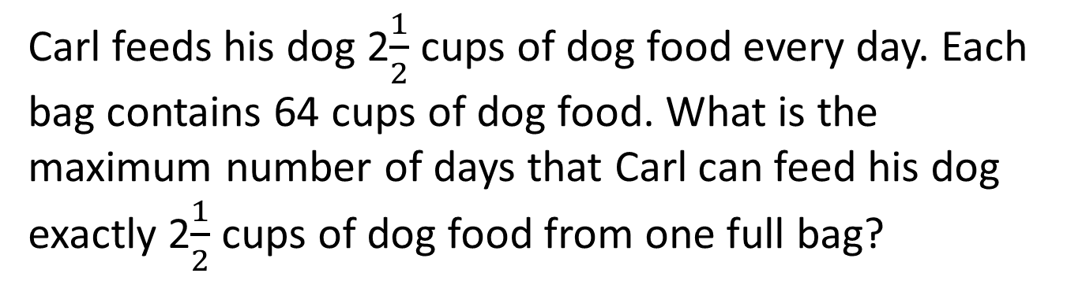
#7

Slide 15
#7 Answer
Rubric:
(1 point) The student is able to determine the maximum number of servings from one bag of food and interpret the remainder as not being enough for another serving.
Answer: 25

Slide 16
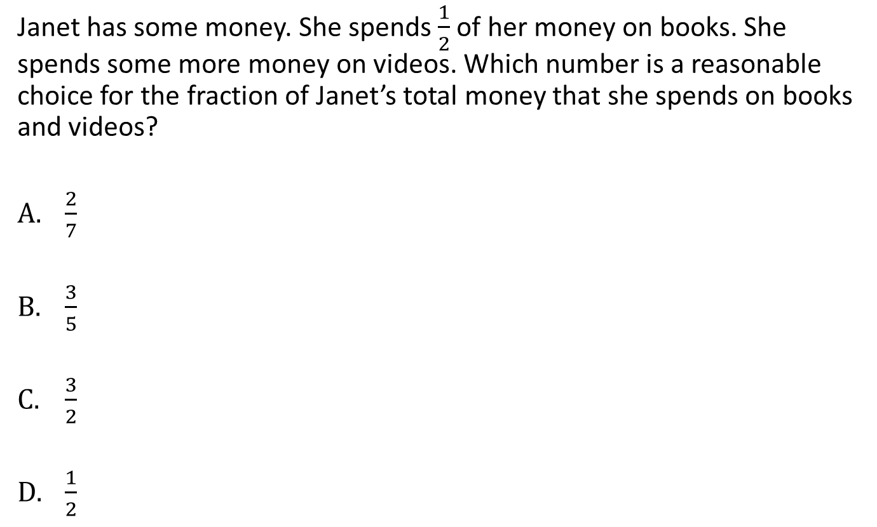
#8

Slide 17
#8 Answer
Rubric:
(1 point) The student enters the most reasonable choice.
Answer: B

Slide 18
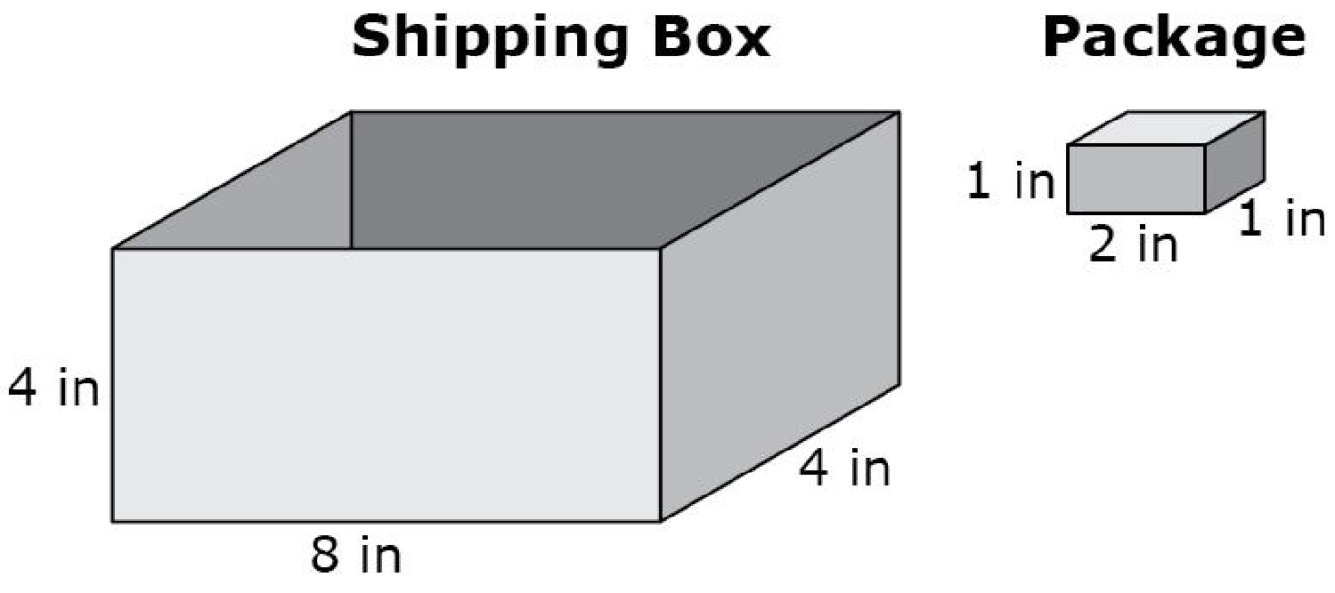
#9
Tonya must completely fill a shipping box with as many packages as possible. Each package measures 1 inch by 2 inches by 1 inch. The shipping box she must use measures 4 inches by 8 inches by 4 inches. What is the greatest number of packages that can fit into the shipping box? Enter your answer in the response box.

Slide 19
#9 Answer
Rubric:
(1 point) The student enters the number of packages that can fit into the box.
Answer: 64

Slide 20
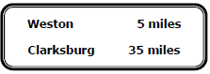
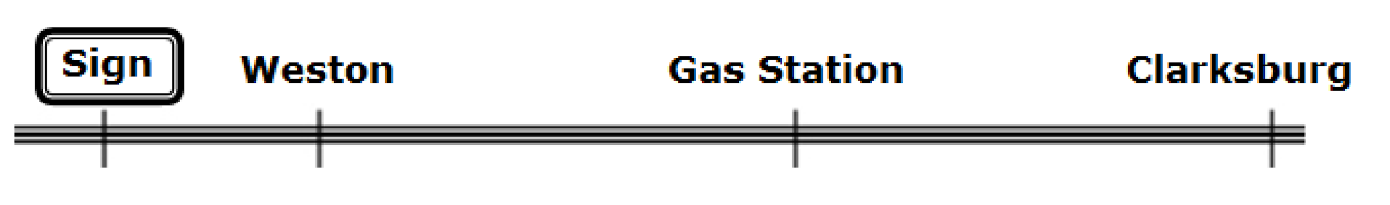
#10
Mia is traveling along a road toward Clarksburg and sees the following sign.
A gas station is located halfway between Weston and Clarksburg as shown on this diagram.
How many miles is it from Weston to Clarksburg?
Enter your answer in the first response box.
How many miles is it from the sign to the gas station?
Enter your answer in the second response box.

Slide 21
#10 Answer
Rubric:
(2 points) The student enters the correct distances for each question.
(1 point) The student enters only one correct distance.
Answer: 30 or 20

Slide 22
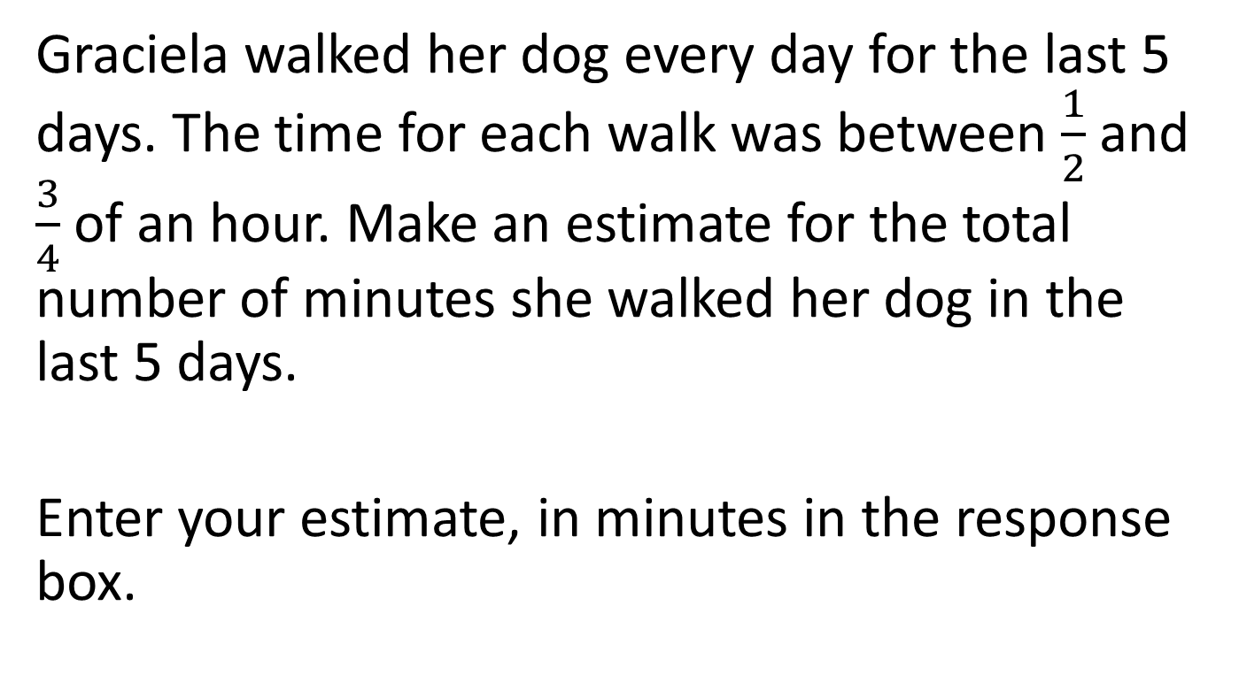
#11

Slide 23
#11 Answer
Rubric:
(1 point) The student enters a value in the correct range.
Answer: Any number from 150 to 225, inclusive.

Slide 24
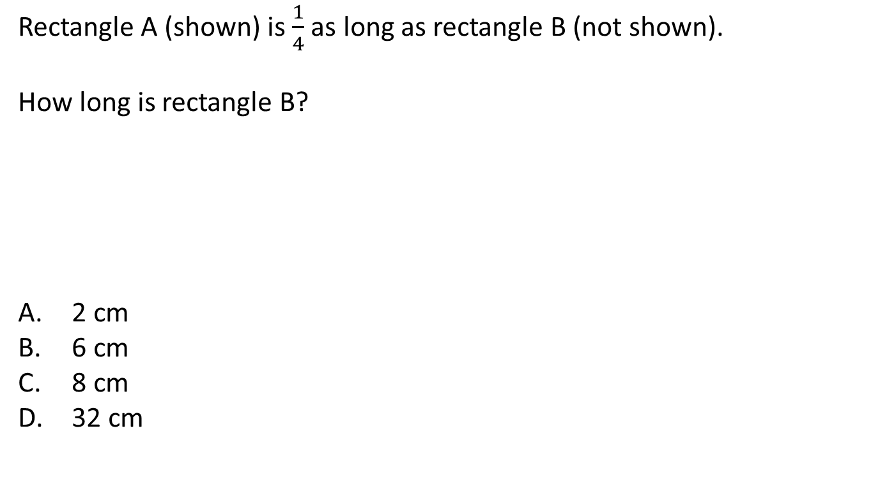
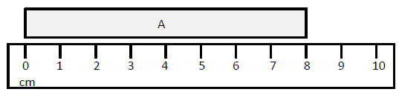
#12

Slide 25
#12 Answer
Rubric:
(1 point) The student selects the correct option.
Answer: D

Slide 26
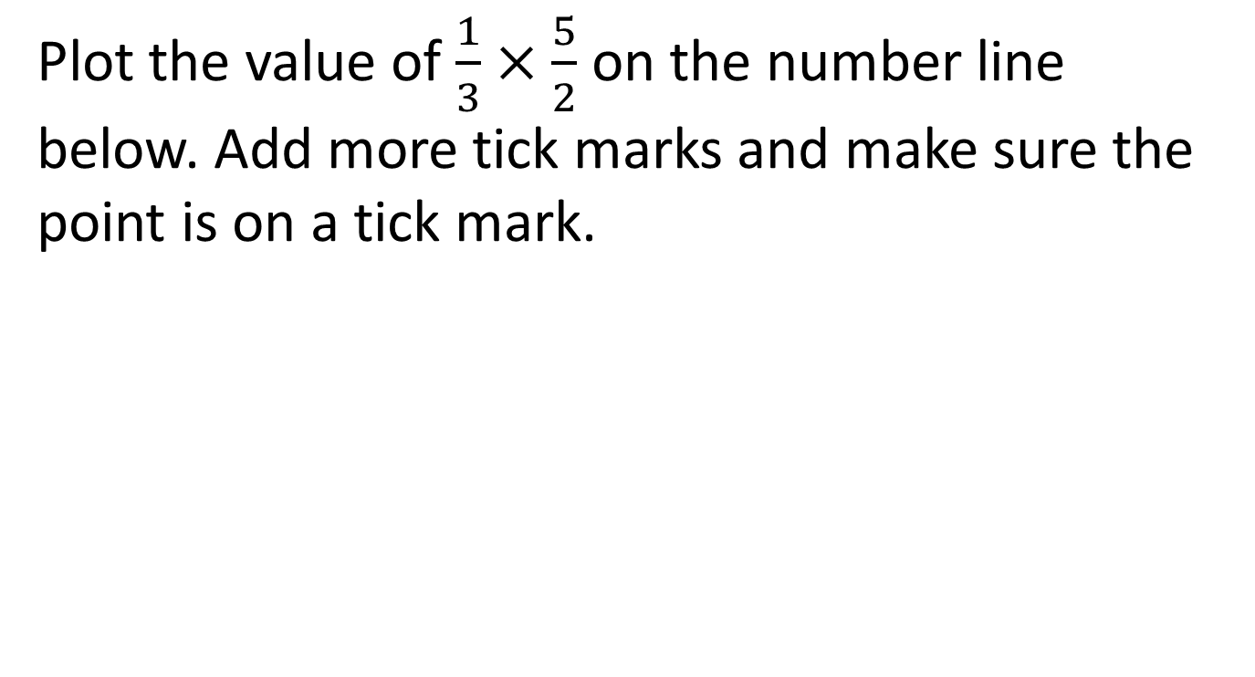

#13

Slide 27
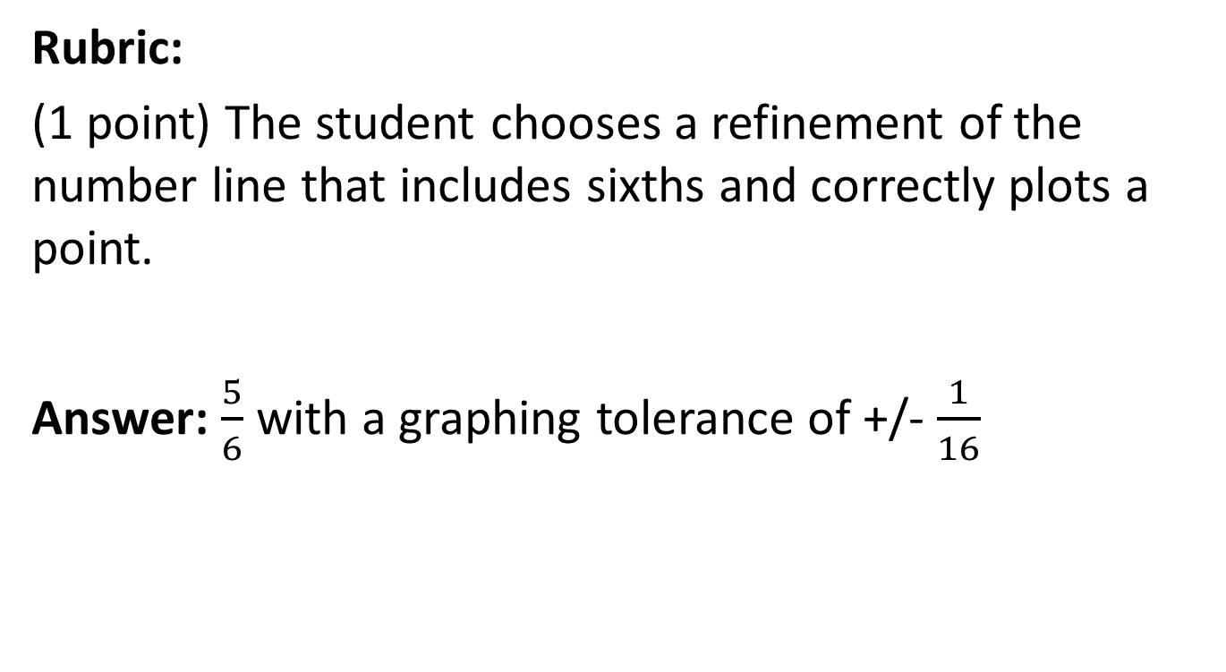
#13 Answer

Slide 28

#14
Scott is buying water bottles and apples for his soccer team. The cost of buying packs of water bottles and bags of apples is shown in the table.
What is the least amount of money that he can spend on whole packs of water bottles and bags of apples so that all 18 players on his team can have both a bottle of water and an apple?
Enter your answer, in dollars, in the response box.

Slide 29
#14 Answer
Rubric:
(1 point) The student enters the correct minimum cost.
Answer: $27.20

Slide 30
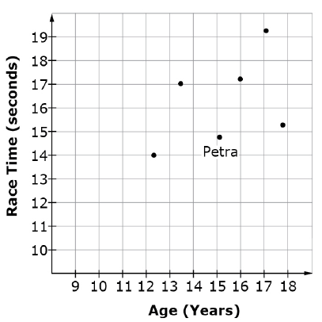
#15
Six students ran a race. The graph shows the ages and times of the six students.
What was Petra’s time in seconds?

Slide 31
#15 Answer
Rubric:
The student correctly identifies Petra’s time.
Note: Accept a tolerance of +/- 0.2 seconds.
Answer: 14.8

