Slide 1

Claim 1
Smarter Balanced Sample Items
Grade 5 - Target K
Classify two-dimensional figures into categories based on their properties.
Questions courtesy of the Smarter Balanced Assessment Consortium Item Specifications – Version 3.0
Slideshow organized by SMc Curriculum – www.ccssmathactivities.com

Slide 2

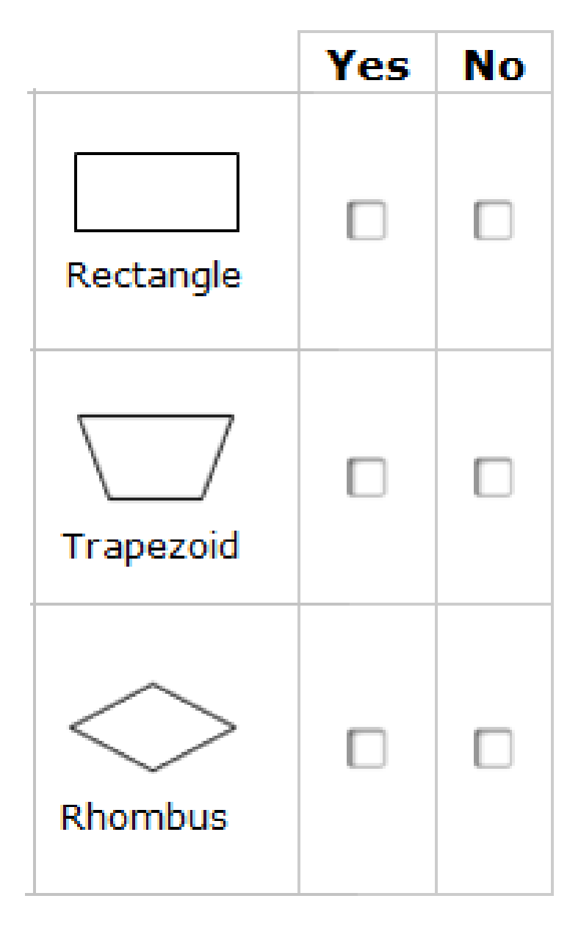
#1
All parallelograms have two pairs of opposite, parallel, equal-length sides. Determine whether each polygon shown is also a parallelogram. Select Yes or No for each polygon.

Slide 3

#1 Answer
Rubric:
(1 point) The student correctly identifies if the given polygon is a parallelogram for all answer choices.
Answer: Y, N, Y

Slide 4
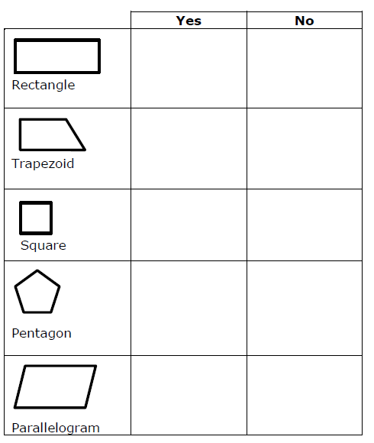
#2
Determine if each polygon is also a rhombus. Select Yes for each polygon that is a rhombus and No for each polygon that is not a rhombus.

Slide 5
#2 Answer
Rubric:
(1 point) The student correctly selects all boxes that apply with no incorrect boxes selected.
Answer: N, N, Y, N, N

Slide 6
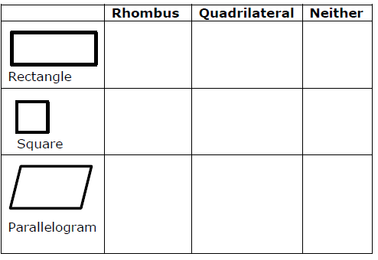
#3
Determine whether each polygon is a rhombus and/or a quadrilateral. Select all boxes that apply next to each polygon. If the polygon is not a rhombus or a quadrilateral, select Neither.

Slide 7
#3 Answer
Rubric:
(1 point) The student correctly selects all boxes that apply with no incorrect boxes selected.
Answer: Rectangle: Quadrilateral; Square: Rhombus, Quadrilateral; Parallelogram: Quadrilateral.

