Slide 1

Claim 1
Smarter Balanced Sample Items
Grade 5 - Target J
Graph points on the coordinate plane to solve real-world and mathematical problems.
Questions courtesy of the Smarter Balanced Assessment Consortium Item Specifications – Version 3.0
Slideshow organized by SMc Curriculum – www.ccssmathactivities.com
Notes:
‹#›

Slide 2

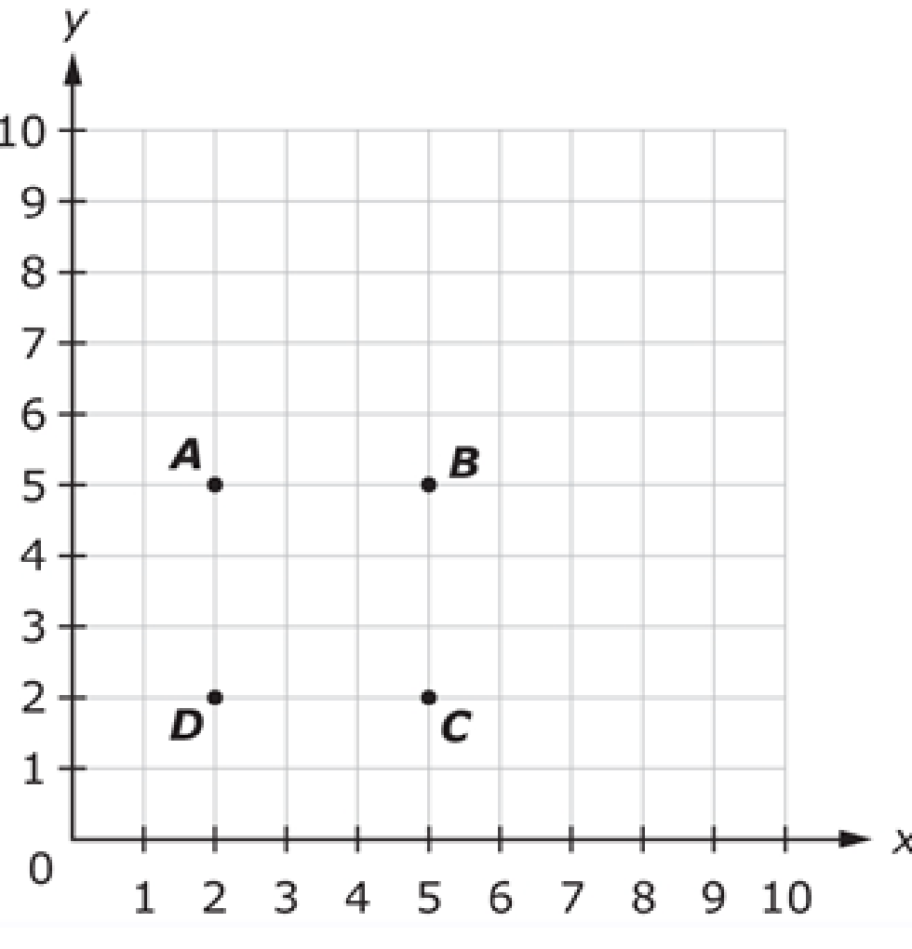
#1
Use the graph to answer the question. Which point is located at (5, 2)?
A. Point A
B. Point B
C. Point C
D. Point D

Slide 3

#1 Answer
Rubric:
(1 point) The student correctly identifies the point located at the given coordinate.
Answer: C
Notes:
‹#›

Slide 4
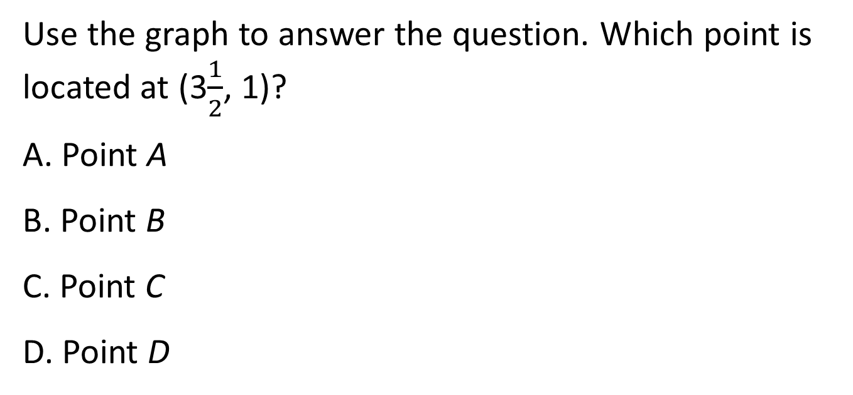
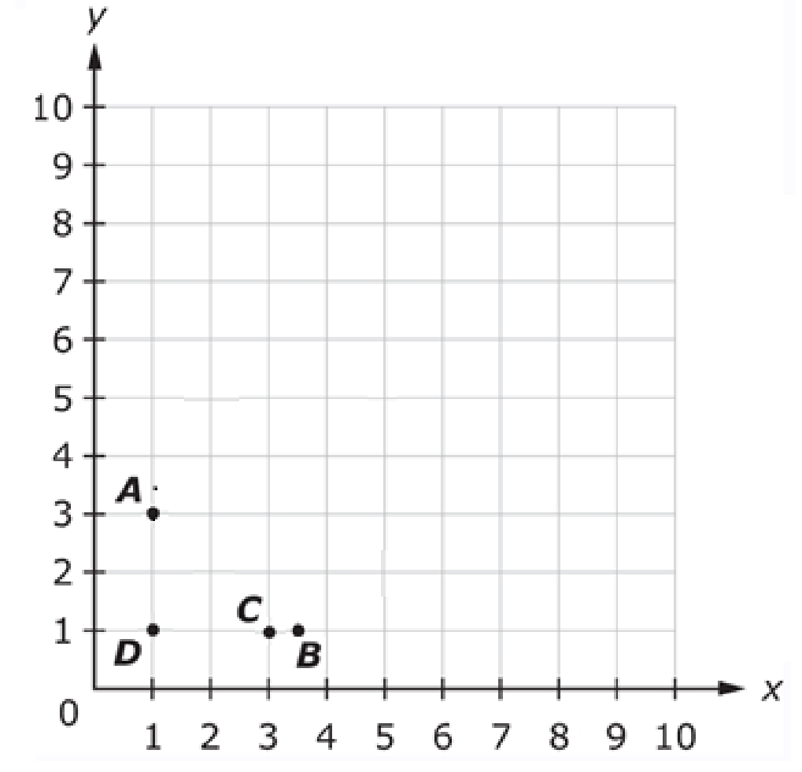
#2
Notes:
‹#›

Slide 5
#2 Answer
Rubric:
(1 point) The student correctly identifies the point located at the given coordinate.
Answer: B
Notes:
‹#›

Slide 6
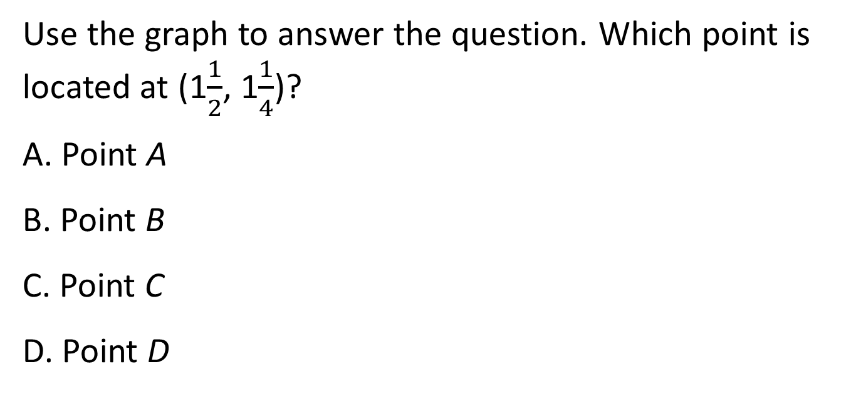
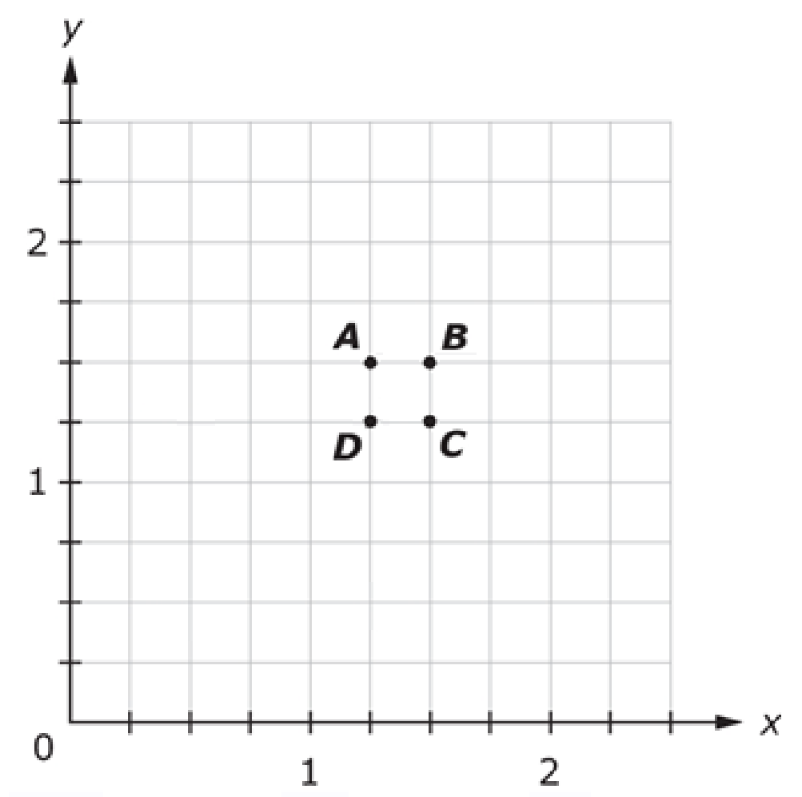
#3

Slide 7
#3 Answer
Rubric:
(1 point) The student correctly identifies the point located at the given coordinate.
Answer: C

Slide 8
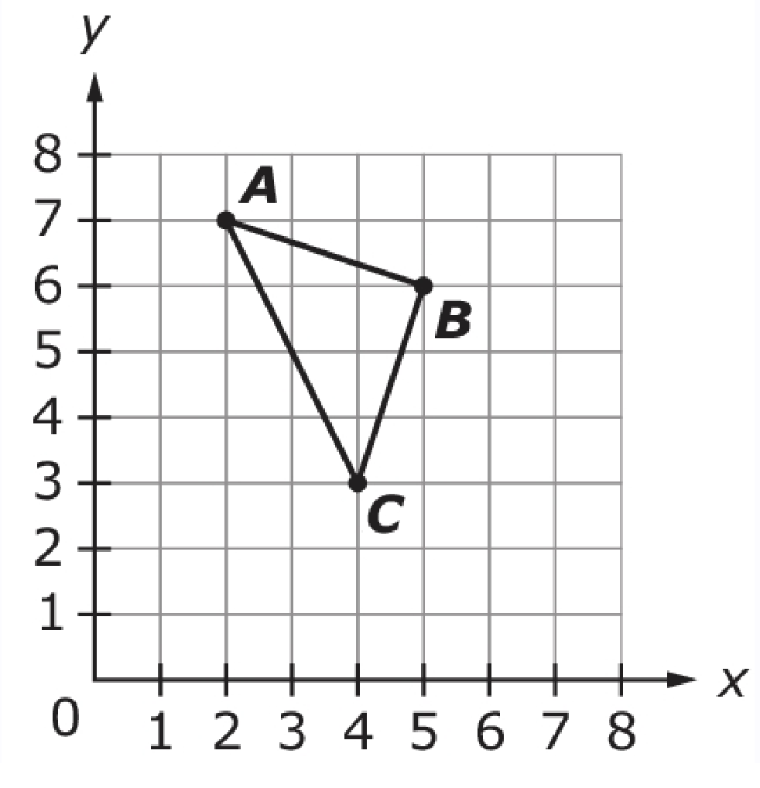
#4
Use the graph to answer the question. Which set of ordered pairs shows the coordinates of points A, B, and C?
A. (7, 2), (6, 5), (3, 4)
B. (7, 2), (5, 6), (3, 3)
C. (2, 7), (5, 6), (4, 3)
D. (2, 7), (6, 5), (4, 3)

Slide 9
#4 Answer
Rubric:
(1 point) The student correctly identifies the pairs for the figure.
Answer: C

Slide 10
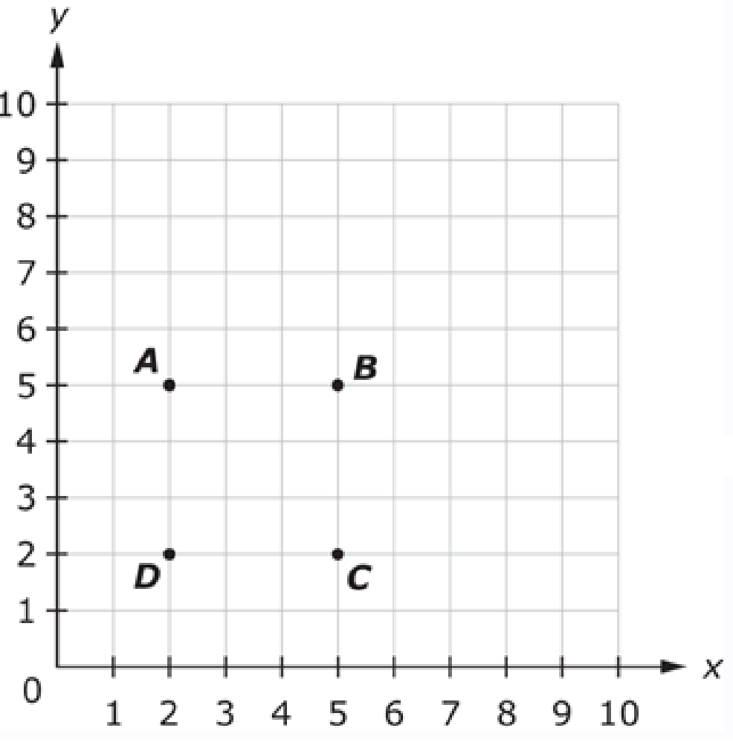
#5
A student plots the following points:
Point A (2, 5)
Point B (6, 5)
Point C (5, 2)
Point D (2, 2)
Which point was not
plotted correctly?
A. Point A
B. Point B
C. Point C
D. Point D

Slide 11
#5 Answer
Rubric:
(1 point) The student correctly identifies the point that is incorrectly plotted.
Answer: B

Slide 12
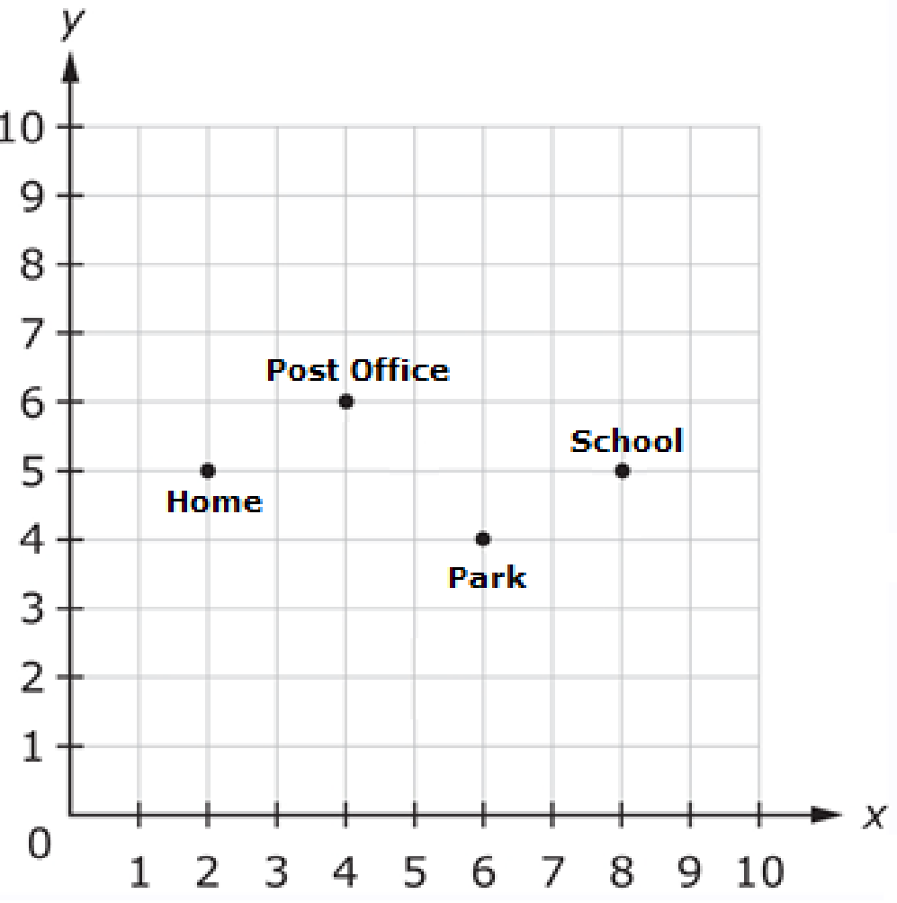

#6
The graph shows the locations of Nina’s home, the park, her school, and the post office. Select the numbers to create the coordinate pair that represents the location of the post office.

Slide 13
#6 Answer
Rubric:
(1 point) The student selects the correct numbers for the coordinate pair indicated.
Answer: (4, 6)

Slide 14
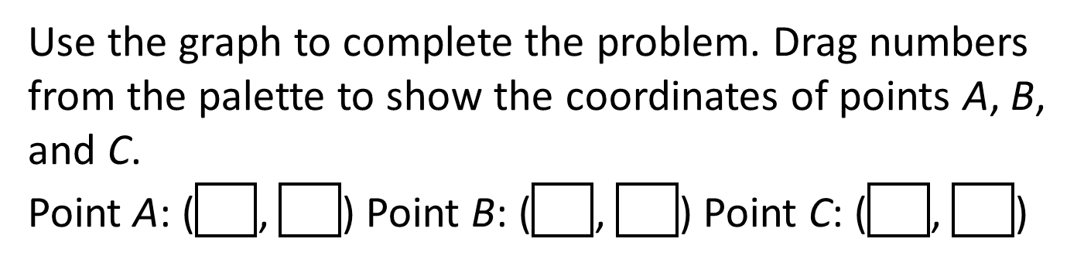
#7

Slide 15
#7 Answer
Rubric:
(1 point) The student correctly creates all three coordinate pairs.
Answer: Point A: (2, 7), Point B: (5, 6), Point C: (4, 3)

Slide 16
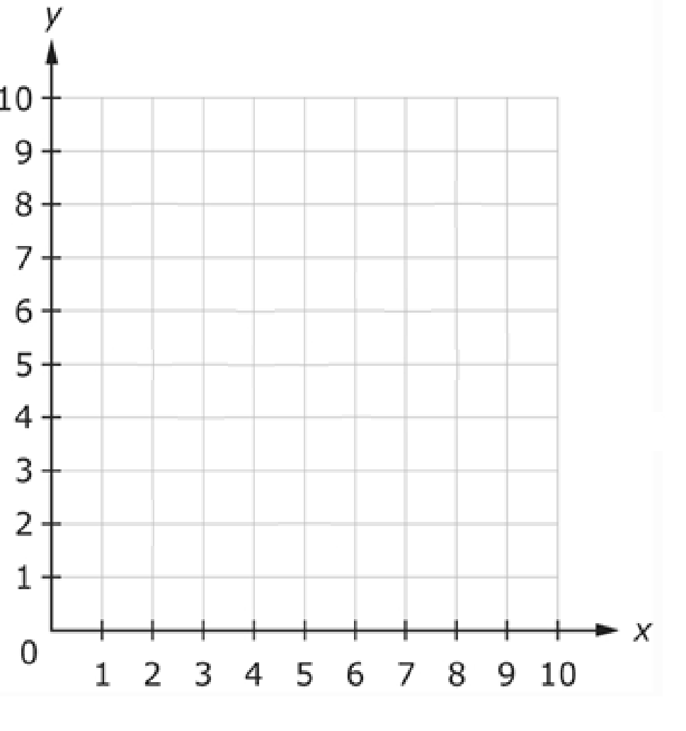
#8
Use the Add Point tool to plot each point on the coordinate plane.
Part A: Plot the point (2, 8).
Part B: Plot the point (4,5).
Part C: Plot the point (7,6).

Slide 17
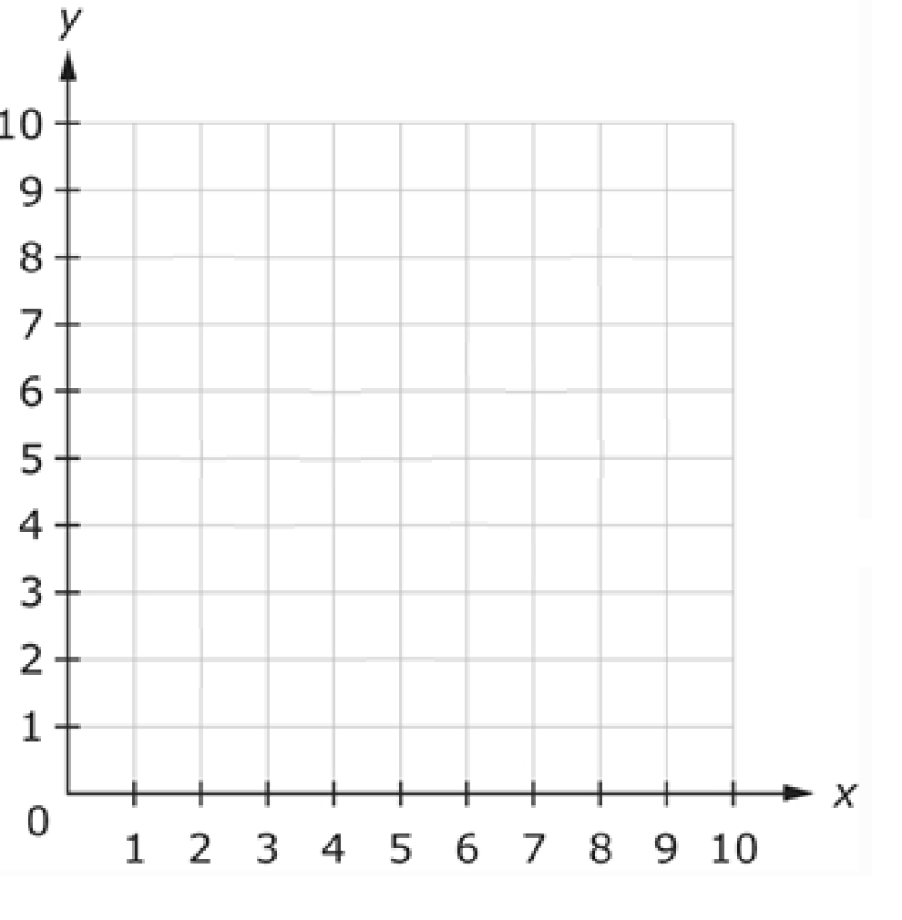
#8 Answer
Rubric:
(1 point) The student correctly plots all three points on the coordinate grid.
Answer:

Slide 18
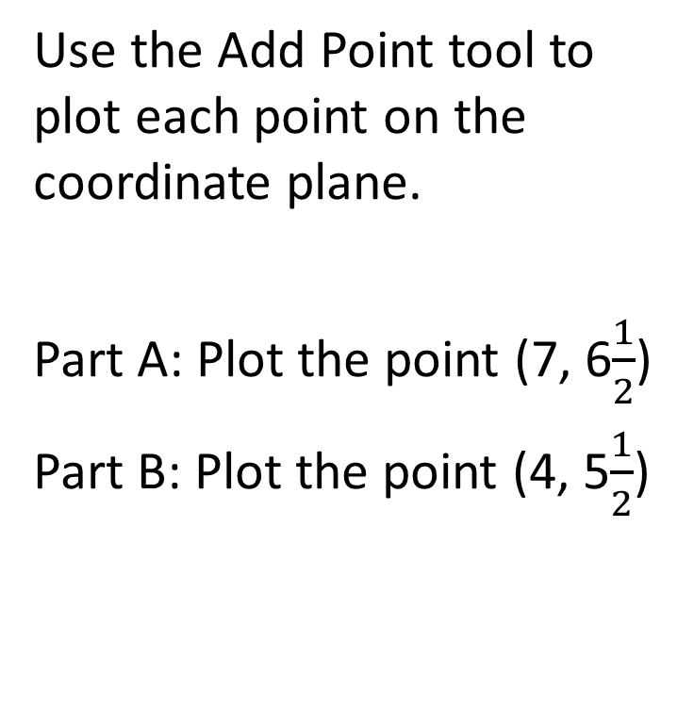
#9

Slide 19

#9 Answer
Rubric:
(1 point) The student correctly plots both points on the coordinate grid.
Answer:

Slide 20
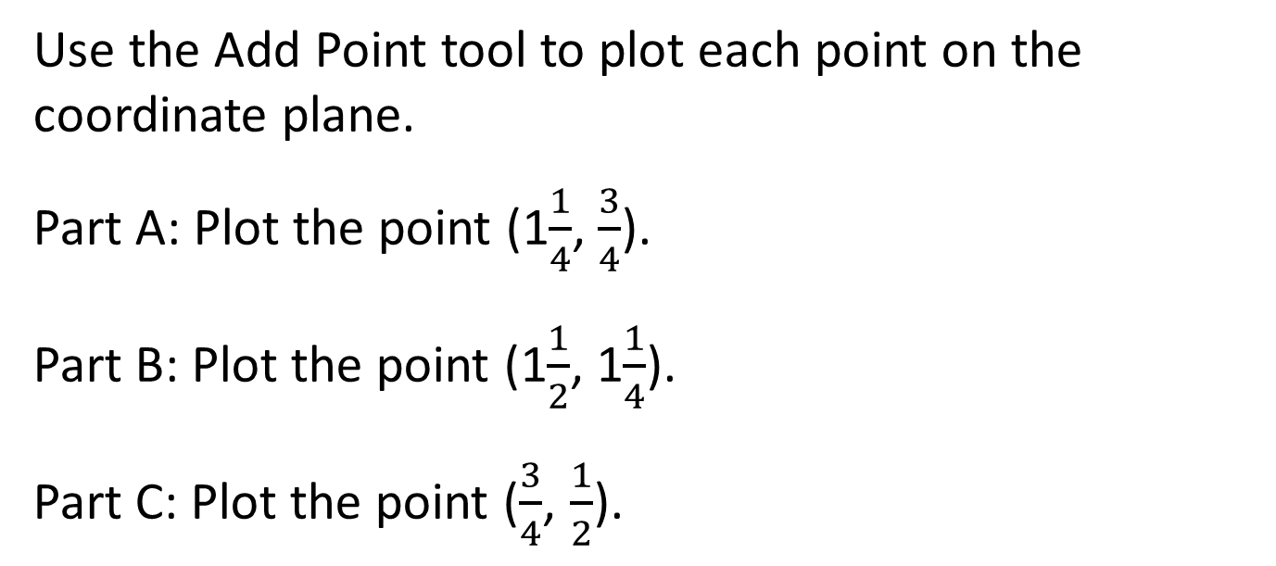
#10
2
1
1
2

Slide 21

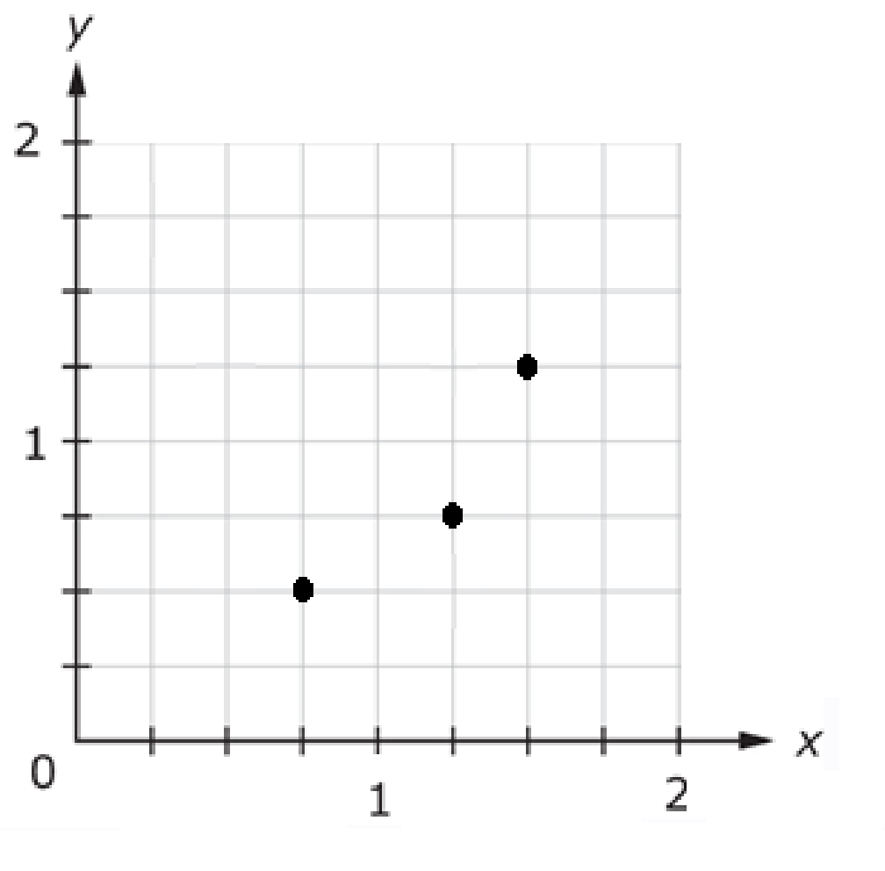
#10 Answer
Rubric:
(1 point) The student correctly plots all three points on the coordinate grid.
Answer:

