Slide 1

Claim 1
Smarter Balanced Sample Items
Grade 5 - Target I
Geometric measurement: understand concepts of volume and relate volume to multiplication and to addition.
Questions courtesy of the Smarter Balanced Assessment Consortium Item Specifications – Version 3.0
Slideshow organized by SMc Curriculum – www.ccssmathactivities.com
Notes:
‹#›

Slide 2
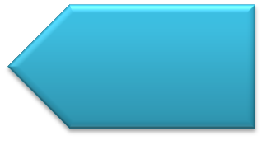
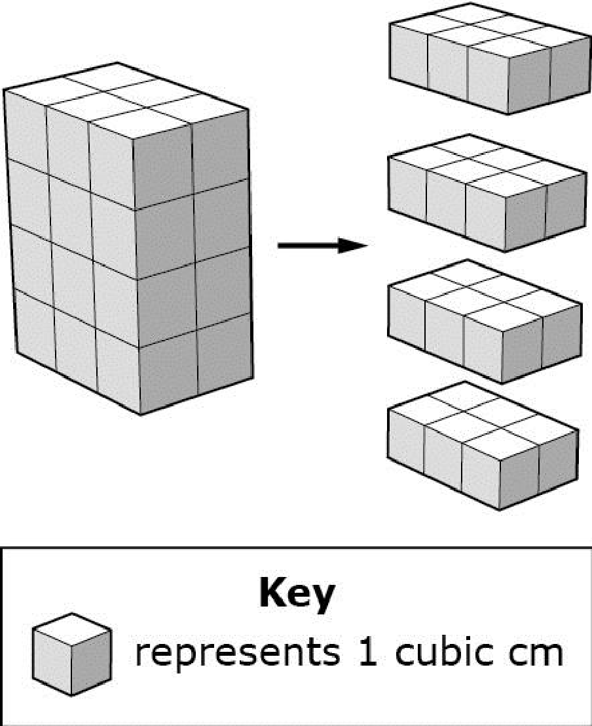
#1
The layers of a rectangular prism are shown to the right of the prism. Enter the volume, in cubic centimeters, of the rectangular prism.

Slide 3
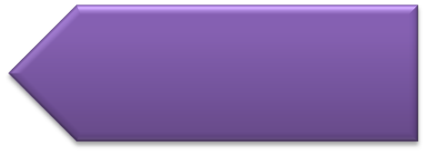
#1 Answer
Rubric:
(1 point) The student correctly enters the volume of the completed rectangular prism.
Answer: 24
Notes:
‹#›

Slide 4
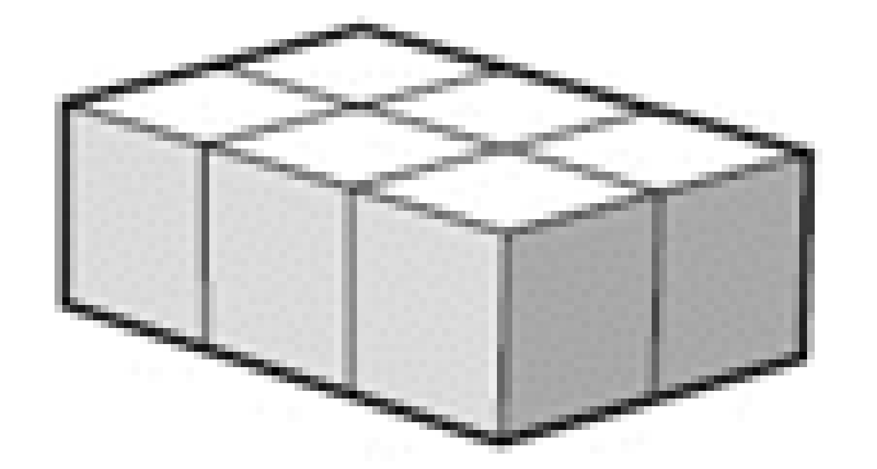
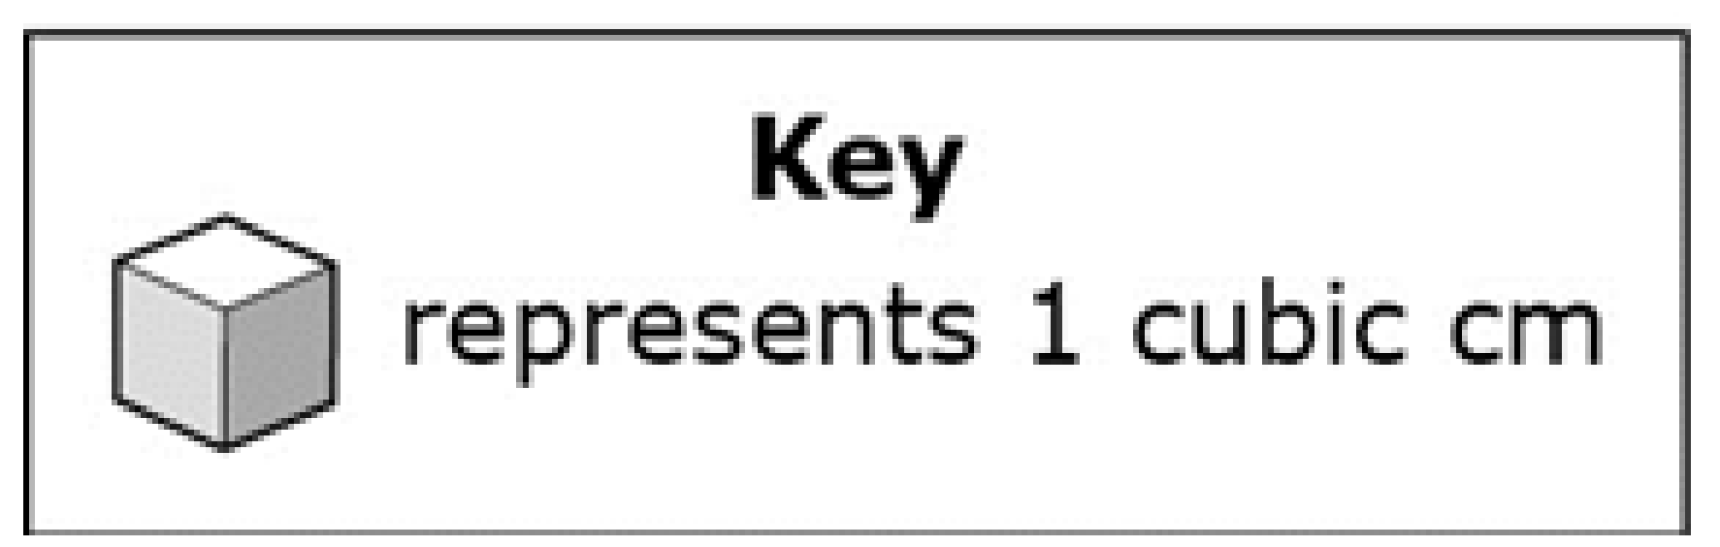
#2
Elias is building a rectangular prism. The bottom layer of the rectangular prism is shown. He builds a prism that has 4 layers. Enter the volume, in cubic centimeters, of the completed rectangular prism.
Notes:
‹#›

Slide 5
#2 Answer
Rubric:
(1 point) The student correctly enters the volume of the completed rectangular prism.
Answer: 24
Notes:
‹#›

Slide 6
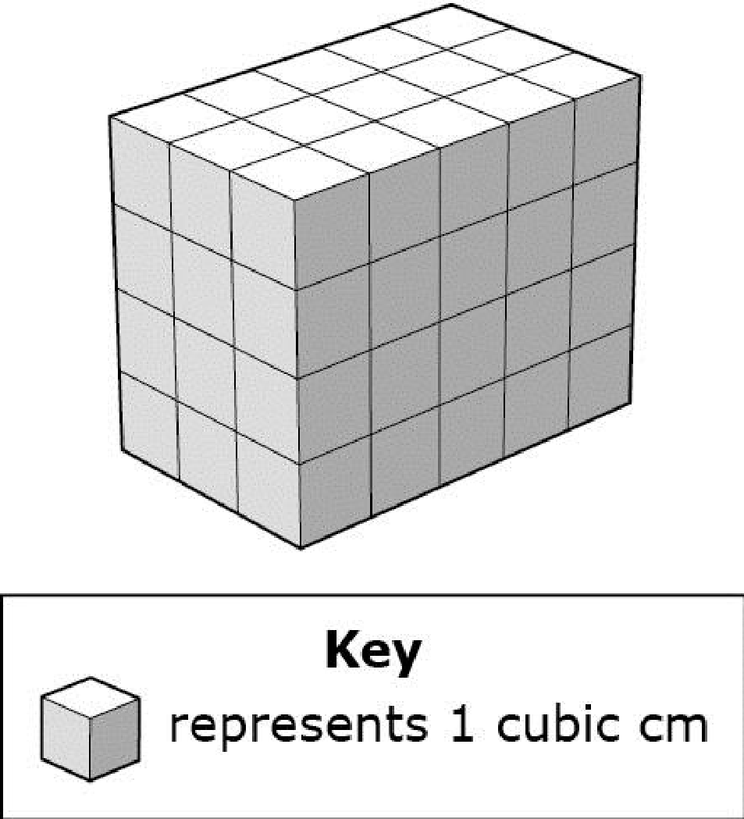
#3
The rectangular prism shown is solid. Enter the volume, in cubic centimeters, of the rectangular prism.

Slide 7
#3 Answer
Rubric:
(1 point) The student correctly enters the volume of the completed rectangular prism.
Answer: 60

Slide 8
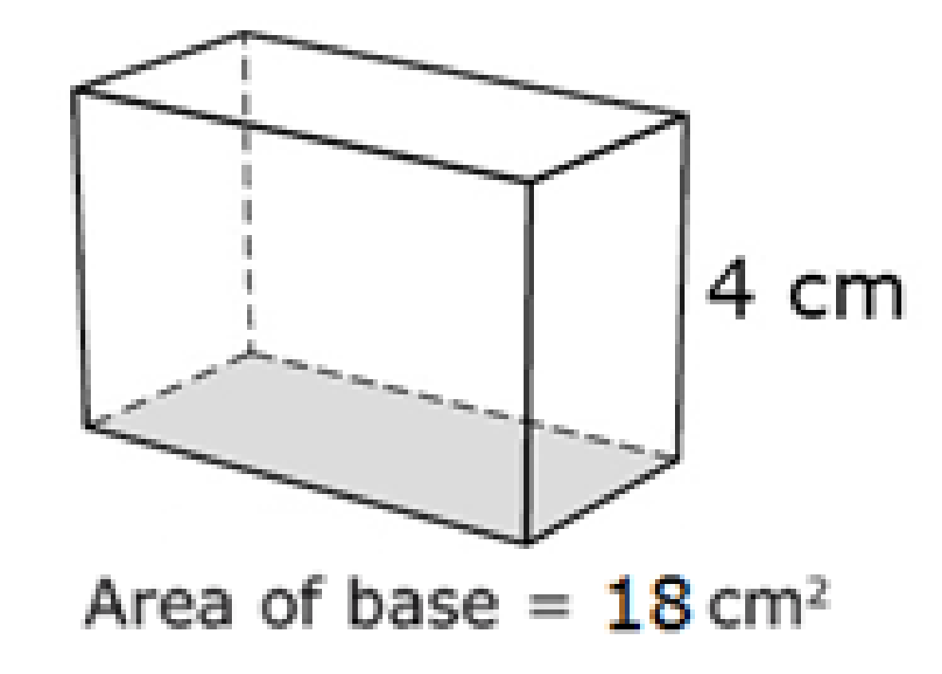
#4
The area of the base of this right rectangular prism is 18 square centimeters and the height is 4 centimeters. Enter the volume, in cubic centimeters, of this prism.

Slide 9
#4 Answer
Rubric:
(1 point) The student correctly enters the volume of the right rectangular prism.
Answer: 72

Slide 10
#5
Sam has a small box in the shape of a right rectangular prism.
The area of the base of the box is 18 square centimeters.
The height of the box is 4 centimeters.
Enter the volume, in cubic centimeters, of Sam’s box.

Slide 11
#5 Answer
Rubric:
(1 point) The student correctly enters the volume of the right rectangular prism.
Answer: 72

Slide 12
#6
Sara has a small box in the shape of a right rectangular prism.
The area of the base of the box is 20 square centimeters.
The height of the box is 5 centimeters.
Enter the volume, in cubic centimeters, of Sara’s box.

Slide 13
#6 Answer
Rubric:
(1 point) The student correctly enters the volume of the right rectangular prism.
Answer: 100

Slide 14
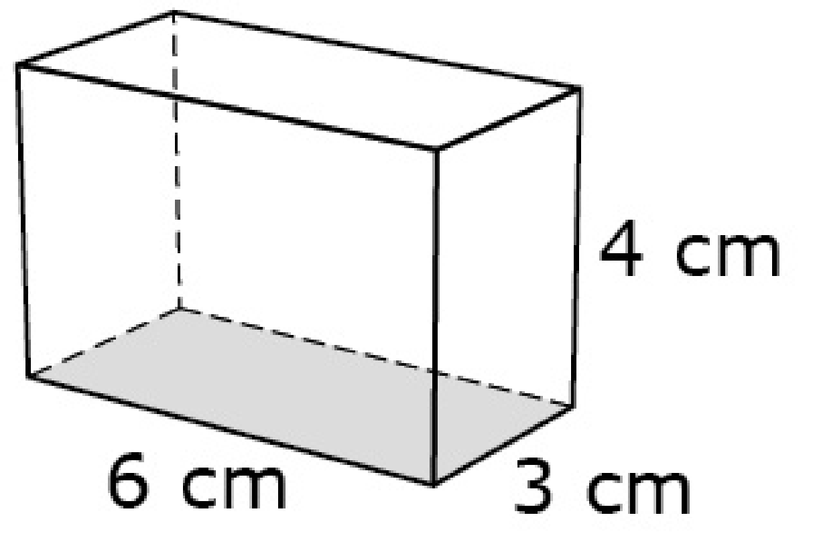
#7
The edge lengths, in centimeters, of the right rectangular prism shown are 4, 3, and 6. Enter the volume, in cubic centimeters, of this prism.

Slide 15
#7 Answer
Rubric:
(1 point) The student correctly enters the volume of the right rectangular prism.
Answer: 72

Slide 16
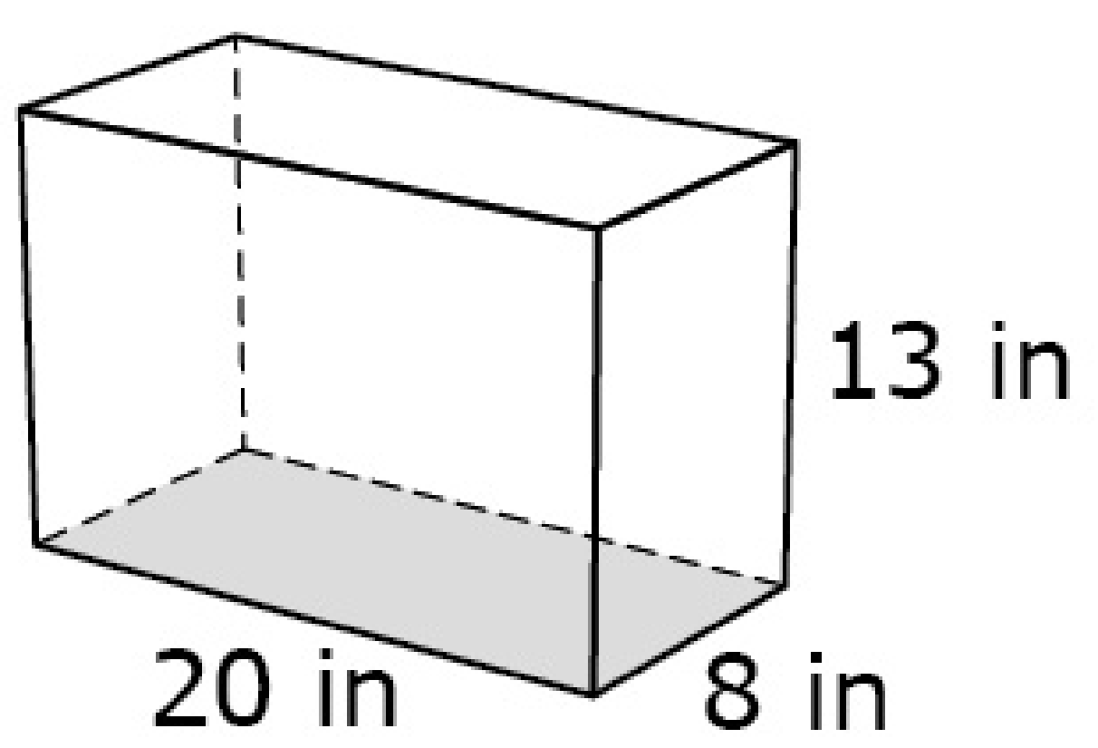
#8
Danny has a fish tank, in the shape of a right rectangular prism. The edge lengths of the prism, in inches, are 8, 13, and 20. Enter the volume, in cubic inches, of the fish tank.

Slide 17
#8 Answer
Rubric:
(1 point) The student correctly enters the volume of the right rectangular prism.
Answer: 2,080

Slide 18
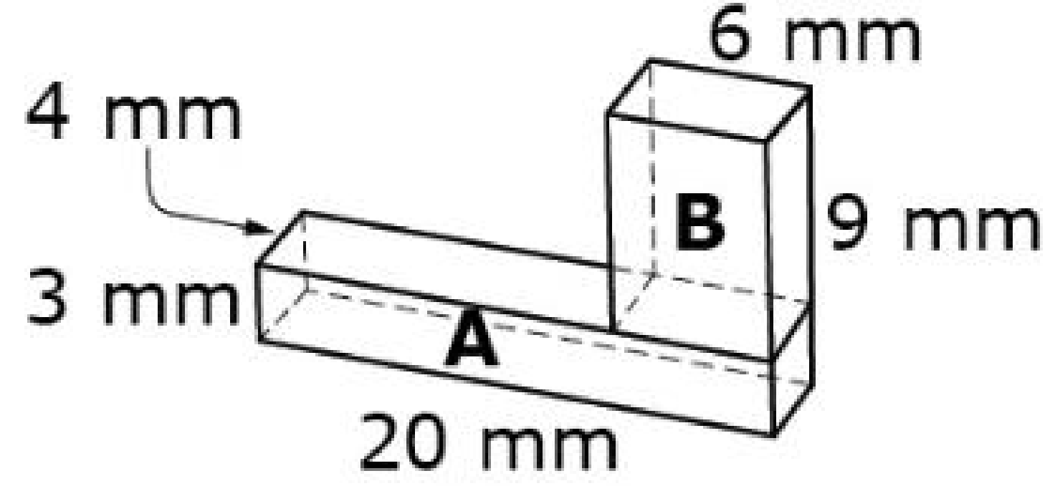
#9
Right rectangular prisms A and B are combined to create this model.
The dimensions of Prism A are 4 by 3 by 20 millimeters.
The dimensions of Prism B are 6 by 9 by 4 millimeters.
Enter the combined volume, in cubic millimeters, of Prisms A and B.

Slide 19
#9 Answer
Rubric:
(1 point) The student correctly enters the combined volume in the specified units.
Answer: 456

Slide 20
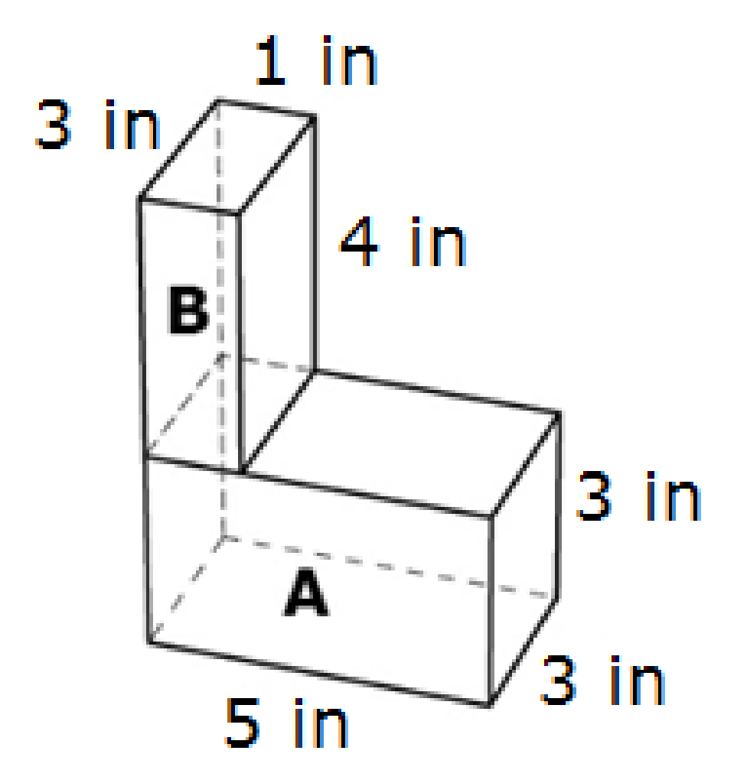
#10
Sally uses Block A and Block B to create this model of a building.
The dimensions of Block A are 3 by 3 by 5 inches.
The dimensions of Block B are 1 by 3 by 4 inches.
Enter the combined volume, in cubic inches, of the entire model.

Slide 21
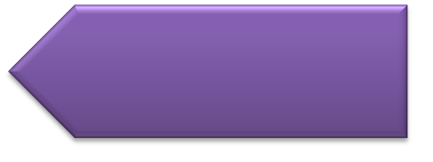
#10 Answer
Rubric:
(1 point) The student correctly enters the combined volume in the specified units.
Answer: 57

Slide 22
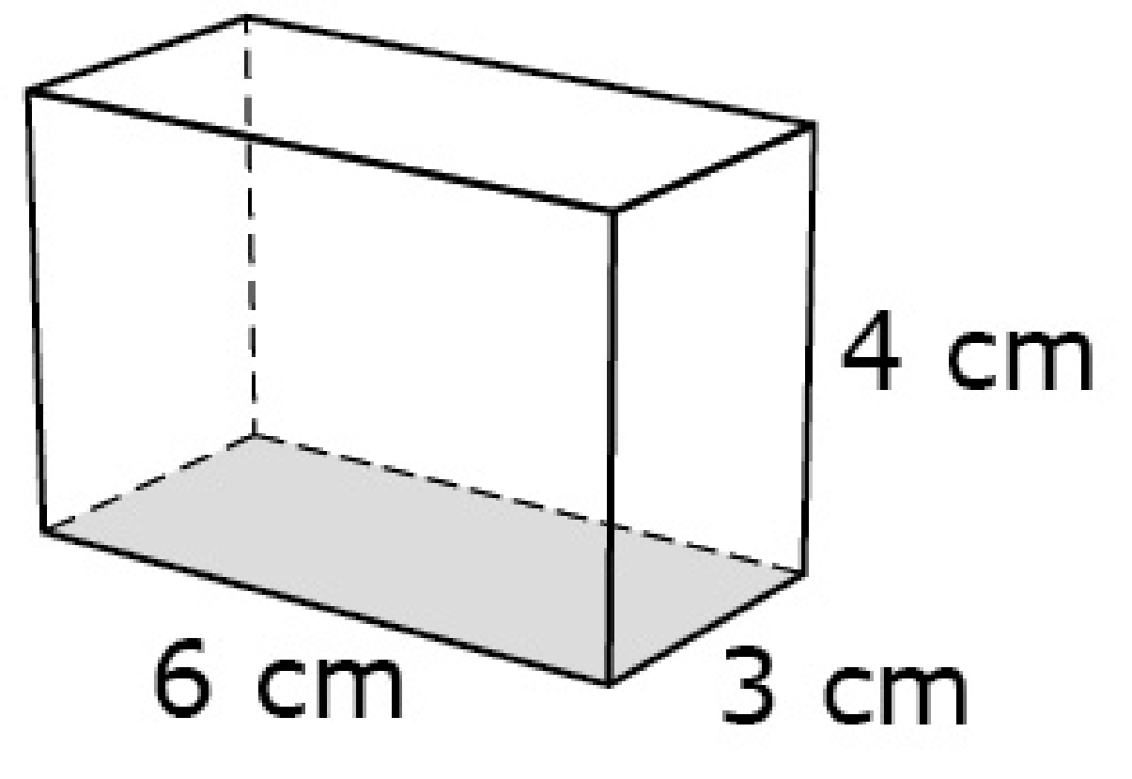
#11
The right rectangular prism shown has a length 6 centimeters, width 3 centimeters, and height
4 centimeters. Determine whether each equation can be used to find the volume (V) of this prism. Select Yes or No for each equation.
 | Yes | No
V = 18 × 4
V = (6 + 3) × 4
V = 6 × 3 × 4
V = 9 × 4
V = 6 × (3 × 4)

Slide 23
#11 Answer
Rubric:
(1 point) The student correctly selects all of the equations that show a variety of ways volume can be determined with given dimensions, including
V = l × w × h and V = b × h.
Answer: Y, N, Y, N, Y

