Slide 1

Claim 1
Smarter Balanced Sample Items
Grade 5 - Target H
Represent and interpret data.
Questions courtesy of the Smarter Balanced Assessment Consortium Item Specifications – Version 3.0
Slideshow organized by SMc Curriculum – www.ccssmathactivities.com

Slide 2

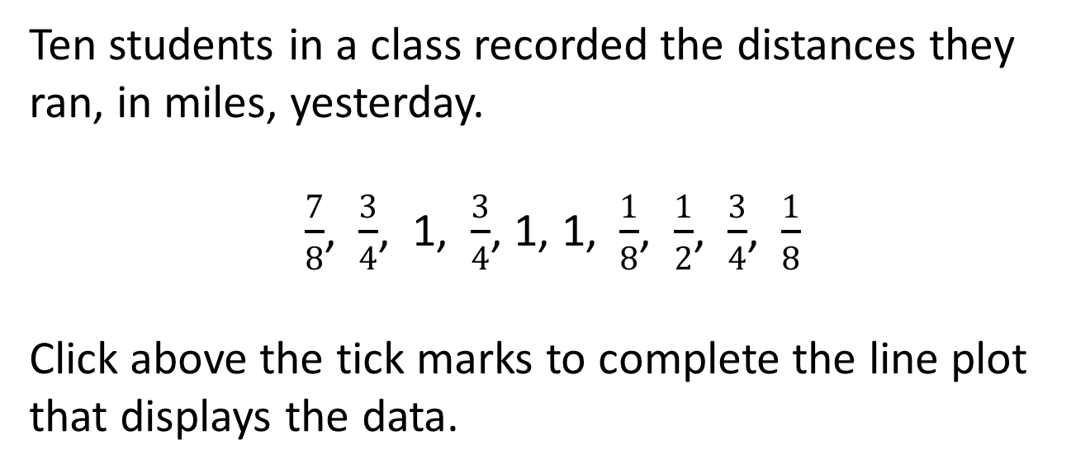
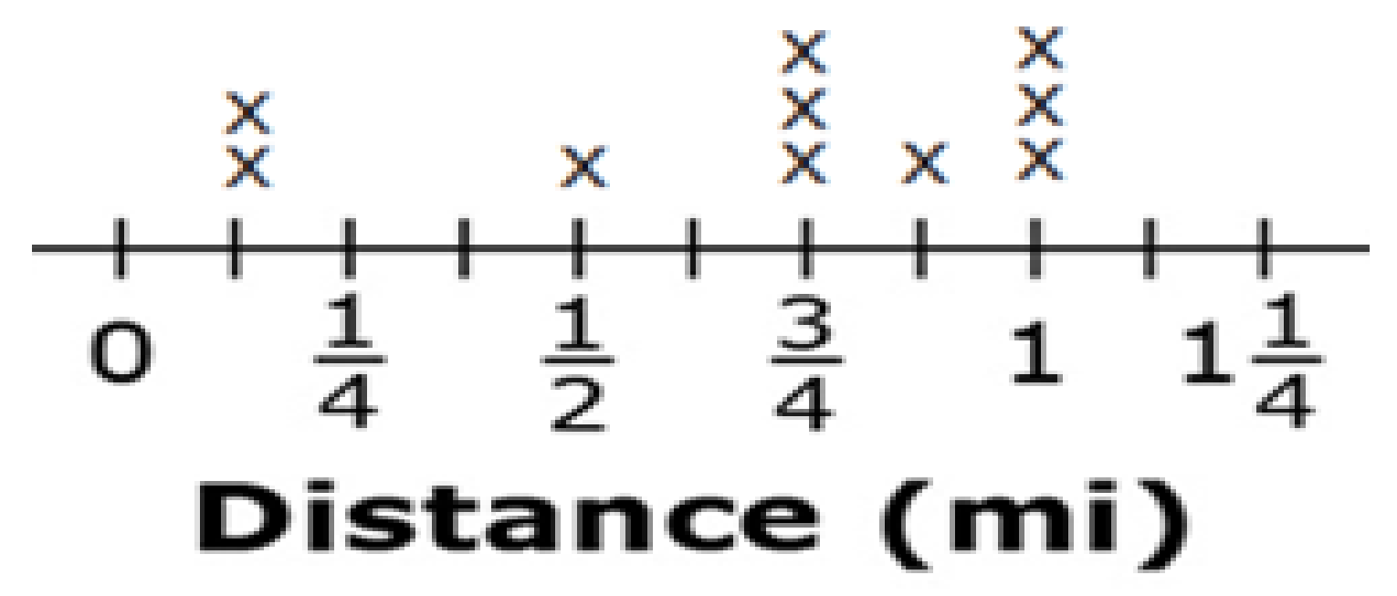
#1

Slide 3

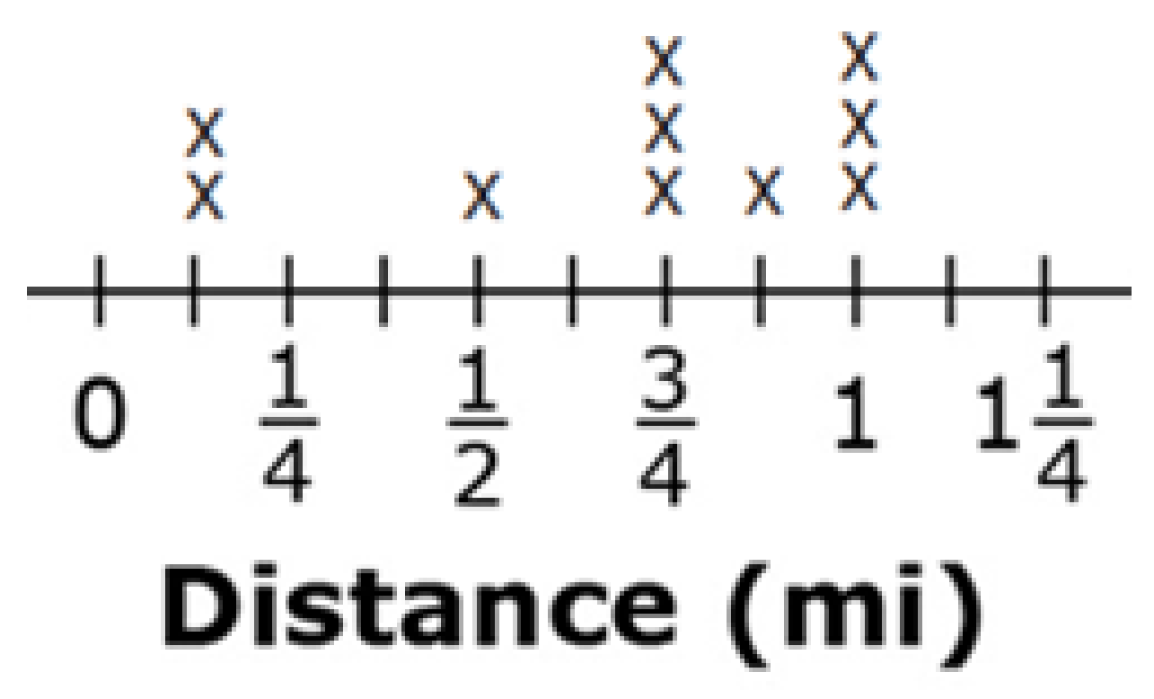
#1 Answer
Rubric:
(1 point) The student correctly completes a line plot that displays all 10 data points with no incorrect or missing points.
Answer:

Slide 4
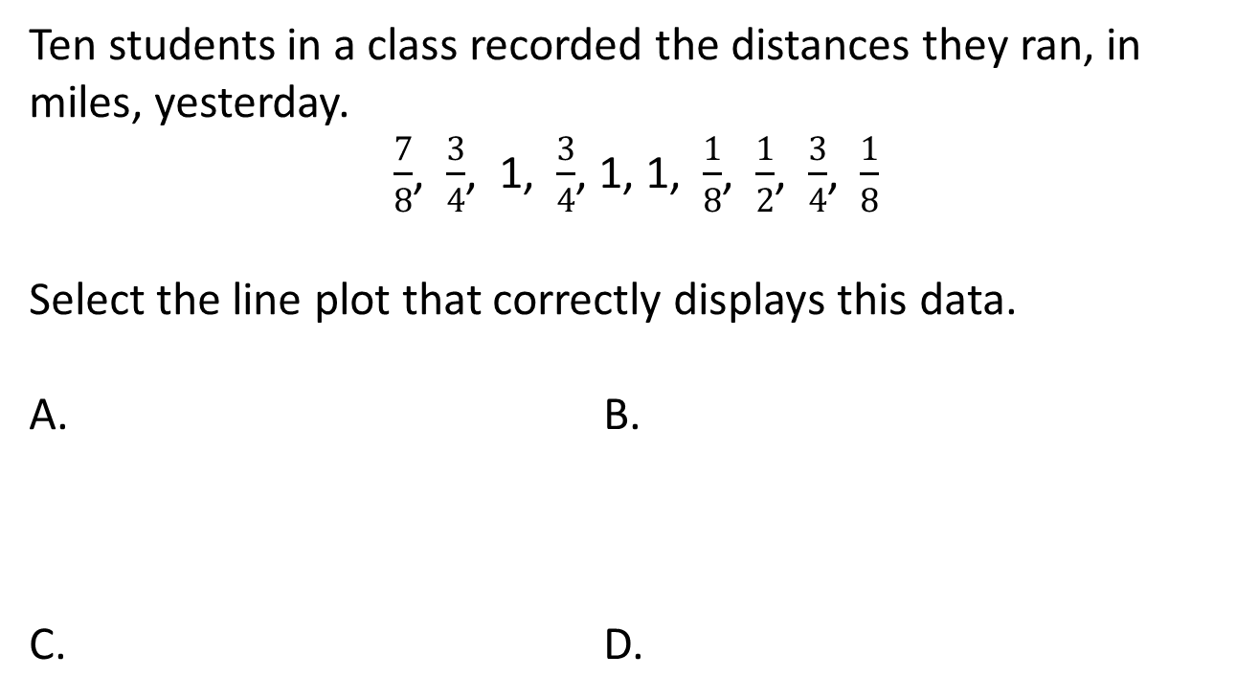
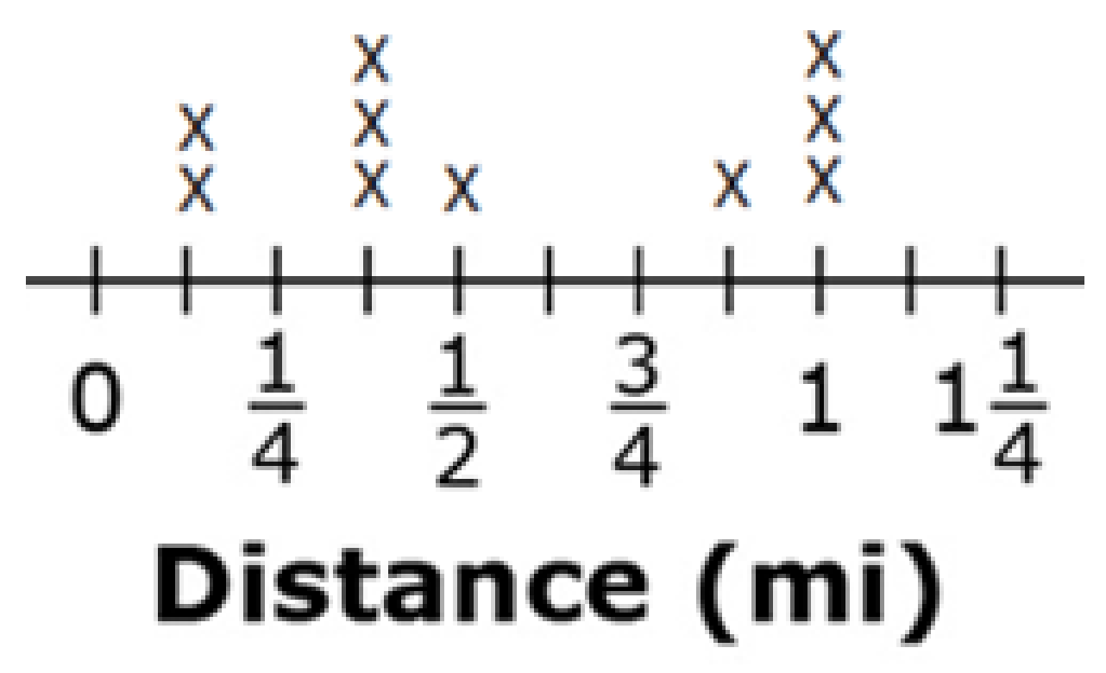
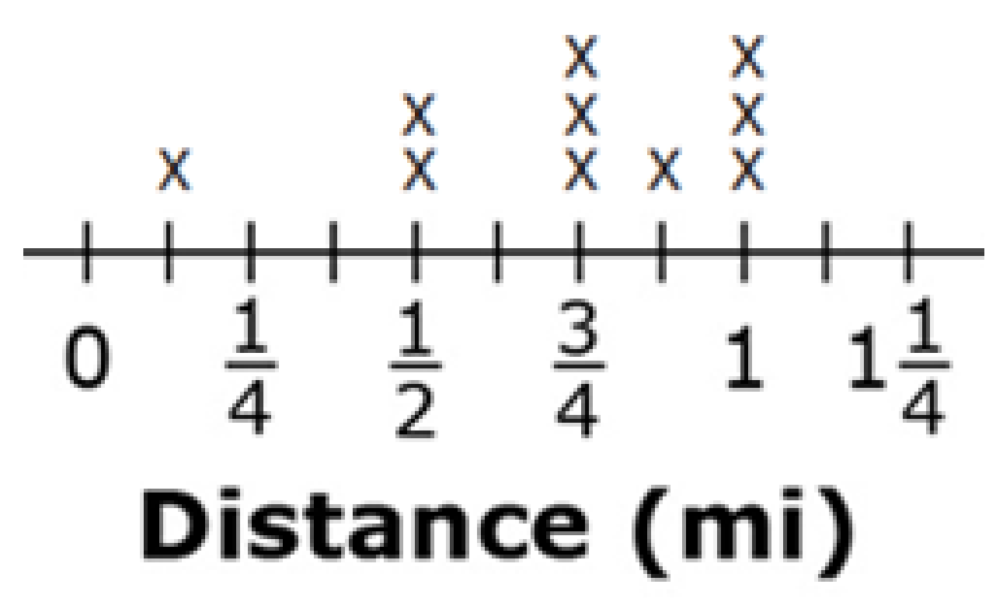
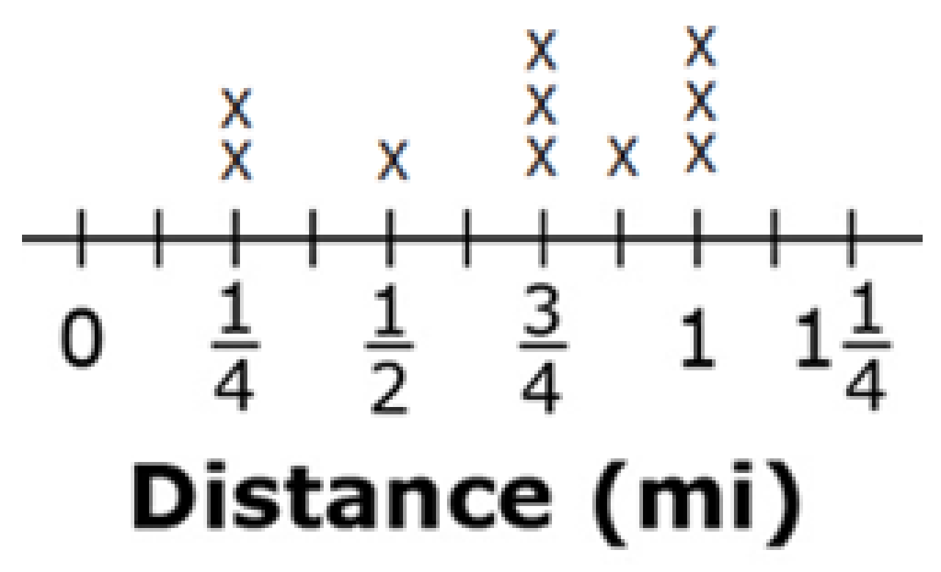
#2

Slide 5
#2 Answer
Rubric:
(1 points) The student selects the line plot that correctly displays the data.
Answer: C

Slide 6
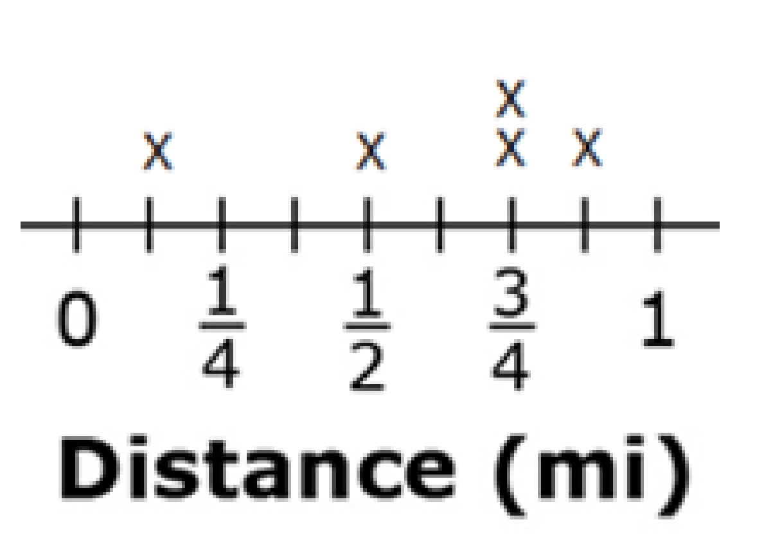
#3
The line plot shows the distance, in miles, that five students ran in a race. Enter the total distance, in miles, these students ran in the race.

Slide 7
#3 Answer
Rubric:
(1 point) The student correctly uses the data from a line plot to find a sum.
Answer: 3

