Slide 1

Claim 1
Smarter Balanced Sample Items
Grade 5 - Target F
Apply and extend previous understandings of multiplication and division to multiply and divide fractions.
Questions courtesy of the Smarter Balanced Assessment Consortium Item Specifications – Version 3.0
Slideshow organized by SMc Curriculum – www.ccssmathactivities.com
Notes:
‹#›

Slide 2

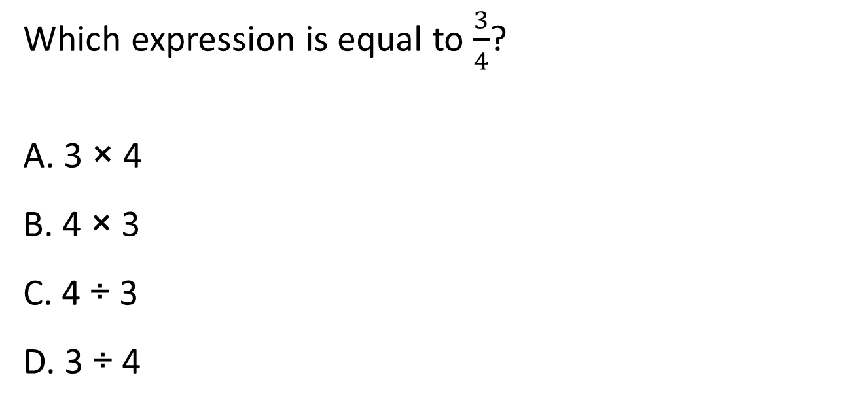
#1

Slide 3

#1 Answer
Rubric:
(1 point) The student identifies the correct fractional quotient.
Answer: D
Notes:
‹#›

Slide 4
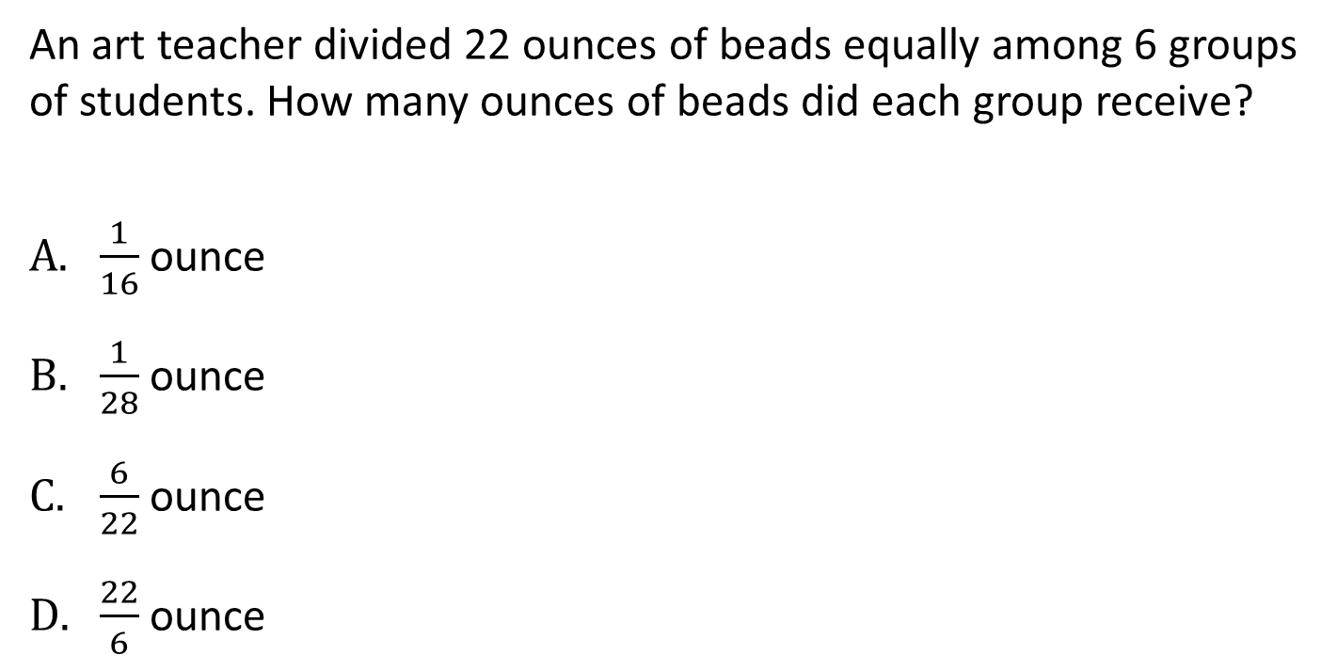
#2
Notes:
‹#›

Slide 5
#2 Answer
Rubric:
(1 point) The student identifies the correct fractional quotient.
Answer: D
Notes:
‹#›

Slide 6
#3
John has 25 ounces of juice. He pours an equal amount of juice into 7 cups.
Enter the number of ounces of juice in each cup.

Slide 7
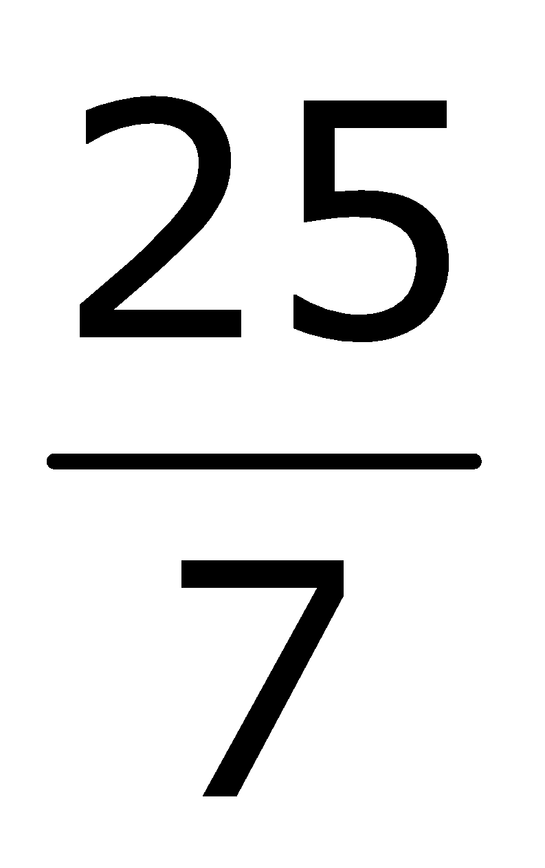

#3 Answer
Rubric:
(1 point) The student correctly enters a fraction which represents a solution involving quotients.
Answer: or 3

Slide 8
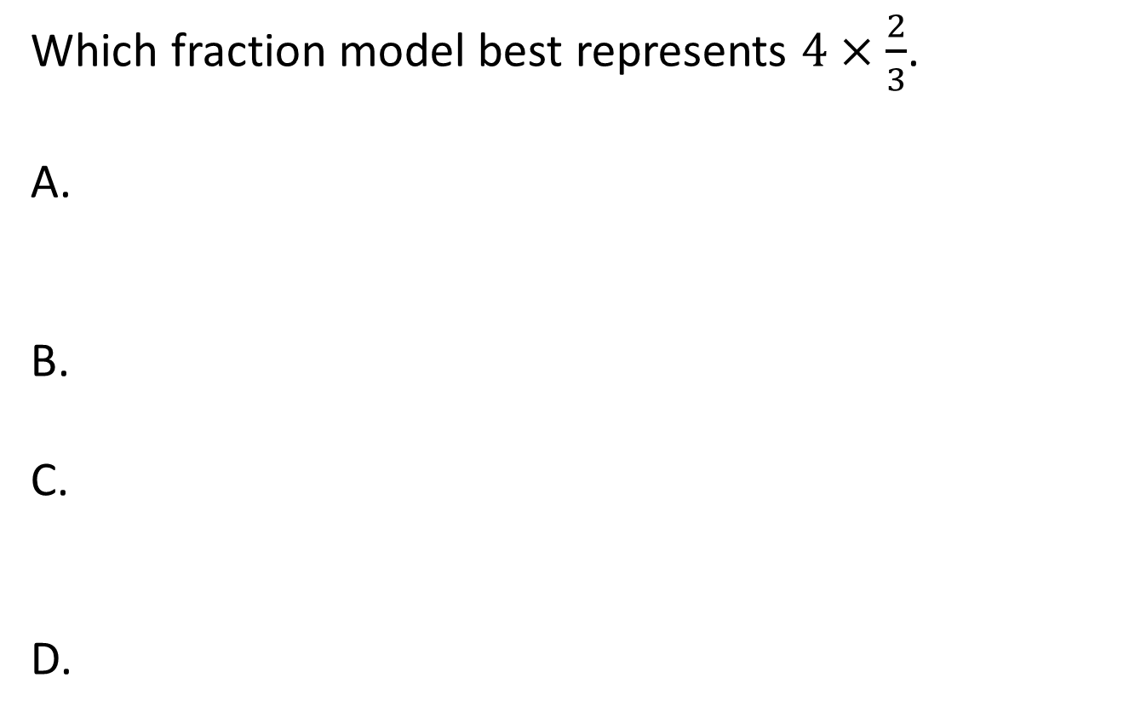
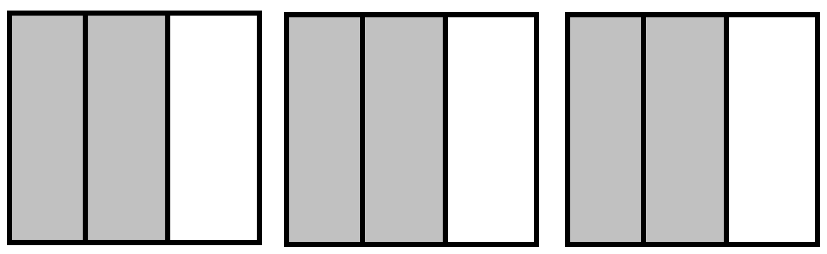
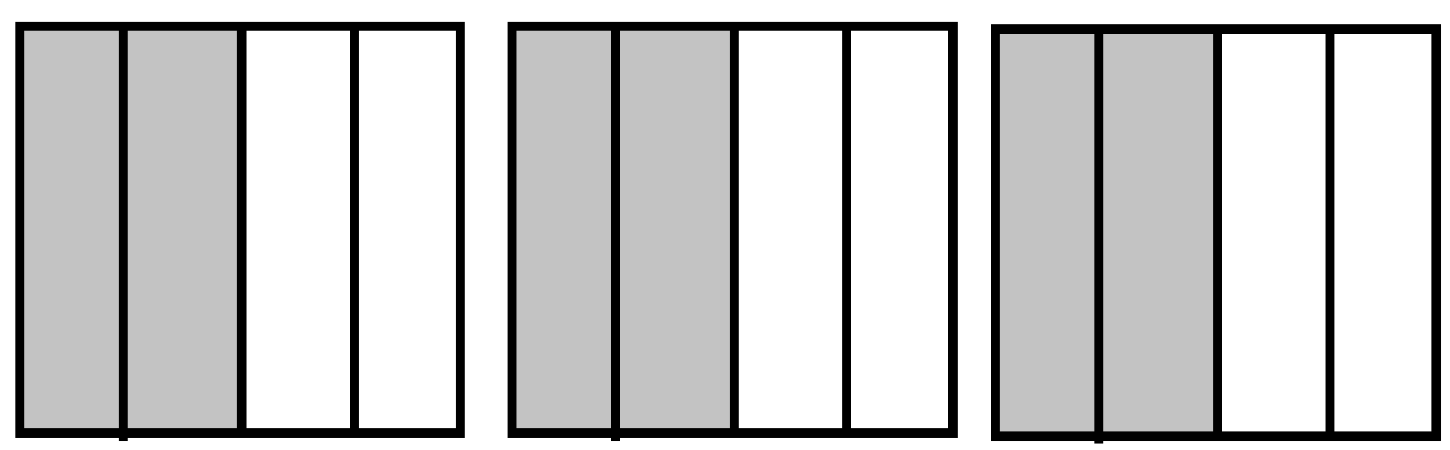
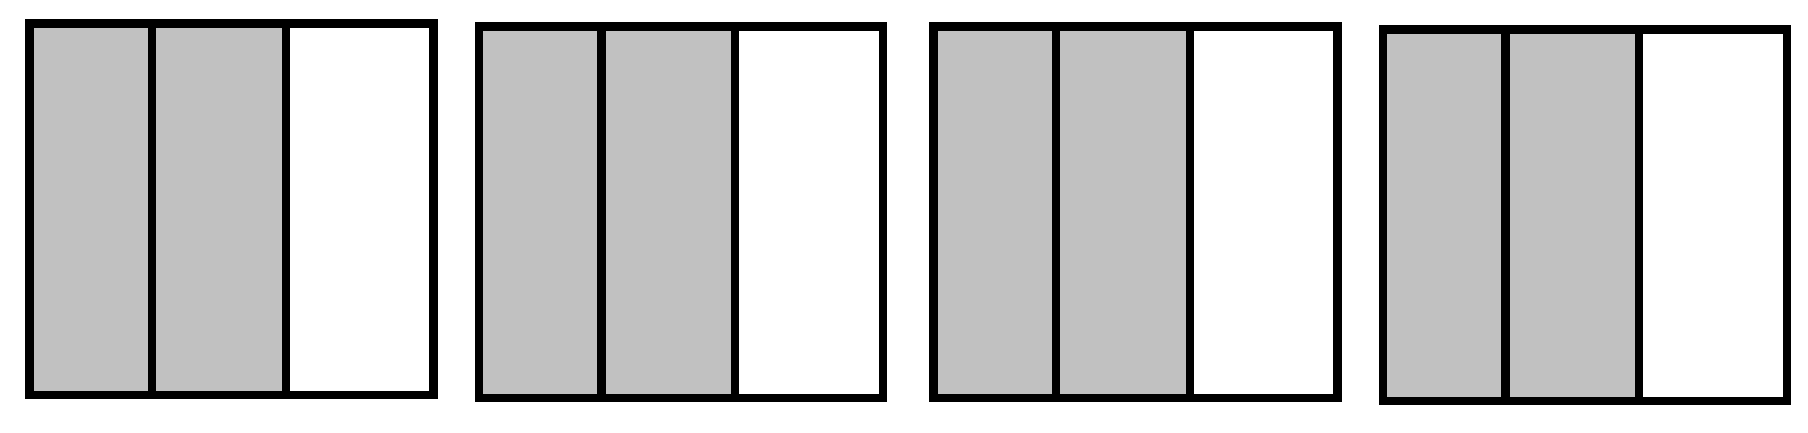
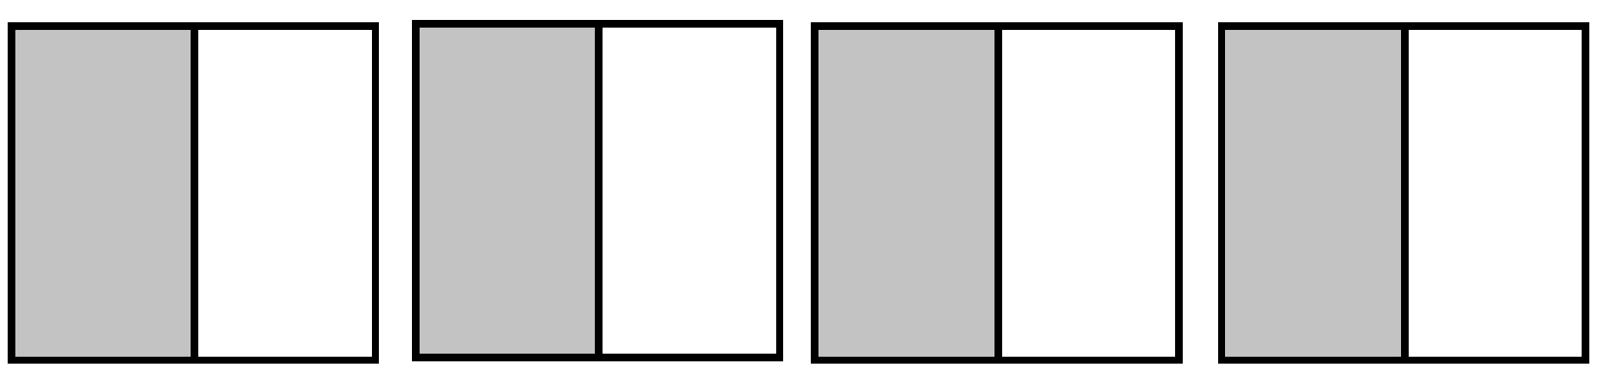
#4

Slide 9
#4 Answer
Rubric:
(1 point) The student identifies the correct fraction model for the given multiplication problem.
Answer: C

Slide 10
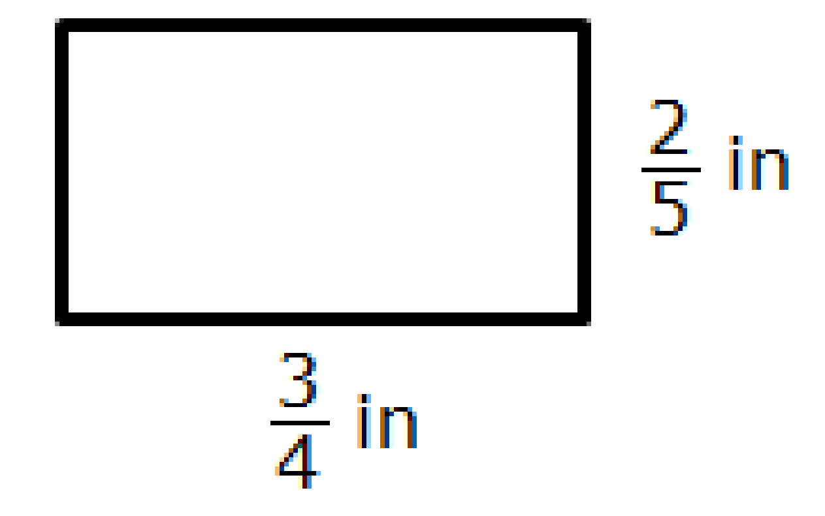
#5
Use this rectangle to solve the problem.
Enter the area, in square inches, of the rectangle.

Slide 11
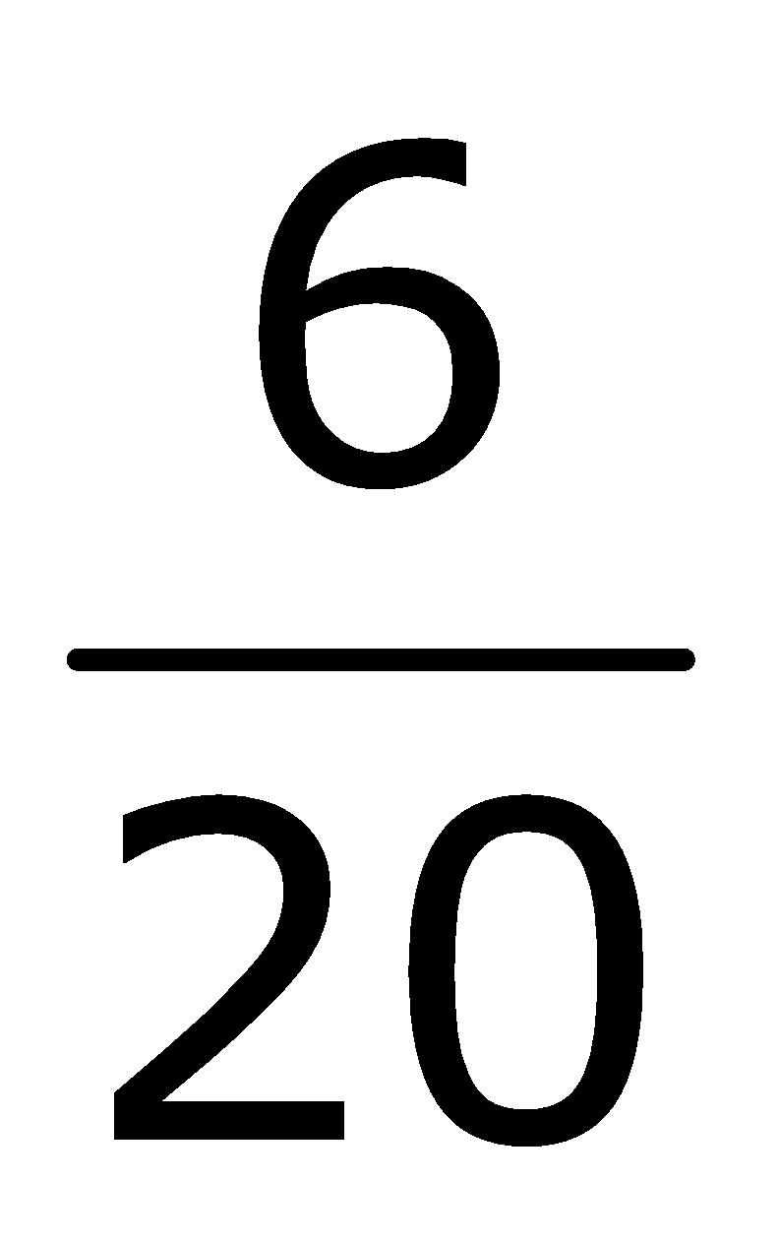
#5 Answer
Rubric:
(1 point) The student correctly finds the area of a given rectangle with fractional side length.
Answer:

Slide 12
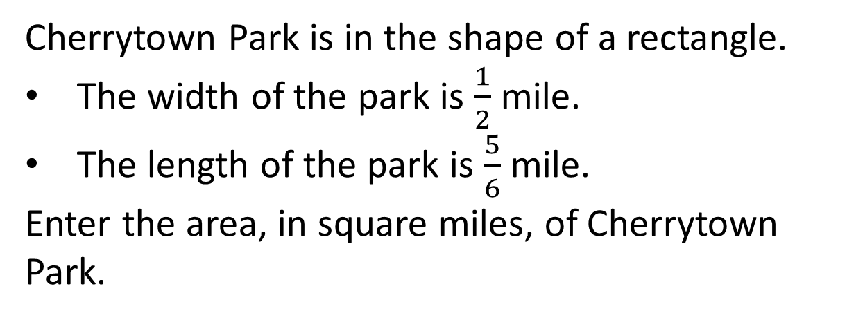
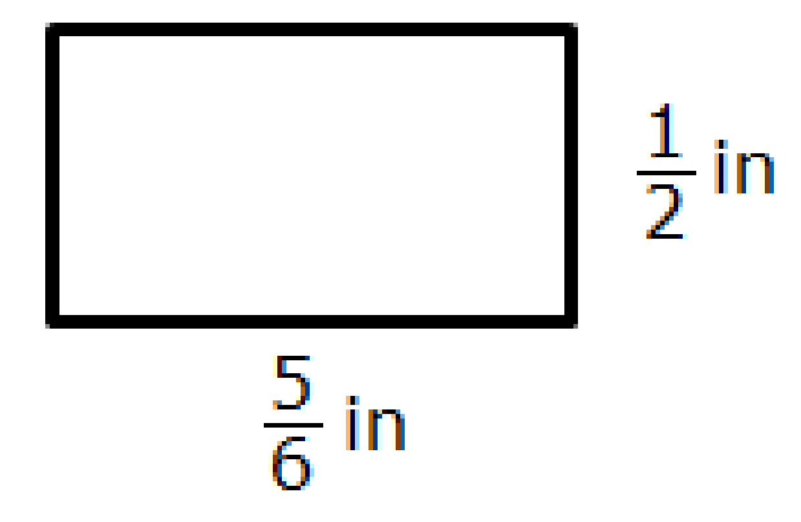
#6

Slide 13
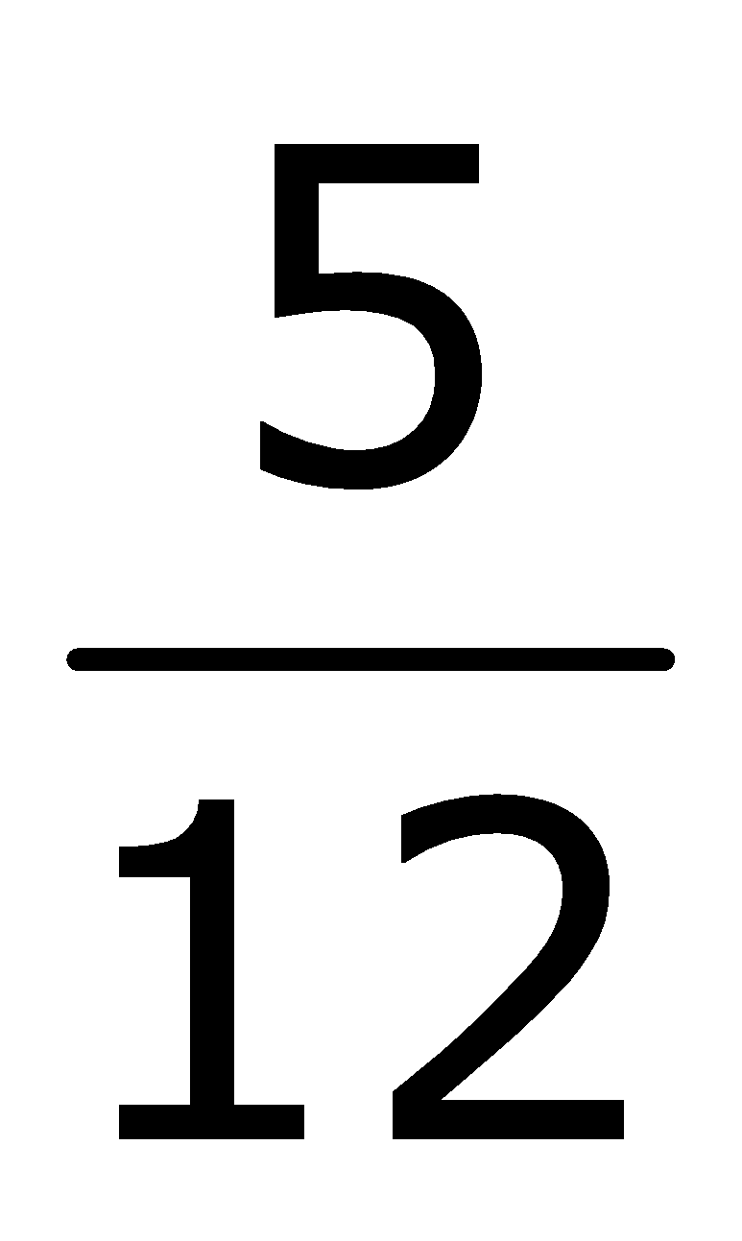
#6 Answer
Rubric:
(1 point) The student correctly finds the area of a given rectangle with fractional side length.
Answer:

Slide 14
#7
Enter a value for b that makes this statement true: 5 × b is less than 5 but greater than 0.

Slide 15

#7 Answer
Rubric:
(1 point) The student enters a correct value in the given range.
Answer:

Slide 16
#8
Enter a value for b that makes this statement true: 5 × b is greater than 5 but less than 10.

Slide 17
#8 Answer
Rubric:
(1 point) The student enters a correct value in the given range.
Answer: 1

Slide 18
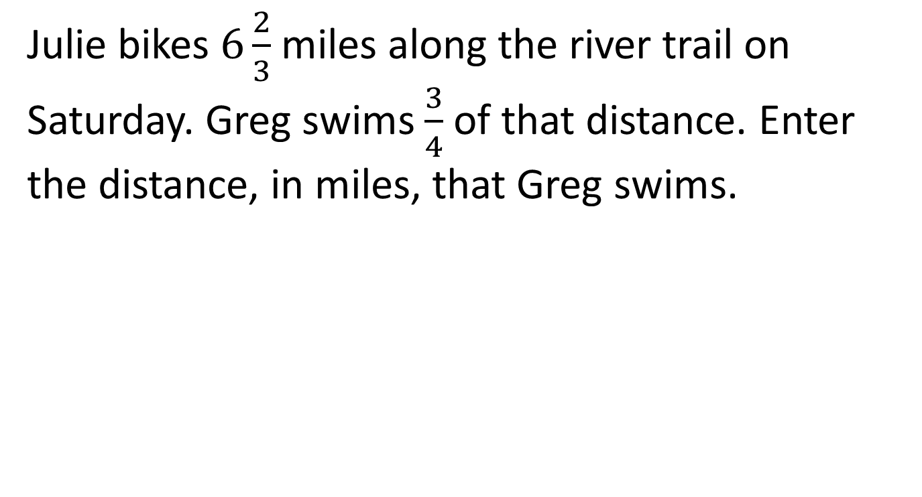
#9

Slide 19
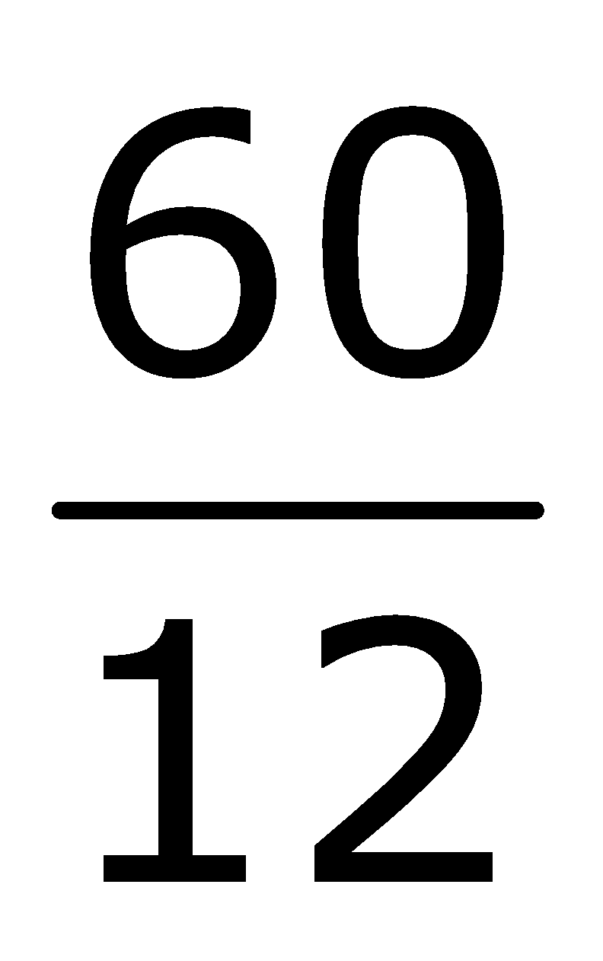
#9 Answer
Rubric:
(1 point) The student correctly enters the solution.
Answer: 5 or

Slide 20
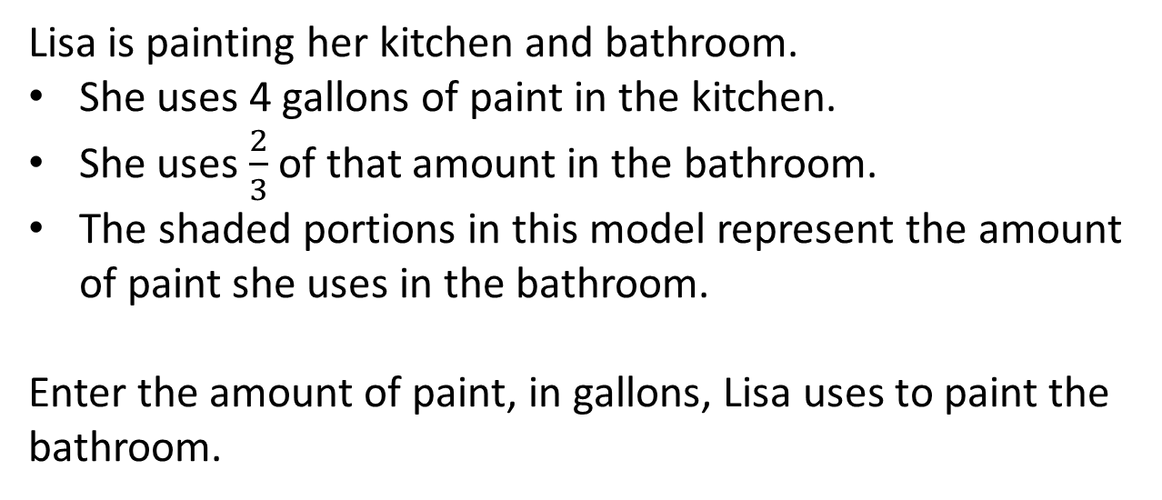
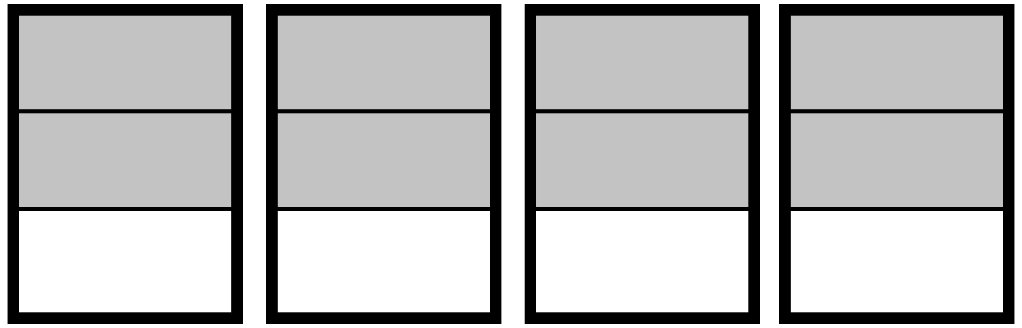
#10

Slide 21



#10 Answer
Rubric:
(1 point) The student correctly enters the solution to the division problem.
Answer: or 2

Slide 22
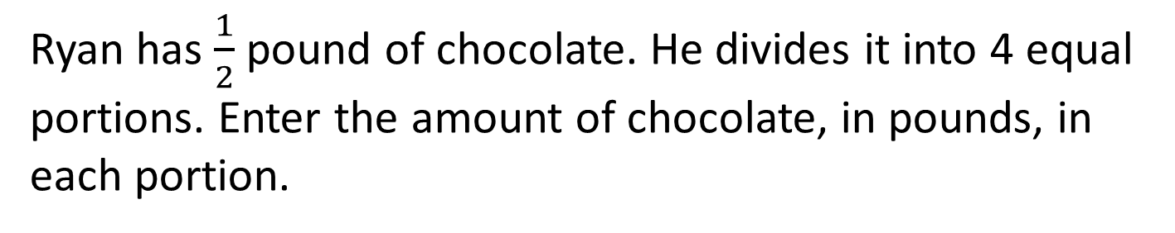
#11

Slide 23

#11 Answer
Rubric:
(1 point) The student correctly enters the solution to the division problem.
Answer:

