Slide 1

Claim 1
Smarter Balanced Sample Items
Grade 5 - Target E
Use equivalent fractions as a strategy to add and subtract fractions.
Questions courtesy of the Smarter Balanced Assessment Consortium Item Specifications – Version 3.0
Slideshow organized by SMc Curriculum – www.ccssmathactivities.com
Notes:
‹#›

Slide 2

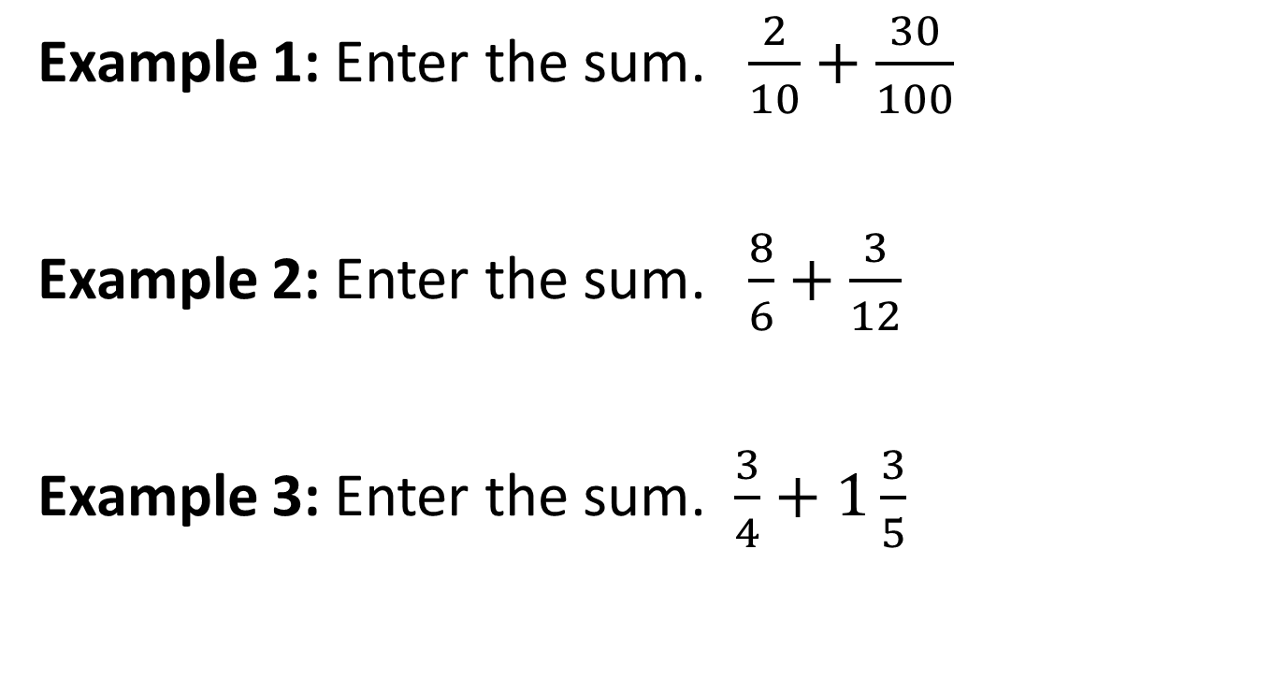
#1

Slide 3

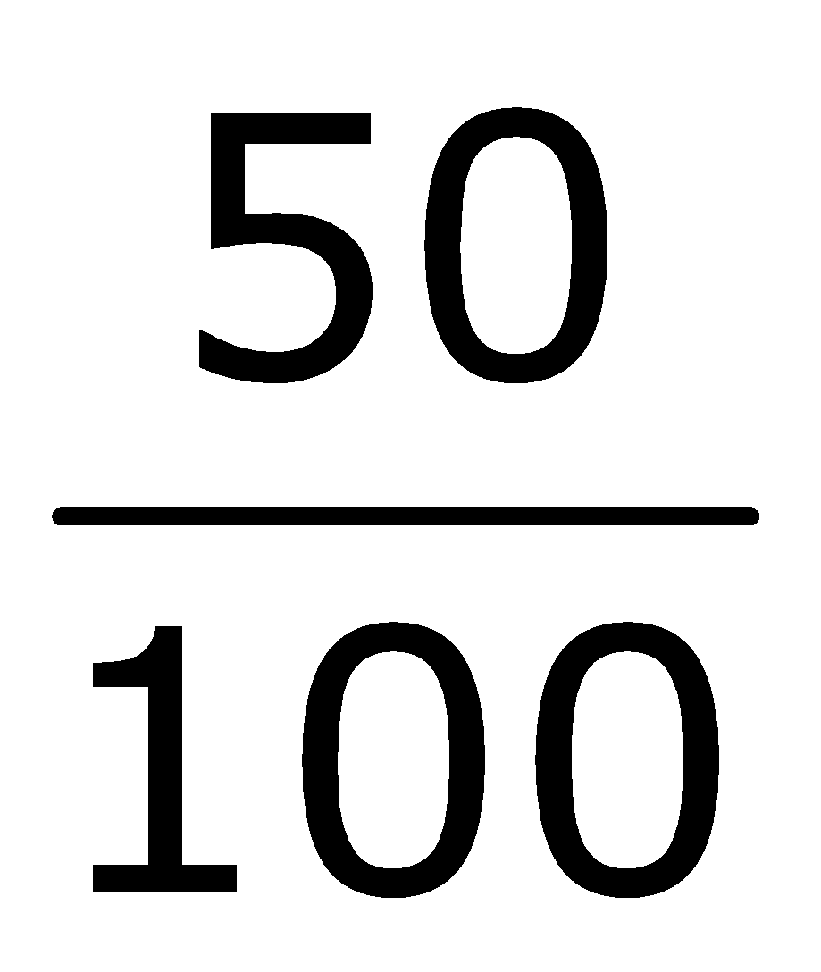

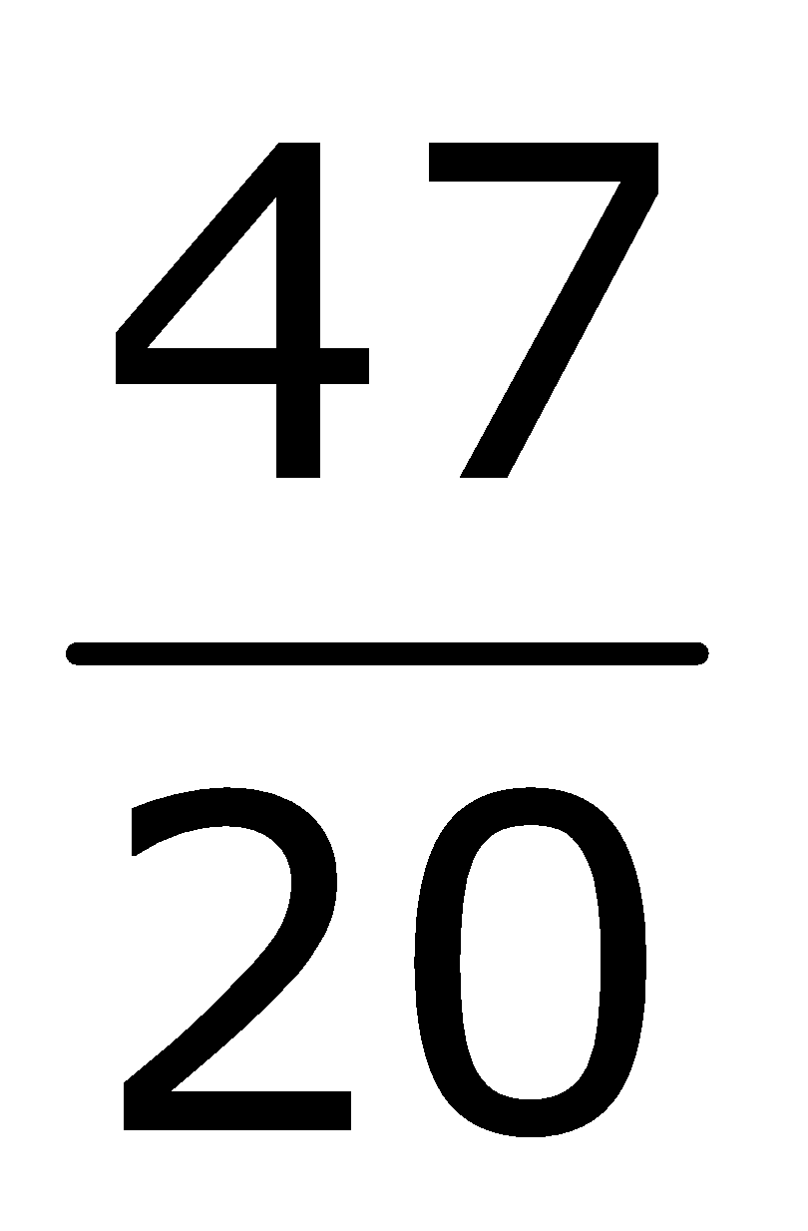
#1 Answer
Rubric:
(1 point each) The student enters the correct sum.
Answers:
Example 1:
Example 2:
Example 3:
Notes:
‹#›

Slide 4
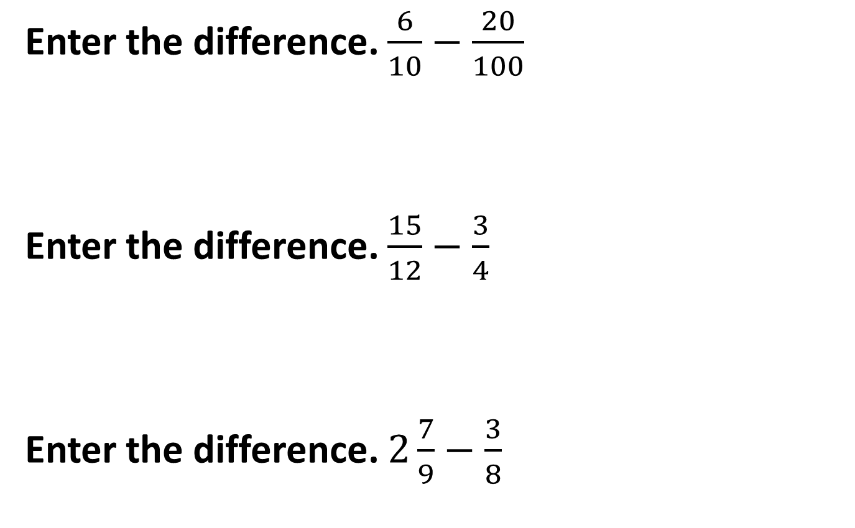
#2
Notes:
‹#›

Slide 5
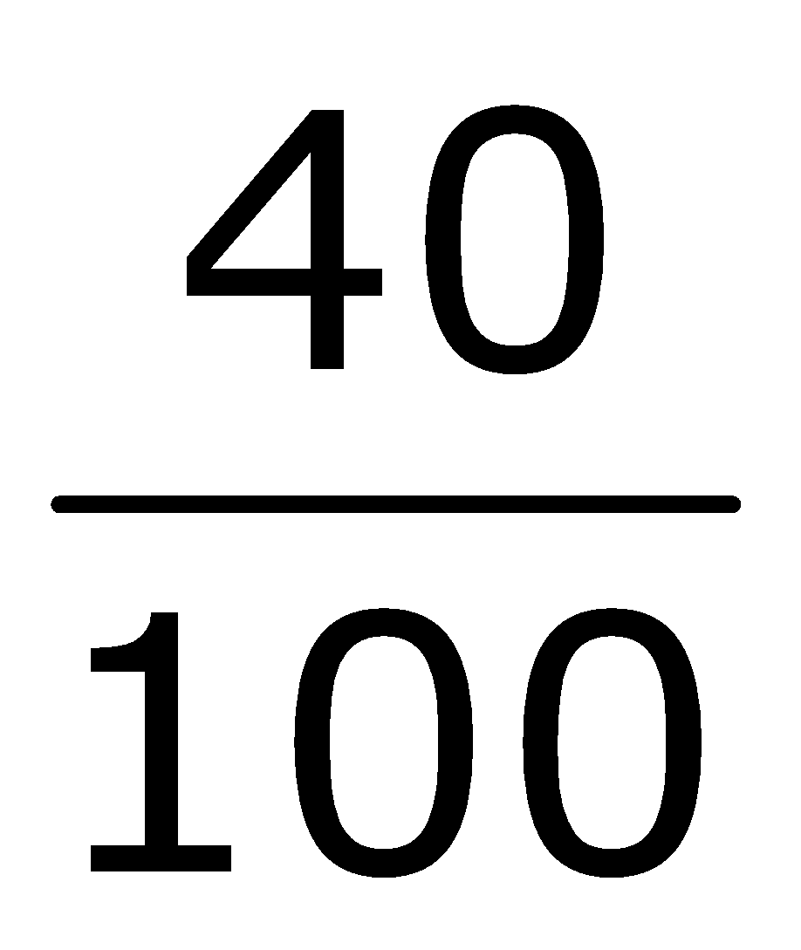
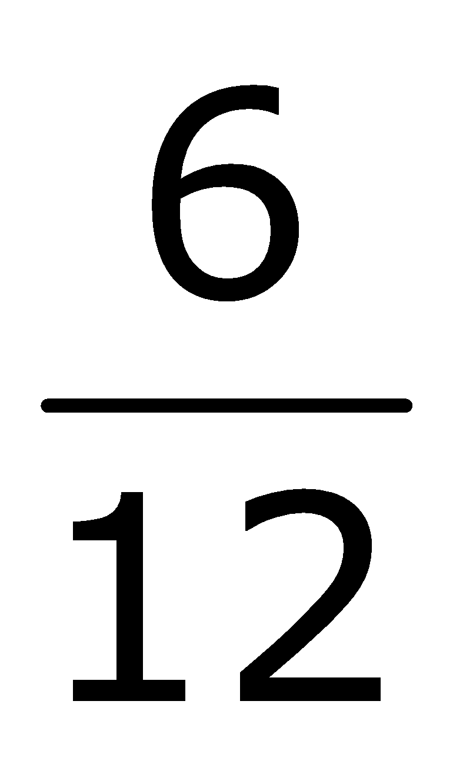
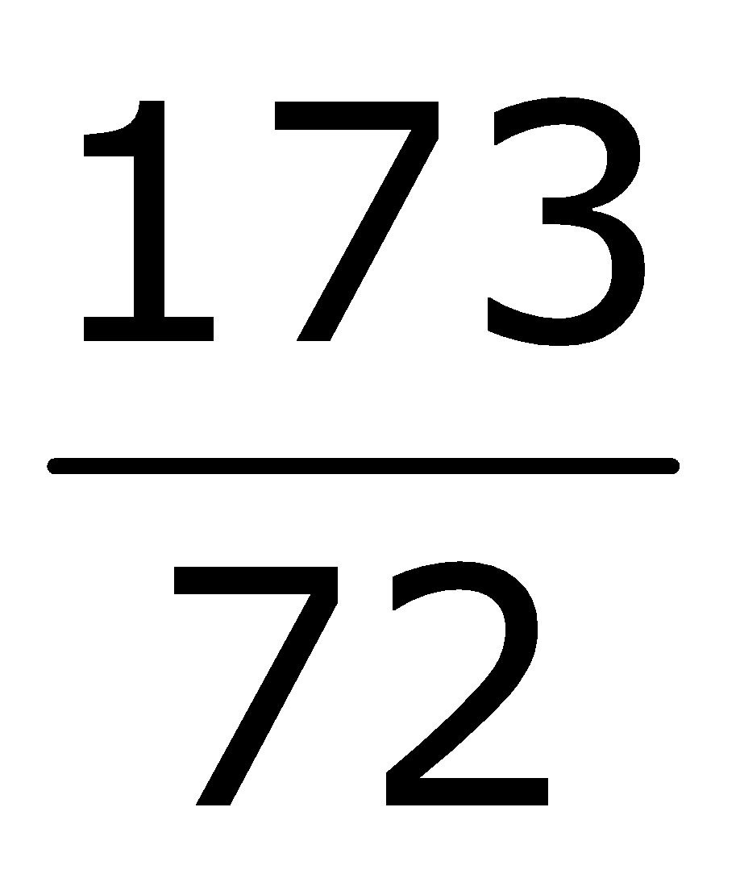
#2 Answer
Rubric:
(1 point each) The student correctly calculates the solution to a subtraction problem involving fractions.
Answers:
Example 1:
Example 2:
Example 3:
Notes:
‹#›

Slide 6
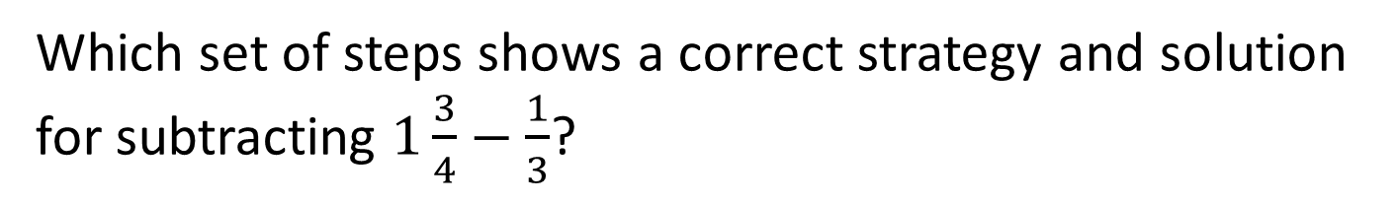
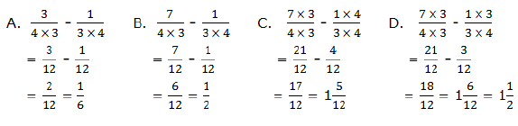
#3

Slide 7
#3 Answer
Rubric:
(1 point) The student selects the correct set of steps.
Answer: C

Slide 8
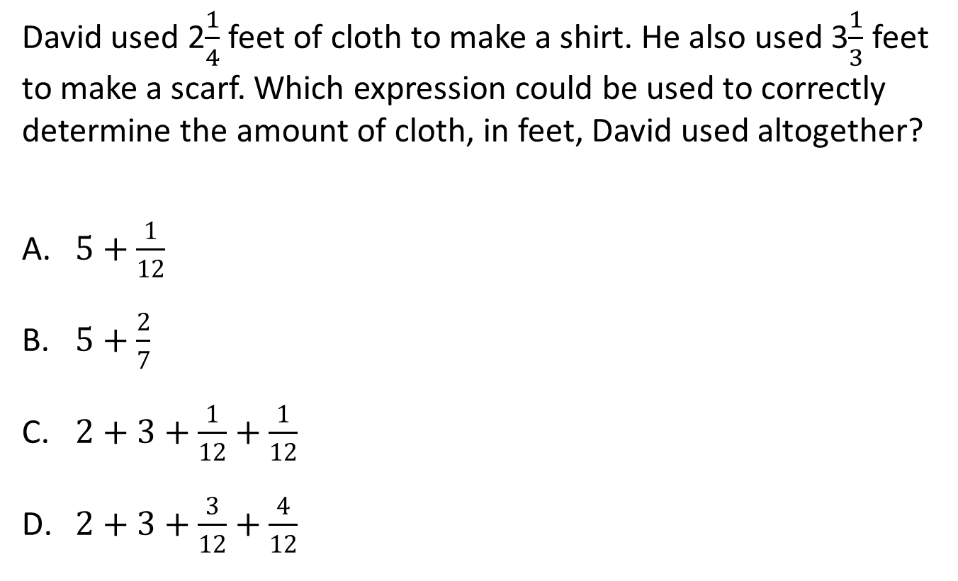
#4
Notes:
‹#›

Slide 9
#4 Answer
Rubric:
(1 point) The student selects the correct equivalent expression.
Answer: D
Notes:
‹#›

Slide 10
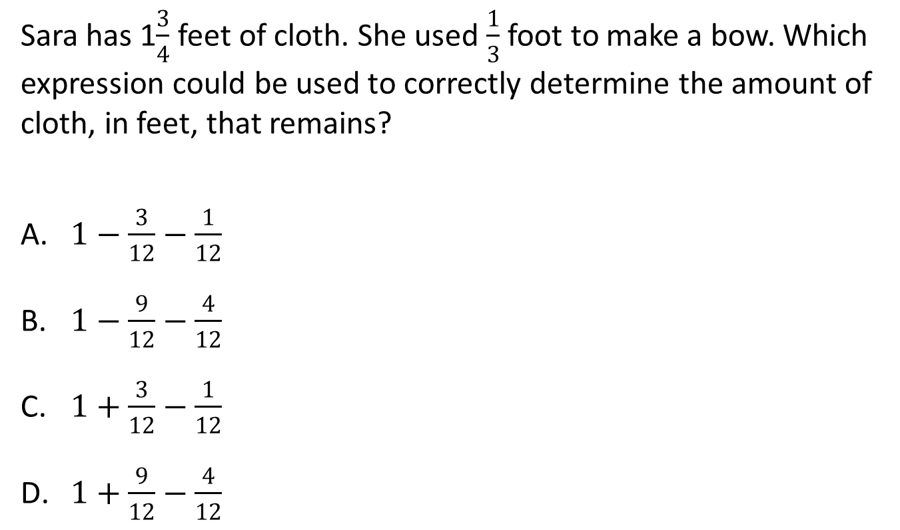
#5

Slide 11
#5 Answer
Rubric:
(1 point) The student selects the correct equivalent expression.
Answer: D

Slide 12
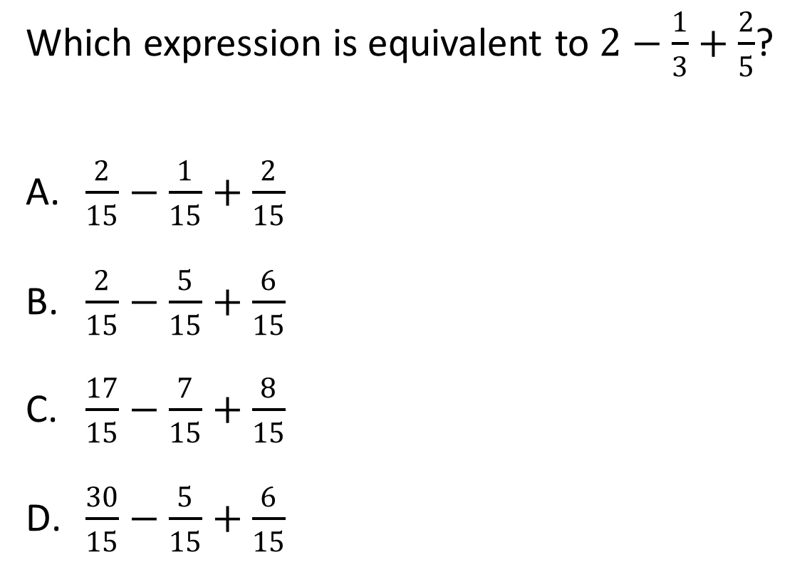
#6

Slide 13
#6 Answer
Rubric:
(1 point) The student selects the correct expression.
Answer: D

Slide 14
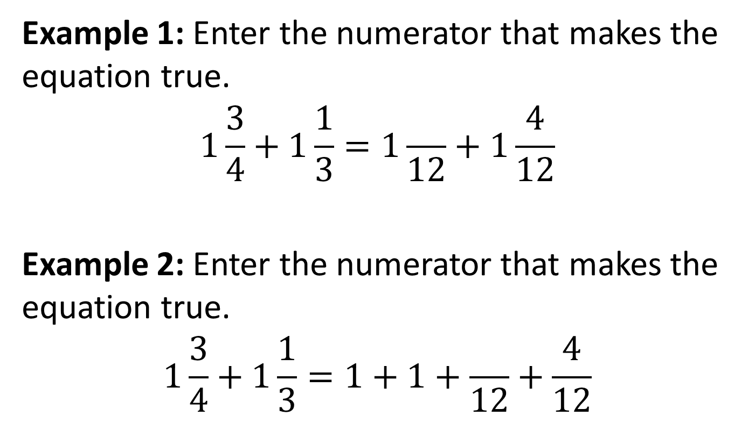
#7

Slide 15
#7 Answer
Rubric:
(1 point each) The student enters the number that will make the equation true.
Answers:
Example 1: 9
Example 2: 9

