Slide 1

Claim 1
Smarter Balanced Sample Items
Grade 5 - Target D
Perform operations with multi-digit whole numbers and with decimals to hundredths.
Questions courtesy of the Smarter Balanced Assessment Consortium Item Specifications – Version 3.0
Slideshow organized by SMc Curriculum – www.ccssmathactivities.com
Notes:
‹#›

Slide 2

#1
Enter the product.
4 × 39

Slide 3

#1 Answer
Rubric:
(1 point) The student correctly solves the multiplication problem.
Answer: 156
Notes:
‹#›

Slide 4
#2
Enter the product.
4238
× 32
Notes:
‹#›

Slide 5
#2 Answer
Rubric:
(1 point) The student correctly solves the multiplication problem.
Answer: 135,616
Notes:
‹#›

Slide 6
#3
Enter the quotient.
335 ÷ 5

Slide 7
#3 Answer
Rubric:
(1 point) The student correctly solves the division problem.
Answer: 67

Slide 8
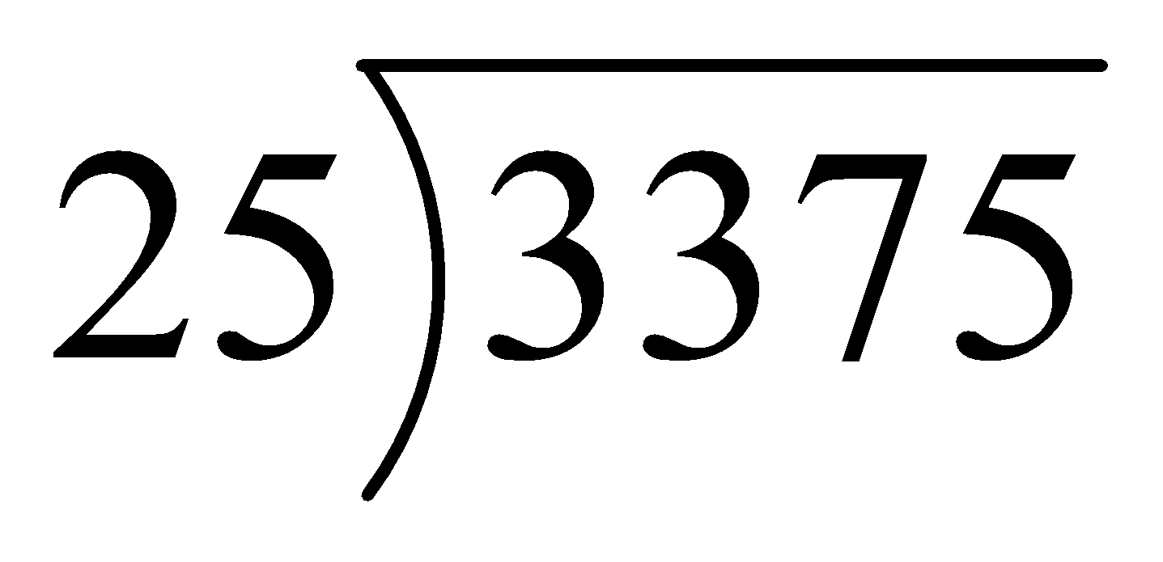
#4
Enter the quotient.

Slide 9
#4 Answer
Rubric:
(1 point) The student correctly solves the division problem.
Answer: 135

Slide 10
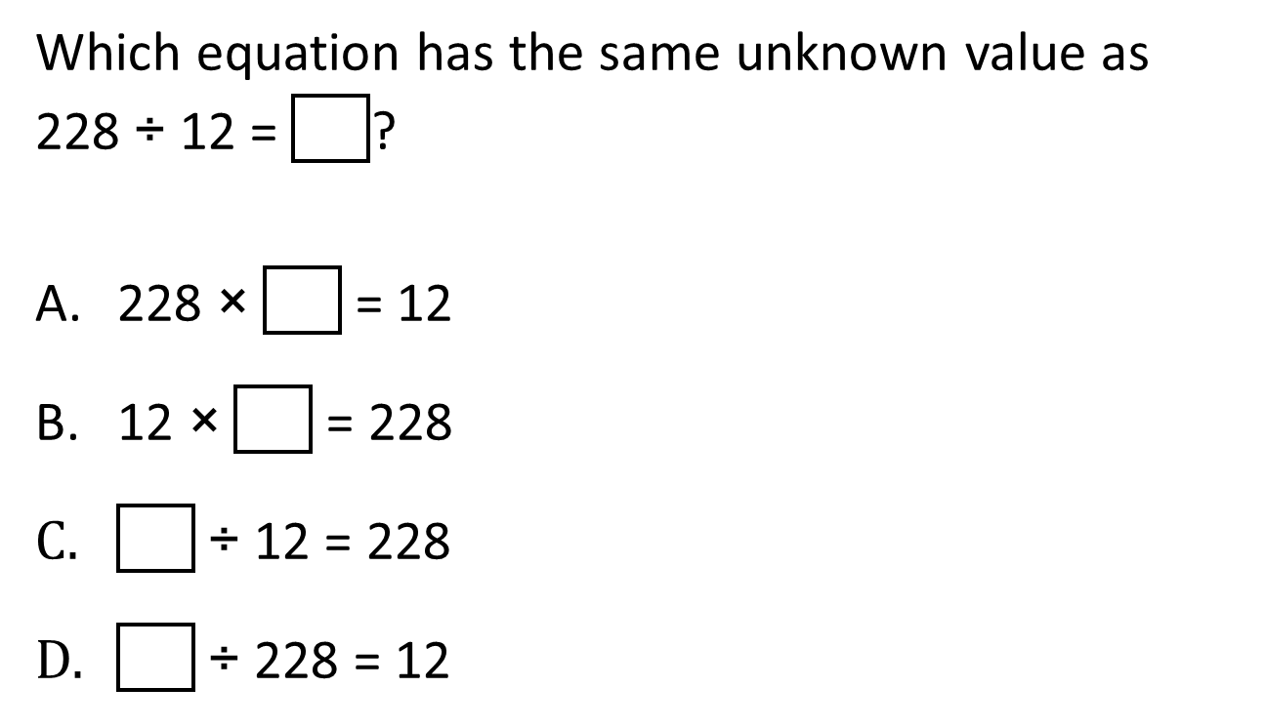
#5

Slide 11
#5 Answer
Rubric:
(1 point) The student selects the correct option.
Answer: B

Slide 12

#6

Slide 13
#6 Answer
Rubric:
(1 point) The student enters the correct number.
Answer: 5

Slide 14
#7
Enter the sum.
16 + 5.67 + 8.3

Slide 15
#7 Answer
Rubric:
(1 point) The student correctly calculates the solution to a problem involving decimals.
Answer: 29.97

Slide 16
#8
Enter the difference.
20.50 – 3.65

Slide 17
#8 Answer
Rubric:
(1 point) The student correctly calculates the solution to a problem involving decimals.
Answer: 16.85

Slide 18
#9
Enter the product.
7.86 × 3

Slide 19
#9 Answer
Rubric:
(1 point) The student correctly calculates the solution to a problem involving decimals.
Answer: 23.58

Slide 20
#10
Enter the quotient.
8.40 ÷ 5

Slide 21

#10 Answer
Rubric:
(1 point) The student correctly calculates the solution to a problem involving decimals.
Answer: 1.68

Slide 22
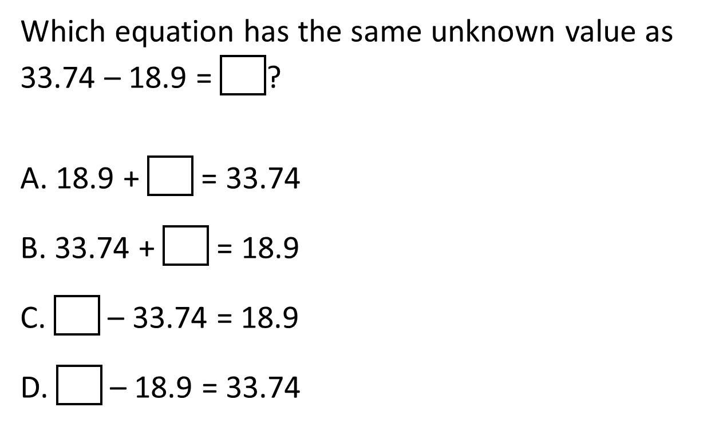
#11

Slide 23
#11 Answer
Rubric:
(1 point) The student selects the correct option.
Answer: A

Slide 24
#12
Example 1: Enter the unknown value in the equation.
18.9 + = 33.74
Example 2: Enter the unknown value in the equation.
– 18.9 = 33.74

Slide 25
#12 Answer
Rubric:
(1 point each) The student enters the correct number.
Answers:
Example 1: 14.84
Example 2: 52.64

Slide 26
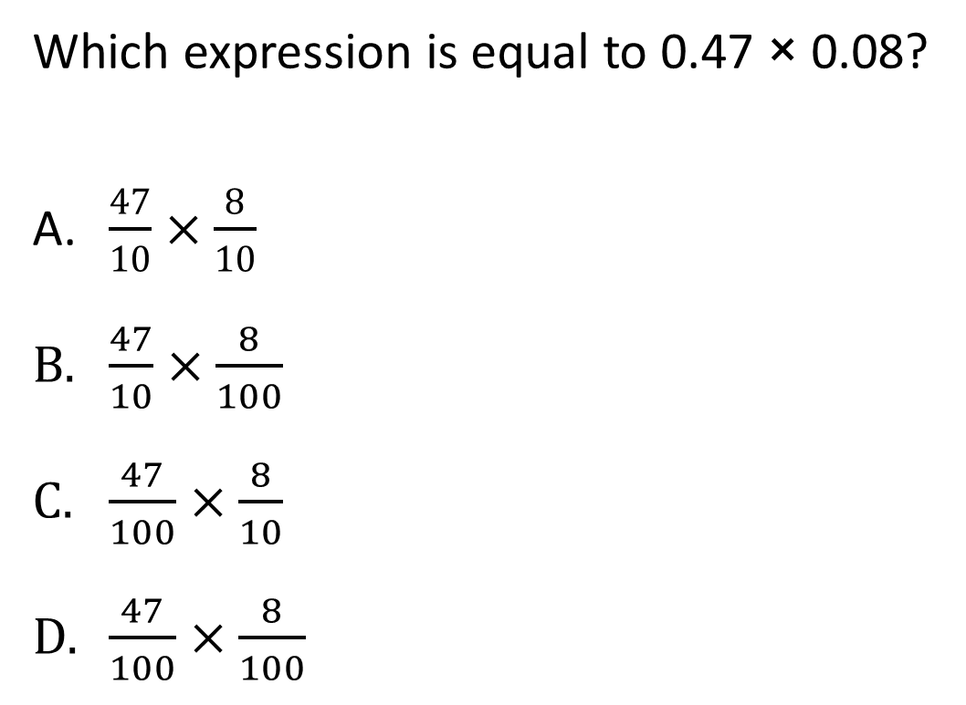
#13

Slide 27
#13 Answer
Rubric:
(1 point) The student selects the correct option.
Answer: D

Slide 28
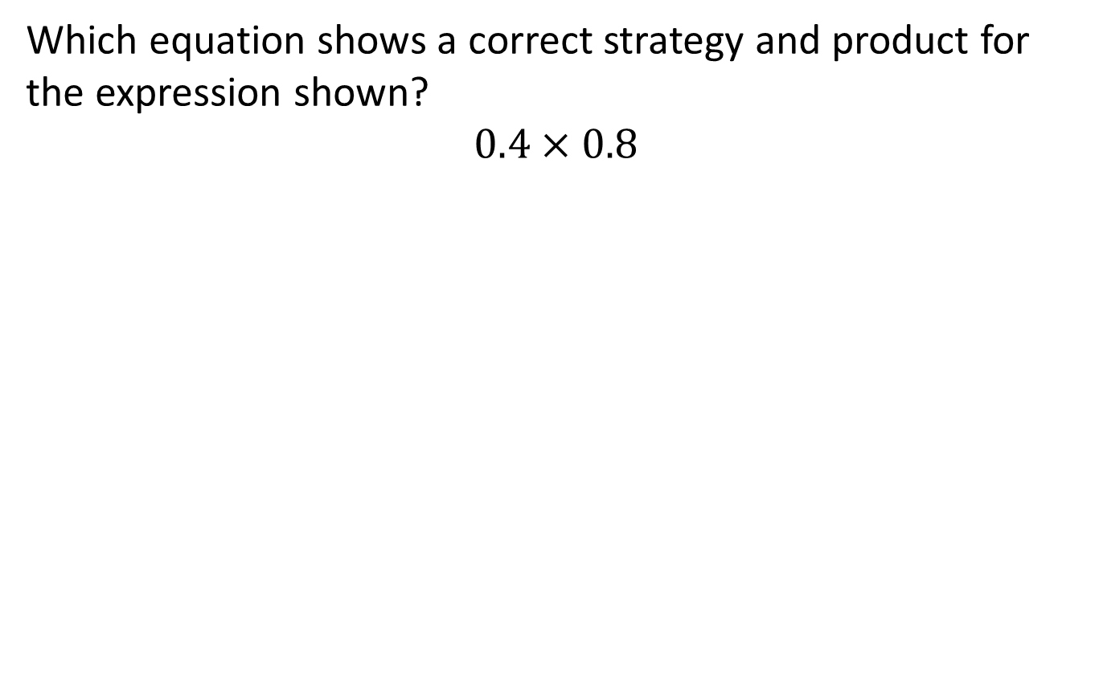
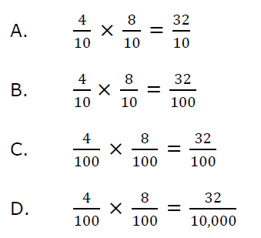
#14

Slide 29
#14 Answer
Rubric:
(1 point) The student selects the correct option.
Answer: B

Slide 30
#15
Which expression is equal to 16.25 ÷ 2.5?
1.625 ÷ 25
16.25 ÷ 25
162.5 ÷ 25
1625 ÷ 25

Slide 31
#15 Answer
Rubric:
(1 point) The student selects the correct option.
Answer: C

