Slide 1

Claim 1
Smarter Balanced Sample Items
Grade 5 - Target C
Understand the place value system.
Questions courtesy of the Smarter Balanced Assessment Consortium Item Specifications – Version 3.0
Slideshow organized by SMc Curriculum – www.ccssmathactivities.com
Notes:
‹#›

Slide 2

#1
Example 1: Enter 10,000 as a power of 10.
Example 2: What power of 10 makes this expression equal to 5000?
5 x 10

Slide 3

#1 Answer
Rubric:
(1 point each) The student enters the correct value.
Answers:
Example 1: 10⁴
Example 2: 3
Notes:
‹#›

Slide 4
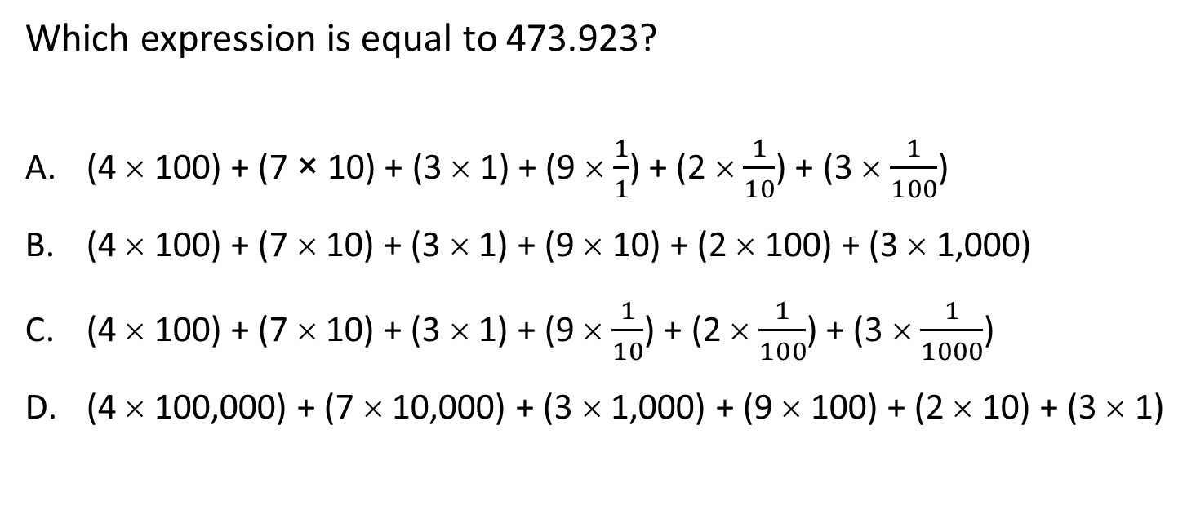
#2

Slide 5
#2 Answer
Rubric:
(1 point) The student enters the correct expression.
Answer: C

Slide 6
#3
Example 1: Enter a number equal to the value of the expression.
Example 2: Enter a number equal to the value of the expression.

Slide 7
#3 Answer
Rubric:
(1 point each) The student correctly enters the decimal number that is equivalent to the expression.
Answers:
Example 1: 473.923
Example 2: 473.923

Slide 8
#4
Enter a number equal to the value of the expression
(7 x 10) + (4 x 1) + (5 x 0.1) + (3 x 0.01)
Notes:
‹#›

Slide 9

#4 Answer
Rubric:
(1 point) The student correctly enters the decimal number that is equivalent to the expression.
Answer: 74.53
Notes:
‹#›

Slide 10
#5
Determine whether each expression is equivalent to 638.4. Select Yes or No for each expression.
 | Yes | No
63 tens + 8 ones + 4 tenths
63 hundreds + 8 ones + 4 tenths
6 hundreds + 3 tens + 84 tenths
6 hundreds + 38 ones + 4 tenths

Slide 11
#5 Answer
Rubric:
(1 point) The student identifies equal expansions for the number.
Answer: Y, N, Y, Y

Slide 12
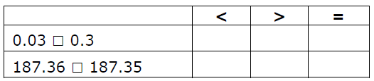
#6
Select the symbol (>, <, or =) that correctly compares each pair of numbers.

Slide 13
#6 Answer
Rubric:
(1 point each) The student selects the correct symbols.
Answers:
Example 1: <
Example 2: >

Slide 14
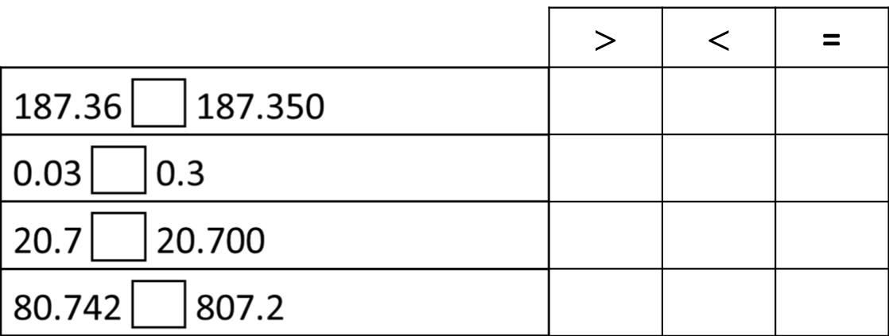
#7
Select the symbol (>, <, or =) that correctly completes each comparison. Click in the table to respond.

Slide 15
#7 Answer
Rubric:
(1 point) The student enters the correct symbol for each comparison.
Answer: >, <, =, <

Slide 16
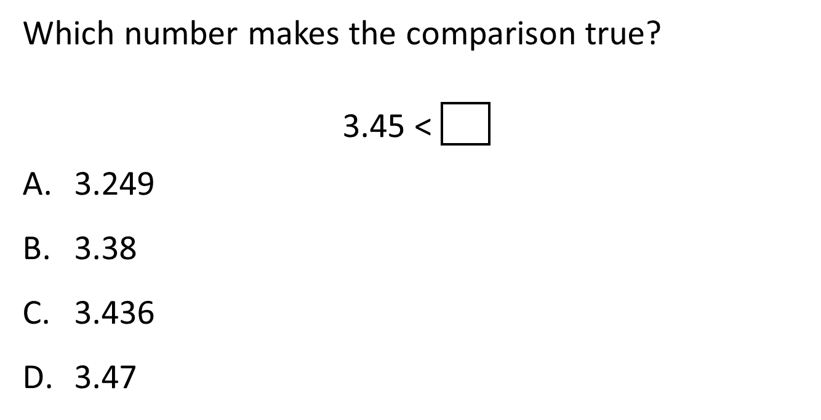
#8

Slide 17
#8 Answer
Rubric:
(1 point) The student selects the correct number.
Answer: D

Slide 18
#9
Determine if each comparison is true or false. Select True or False for each comparison.
 | True | False
4.3 = 4.300
48.2  4.829
56.78  56.760

Slide 19
#9 Answer
Rubric:
(1 point) The student correctly selects True or False for each comparison.
Answer: T, T, F

Slide 20
#10
Round 45.643 to the nearest hundredth. Enter your answer in the response box.

Slide 21

#10 Answer
Rubric:
(1 point) The student enters the correct value.
Answer: 45.64

