Slide 1

Claim 1
Smarter Balanced Sample Items
Grade 5 - Target B
Analyze patterns and relationships.
Questions courtesy of the Smarter Balanced Assessment Consortium Item Specifications – Version 3.0
Slideshow organized by SMc Curriculum – www.ccssmathactivities.com

Slide 2

#1
Patterns A and B are generated using these rules.
Pattern A: Start with 10 and add 5.
Pattern B: Start with 2 and add 1.
Which statement best describes the relationship between the corresponding terms of Pattern A and Pattern B?
Each term in Pattern A is of the value of the corresponding term in Pattern B.
Each term in Pattern A is 4 more than the value of the corresponding term in Pattern B.
Each term in Pattern A is 5 times the value of the corresponding term in Pattern B.
Each term in Pattern A is 8 more than the value of the corresponding term in Pattern B.

Slide 3

#1 Answer
Rubric:
(1 point) The student selects the correct description of the relationship.
Answer: C

Slide 4
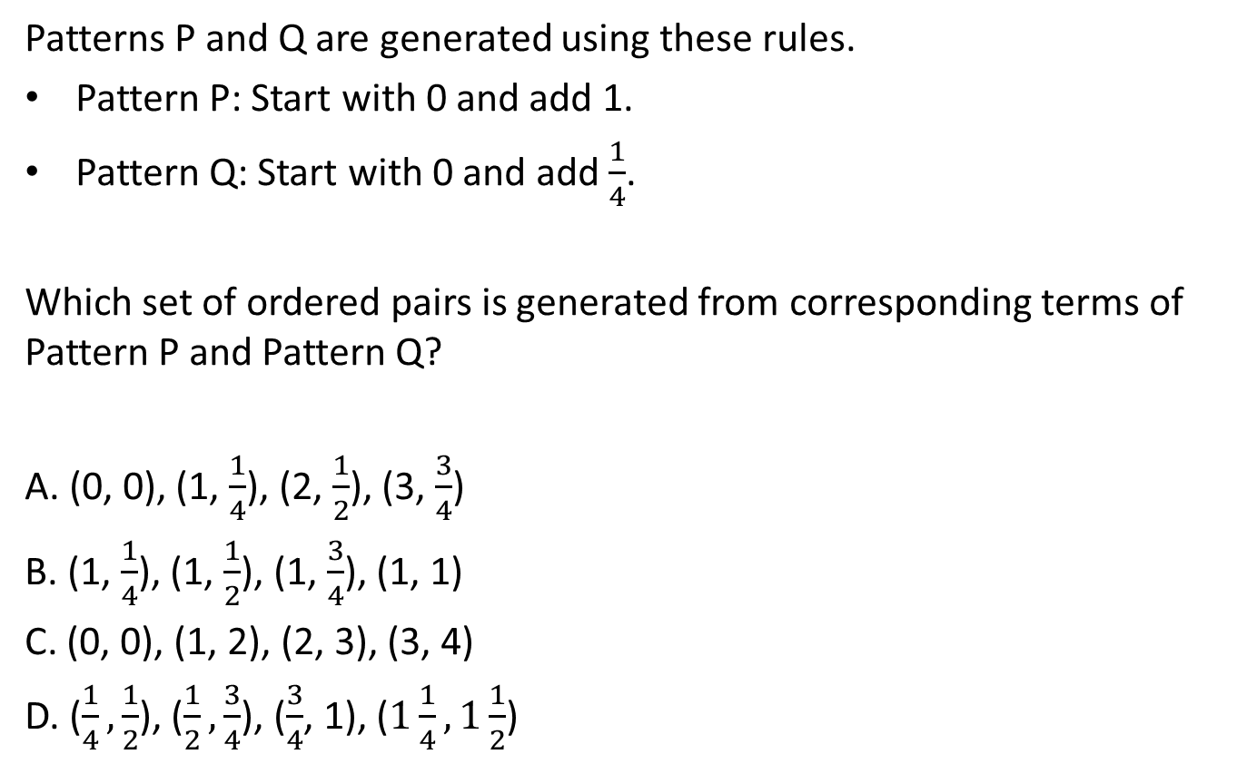
#2

Slide 5
#2 Answer
Rubric:
(1 point) The student selects the correct set of ordered pairs.
Answer: A

Slide 6
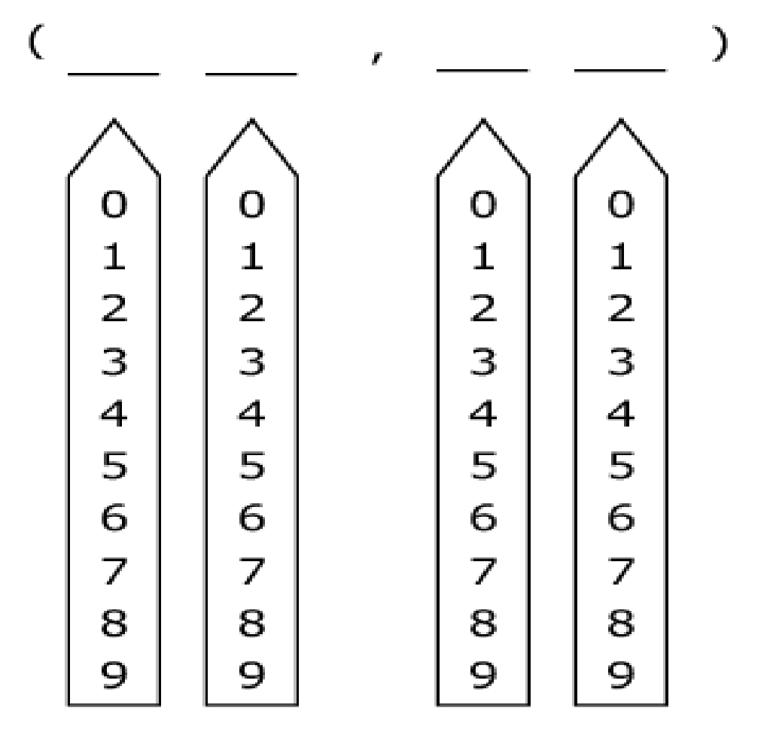
#3
Patterns P and Q are generated using these rules.
Pattern P: Start with 2 and add 3.
Pattern Q: Start with 2 and add 2.
The first two ordered pairs generated by these rules are (2, 2) and (5, 4). Enter an ordered pair formed by the corresponding fifth terms of Pattern P and Pattern Q.

Slide 7
#3 Answer
Rubric:
(1 point) The student correctly enters the ordered pair for the corresponding fifth terms in the given patterns.
Answer: (14, 10)

Slide 8
#4
Patterns X and Y are generated using these rules.
Pattern X: Start with 0 and add 3.
Pattern Y: Start with 2 and add 2.
Draw a graph to show four sets of points representing ordered pairs formed by corresponding terms in these two patterns.

Slide 9
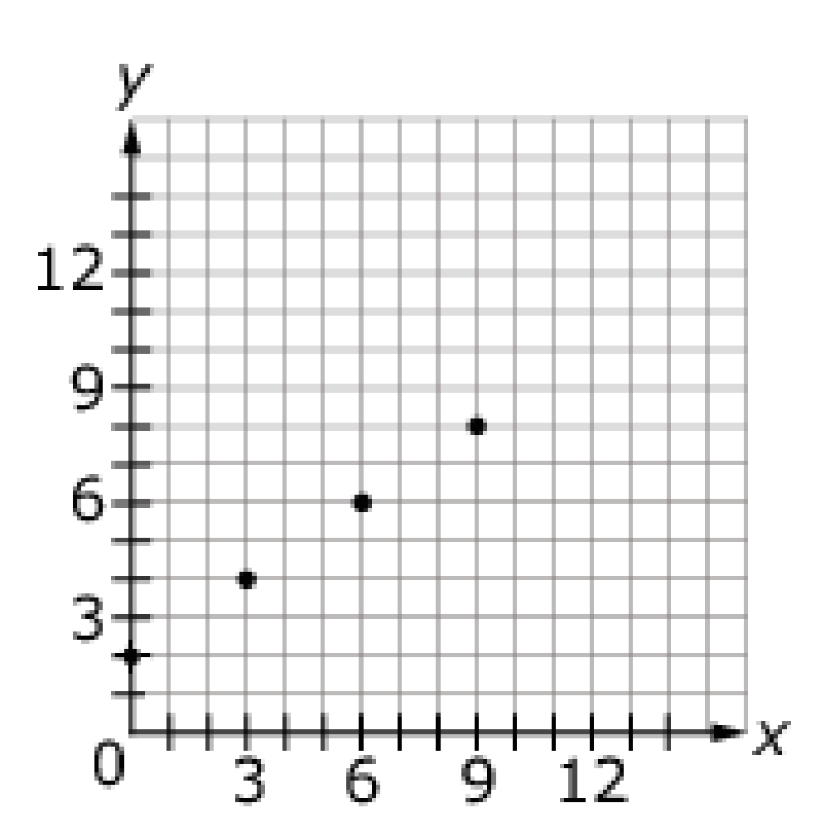
#4 Answer
Rubric:
(1 point) The student draws the correct graph.
Answer:

Slide 10
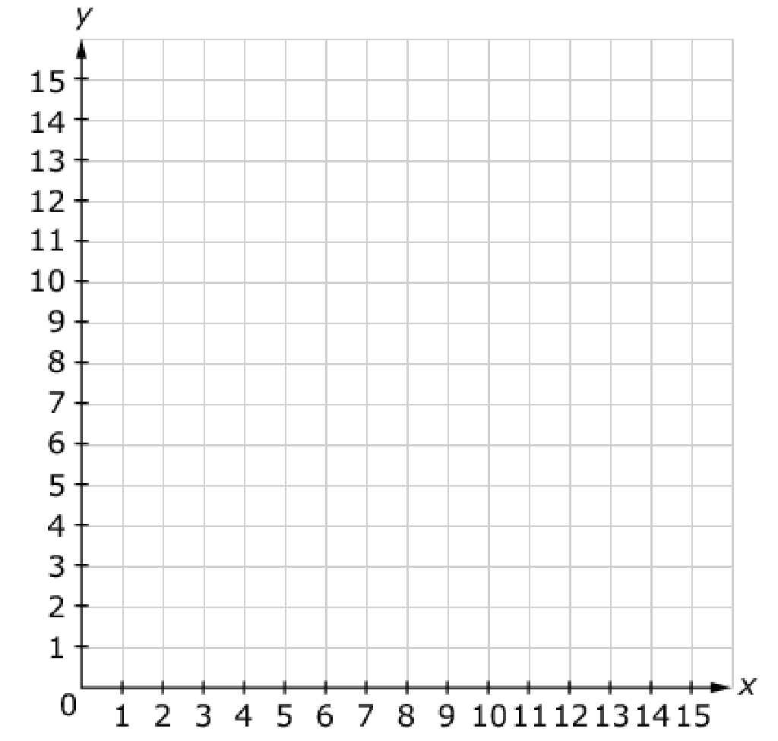
#5
Patterns X and Y are generated using these rules.
Pattern X: Start with 5 and add 5.
Pattern Y: Start with 1 and add 2.
Graph three points to represent the ordered pairs formed by the first three corresponding terms in Pattern X and Pattern Y.

Slide 11
#5 Answer
Rubric:
(1 point) The student correctly plots three points.
Answer: (5, 1), (10, 3), (15, 5) or (1, 5), (3, 10), (5, 15)

