Slide 1

Claim 1
Smarter Balanced Sample Items
Grade 5 - Target A
Write and interpret numerical expressions.
Questions courtesy of the Smarter Balanced Assessment Consortium Item Specifications – Version 3.0
Slideshow organized by SMc Curriculum – www.ccssmathactivities.com
Notes:
‹#›

Slide 2

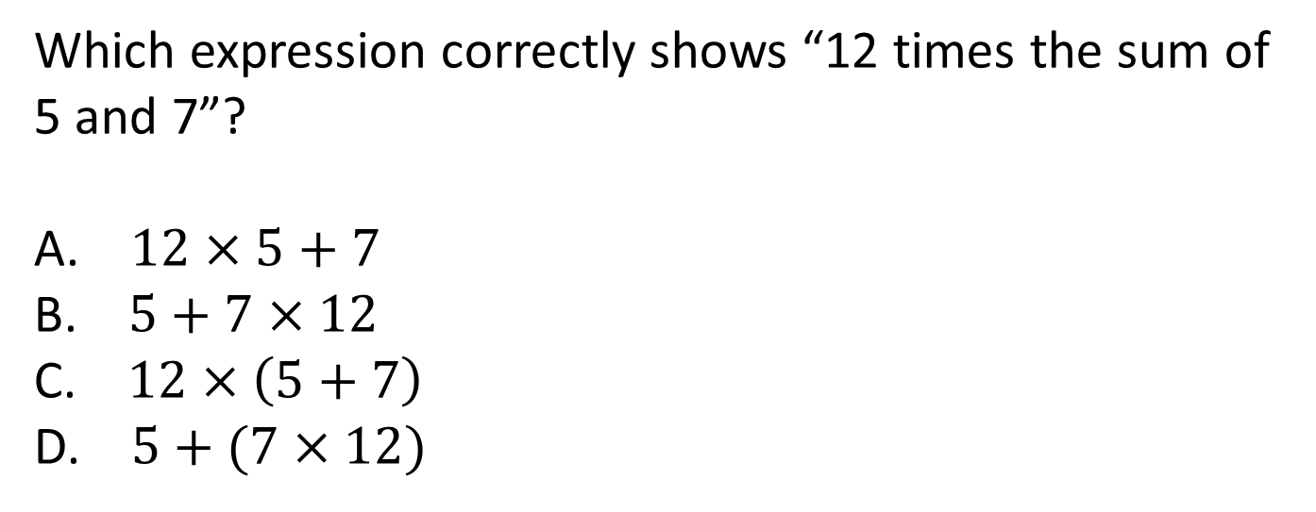
#1

Slide 3

#1 Answer
Rubric:
(1 point) The student selects the correct expression.
Answer: C

Slide 4
#2
Which expression correctly shows the difference between the product of 7 and 9 and the sum of 12 and 5?
A. 7 × (9 – 12) + 5
B. 7 × (9 + 12) + 5
C. (7 × 9) – (12 + 5)
D. (7 + 9) + (12 + 5)
Notes:
‹#›

Slide 5
#2 Answer
Rubric:
(1 point) The student selects the correct expression.
Answer: C
Notes:
‹#›

Slide 6
#3
Which statement describes the value of the expression 4 × (18,932 + 921)?
The value is 921 more than the product of 4 and 18,932.
The value is 18,932 more than the product of 4 and 921.
The value is 4 times as large as the sum of 18,932 and 921.
The value is 4 times as large as the product of 18,932 and 921.
Notes:
‹#›

Slide 7
#3 Answer
Rubric:
(1 point) The student selects the correct interpretation of the expression
Answer: C
Notes:
‹#›

Slide 8
#4
Example 1: Enter the value of 7 + (5 × 12).
Example 2: Enter the value of 7 + (5 × 12) – 4.
Notes:
‹#›

Slide 9
#4 Answer
Rubric:
(1 point each) The student enters the correct value.
Answers:
Example 1: 67
Example 2: 63
Notes:
‹#›

Slide 10
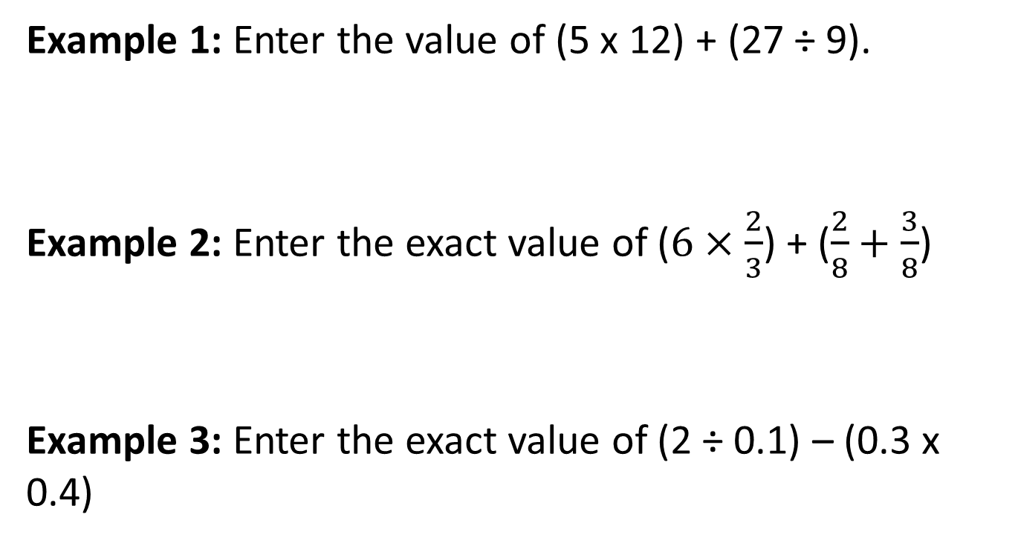
#5

Slide 11
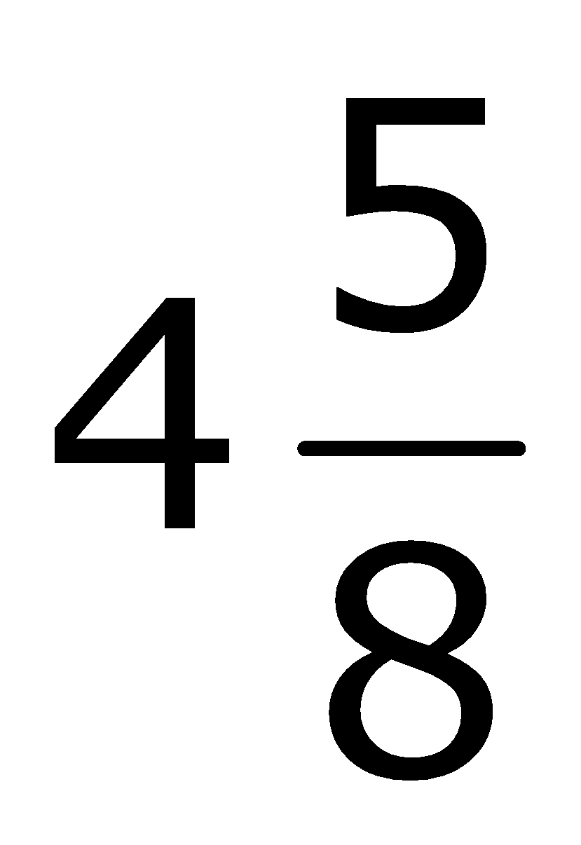
#5 Answer
Rubric:
(1 point each) The student enters the correct value.
Answers:
Example 1: 63
Example 2:
Example 3: 19.88

Slide 12
#6
Taryn must place parentheses around numbers in this expression in order to make it equal 2.
30 ÷ 2 + 4 – 3
Which expression equals 2?
30 ÷ (2 + 4 – 3)
30 ÷ (2 + 4) – 3
30 ÷ 2 + (4 – 3)
(30 ÷ 2) + 4 – 3

Slide 13

#6 Answer
Rubric:
(1 point) The student identifies the correct placement of parentheses.
Answer: B

