Slide 1

Claim 4
Smarter Balanced Sample Items
Grade 4
Modeling and Data Analysis
Questions courtesy of the Smarter Balanced Assessment Consortium Item Specifications – Version 3.0
Slideshow organized by SMc Curriculum – www.ccssmathactivities.com

Slide 2
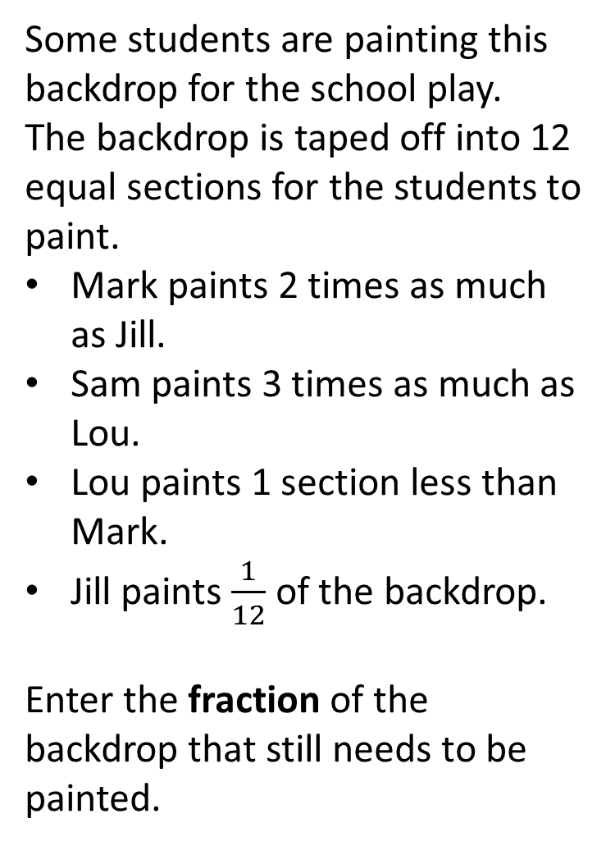
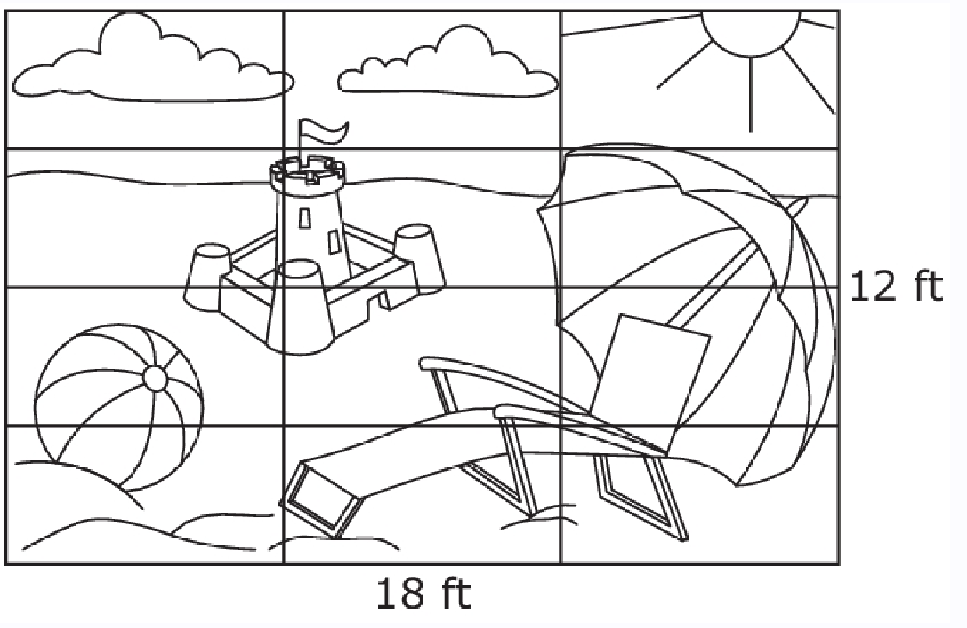
#1

Slide 3
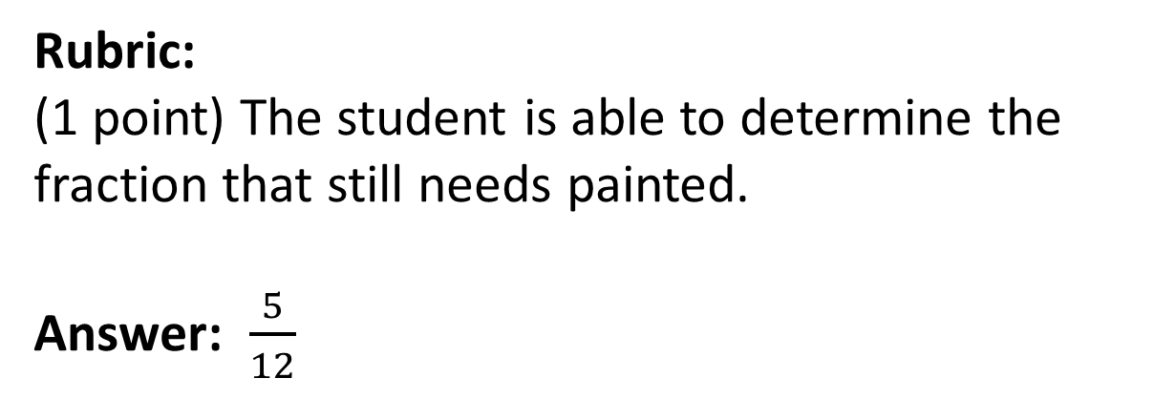
#1 Answer

Slide 4
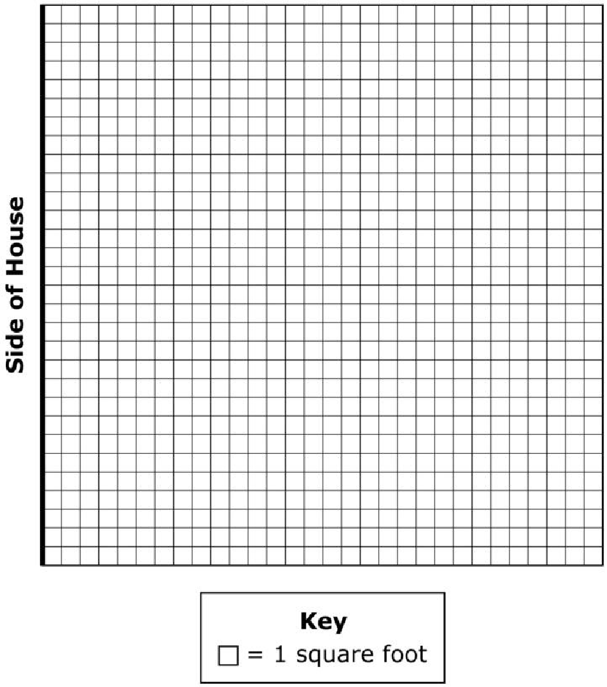
#2
Tyra wants to enclose a section of her lawn for her dog to be able to have an outdoor play area. She knows that if she uses the side of her house as one side of the play area, her dog will have a larger outdoor play area. Tyra’s plan for the play area includes the following:
It will be in the shape of a rectangle.
The side of the house will be used as one side of the rectangular area.
She will use exactly 24 feet of fence material to
enclose the play area.
The length and width of the enclosure will be whole units.
She wants the play area to be greater than 60 square feet.
Use the Connect Line tool to create a rectangular play area that meets Tyra’s plan.

Slide 5
#2 Answer
Rubric:
(2 points) The student is able to construct a 4 by 16 or 8 by 8 rectangle using the side of the house.
(1 point) Partial credit is possible for constructing a rectangle that uses exactly 24 feet of fencing, but doesn’t reflect using the side of the house as one of the sides, nor the area being greater than 60 square feet. Examples: 1 by 11, 2 by 10, 3 by 9, 4 by 8, 5 by 7, or
6 by 6

Slide 6
#3
A group of 137 students and 15 adults go to a museum. The students and adults have to take the elevator up to the 6th floor.
The elevator can hold a maximum of 12 people.
At least one adult must ride with each group of students on the elevator.
Part A:
What is the fewest number of elevator trips it will take to get all of the students and adults to the 6th floor? Enter your response in the first response box.
Part B:
What is the fewest number of people on the final elevator trip?
Enter your response in the second response box.

Slide 7
#3 Answer
Rubric:
(2 points) The student correctly enters the minimum number of trips and the total number of people on the last elevator.
(1 point) Partial credit is possible for correctly entering the minimum number of trips or the total number of people on the last elevator.
Answer: 13, 8

Slide 8
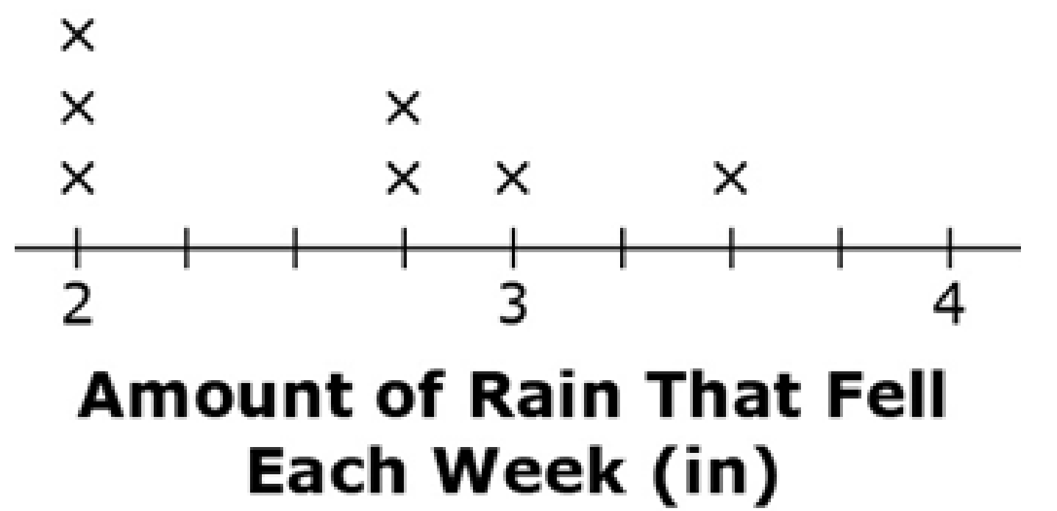
#4
This line plot shows the amounts of rain, in inches, that fell each week for 8 weeks. Decide if each statement is True or False. Click True or False for each statement.
Statement | True | False
The most rain that fell in one week is 4 inches.

Slide 9
#4 Answer
Rubric:
(1 point) The student correctly identifies all three statements as true or false.
Answer: F, F, T

Slide 10
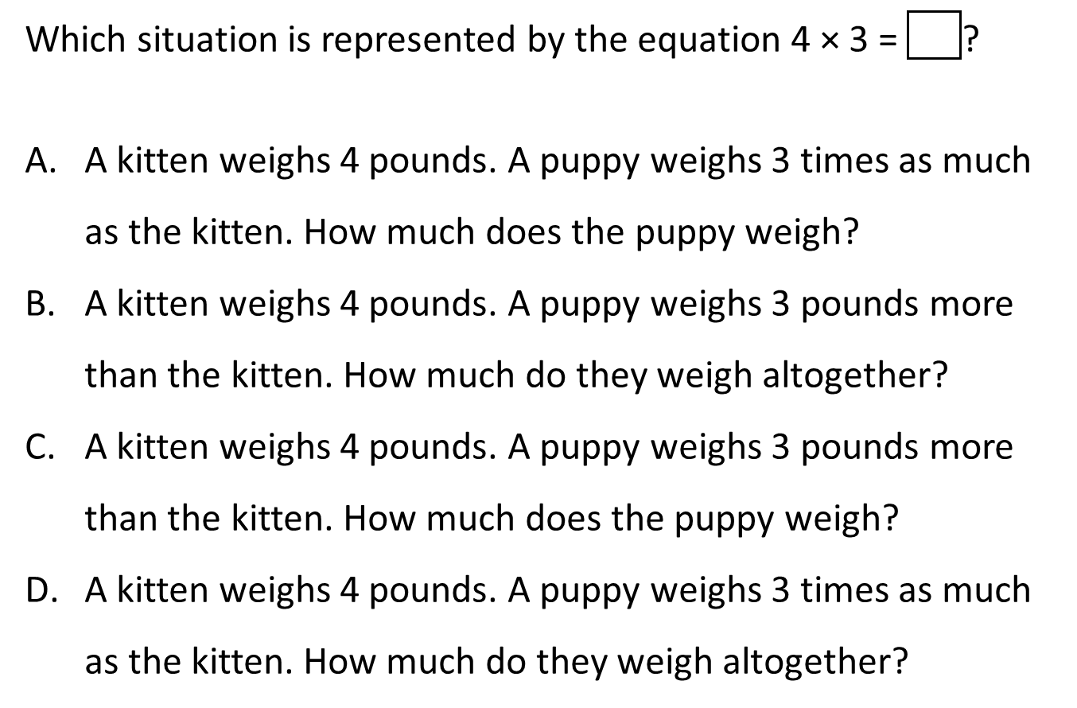
#5

Slide 11
#5 Answer
Rubric:
(1 point) The student correctly identifies the context that represents the multiplication equation as a multiplicative comparison.
Answer: A

Slide 12

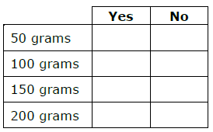
#6
A bag of 5 apples at the grocery store has a mass of 825 grams. The largest apple has a mass of 185 grams.
What is a reasonable estimate for the mass, in grams, of the smallest apple in the bag? Select Yes for each reasonable mass and No for each mass that is not reasonable.

Slide 13
#6 Answer
Rubric:
(1 point) The student selects numbers that are reasonable estimates for the mass of the smallest apple. The student should select just 150 since an argument can be made that if the apples are fairly similar in size, then 150 is the only reasonable estimate, but if they vary a lot, then 100 would be reasonable as well. 200 would not be possible as that is larger than the largest apple, and 50 is not possible because that would require at least one other apple to be 197 grams.
Answer: There are three correct response patterns: 100; 150; or 100,150

Slide 14
#7
Sarah is helping her dad make cookies for her class using a recipe they found online. Her dad asks, “Do you think one batch of cookies will be enough?” Select all of the information they need to answer the question.
The amount of flour in the recipe.
The number of cookies in one batch.
The number of students in the class.
The temperature of the oven for baking the cookies.
The number of cookies you can fit onto a cookies sheet.

Slide 15
#7 Answer
Rubric:
(1 point) The student selects the correct pieces of information.
Answer: B and C

Slide 16
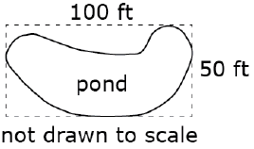
#8
Liam uses string to form a rectangle with length 100 feet and width 50 feet to estimate the area of a small pond.
Enter an estimate for the area of the pond in square feet in the response box.
Select a statement that supports your estimate.
The area of the rectangle is bigger than the area of the pond.
The area of the rectangle is smaller than the area of the pond.
The distance around the rectangle is bigger than the distance around the pond.
The distance around the rectangle is smaller than the distance around the pond.

Slide 17
#8 Answer
Rubric:
(1 point) The student enters a reasonable estimate and select the supporting reason.
Answer: An estimate between 2500 and 5000; A

