Slide 1

Claim 3
Smarter Balanced Sample Items
Grade 4
Communicating Reasoning
Questions courtesy of the Smarter Balanced Assessment Consortium Item Specifications – Version 3.0
Slideshow organized by SMc Curriculum – www.ccssmathactivities.com

Slide 2
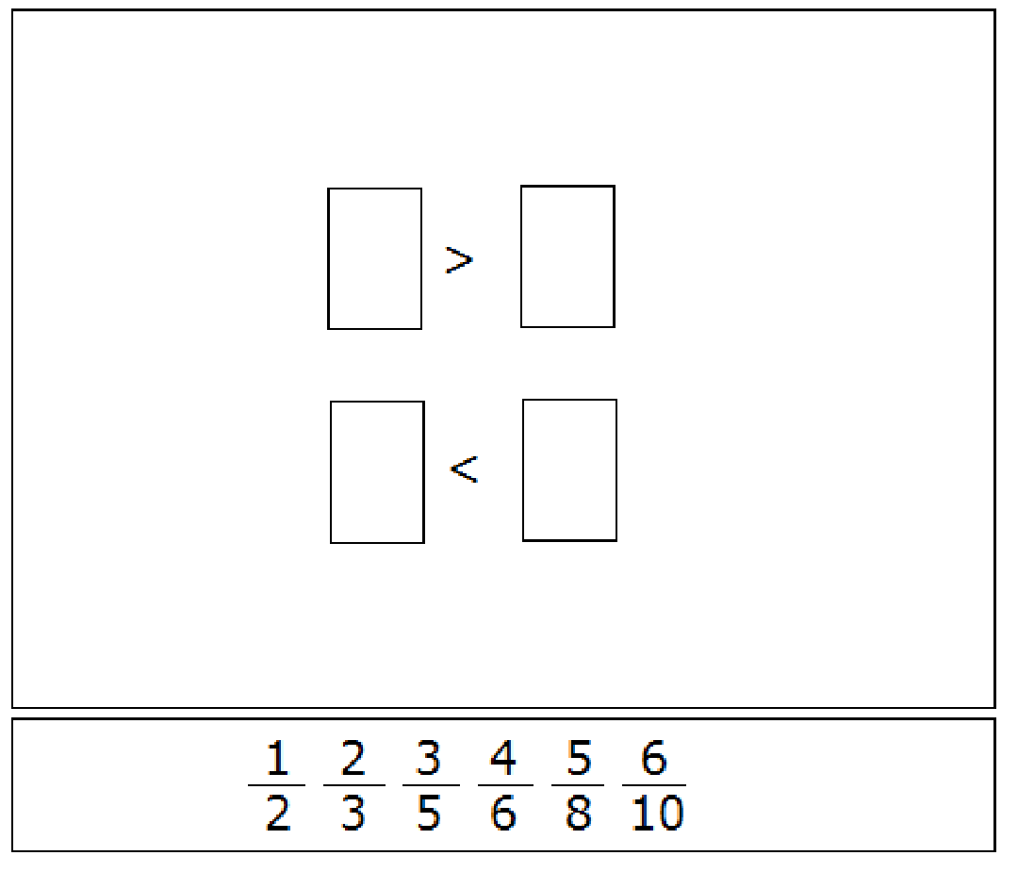
#1
Drag one fraction to each box to create two true comparisons.

Slide 3
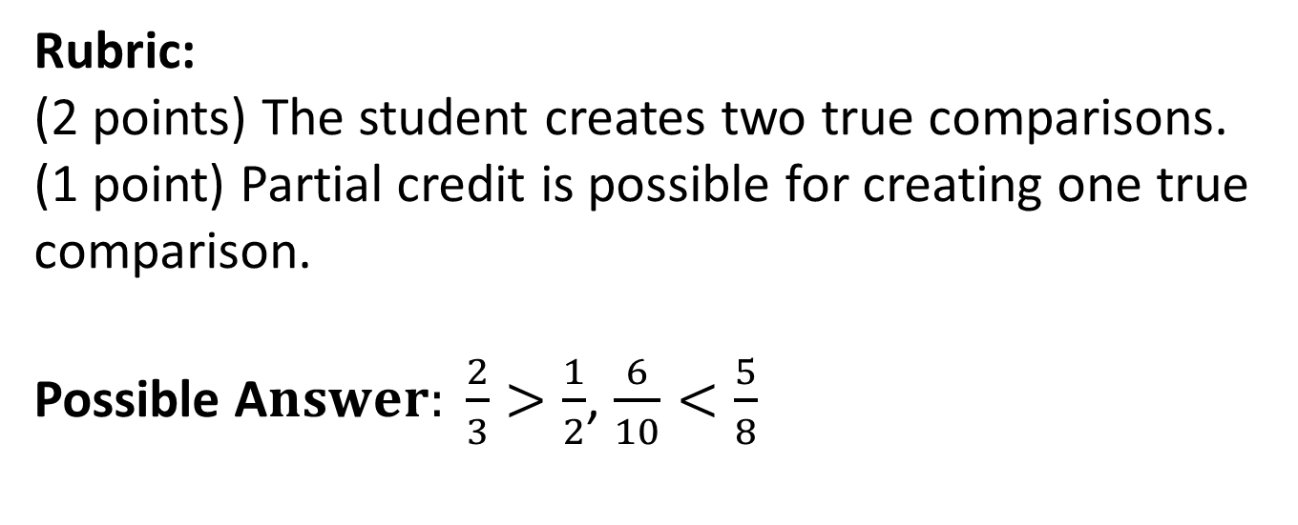
#1 Answer

Slide 4
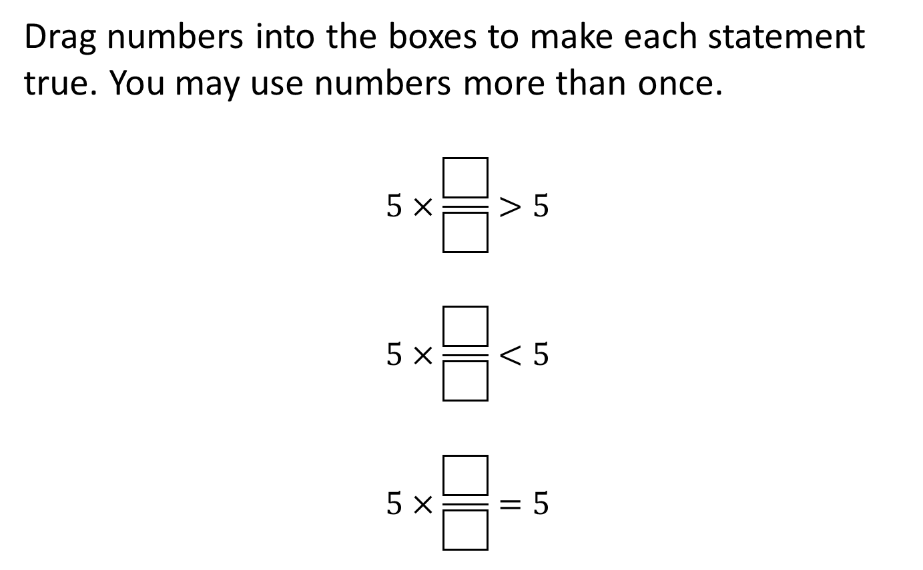
#2

Slide 5
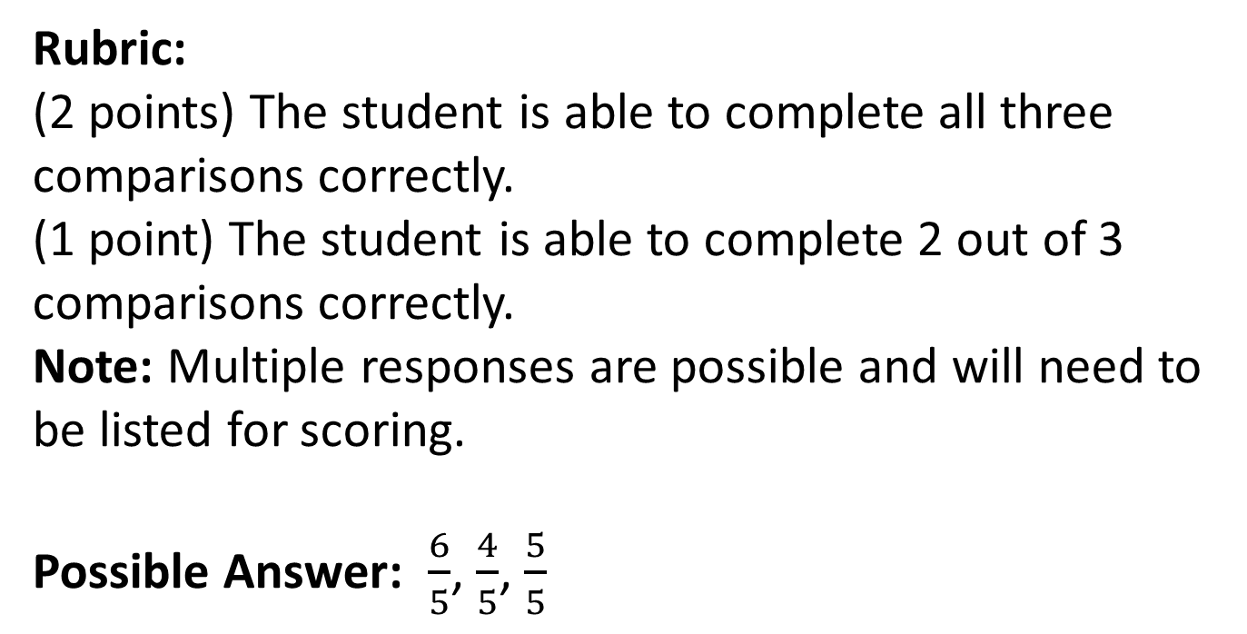
#2 Answer

Slide 6
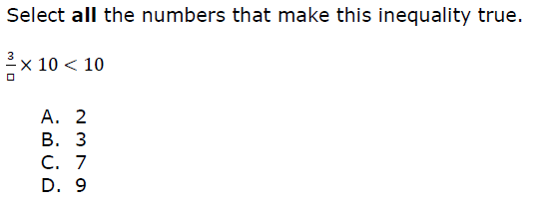
#3

Slide 7
#3 Answer
Rubric:
(1 point) The student identifies all the correct conditions that make the argument true.
Answer: C and D

Slide 8
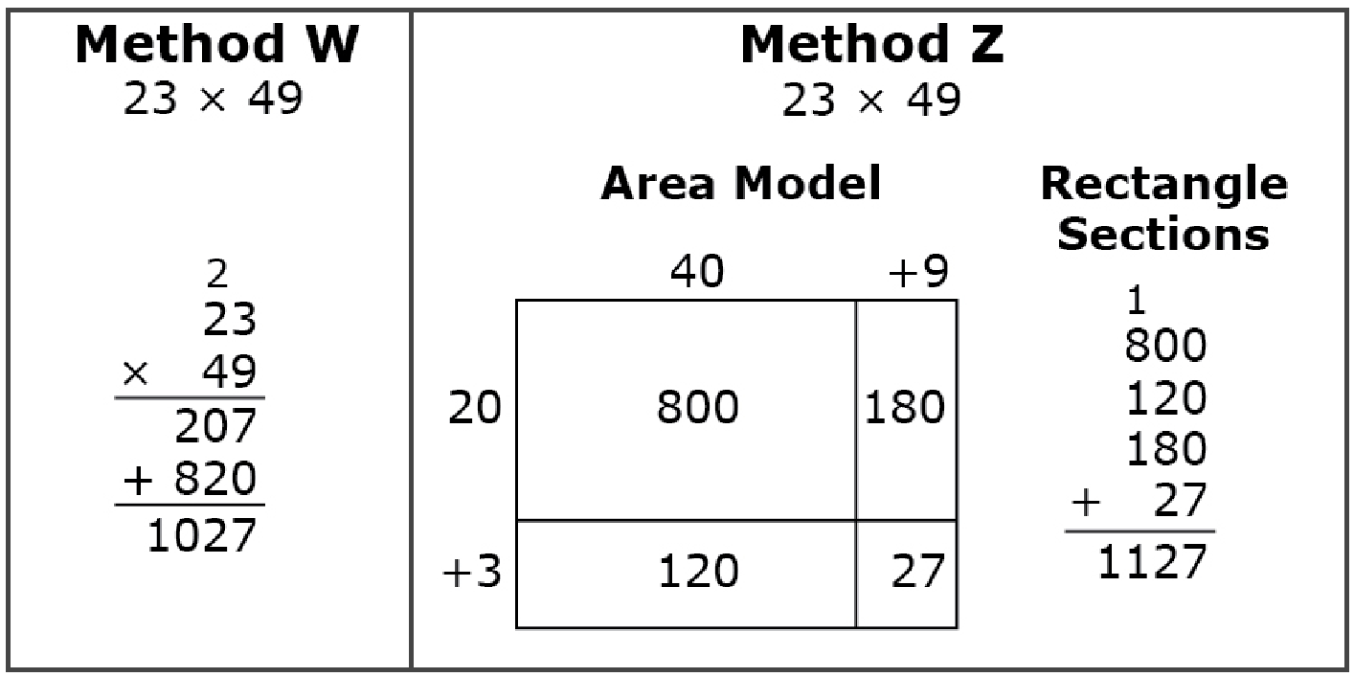
#4
Pablo solved a multiplication problem using two different methods. He made a mistake in either Method W or Method Z. Which method was solved incorrectly, and where did the mistake first occur?
Method Z because 2 hundreds should have been added to the hundreds column
Method Z because only two numbers should be added together, not four numbers
Method W because only 1 ten should have been added to the product of 20 and 9
Method W because 1 hundred should have been added to the product of 20 and 40

Slide 9
#4 Answer
Rubric:
(1 point) The student selects the correct response.
Answer: D

Slide 10
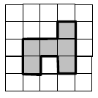
#5
William shaded 6 squares in a grid to make the figure shown.
He claims that if he adds 1 more square to this figure in different places, the perimeter can be greater than, less than, or equal to the perimeter of the original figure.
Part A. Click to shade one more square so the perimeter is greater than the original figure.
Part B. Click to shade one more square so the perimeter is less than the original figure.
Part C. Click to shade one more square so the perimeter is equal to the original figure.

Slide 11
#5 Answer
Rubric:
(2 points) The student is able to provide an example that supports each conjecture.
(1 point) The student is able to provide two out of three correct examples.
(0 points) The student is unable to provide at least two correct examples.
Answer: For Part A, the perimeter has to be greater than 14 units. For Part B, the perimeter of the figure has to be less than 14 units. For Part C, the perimeter of the figure has to be equal to 14 units.

Slide 12
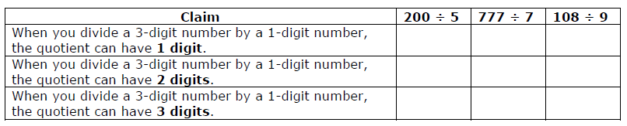
#6
Click in the box that matches each division problem to the correct claim.

Slide 13
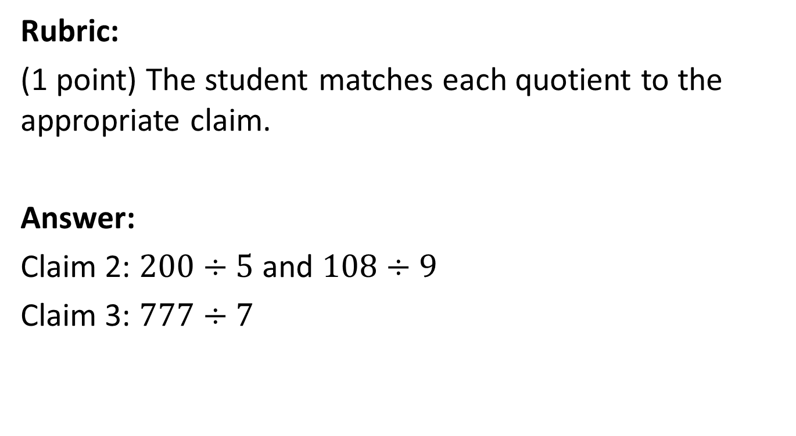
#6 Answer

Slide 14
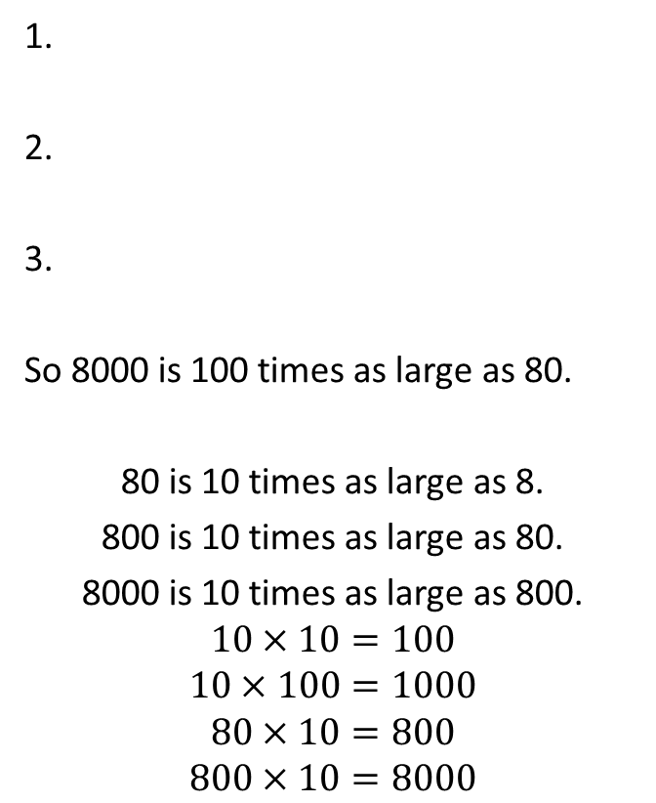
#7
Carter says, “8000 is 100 times as large as 80.”
Choose three statements that support this claim.
Drag them into a logical order in the box.

Slide 15
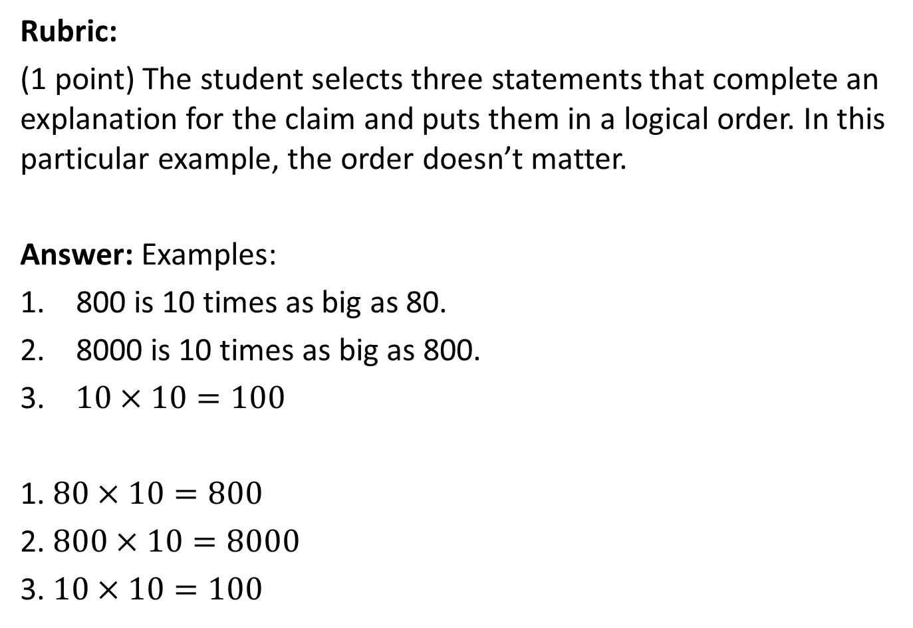
#7 Answer

Slide 16
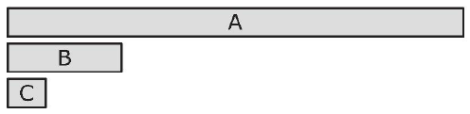
#8
Rectangle A is 4 times as long as rectangle B.
Rectangle B is 3 times as long as rectangle C.
How many times greater is rectangle A than rectangle C?
times
Choose three equations that, when taken together, support your claim. Drag them into a logical order in the box.
1.
2.
3.
4 x A = B 3 x C = B
4 x B = A 4 x (3 x C) = A
3 x B= C 3 x (4 x C) = A

Slide 17
#8 Answer
Rubric:
(2 points) The student enters the correct multiplicative factor in the response box and selects three statements that support the claim and puts them in a logical order.
(1 point) The student does one or the other.
Answer: 12 times
Examples:
4 x B = A 1. 3 x C = B
3 x C = B 2. 4 x B = A
4 x (3 x C) = C 3. 4 x (3 x B) = A

Slide 18
#9
There are 60 seconds in a minute.
There are 60 minutes in an hour.
There are 24 hours in a day.
What is the total number of minutes in 1 day? Enter your answer in the first response box.
Write an expression that shows how you found your answer. Enter your expression in the second response box.

Slide 19
#9 Answer
Rubric:
(2 points) The student enters the correct number of minutes in a day in the first response box and a correct expression in the second response box.
(1 point) The student enters the correct number of minutes in a day in the first response box or a correct expression in the second response box.
Answer: 1440; 60 x 24 or 144 x 10 or equivalent expressions.

Slide 20
#10
When you cut an obtuse angle into two smaller angles, what can be true? (Select all that apply.)
The two smaller angles can be less than 90 degrees.
At least one of the two smaller angles can be greater than 90 degrees.
Both of the two smaller angles can be greater than 90 degrees.

Slide 21
#10 Answer
Rubric:
(1 point) The student selects the possible cases.
Answer: A and B

Slide 22
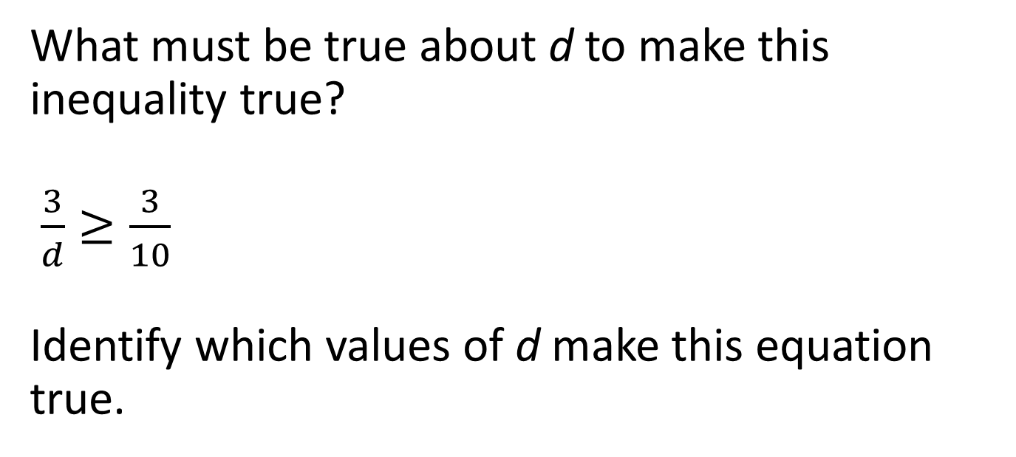

#11

Slide 23
#11 Answer
Rubric:
(1 point) The student identifies the correct values of d
Answer: T, T, F

Slide 24
#12
Harvey was solving this problem: There are 12 packets of gum each with a mass of 65 grams. What is the mass of all of the packets combined?
Harvey said, “I can multiply the tens places and the ones places and add them.”
Then he wrote:
12 = 10 + 2
65 = 60 + 5
600 + 10 = 610
The total mass is 610 grams.
Which statement best describes Harvey’s claim?
Harvey solved the problem correctly and got the right answer.
Harvey made a mistake in solving the problem but got the right answer anyway.
Harvey had a correct way of solving the problem but got the wrong answer.
Harvey’s solution is not correct because he did not multiply the tens with the ones.

Slide 25
#12 Answer
Rubric:
(1 point) The student selects the correct statement.
Answer: D

Slide 26
#13
Zach and Nate both rounded 6481, but used different methods.
Zach thought about it this way: Nate thought about it this way:
6481 rounds to 6480 6481 is closer to 6000
6480 rounds to 6500 so it rounds to 6000.
6500 rounds to 7000
So 6481 rounds to 7000.
Which statement best describes these methods?
Zach’s method is correct.
Nate’s method is correct.
Both methods are correct.
Neither method is correct.

Slide 27
#13 Answer
Rubric:
(1 point) The student selects the correct method.
Answer: B

Slide 28
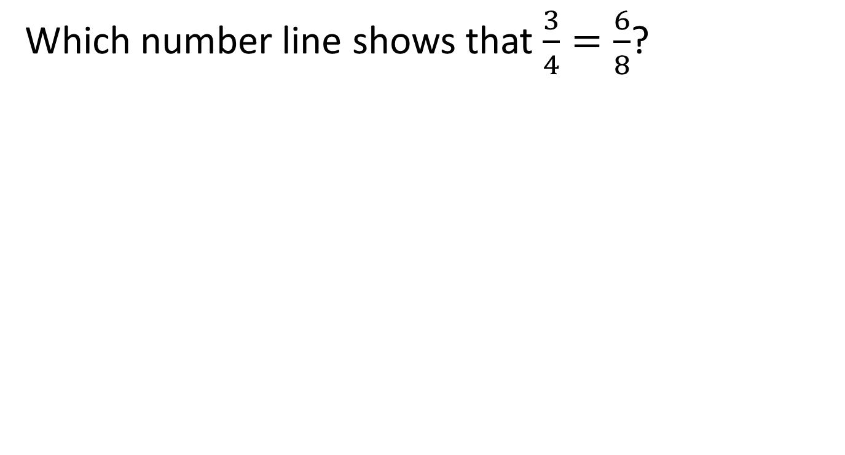
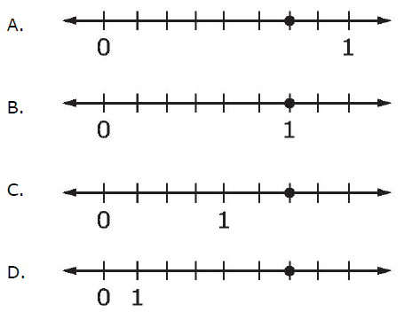
#14

Slide 29
#14 Answer
Rubric:
(1 point) The student selects the correct number line.
Answer: A

