Slide 1

Claim 2
Smarter Balanced Sample Items
Grade 4
Problem Solving
Questions courtesy of the Smarter Balanced Assessment Consortium Item Specifications – Version 3.0
Slideshow organized by SMc Curriculum – www.ccssmathactivities.com

Slide 2
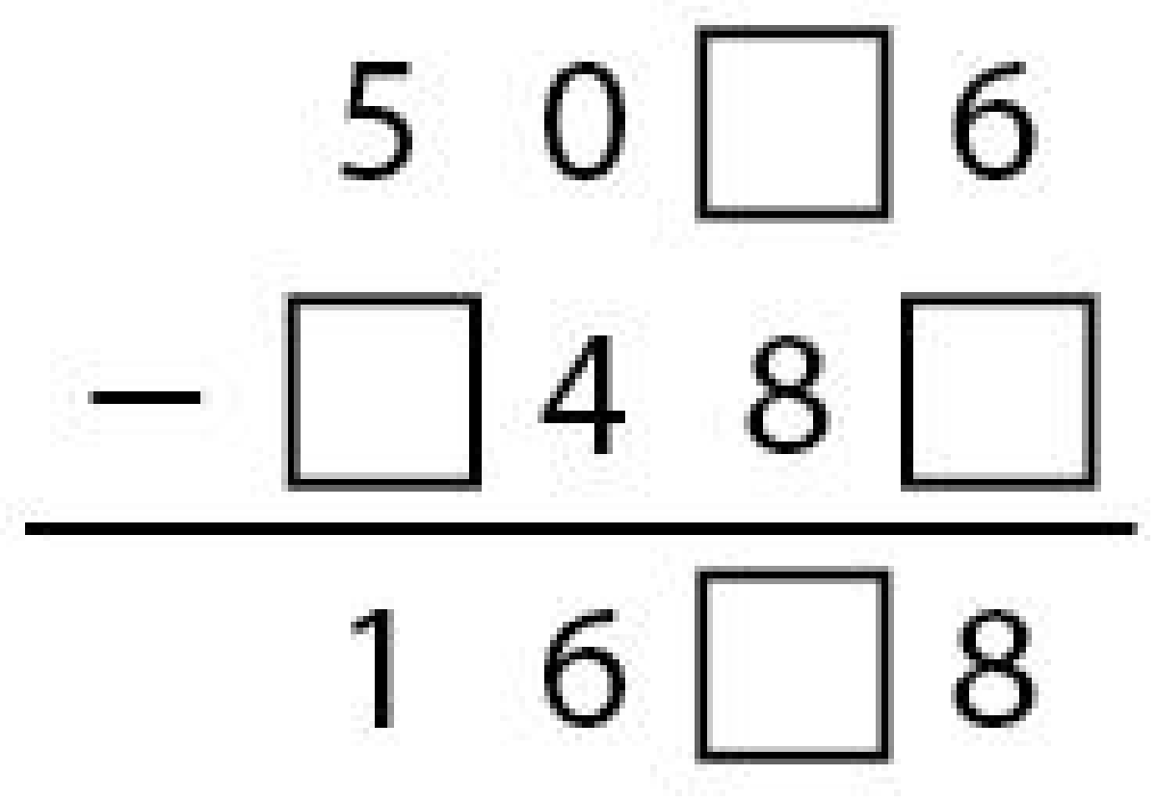
#1
Drag one number into each box to complete the subtraction problem shown.

Slide 3
#1 Answer
Rubric:
(1 point) The student drags the correct digits to complete the subtraction problem.
Answer: 5096 – 3488 = 1608

Slide 4
#2
Tina and Marco play a number game. Tina gives Marco a number and he does three computations.
He multiplies the number by 2.
He adds 7 to the answer.
Then, he subtracts 2 from that answer.
What number should Tina give Marco so that the final answer is 37?

Slide 5
#2 Answer
Rubric:
(1 point) The student enters the correct number.
Answer: 16

Slide 6
#3
Select the response that correctly completes this statement:
41 inches is between ____________.
A. 2 feet and 3 feet.
B. 3 feet and 4 feet.
C. 4 feet and 5 feet.
D. 5 feet and 6 feet.

Slide 7
#3 Answer
Rubric:
(1 point) The student selects the correct range.
Answer: B

Slide 8
#4
Greg has 76 marbles. He gives an equal number of marbles to each of 9 people. He keeps the remaining marbles. How many marbles does Greg keep?

Slide 9
#4 Answer
Rubric:
(1 point) The student enters the correct number.
Answer: 4

Slide 10
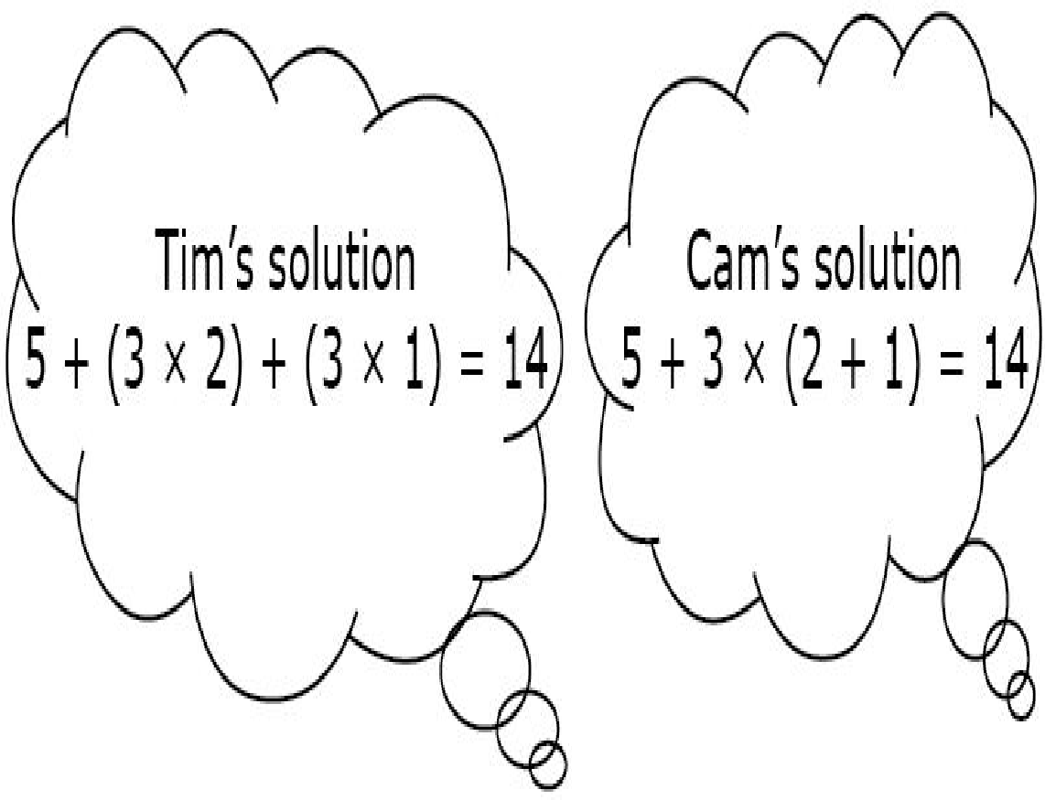
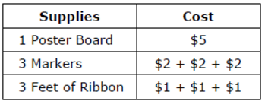

#5
Tim and Cam made posters for art class. They each used 1 poster board, 3 markers, and 3 feet of ribbon. The table shows the cost of their supplies. They each figured out how much the supplies cost in a different way. Which equation can be used to explain why Tim and Cam got the same result?
A. (3 x 2) + (3 x 1) = 3 x (2 + 1)
B. 5 + (3 x 2) = 3 x (2 + 1)
C. (3 x 2) = 3 x (2 + 1)
D. 3 x (5 + 1 + 1) = 5 + 3 x (2 + 1)

Slide 11
#5 Answer
Rubric:
(1 point) The student selects the correct option.
Answer: A

Slide 12
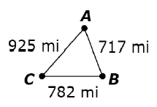
#6
Pia’s family drove City A to City B, then City C, and back to City A. The map shows the distances.
How many miles did they drive all together? Enter your answer in the response box.

Slide 13
#6 Answer
Rubric:
(1 point) The student enters the correct total distance.
Answer: 2424 or 2424 mi.

Slide 14
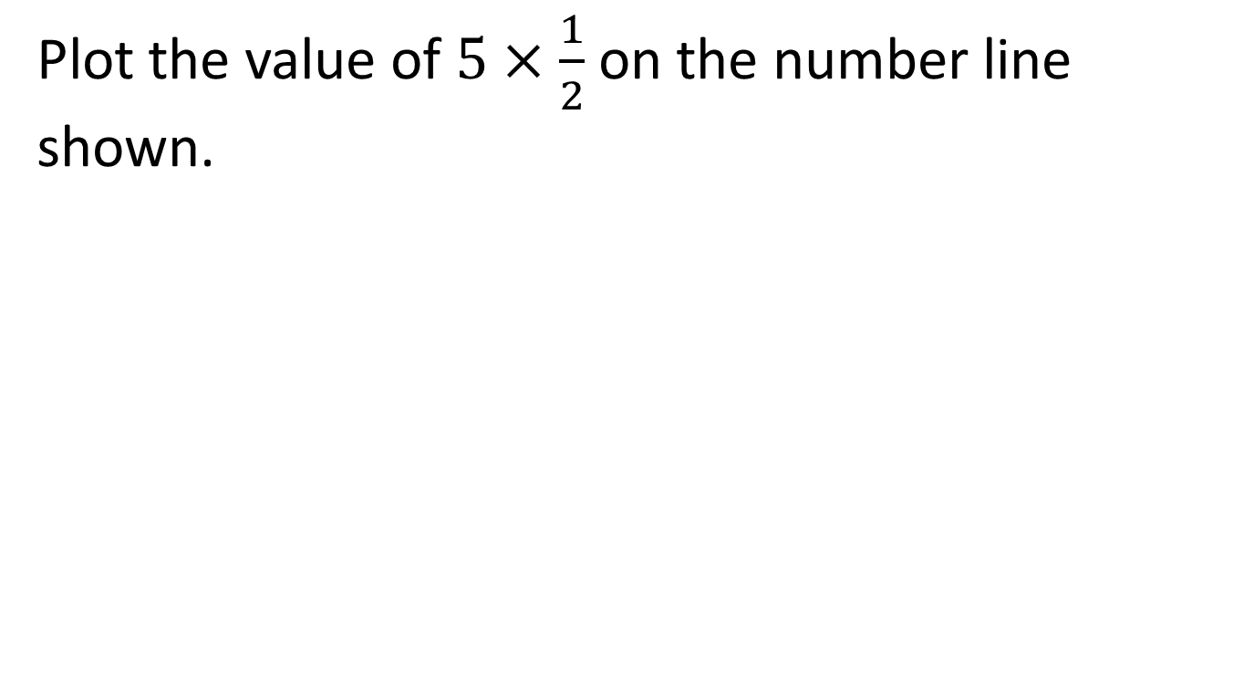
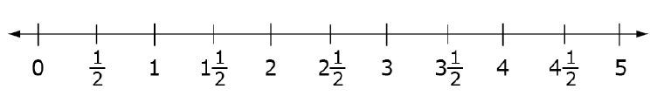
#7

Slide 15
#7 Answer

Slide 16
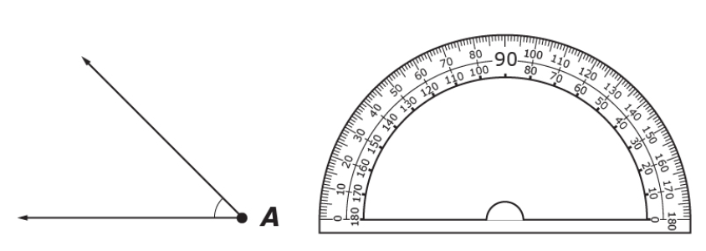
#8
Use the protractor to find the measure of Angle A.
Enter the measure of Angle A, to the nearest whole degree, in the response box.

Slide 17
#8 Answer
Rubric:
(1 point) Student enters the correct angle measure in degrees.
Answer: 45

Slide 18
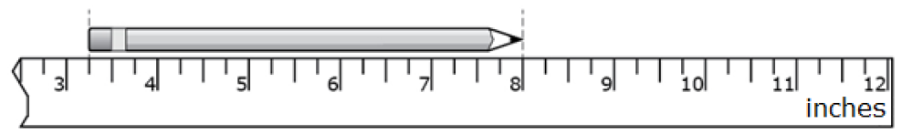
#9
What is the length, in inches, of the pencil shown?
Enter your answer in the response box.

Slide 19
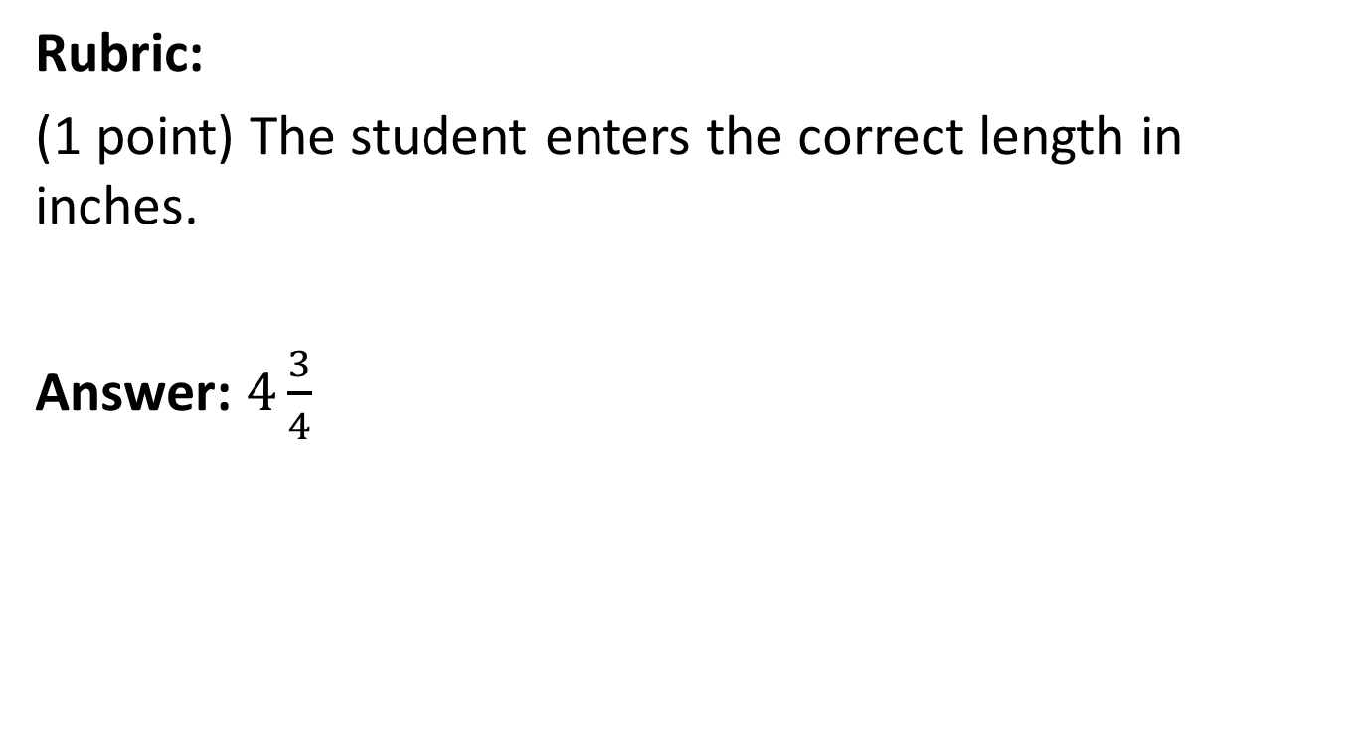
#9 Answer

Slide 20

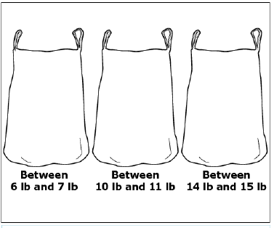
#10
Jared is testing how much weight a bag can hold. He plans to put juice bottles into three bags. He wants each bag to have a total weight within the given range.
Drag juice bottles into each bag so that the weight is within the given range.
Leave the bag empty if the given range is not possible using juice bottles.

Slide 21
#10 Answer
Rubric:
(2 points) The student enters the correct number of juice bottles for all three bags for 2 points or for two of the three bags for 1 point.
Answer: no bottles, 3, 4

Slide 22
#11
There are 70 students traveling to a soccer tournament. All of the vans can take 9 students each.
How many vans are needed to take all of the students to the tournament?
Enter your answer in the response box.

Slide 23
#11 Answer
Rubric:
(1 point) The student enters the correct number of vans needed.
Answer: 8

Slide 24
#12
Najoo is 10 years old. Her pet turtle is 40 years old. How do their ages compare?
Najoo is 4 years older than her turtle.
Her turtle is 4 years older than Najoo.
Najoo is 4 times as old as her turtle.
Her turtle is 4 times as old as Najoo.

Slide 25
#12 Answer
Rubric:
(1 point) The student selects the correct option.
Answer: D

