Slide 1

Claim 1
Smarter Balanced Sample Items
Grade 4 - Target L
Draw and identify lines and angles, and classify shapes by properties of their lines and angles.
Questions courtesy of the Smarter Balanced Assessment Consortium Item Specifications – Version 3.0
Slideshow organized by SMc Curriculum – www.ccssmathactivities.com
Notes:
‹#›

Slide 2
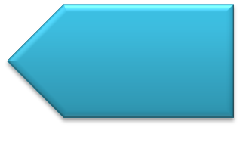
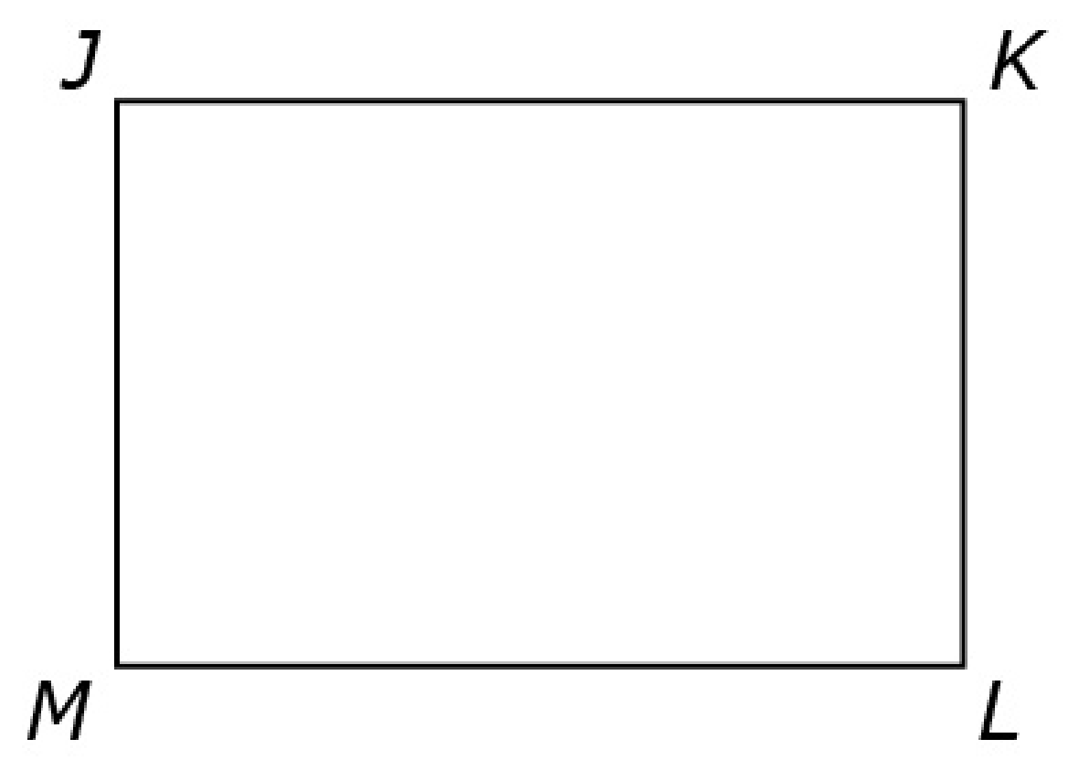
#1
Click on line segment ML.

Slide 3

#1 Answer
Rubric:
(1 point) The student selects the correct element.
Answer: line segment ML

Slide 4
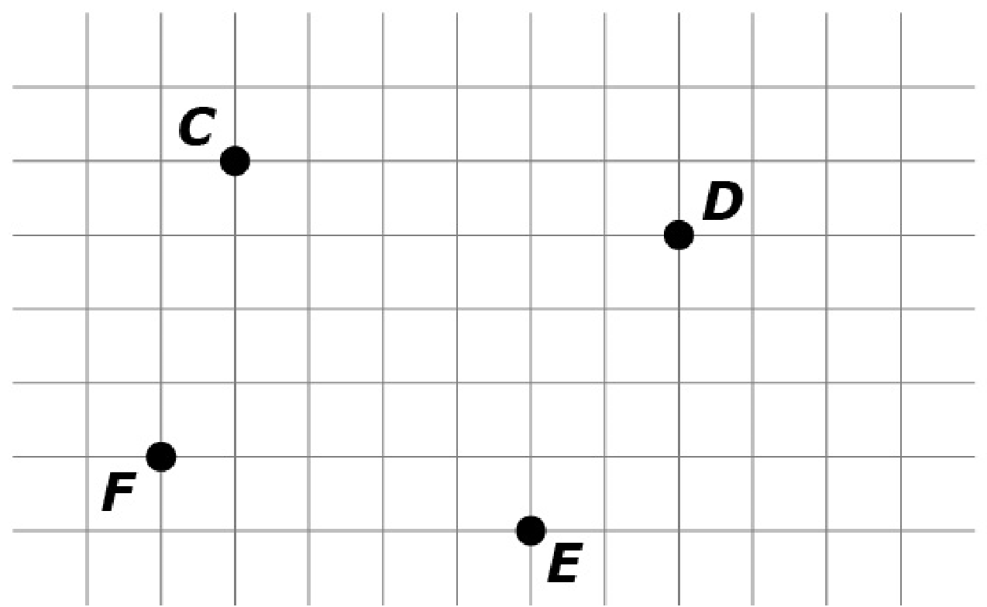
#2
Use the Connect Line tool to draw line segment CD.
Notes:
‹#›

Slide 5
#2 Answer
Rubric:
(1 point) The student draws the correct line segment.
Answer: line segment CD
Notes:
‹#›

Slide 6
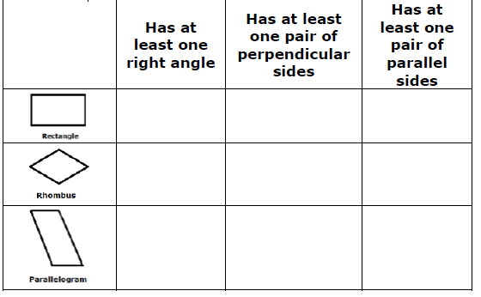
#3
Click in the box that matches each figure with its description. Each figure may be matched to more than one description.

Slide 7
#3 Answer
Rubric:
(1 point) The student correctly classifies the given figures.
Answer: Rectangle: Right, Perpendicular, Parallel; Rhombus: Parallel; Parallelogram: Parallel

Slide 8
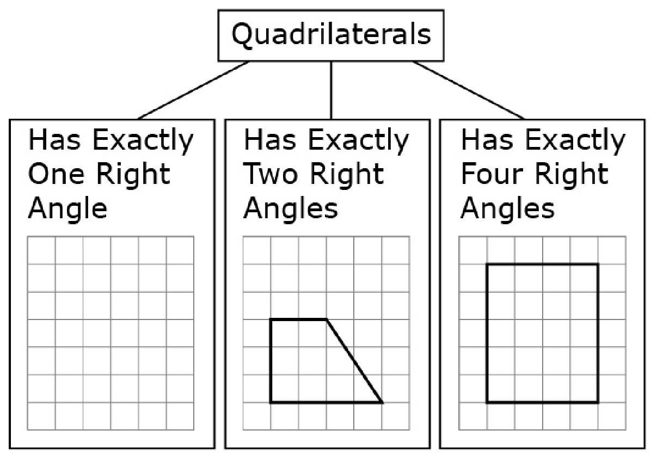
#4
This chart shows one way to classify quadrilaterals. Use the Connect Line tool to draw a quadrilateral that belongs in the box labeled “Has Exactly One Right Angle.”

Slide 9
#4 Answer
Rubric:
(1 point) The student constructs a shape that meets the requirements of a classification schema.
Answer: a quadrilateral with exactly one right angle

Slide 10
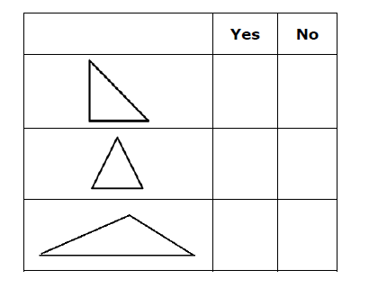
#5
Decide whether the shape appears to be a right triangle. Select Yes or No for each triangle.

Slide 11
#5 Answer
Rubric:
(1 point) The student correctly identifies three triangles as right triangles or not right triangles.
Answer: Y, N, N

Slide 12
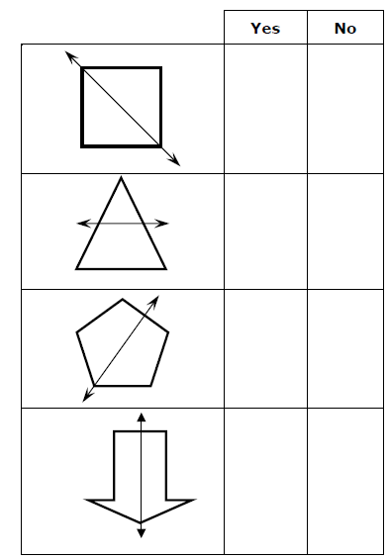
#6
Decide whether the line appears to be a line of symmetry for the shape. Select Yes or No for each shape.

Slide 13
#6 Answer
Rubric:
(1 point) The student enters the correct responses.
Answer: Y, N, Y, Y

Slide 14
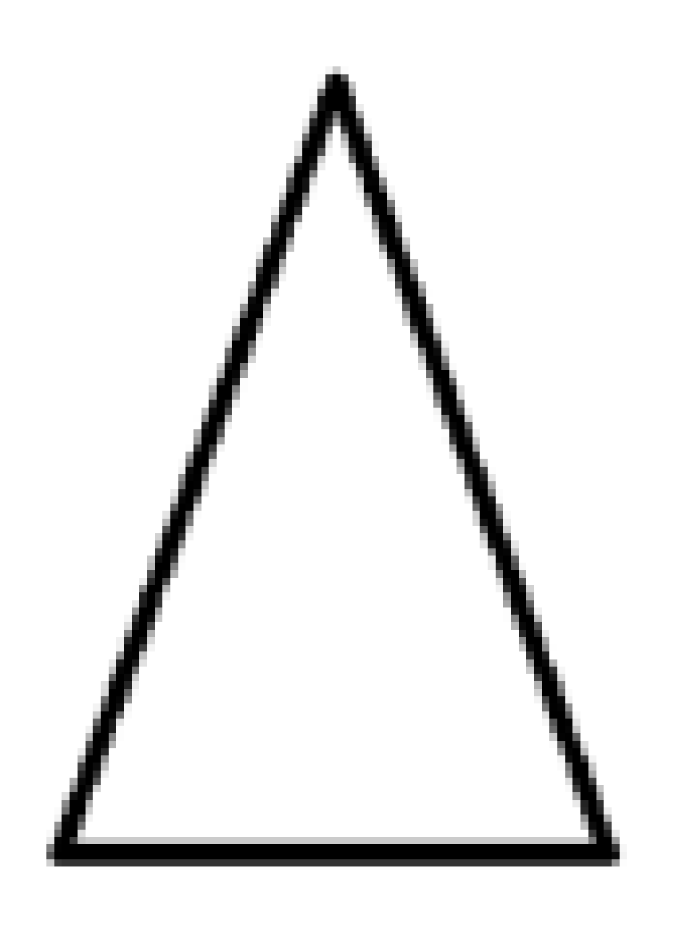
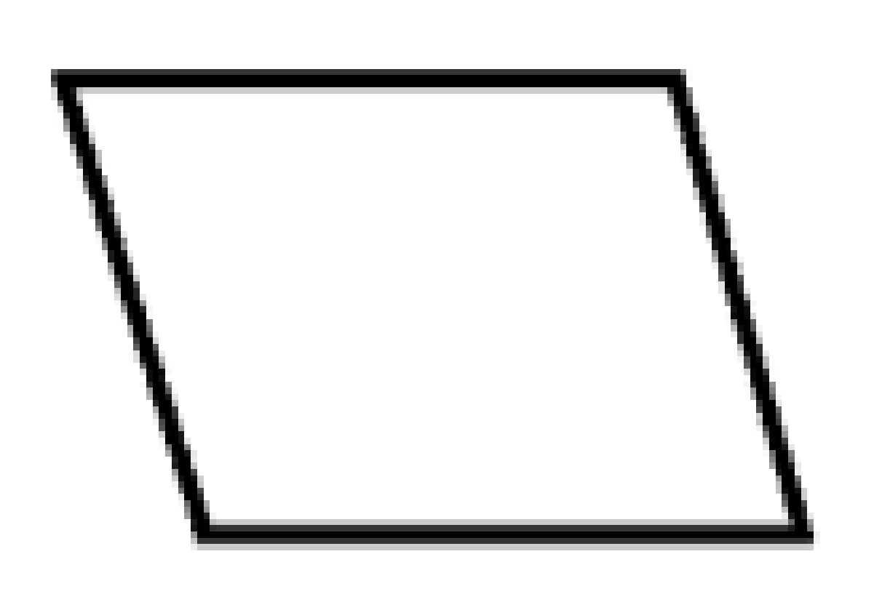

#7
Example 1: Use the Add Arrow tool to draw all the lines of symmetry for the shape. If there are no lines of symmetry, click None.
Example 2: Use the Add Arrow tool to draw all the lines of symmetry for the shape. If there are no lines of symmetry, click None.
Example 3: Use the Add Arrow tool to draw all the lines of symmetry for the shape. If there are no lines of symmetry, click None.

Slide 15
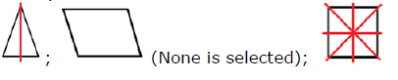
#7 Answer
Rubric:
(1 point) The student correctly draws all lines of symmetry with no incorrect lines, or correctly selects None.
Answer:

Slide 16
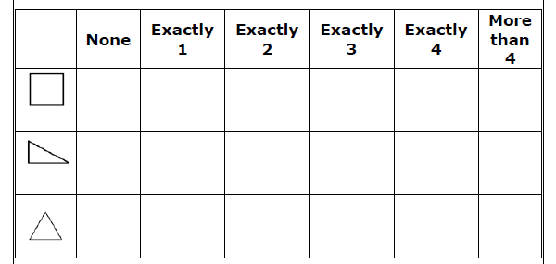
#8
Determine the number of lines of symmetry for each shape. Click in the box that matches the shape to the correct number of lines of symmetry.

Slide 17
#8 Answer
Rubric:
(1 point) The student correctly identifies the number of lines of symmetry in each shape.
Answer: Exactly 4, None, Exactly 3

