Slide 1

Claim 1
Smarter Balanced Sample Items
Grade 4 - Target K
Geometric measurement: understand concepts of angle and measure angles.
Questions courtesy of the Smarter Balanced Assessment Consortium Item Specifications – Version 3.0
Slideshow organized by SMc Curriculum – www.ccssmathactivities.com
Notes:
‹#›

Slide 2

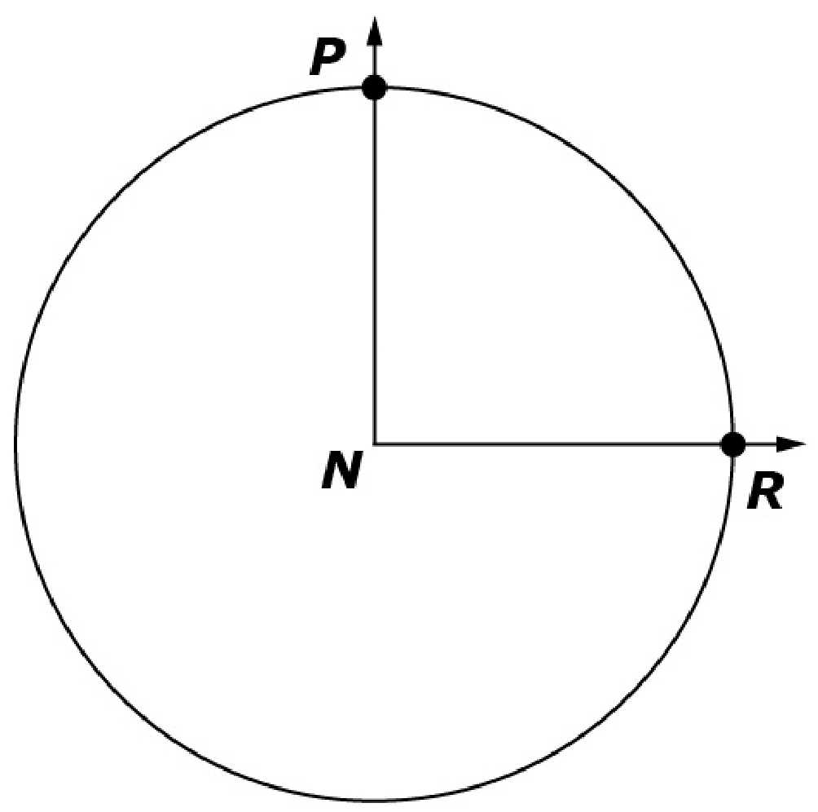
#1
The vertex of ∠PNR is at the center of the circle. The circular arc between Point P and Point R is 1/4 of the circle. Enter the measure, in degrees, of ∠PNR.

Slide 3

#1 Answer
Rubric:
(1 point) The student enters the correct number of degrees.
Answer: 90

Slide 4
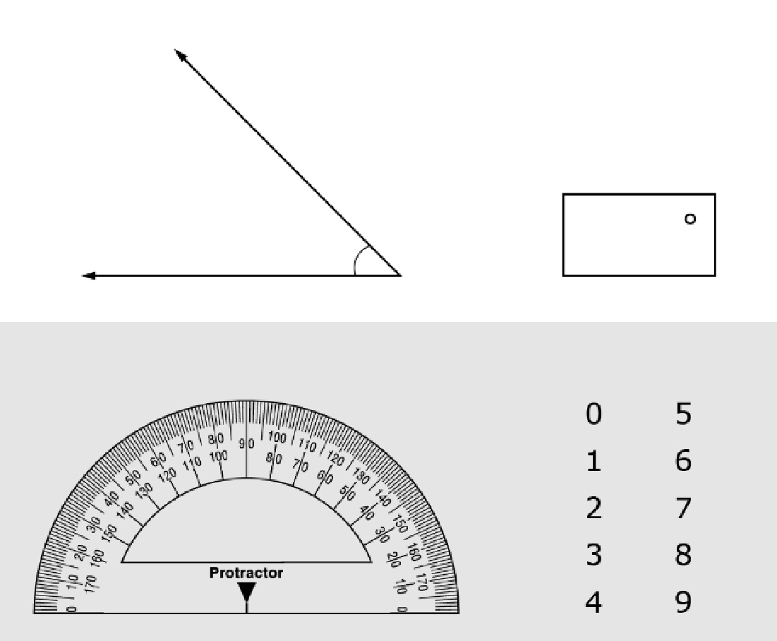
#2
Use the protractor to measure the angle.
Then drag the numbers into the box to enter the measure of the angle, in degrees.
Notes:
‹#›

Slide 5
#2 Answer
Rubric:
(1 point) The student enters the correct number of degrees in the angle.
Answer: 45
Notes:
‹#›

Slide 6
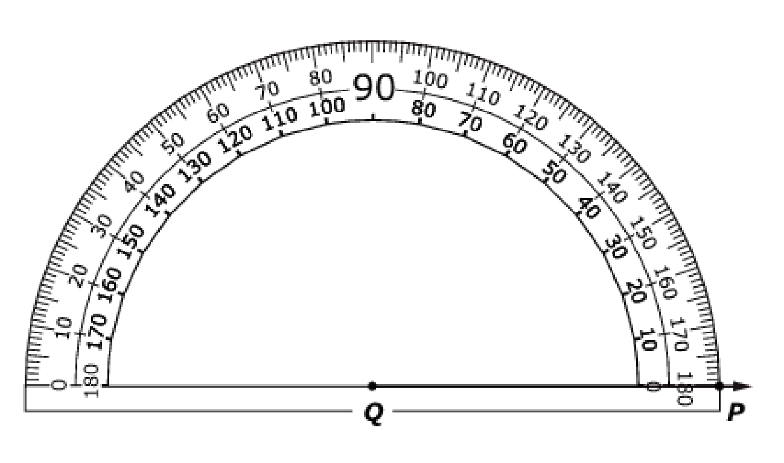
#3
Use the Add Arrow tool to draw a 45° angle that has ray QP as one of its sides.

Slide 7
#3 Answer
Rubric:
(1 point) The student creates an angle of given measure with the given ray as one of its sides.
Answer: 45°

Slide 8
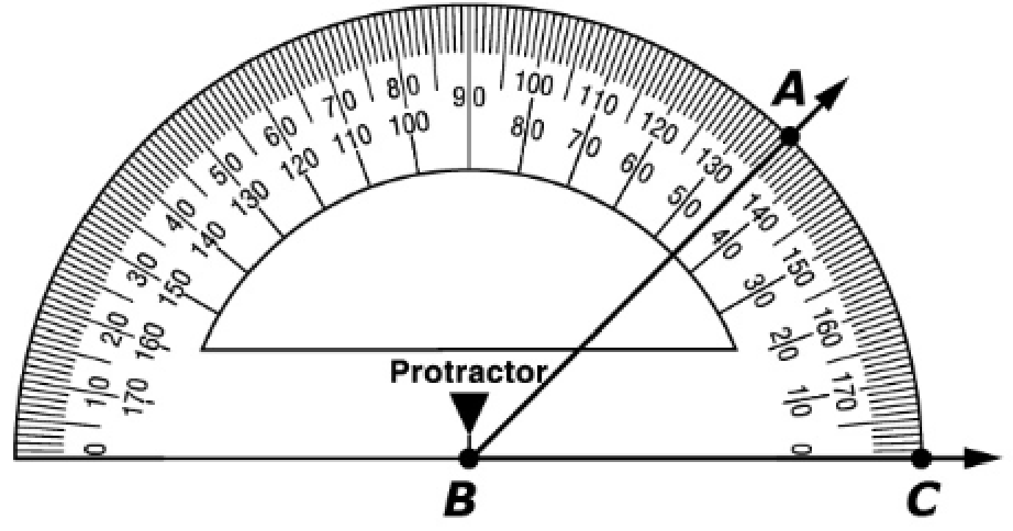
#4
Enter the measure, in degrees, of ∠ABC.

Slide 9
#4 Answer
Rubric:
(1 point) The student enters the correct angle measure, in degrees.
Answer: 45

Slide 10
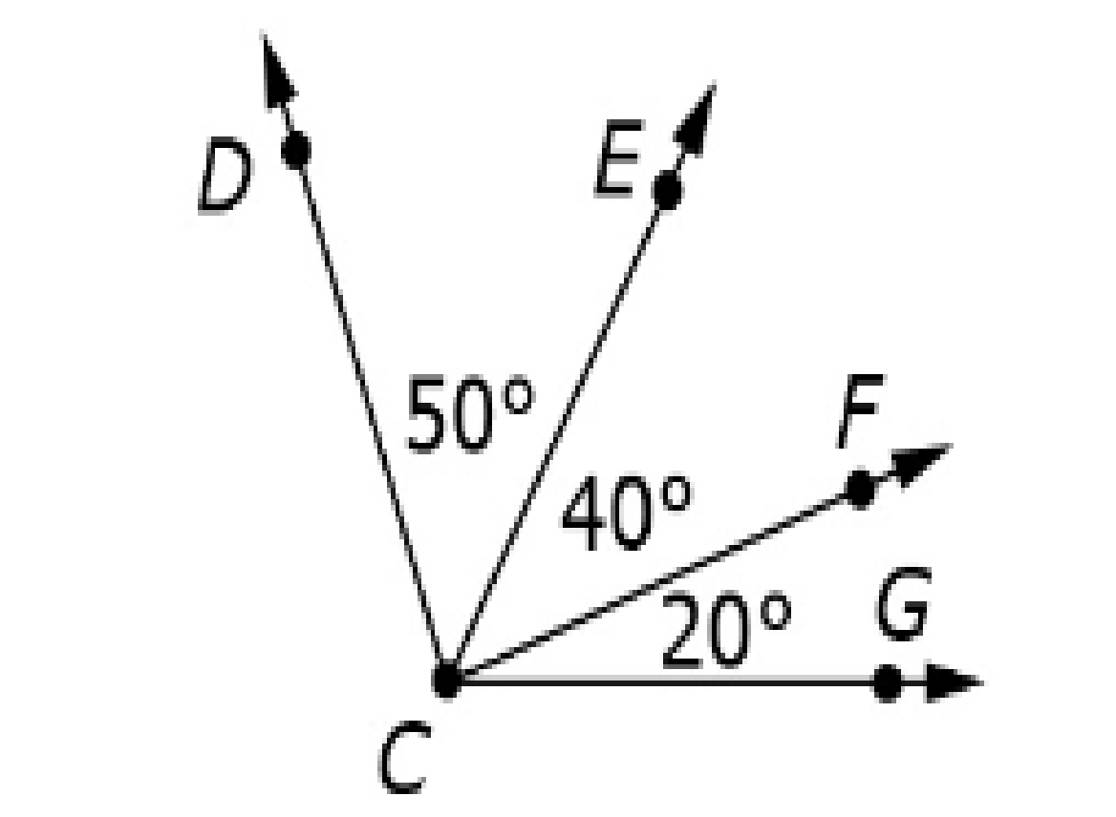
#5
Use the diagram to solve the problem.
The measure of ∠DCE = 50°.
The measure of ∠ECF = 40°.
The measure of ∠FCG = 20°.
Enter the measure, in degrees, of ∠DCG.

Slide 11
#5 Answer
Rubric:
(1 point) The student enters the measure of the whole angle, in degrees.
Answer: 110

Slide 12
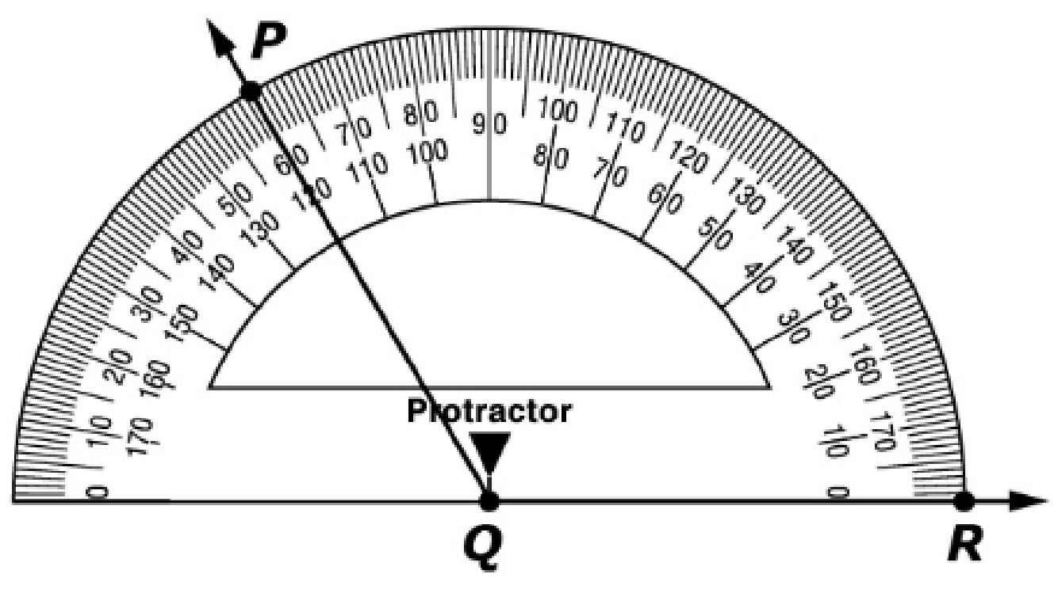
#6
The protractor shows the measure of ∠PQR. Use the Add Arrow tool to divide ∠PQR into two equal angles.
Enter the measure, in degrees, of ∠SWT.

Slide 13
#6 Answer
Rubric:
(1 point) The student draws a ray that correctly divides the angle into two equal angles.
Answer: two 60° angles

Slide 14
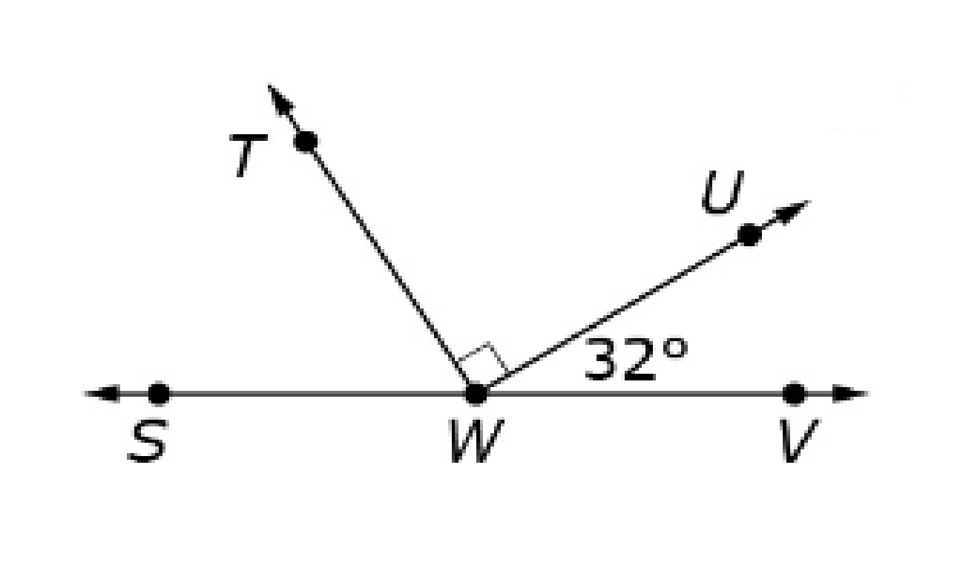
#7
Use the figure to answer the question.
The measure of ∠UWV = 32°.
∠TWU is a right angle.
The measure of ∠SWV = 180°.
Enter the measure, in degrees of ∠SWT

Slide 15
#7 Answer
Rubric:
(1 point) The student enters the correct angle measure in degrees.
Answer: 58

Slide 16
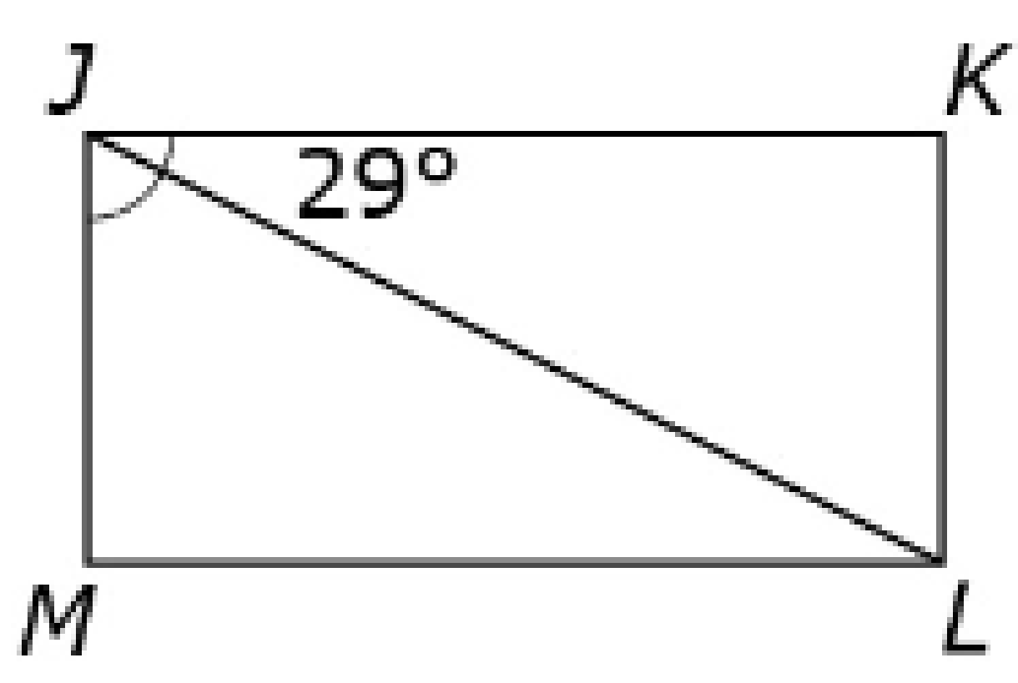
#8
In the figure shown, JKLM is a rectangle and ∠KJL = 29°. Enter the measure, in degrees, of ∠MJL.

Slide 17
#8 Answer
Rubric:
(1 point) The student enters the correct angle measure in degrees.
Answer: 61

Slide 18
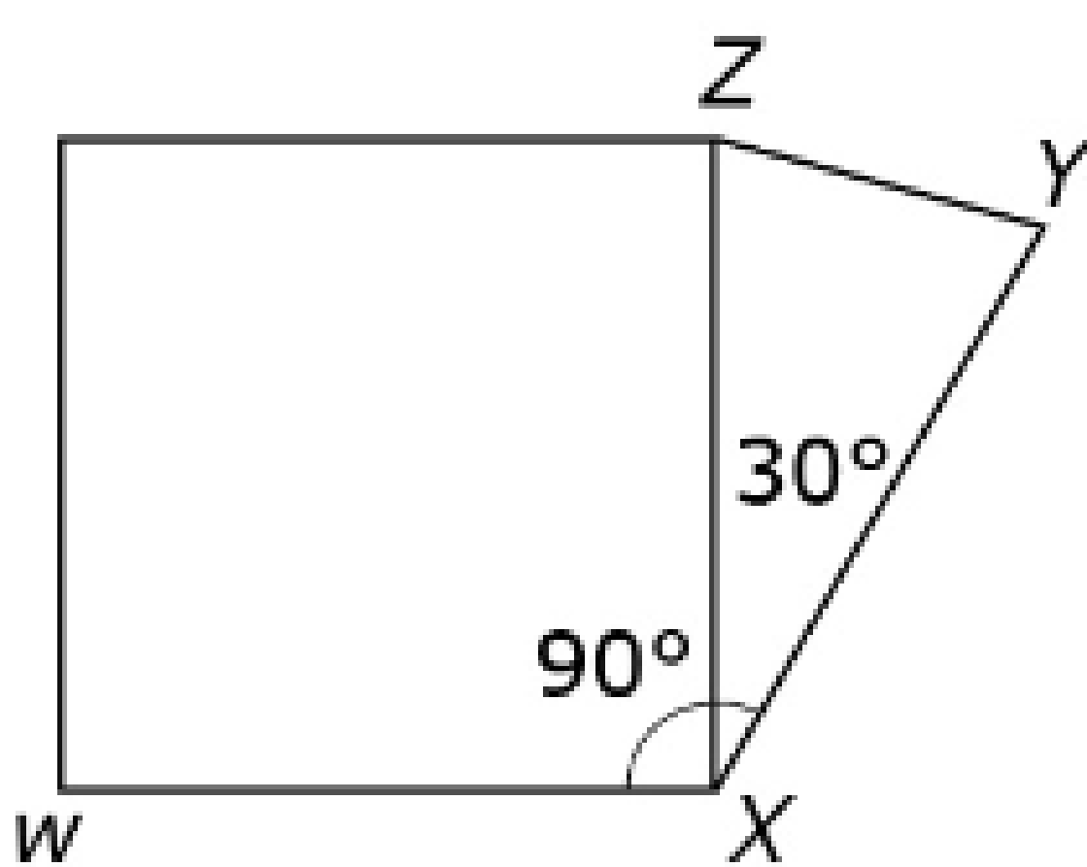
#9
A student made the design shown with shapes.
The measure of ∠WXZ = 90°.
The measure of ∠YXZ = 30°.
Enter the measure in degrees, of ∠WXY

Slide 19
#9 Answer
Rubric:
(1 point) The student enters the correct angle measure in degrees.
Answer: 120

Slide 20
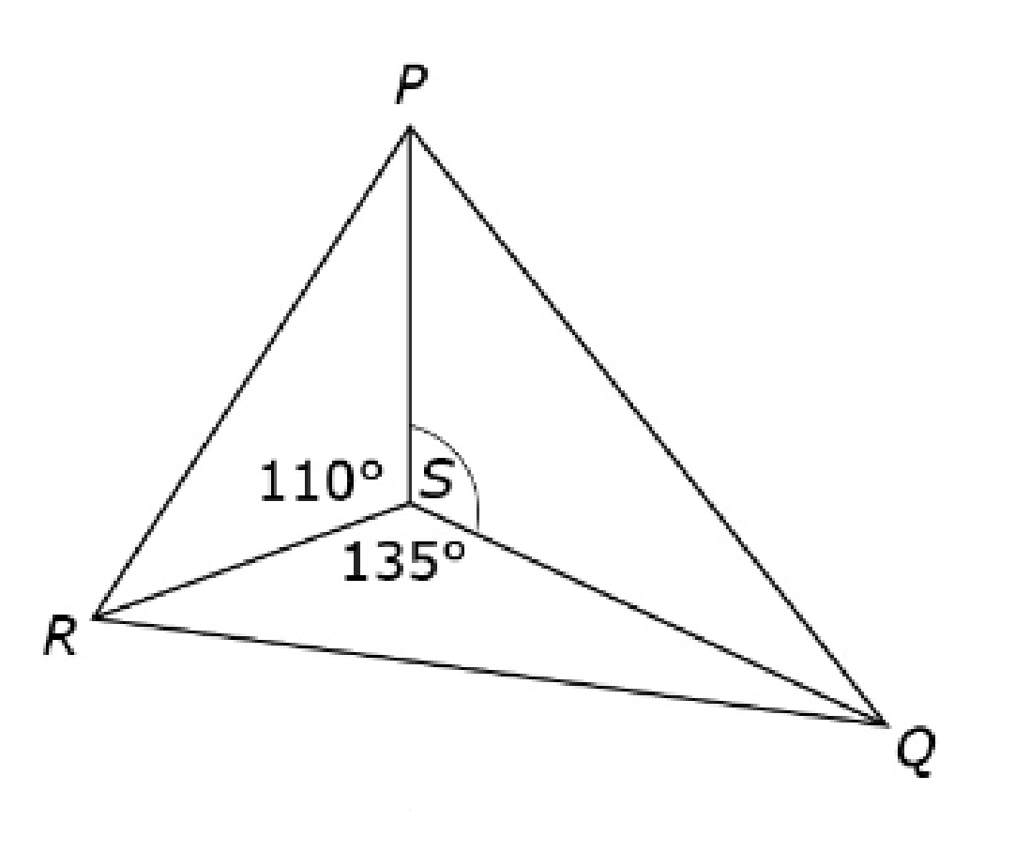
#10
A student made the design shown with shapes.
The measure of ∠PSR = 110°.
The measure of ∠RSQ = 135°.
Enter the measure, in degrees, of ∠PSQ.

Slide 21

#10 Answer
Rubric:
(1 point) The student enters the correct angle measure in degrees.
Answer: 115

