Slide 1

Claim 1
Smarter Balanced Sample Items
Grade 4 - Target J
Represent and interpret data.
Questions courtesy of the Smarter Balanced Assessment Consortium Item Specifications – Version 3.0
Slideshow organized by SMc Curriculum – www.ccssmathactivities.com
Notes:
‹#›

Slide 2
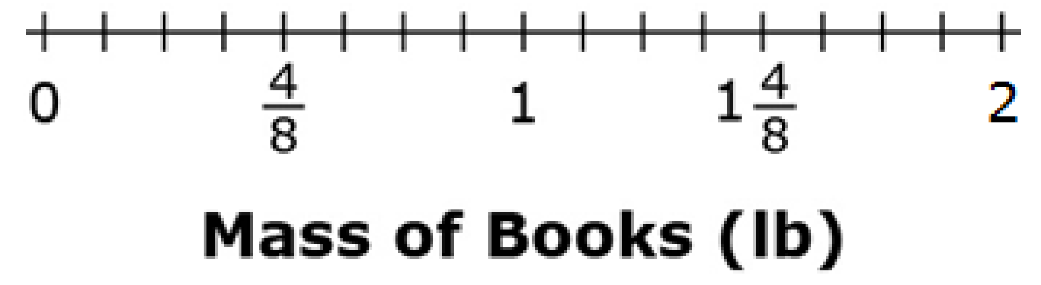
#1

Slide 3

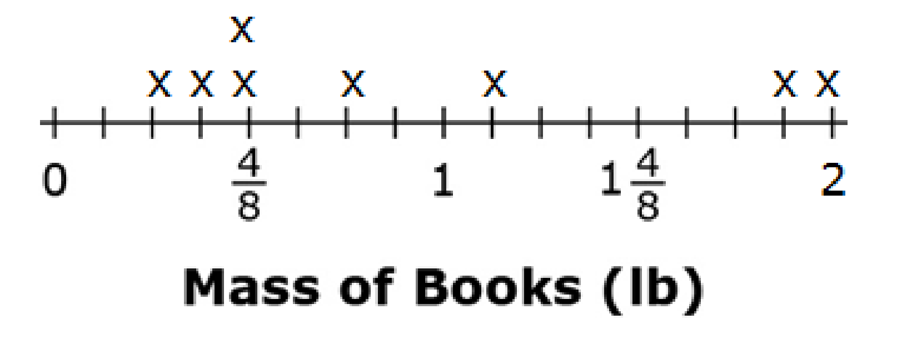
#1 Answer
Rubric:
(1 point) The student places all of the correct data points to complete the line plot with no incorrect or missing points
Answer:
Notes:
‹#›

Slide 4
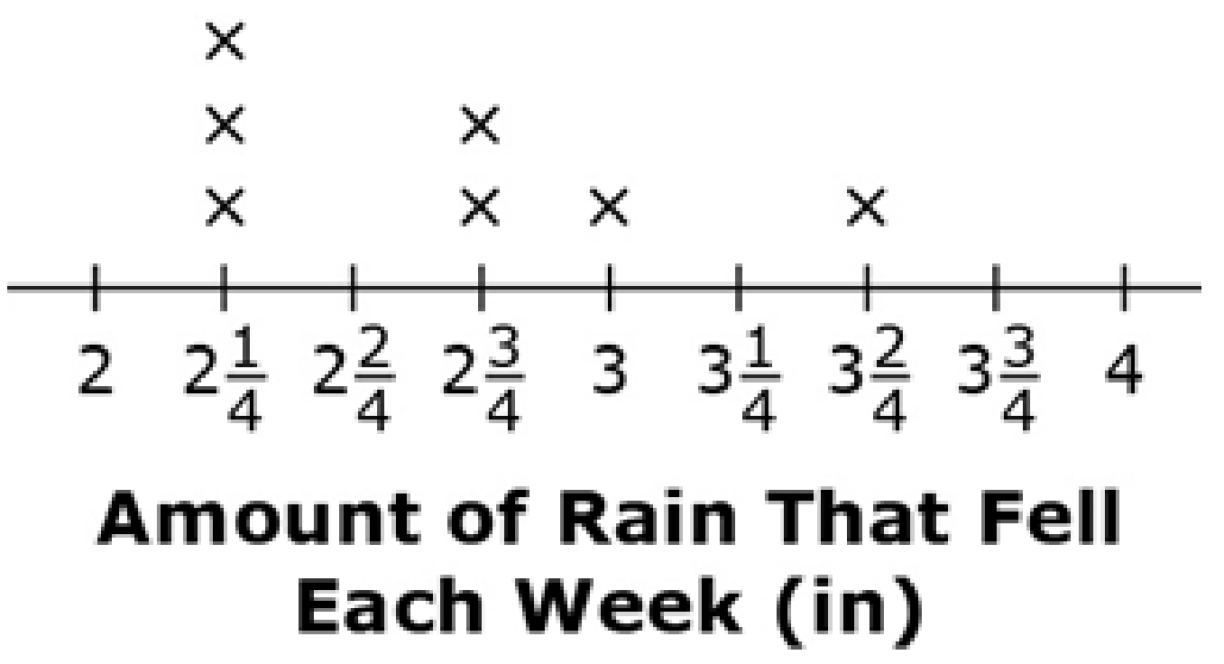
#2
A student measured how much rain fell each week. This line plot shows the amount of rain, in inches, that fell each week.
How much more rain, in inches, was there during the week with the greatest amount of rain than during the week with the least amount of rain? Enter your answer in the response box.
Notes:
‹#›

Slide 5
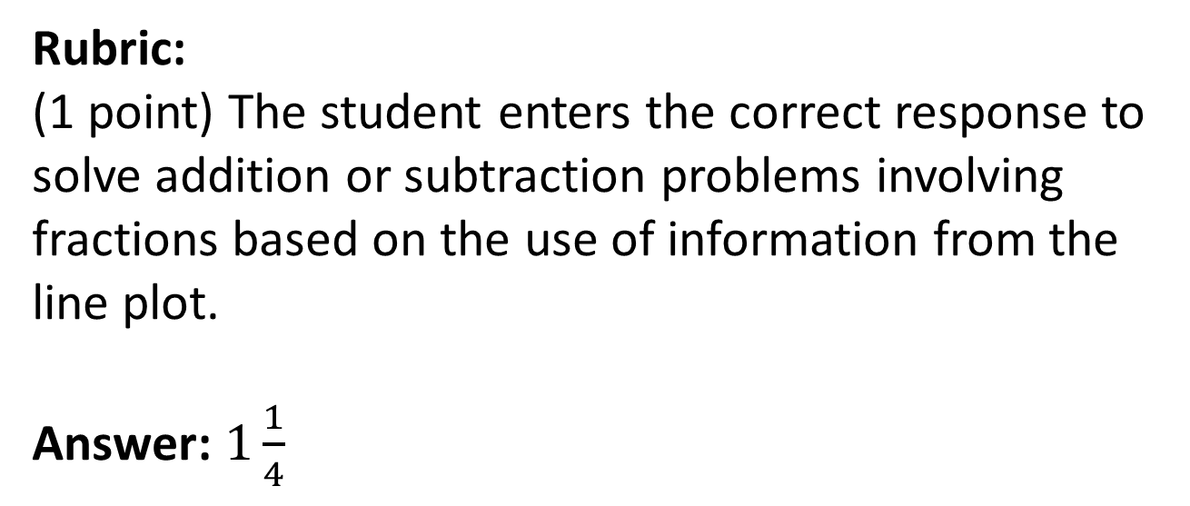
#2 Answer
Notes:
‹#›

