Slide 1

Claim 1
Smarter Balanced Sample Items
Grade 4 - Target I
Solve problems involving measurement and conversion of measurements from a larger unit to a smaller unit.
Questions courtesy of the Smarter Balanced Assessment Consortium Item Specifications – Version 3.0
Slideshow organized by SMc Curriculum – www.ccssmathactivities.com
Notes:
‹#›

Slide 2

#1
Example 1: Enter the unknown number that makes the statement true.
3.5 centimeters = millimeters
Example 2: Enter the unknown number that makes the statement true.
6 feet = inches

Slide 3

#1 Answer
Rubric:
(1 point) The student enters the correct value.
Answer: 35; 72
Notes:
‹#›

Slide 4
#2
Decide whether each measurement is equal to 5 yards. Select Yes or No for each measurement.
 | Yes | No
180 inches
27 inches
15 feet
Notes:
‹#›

Slide 5
#2 Answer
Rubric:
(1 point) Student correctly selects yes or no for each of the given equivalencies.
Answer: Y, N, Y
Notes:
‹#›

Slide 6
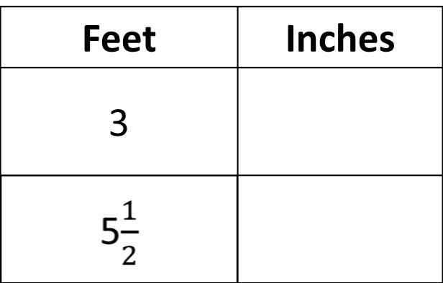
#3
Enter the unknown numbers to complete the table of equal measurements.

Slide 7
#3 Answer
Rubric:
(1 point) The student enters the correct equivalencies for the given measurements.
Answer: 36, 66

Slide 8
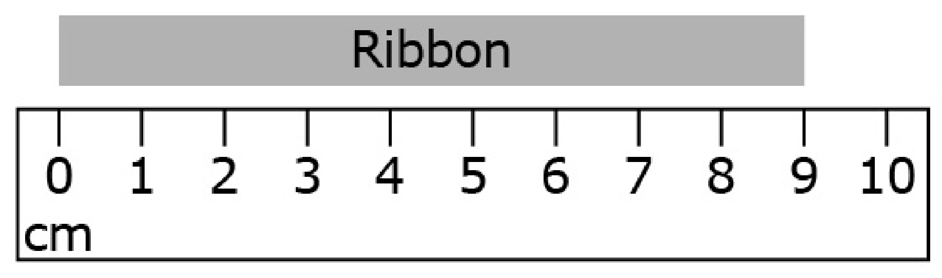
#4
Enter the length, in millimeters, of the ribbon.

Slide 9
#4 Answer
Rubric:
(1 point) The student enters the correct measurement shown in the diagram.
Answer: 90

Slide 10
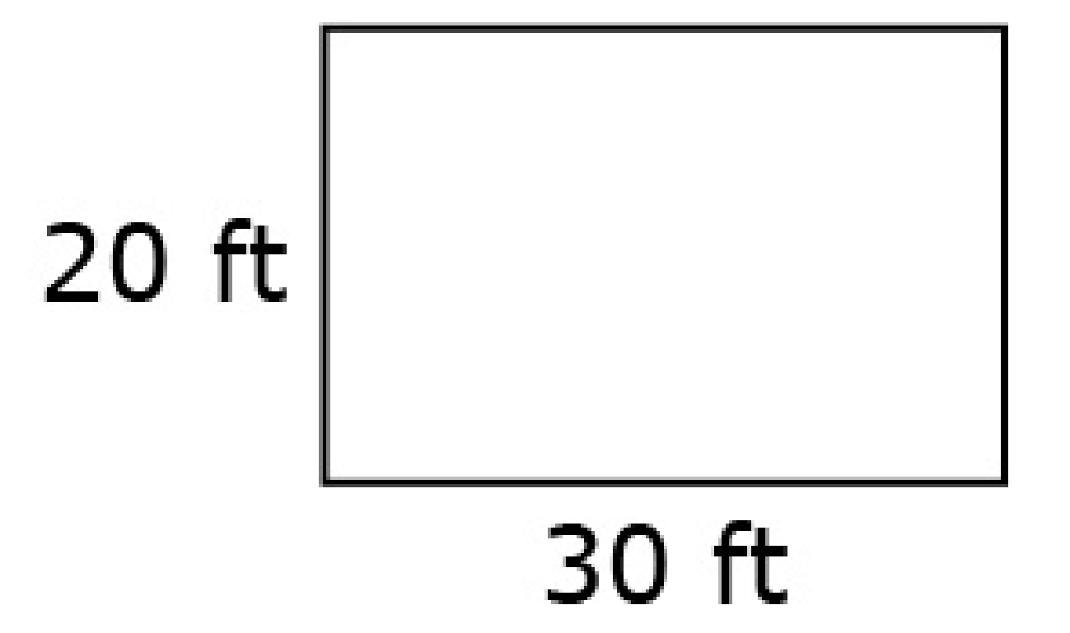
#5
Use the diagram of the rectangular garden to solve the problem. Enter the area, in square feet, of the garden.

Slide 11
#5 Answer
Rubric:
(1 point) The student enters the correct number.
Answer: 600

Slide 12
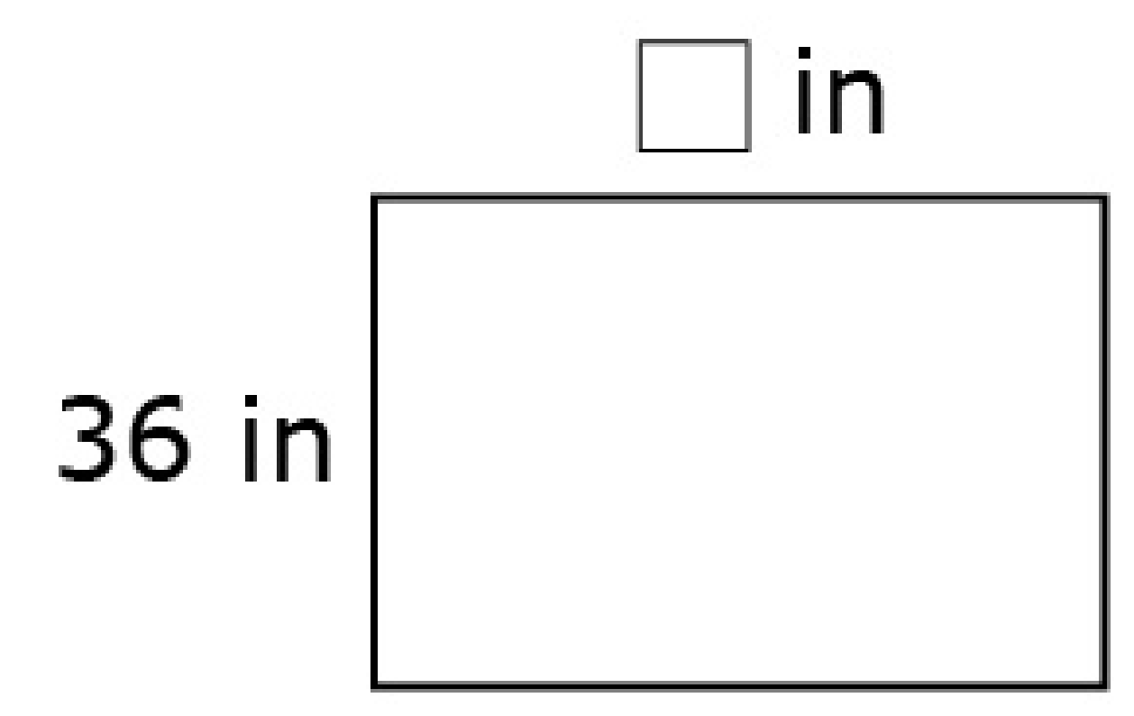
#6
Use the diagram of the rectangle to solve the problem. The perimeter of the rectangle is 192 inches. What is the length, in inches, of the unknown side?

Slide 13
#6 Answer
Rubric:
(1 point) The student enters the correct number.
Answer: 60

Slide 14
#7
The dimensions for three rectangles are shown. Decide whether each rectangle has an area equal to 100 square feet. Select Yes or No for each rectangle.
 | Yes | No
Rectangle 1: • Length = 5 ft • Width = 20 ft
Rectangle 2: • Length =10 ft • Width = 10 ft
Rectangle 3: • Length = 4 ft • Width = 25 ft

Slide 15
#7 Answer
Rubric:
(1 point) The student selects all of the correct dimensions for the rectangle.
Answer: Y, Y, Y

Slide 16
#8
The dimensions for three rectangular gardens are shown. Decide whether each garden has a perimeter equal to 100 meters. Select Yes or No for each garden.
 | Yes | No
Garden 1: • Length = 5 m • Width = 45 m
Garden 2: • Length =50 m • Width = 50 m
Garden 3: • Length = 4 m • Width = 25 m

Slide 17
#8 Answer
Rubric:
(1 point) The student selects all of the correct dimensions for the rectangle.
Answer: Y, N, N

