Slide 1

Claim 1
Smarter Balanced Sample Items
Grade 4 - Target H
Understand decimal notation for fractions, and compare decimal fractions.
Questions courtesy of the Smarter Balanced Assessment Consortium Item Specifications – Version 3.0
Slideshow organized by SMc Curriculum – www.ccssmathactivities.com
Notes:
‹#›

Slide 2

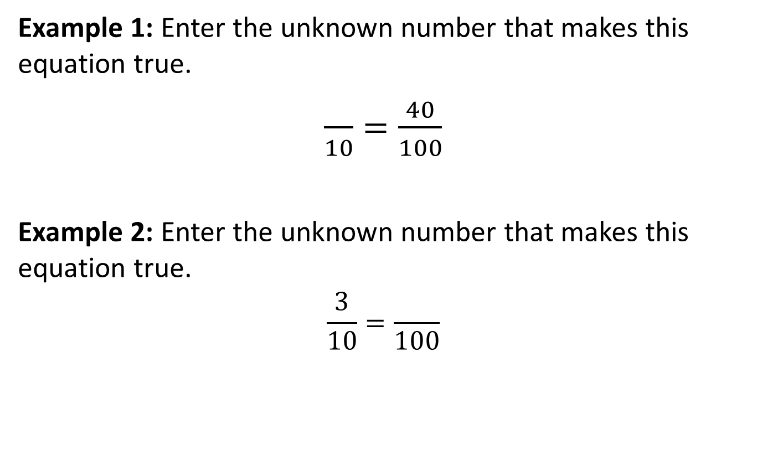
#1

Slide 3
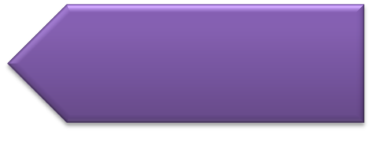
#1 Answer
Rubric:
(1 point each) The student determines an equivalent fraction and enters the correct number.
Answers:
Example 1: 4
Example 2: 30

Slide 4
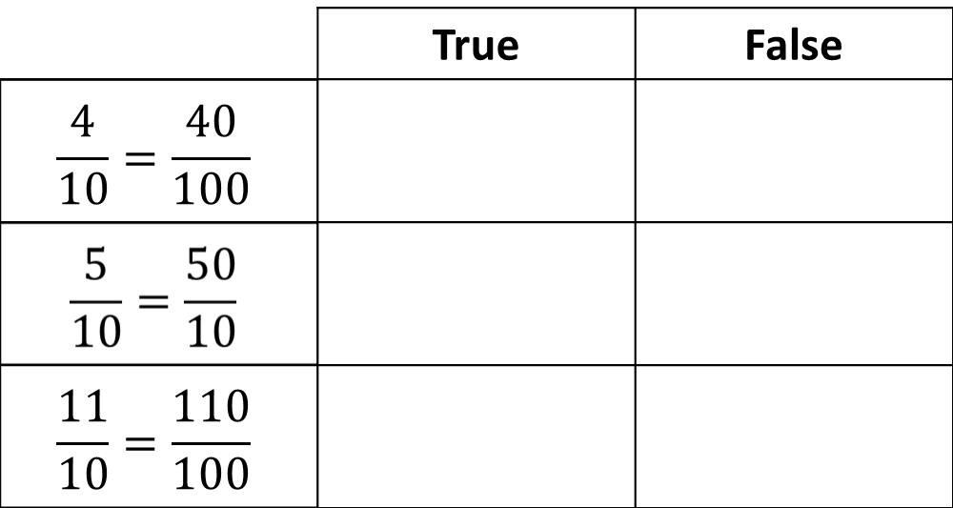
#2
Determine if each equation is true or false. Select True or False for each equation.
Notes:
‹#›

Slide 5
#2 Answer
Rubric:
(1 point) The student correctly identifies all three equations as true or false, showing understanding of equivalent fractions with denominators 10 or 100.
Answer: T, F, T
Notes:
‹#›

Slide 6
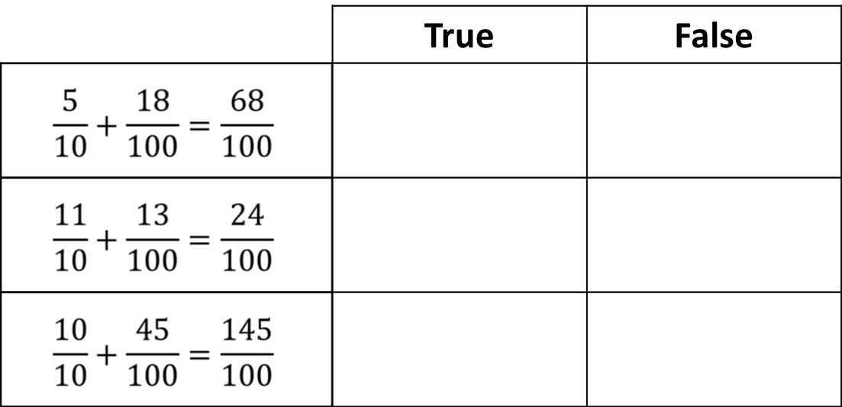
#3
Determine if each equation is true or false. Select True or False for each equation.

Slide 7
#3 Answer
Rubric:
(1 point) The student shows the ability to add fractions with denominators 10 and 100 by correctly identifying all three equations as true or false.
Answer: T, F, T

Slide 8


#4
Example 1: Enter the unknown numerator that makes this equation true.
Example 2: Enter the unknown number that makes this equation true.

Slide 9
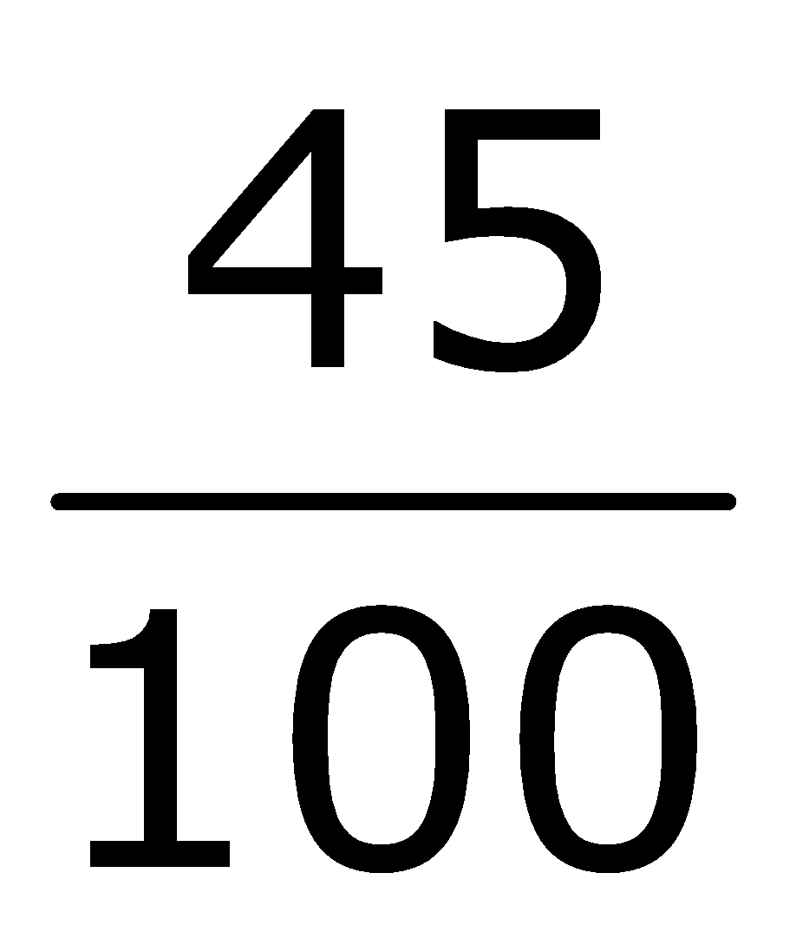
#4 Answer
Rubric:
(1 point each) The student finds the sum of fractions with denominators 10 or 100 and correctly enters the value of the unknown number. The student may also give a correct decimal equivalent to an unknown fraction.
Answers:
Example 1: 63
Example 2:

Slide 10


#5
Example 1: Enter the unknown numerator that makes this equation true.
Example 2: Enter the unknown number that makes this equation true.

Slide 11
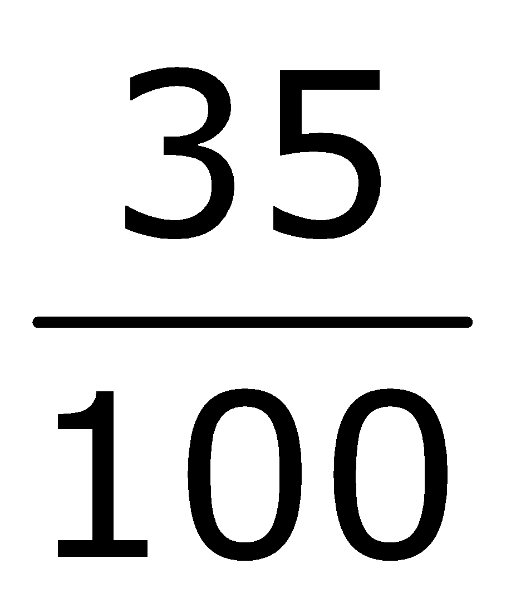
#5 Answer
Rubric:
(1 point each) The student finds the sum of fractions with denominators 10 or 100 and correctly enters the value of the unknown number. The student may also give a correct decimal equivalent to an unknown fraction.
Answers:
Example 1: 5
Example 2:

Slide 12
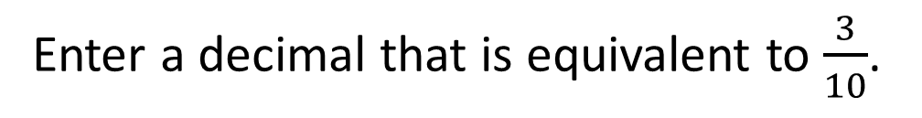
#6

Slide 13
#6 Answer
Rubric:
(1 point) The student determines an equivalent decimal representation of the given fraction and enters the correct decimal.
Answer: 0.3

Slide 14
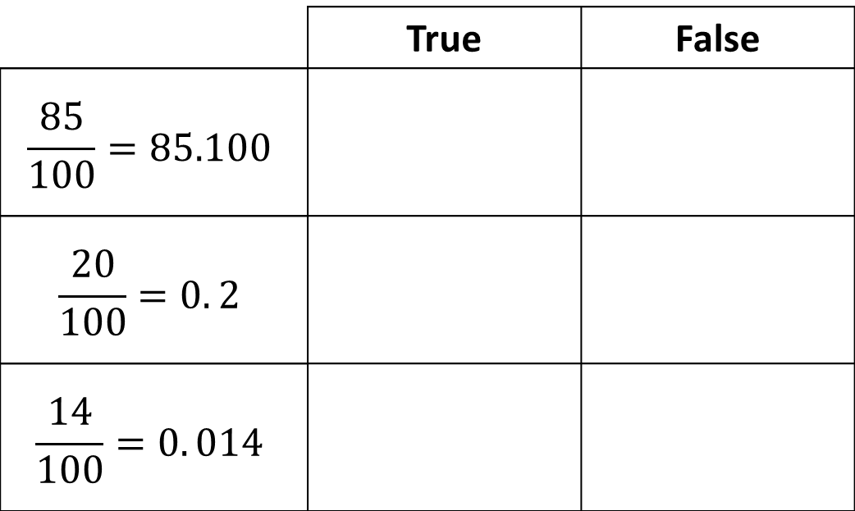
#7
Determine if each equation is true or false. Select True or False for each equation.

Slide 15
#7 Answer
Rubric:
(1 point) The student correctly identifies all three equations as true or false, showing the ability to translate between decimal and fraction representations.
Answer: F, T, F

Slide 16
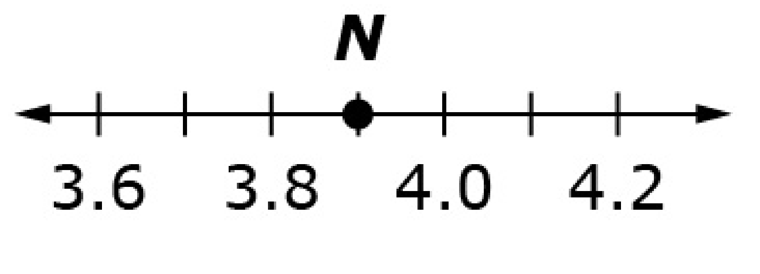
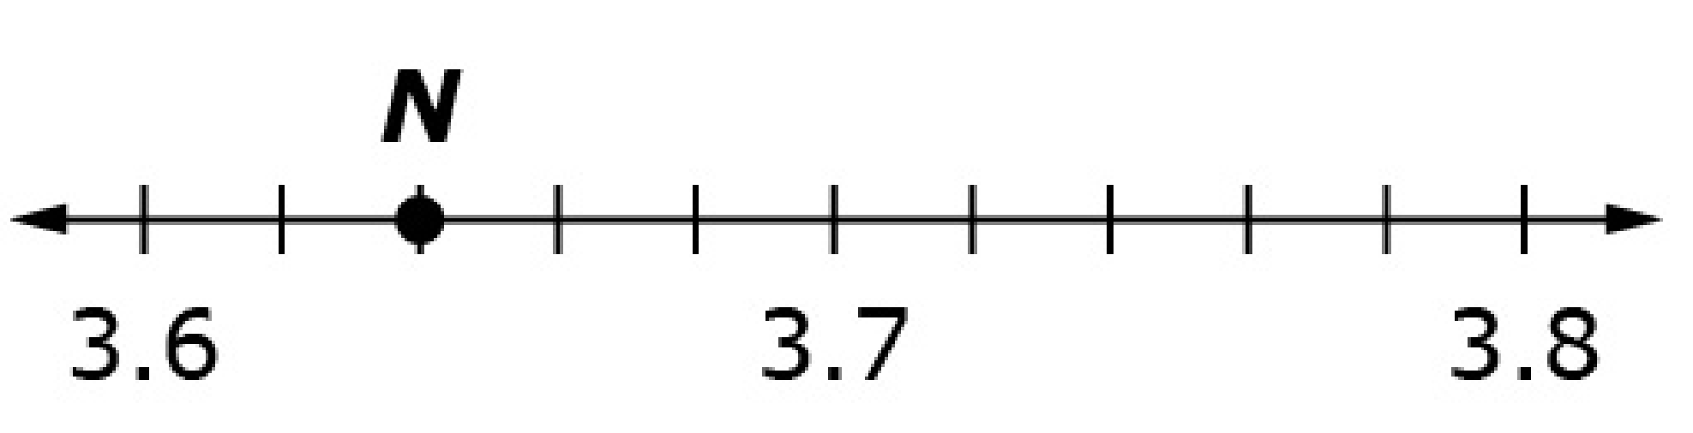
#8
Example 1: Enter the decimal value of the unknown number located at point N.
Example 2: Enter the decimal value of the unknown number located at point N.

Slide 17
#8 Answer
Rubric:
(1 point each) The student locates a decimal number on a number line and enters the correct value of the variable.
Answers:
Example 1: 3.9
Example 2: 3.64

Slide 18
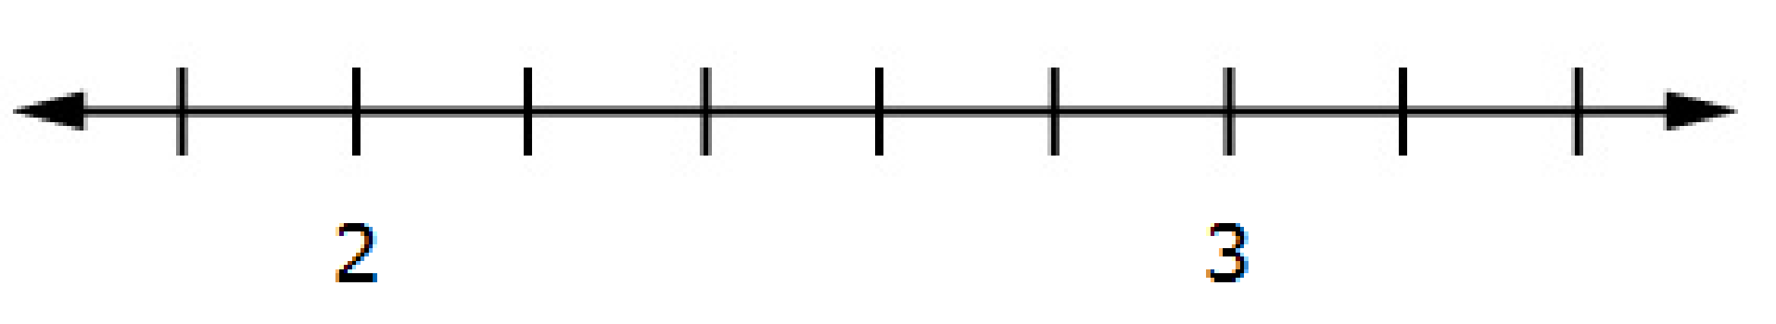
#9
Use the Add Point tool to put a point on the number line to show the location of 2.2.

Slide 19
#9 Answer
Rubric:
(1 point) The student locates a decimal number on a number line and places the point on the correct tick mark.
Answer: Student places the point at 2.2

Slide 20
#10
Use the Add Point tool to put a point on the number line to show the location of 2.32.

Slide 21
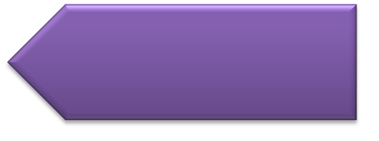
#10 Answer
Rubric:
(1 point) The student locates a decimal number on a number line and places the point within a range equal to 10% of the interval above or below the correct spot, without placing the point on or beyond the nearest tick mark.
Answer: student places the point in the range of 2.30 – 2.34

Slide 22
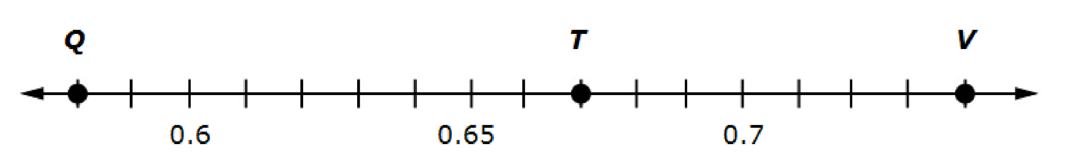
#11
Use this number line to identify the numbers that each letter represents. Enter the number for Q in the first box, T in the second box, and V in the third box.

Slide 23
#11 Answer
Rubric:
(1 point) The student shows an understanding of decimal number lines by correctly identifying the value of all three letters on the number line.
Answer: 0.58, 0.67, and 0.74

Slide 24
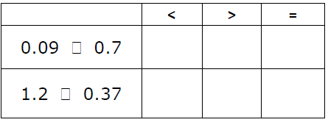
#12
Select the symbol (<, >, or = ) that correctly compares each pair of numbers.

Slide 25
#12 Answer
Rubric:
(1 point) The student identifies the correct symbol to compare pairs of decimals.
Answer: <; >

