Slide 1

Claim 1
Smarter Balanced Sample Items
Grade 4 - Target G
Build fractions from unit fractions by applying and extending previous understandings of operations on whole numbers.
Questions courtesy of the Smarter Balanced Assessment Consortium Item Specifications – Version 3.0
Slideshow organized by SMc Curriculum – www.ccssmathactivities.com

Slide 2


#1
Example 1: Enter the unknown number that makes the equation true.
Example 2: Enter the unknown number that makes the equation true.

Slide 3
#1 Answer
Rubric:
(1 point each) The student shows understanding of addition and subtraction of fractions by entering the correct sum or difference of two fractions with like denominators.
Answers:
Example 1:
Example 2:

Slide 4


#2
Example 1: Enter the unknown number that makes the equation true.
Example 2: Enter the unknown number that makes the equation true.

Slide 5
#2 Answer
Rubric:
(1 point each) The student shows understanding of addition and subtraction of fractions by entering the correct sum or difference of two fractions with like denominators.
Answers:
Example 1:
Example 2:

Slide 6
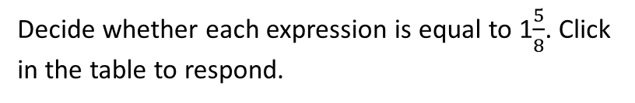
#3

Slide 7
#3 Answer
Rubric:
(1 point) The student correctly identifies all three expressions as either equal or not equal to the given fraction.
Answer: Equal, Equal, Not Equal

Slide 8
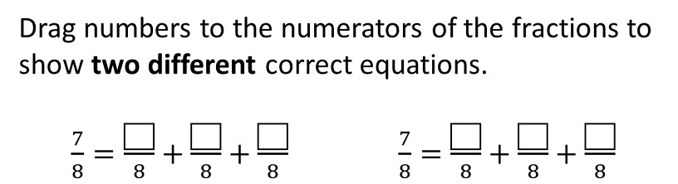
#4

Slide 9
#4 Answer
Rubric:
(1 point) The student correctly completes the equations provided.
Answer: 2, 1, 4 and 4, 3, 0

Slide 10
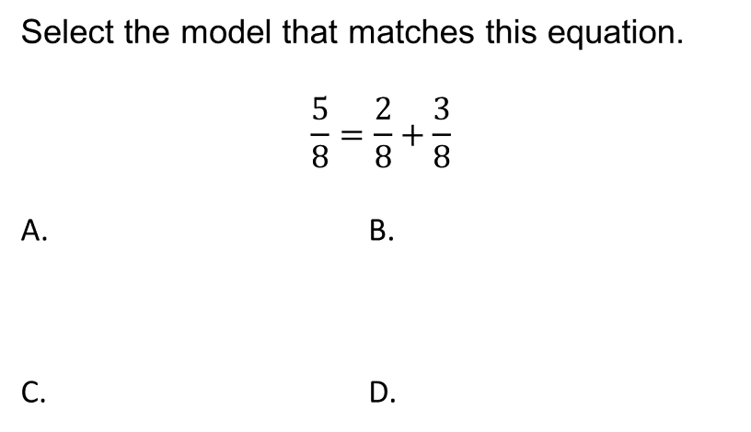
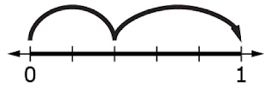
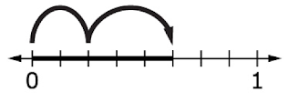
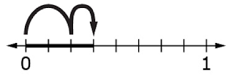
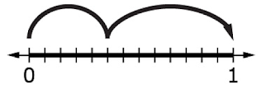
#5

Slide 11
#5 Answer
Rubric:
(1 point) The student selects the correct visual representation of the decomposition of a fraction.
Answer: B

Slide 12
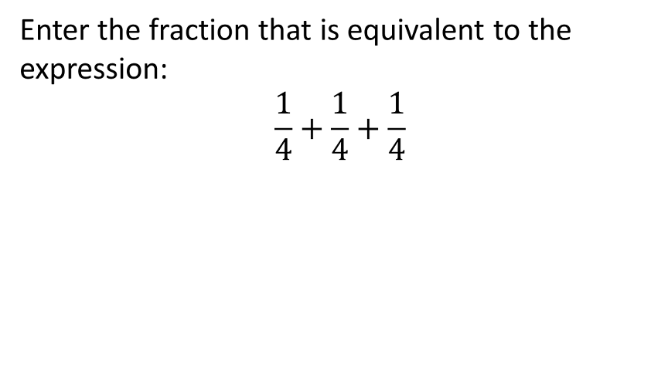
#6

Slide 13

#6 Answer
Rubric:
(1 point) The student enters the correct fraction.
Answer:

Slide 14
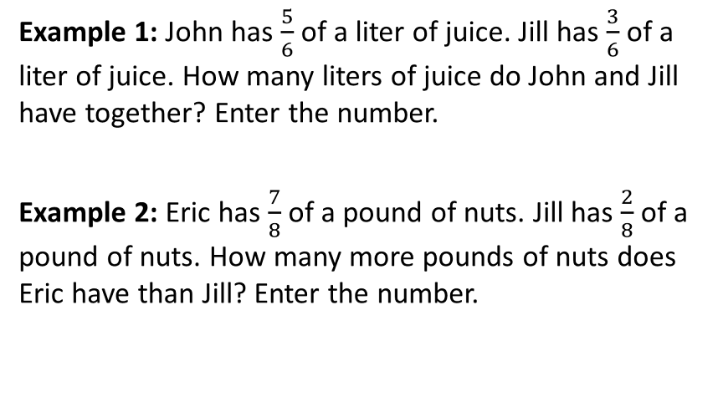
#7

Slide 15
#7 Answer
Rubric:
(1 point each) The student enters the correct fraction.
Answers:
Example 1:
Example 2:

Slide 16
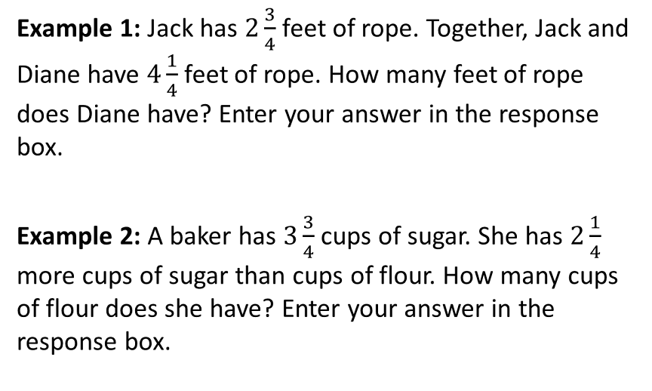
#8

Slide 17


#8 Answer
Rubric:
(1 point each) The student enters the correct fraction.
Answers:
Example 1:
Example 2:

Slide 18
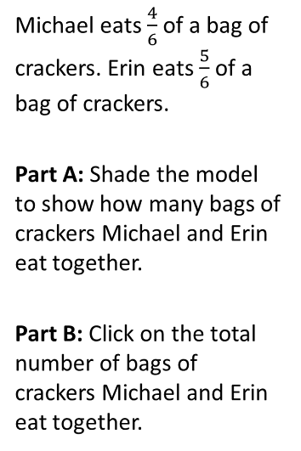

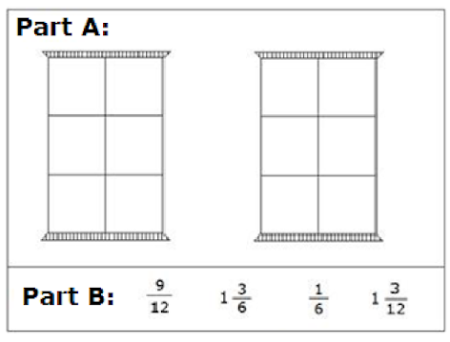
#9

Slide 19

#9 Answer
Rubric:
Part A: (1 point) The student builds a model correctly represents a fraction addition or subtraction problem.
Answer:
Part B: (1 point) The student selects the correct number.
Answer:

Slide 20
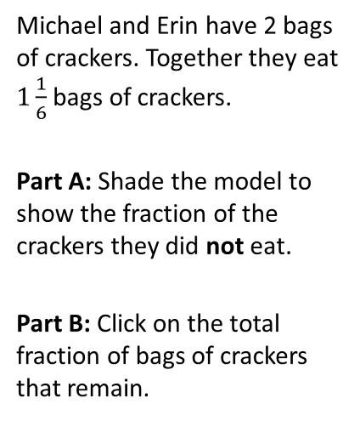
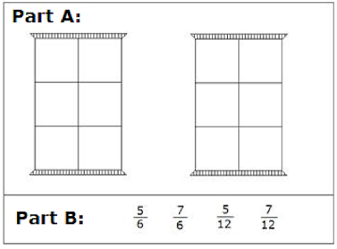
#10

Slide 21
#10 Answer
Rubric:
Part A: (1 point) The student builds a model correctly represents a fraction addition or subtraction problem.
Answer:
Part B: (1 point) The student selects the correct number.
Answer:

Slide 22
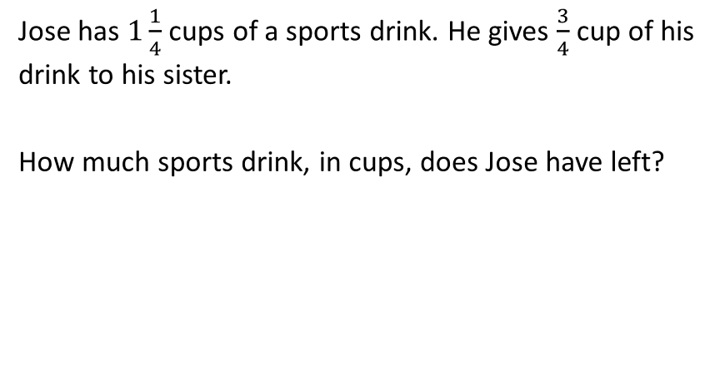
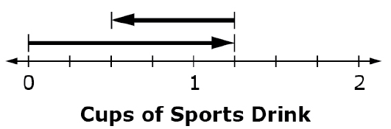
#11

Slide 23
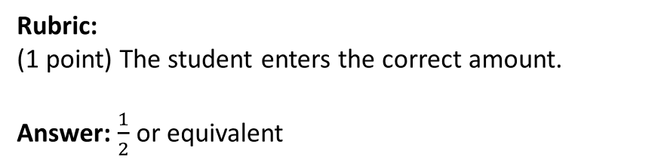
#11 Answer

Slide 24
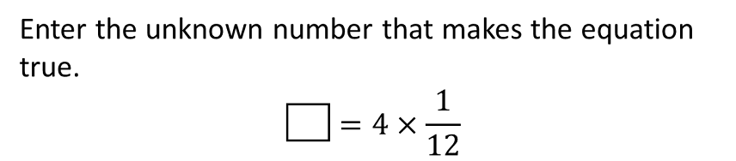
#12

Slide 25

#12 Answer
Rubric:
(1 point) The student identifies the equivalent fraction or whole number which will make the equation true.
Answer:

Slide 26
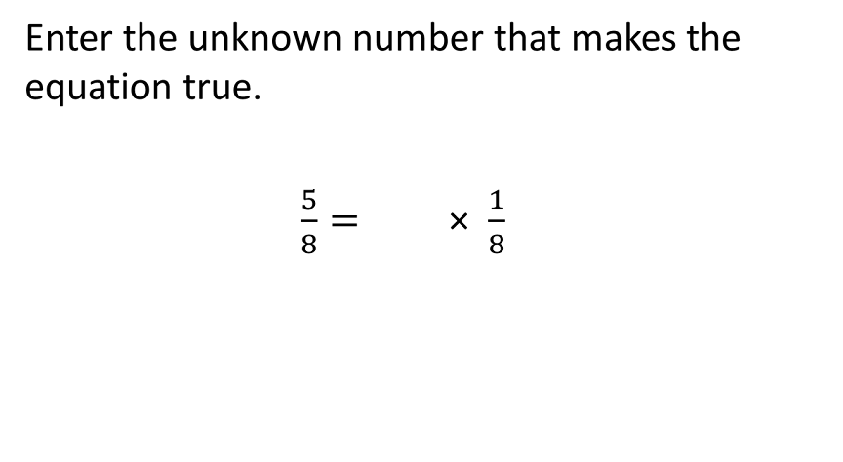
#13

Slide 27
#13 Answer
Rubric:
(1 point) The student identifies the equivalent fraction or whole number which will make the equation true.
Answer: 5

Slide 28
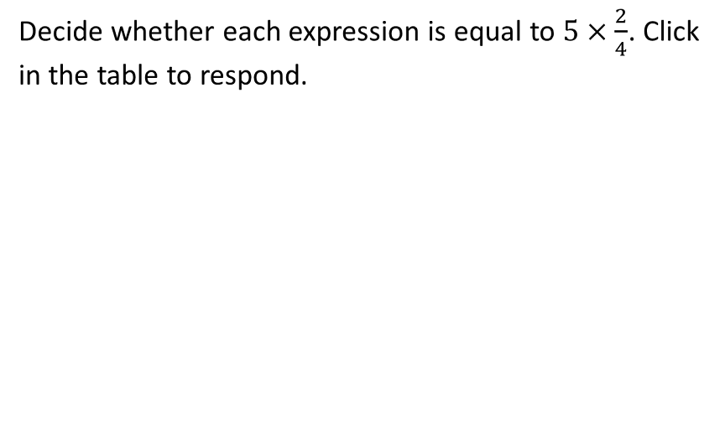
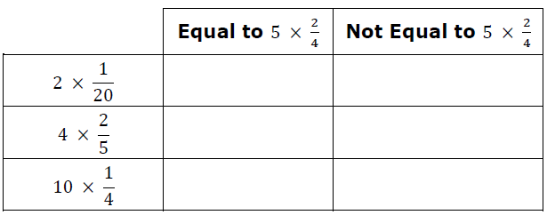
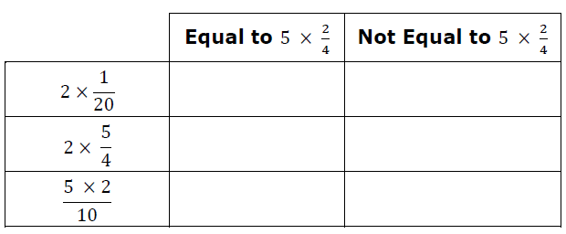
#14

Slide 29
#14 Answer
Rubric:
(1 point each) The student correctly identifies the expressions as Equal or Not Equal.
Answers:
Not Equal, Not Equal, Equal, Not Equal, Equal, Not Equal

Slide 30
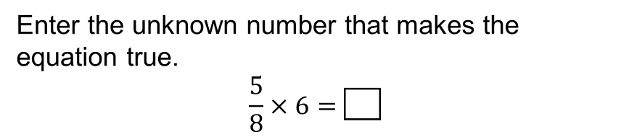
#15

Slide 31

#15 Answer
Rubric:
(1 point) The student multiplies a fraction and a whole number and enters the correct product.
Answer:

Slide 32
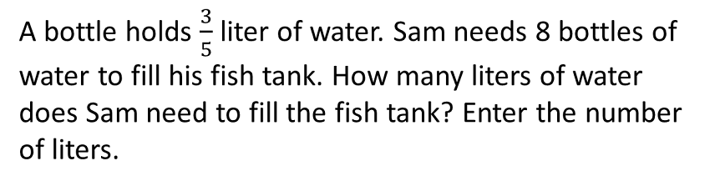
#16

Slide 33


#16 Answer
Rubric:
(1 point) The student enters the correct product.
Answer: or

Slide 34
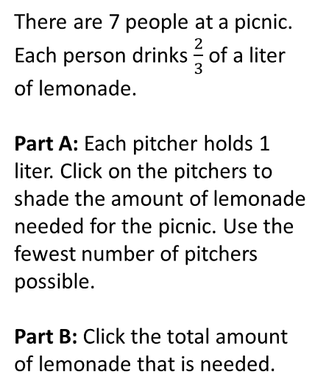
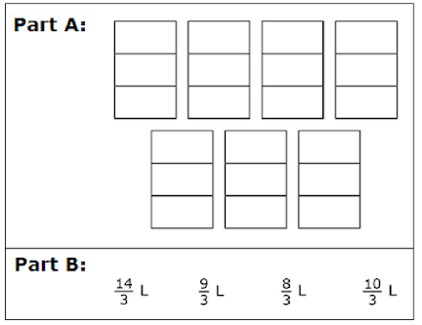
#17

Slide 35


#17 Answer
Rubric:
Part A: (1 point) The student correctly shades the model to represent the product.
Answer:
Part B: (1 point) The student selects the correct product.
Answer:

