Slide 1

Claim 1
Smarter Balanced Sample Items
Grade 4 - Target F
Extend understanding of fraction equivalence and ordering.
Questions courtesy of the Smarter Balanced Assessment Consortium Item Specifications – Version 3.0
Slideshow organized by SMc Curriculum – www.ccssmathactivities.com
Notes:
‹#›

Slide 2

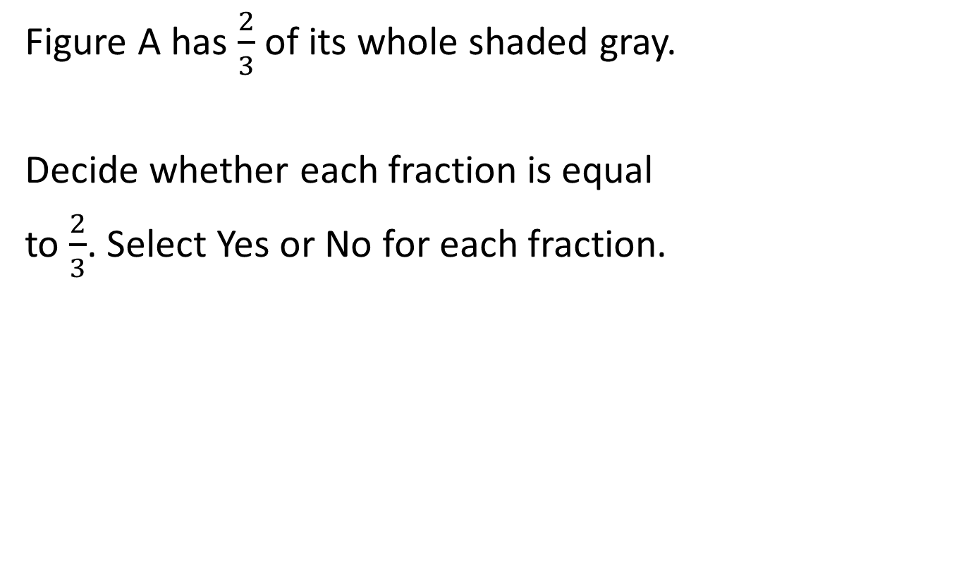
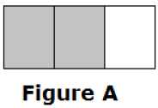
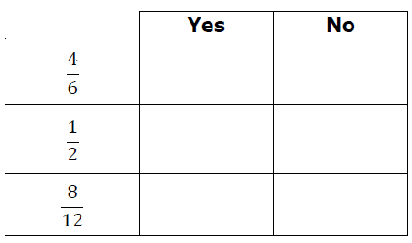
#1

Slide 3

#1 Answer
Rubric:
(1 point) The student correctly identifies all of the fractions as equivalent or not equivalent.
Answer: Y, N, Y
Notes:
‹#›

Slide 4
#2
Select True if the equation is true. Select False if the equation is not true.
Notes:
‹#›

Slide 5
#2 Answer
Rubric:
(1 point) The student correctly identifies all fraction equivalencies as True or False.
Answer: T, F, T
Notes:
‹#›

Slide 6
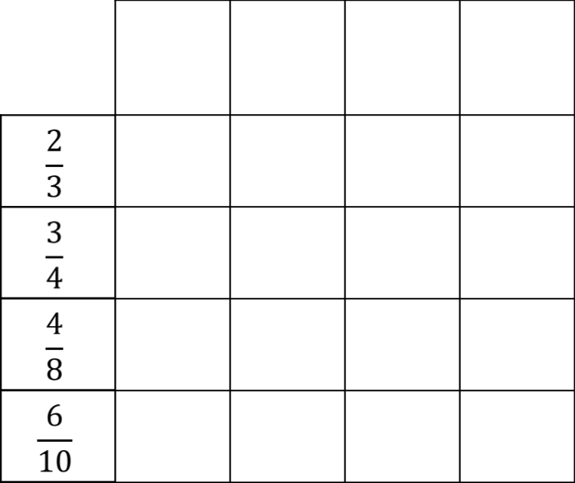
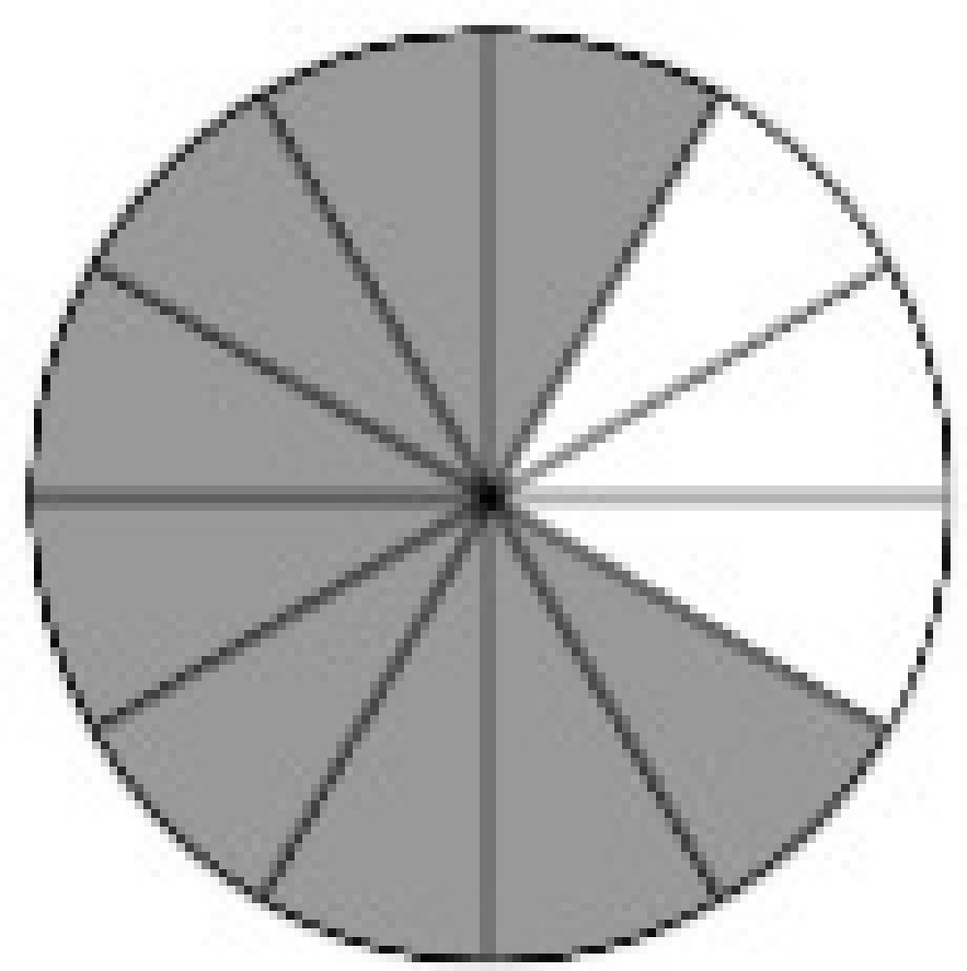
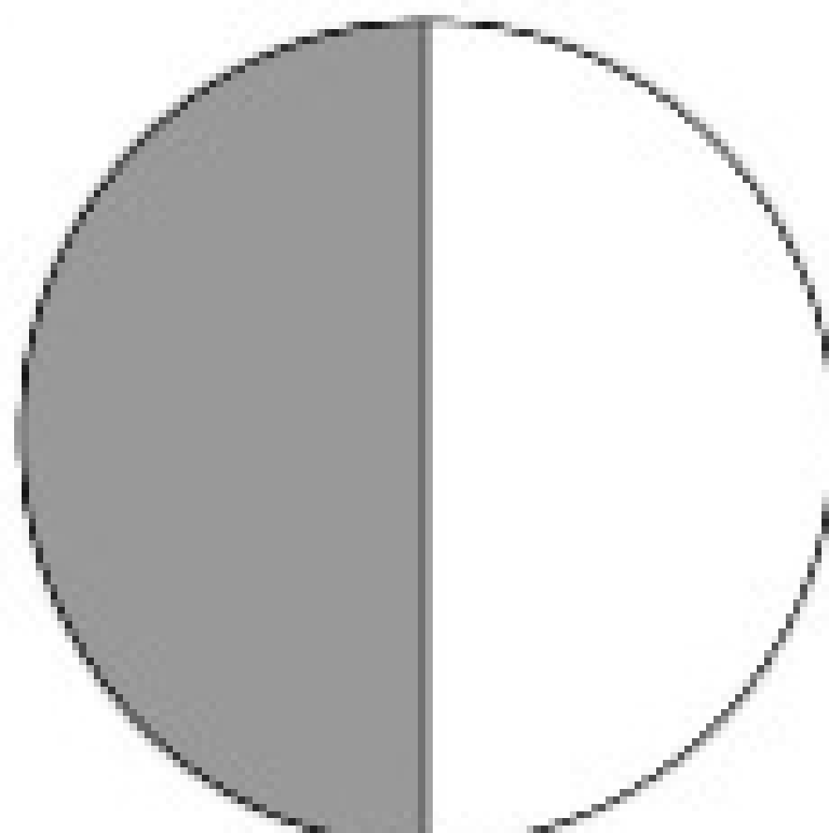
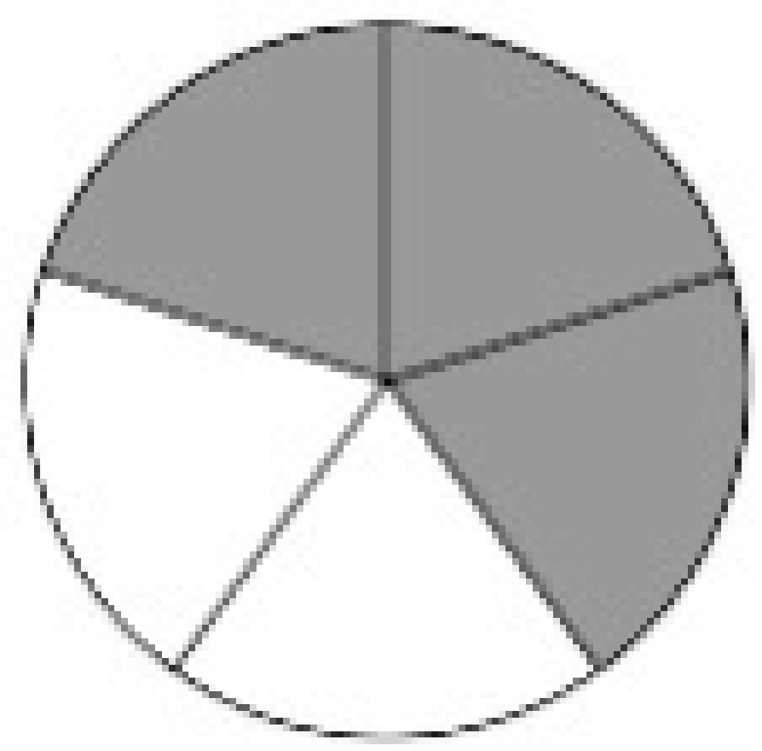
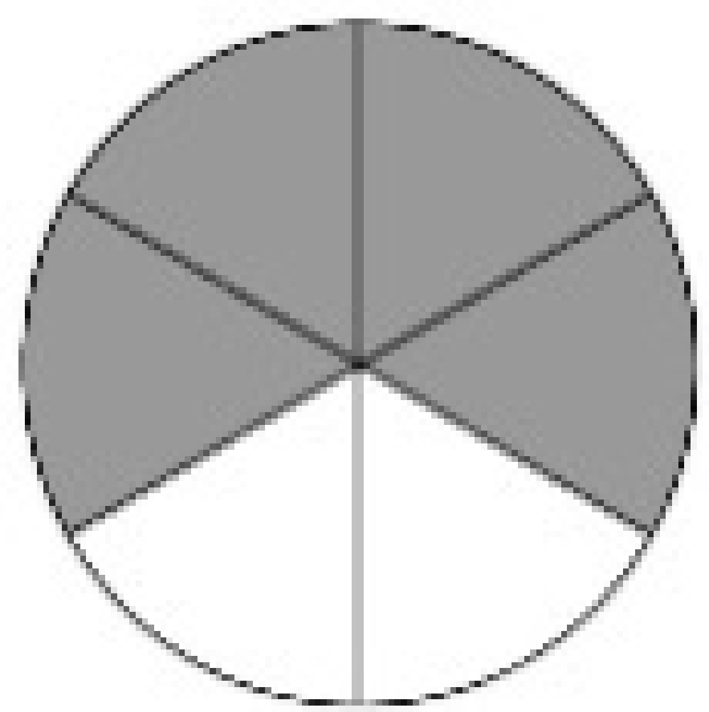
#3
A fraction of the whole is shaded in each model. Click in the chart to match each fraction to the model that shows an equivalent fraction.

Slide 7
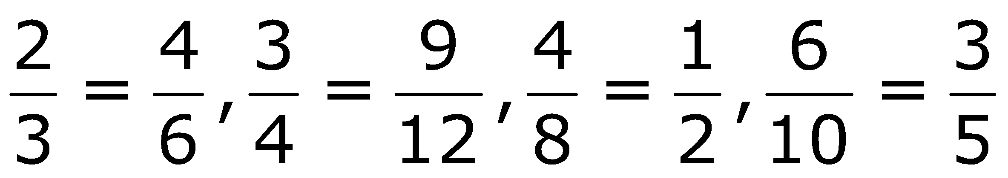
#3 Answer
Rubric:
(1 point) The student makes all of the correct matches of equivalent fractions.
Answer:

Slide 8


#4

Slide 9
#4 Answer
Rubric: (1 point) The student selects all of the equivalent fractions.
Answer: D, F

Slide 10
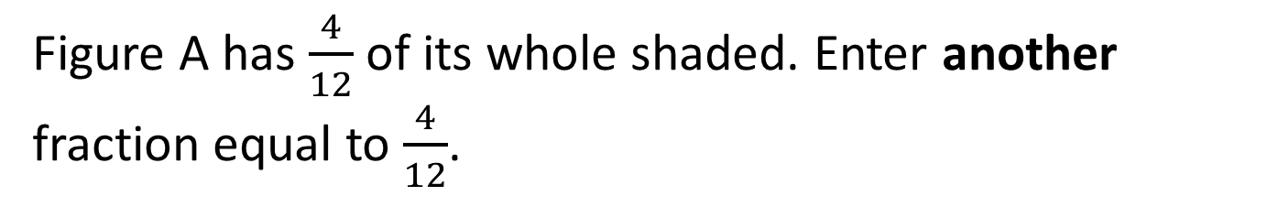
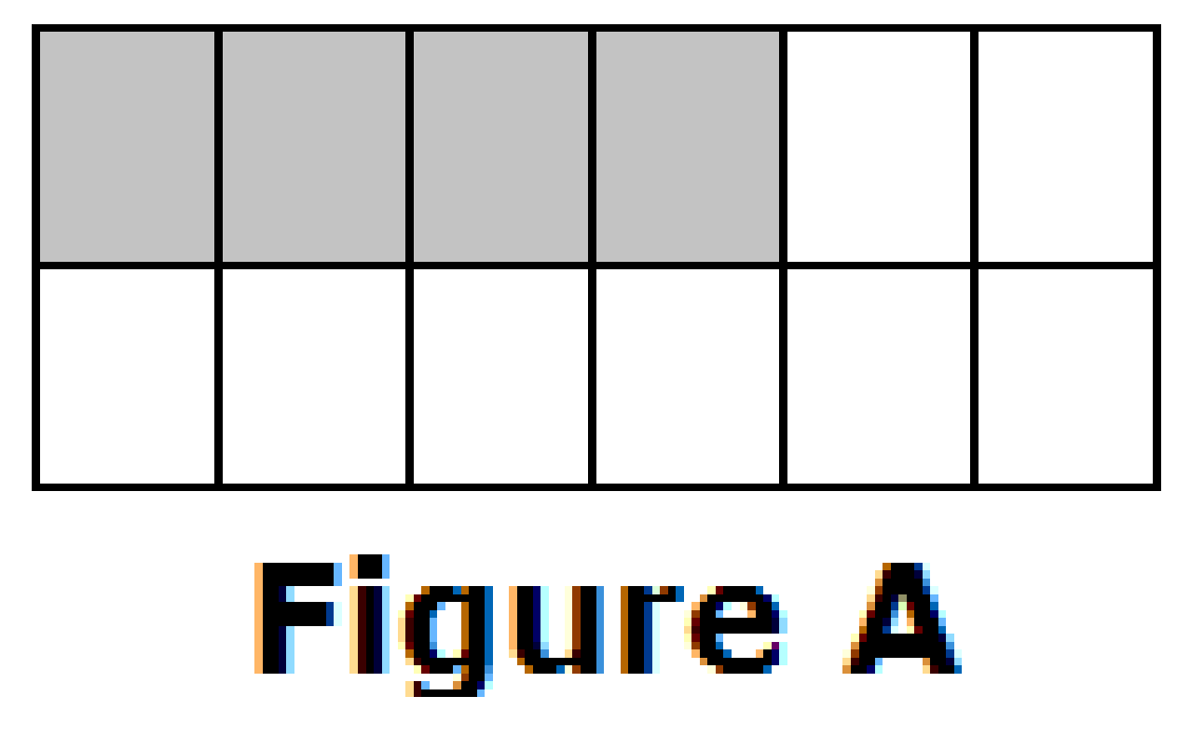
#5

Slide 11


#5 Answer
Rubric:
(1 point) The student enters a fraction equivalent to the given fraction.
Scoring Note: The fraction given in the stem ( ) will not be accepted as a correct answer.
Answer:

Slide 12

#6

Slide 13


#6 Answer
Rubric:
(1 point) The student enters a fraction equivalent to the given fraction.
Scoring Note: The fraction given in the stem ( ) will not be accepted as a correct answer.
Possible Answer:

Slide 14
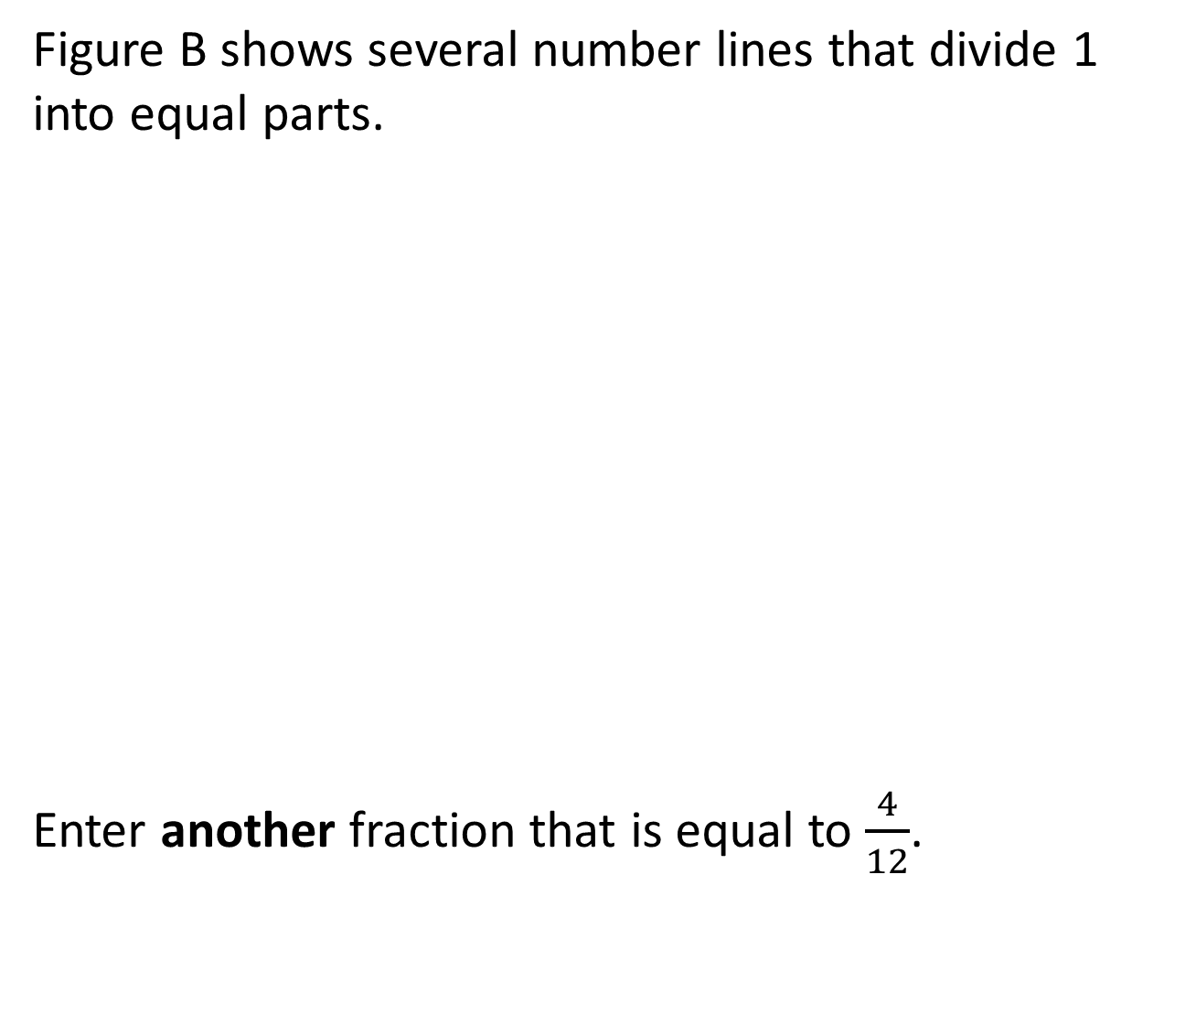
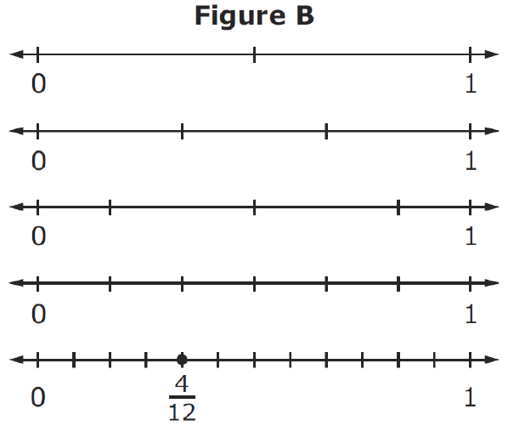
#7

Slide 15
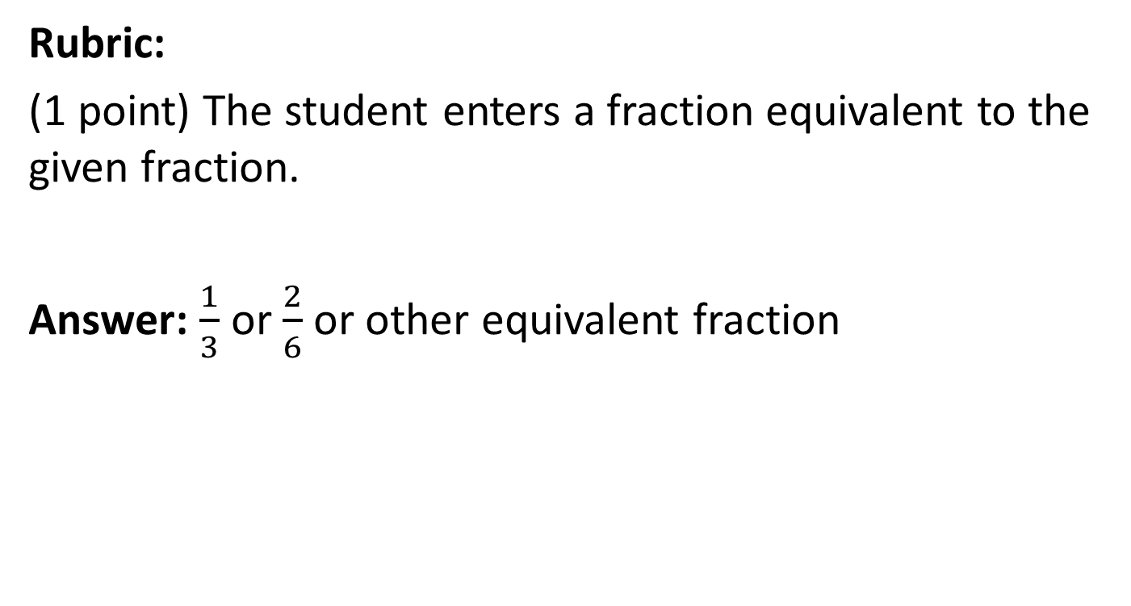
#7 Answer

Slide 16

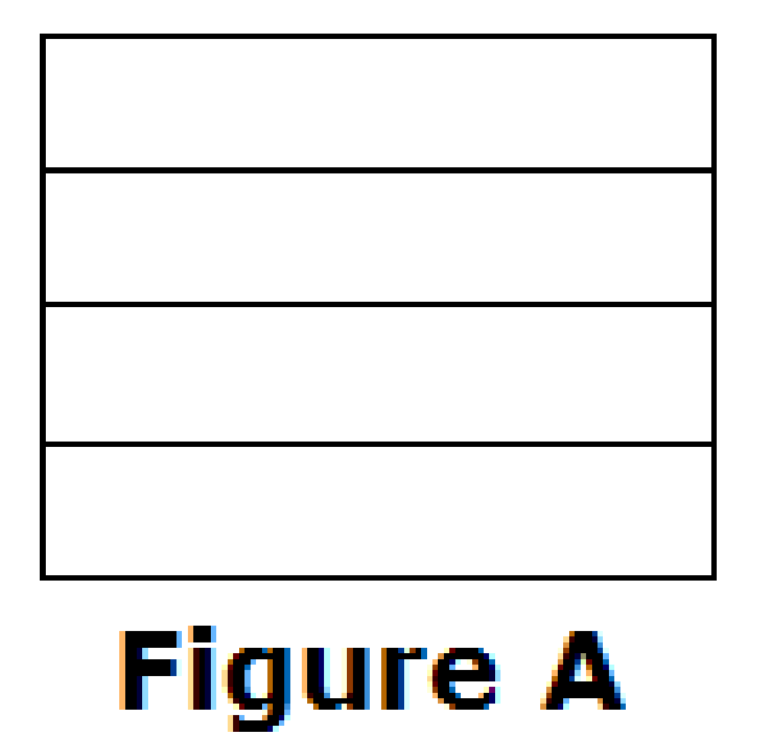
#8

Slide 17

#8 Answer
Rubric:
(1 point) The student builds a model of an equivalent fraction.
Answer:

Slide 18
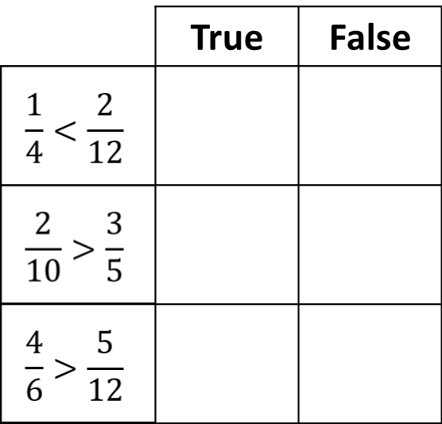
#9
Select True if the comparison is true. Select False if the comparison is not true.

Slide 19
#9 Answer
Rubric: (1 point) The student correctly identifies three fraction comparisons as either true or false.
Answer: F, F, T

Slide 20
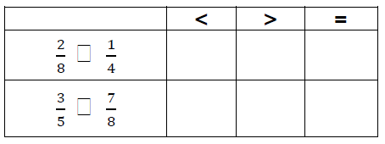
#10
Select the symbol (<, >, or = ) that correctly compares each pair of numbers.

Slide 21

#10 Answer
Rubric: (1 point) The student selects the correct symbols.
Answer: =; <

Slide 22
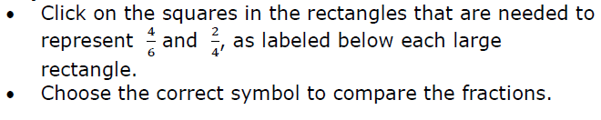
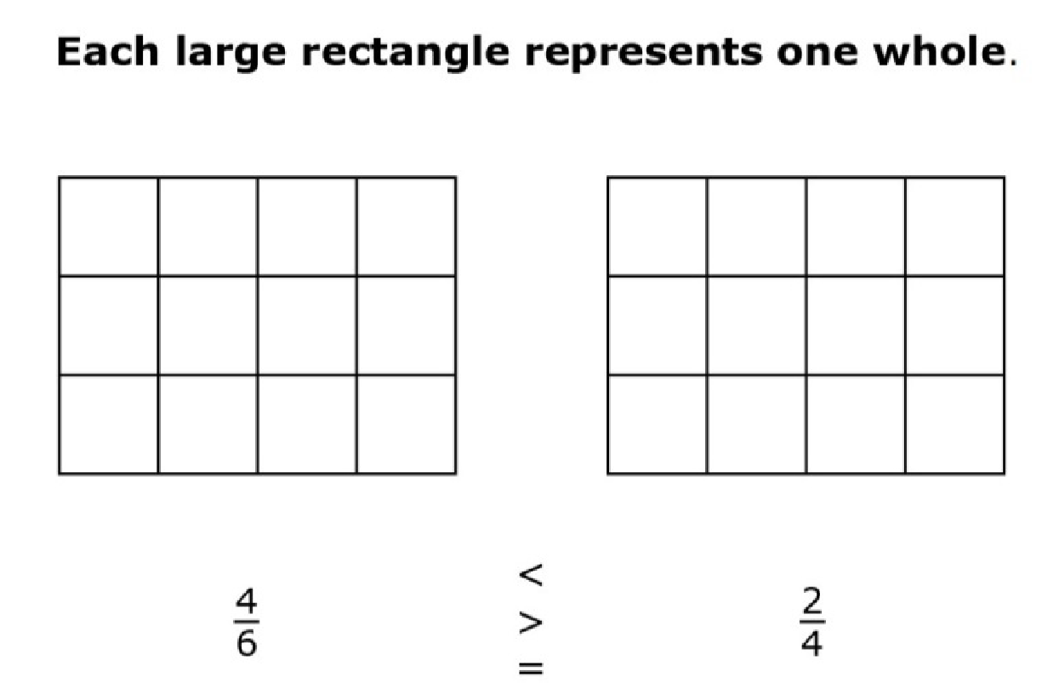
#11

Slide 23


#11 Answer
Rubric:
(2 points) The student correctly shades the fraction models and chooses the correct comparison symbol (e.g., the left model shows , the right model shows and the symbol selected is >).
(1 point) Partial credit is possible for either shading the fraction models correctly, or for choosing the correct comparison symbol.

