Slide 1

Claim 1
Smarter Balanced Sample Items
Grade 4 - Target E
Use place value understanding and properties of operations to perform multi-digit arithmetic.
Questions courtesy of the Smarter Balanced Assessment Consortium Item Specifications – Version 3.0
Slideshow organized by SMc Curriculum – www.ccssmathactivities.com
Notes:
‹#›

Slide 2

#1
Example 1: Enter the sum.
4325
+ 654
Example 2: Add together 33, 149, and 67. Enter the sum in the response box.

Slide 3

#1 Answer
Rubric:
(1 point each) The student enters the correct number.
Answers:
Example 1: 4979
Example 2: 249
Notes:
‹#›

Slide 4
#2
Example 1: Enter the difference.
7529
− 382
Example 2: Enter the difference.
4003
− 1486
Notes:
‹#›

Slide 5
#2 Answer
Rubric:
(1 point each) The student enters the correct number.
Answers:
Example 1: 7147
Example 2: 2517
Notes:
‹#›

Slide 6
#3
Enter the product.
5327
× 4

Slide 7
#3 Answer
Rubric:
(1 point) The student multiplies two whole numbers and enters the correct product.
Answer: 21308

Slide 8
#4
Enter the unknown number that makes the equation true.
36 x 94 = (30 + 6) x ( + 4)
Notes:
‹#›

Slide 9
#4 Answer
Rubric:
(1 point each) The student enters the unknown number to complete the strategy.
Answer: 90
Notes:
‹#›

Slide 10
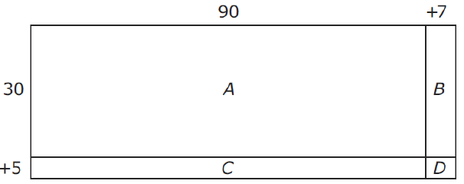
#5
In the area model shown, A = 2700 and D = 7. What are the values of B and C?

Slide 11
#5 Answer
Rubric:
(1 point) The student enters correct numbers for B and C.
Answer: B = 210; C = 450

Slide 12
#6
Which expression is equal to 36 × 94?
A. (30 × 90) + (6 × 4)
B. (30 + 6) × (90 + 4)
C. (30 + 6) × 94 + (30 + 6) × 4
D. (30 × 90) + (30 × 6) + (90 × 6) + (90 × 4)

Slide 13
#6 Answer
Rubric:
(1 point) The student selects a correct strategy.
Answer: B

Slide 14
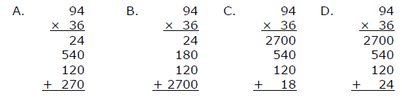
#7
Which strategy for multiplying 36 and 94 should result in the correct product?

Slide 15
#7 Answer
Rubric:
(1 point) The student selects a correct strategy.
Answer: D

Slide 16
#8
Example 1: Enter the unknown number that makes the equation true.
2571 ÷ 3 =
Example 2: Enter the unknown number that makes the equation true.
120 x 5 + = 603

Slide 17
#8 Answer
Rubric:
(1 point) The student enters the correct unknown number.
Answer:
Example 1: 857
Example 2: 3

Slide 18
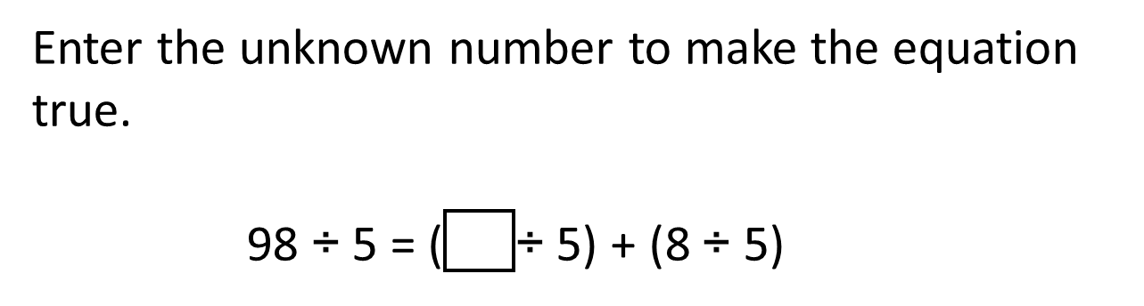
#9

Slide 19
#9 Answer
Rubric:
(1 point) The student enters the correct number.
Answer: 90

Slide 20
#10
Select the equation that has the same unknown number as 90 ÷ 5 =
50 x 90 =
90 x = 5
5 x = 90
x 90 = 5

Slide 21

#10 Answer
Rubric:
(1 point) The student selects the related multiplication equation.
Answer: C

Slide 22
#11
A teacher has 1247 craft sticks. She divides them equally among 9 students.
How many craft sticks does each student get? Enter your answer in the first response box.
How many craft sticks are left over? Enter your answer in the second response box.

Slide 23
#11 Answer
Rubric:
(1 point) The student enters the correct numbers in each response box.
Answer: 138; 5

