Slide 1

Claim 1
Smarter Balanced Sample Items
Grade 4 - Target D
Generalize place value understanding for multi-digit whole numbers.
Questions courtesy of the Smarter Balanced Assessment Consortium Item Specifications – Version 3.0
Slideshow organized by SMc Curriculum – www.ccssmathactivities.com
Notes:
‹#›

Slide 2
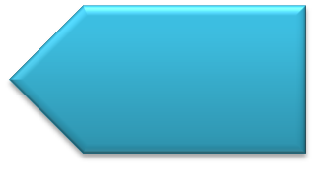
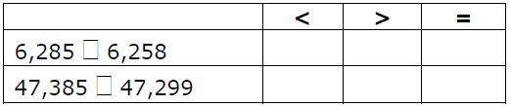
#1
Select the symbol (<, >, or = ) that correctly compares each pair of numbers.

Slide 3
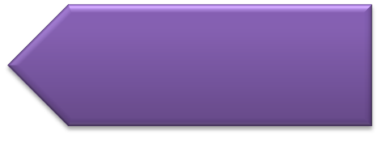
#1 Answer
Rubric:
(1 point) The student selects the correct symbols.
Answer: >, >

Slide 4
#2
What digit can you put in the box to make the comparison true?.
524,9 7  524,932

Slide 5
#2 Answer
Rubric:
(1 point) The student enters a digit to create a correct comparison.
Answer: 2, 1, or 0

Slide 6
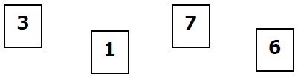
#3
Joe and Kate were playing a number game with the following four cards.
The winner of the game is the person that makes the number with the greatest value.
Joe made the number 6731. Using the same cards, what number could Kate make to win the game?

Slide 7
#3 Answer
Rubric:
(1 point) The student enters a number greater than 6731.
Answer: E.g., 7631, 7613, 7361, 7163, 7136, etc.

Slide 8
#4
Example 1: Round 4108 to the nearest thousand. Enter your answer in the response box.
Example 2: Round 659,749 to the nearest ten thousand. Enter your answer in the response box.

Slide 9
#4 Answer
Rubric:
(1 point each) The student enters the number correctly rounded to the nearest designated place value.
Answers:
Example 1: 4,000
Example 2: 660,000

Slide 10
#5
When rounding to the nearest thousand, what is the least whole number that rounds to 16,000? Enter your answer in the response box.

Slide 11
#5 Answer
Rubric:
(1 point) The student enters the correct number.
Answer: 15,500

Slide 12
#6
When rounding to the nearest thousand, which numbers round to 16,000? Select Yes if the number rounds to 16,000. Select No if the number does not round to 16,000.
 | Yes | No
15,179
16,523
15,545

Slide 13
#6 Answer
Rubric:
(1 point) The student correctly identifies whether three numbers round to a given number.
Answer: N, N, Y

Slide 14
#7
When rounding to the nearest thousand, select all numbers that round to 25,000.
25,204
24,179
25,523
24,545

Slide 15
#7 Answer
Rubric:
(1 point) The student correctly identifies the numbers that round to a given number.
Answer: A and D

Slide 16
#8
Select Yes or No for each comparison.
 | Yes | No
5 hundreds + 4 tens > 50 + 400
524 < 50 + 200 + 4
50 tens + 20 ones = 520

Slide 17
#8 Answer
Rubric:
(1 point) The student correctly identifies three comparisons as true or false.
Answer: Y, N, Y

Slide 18
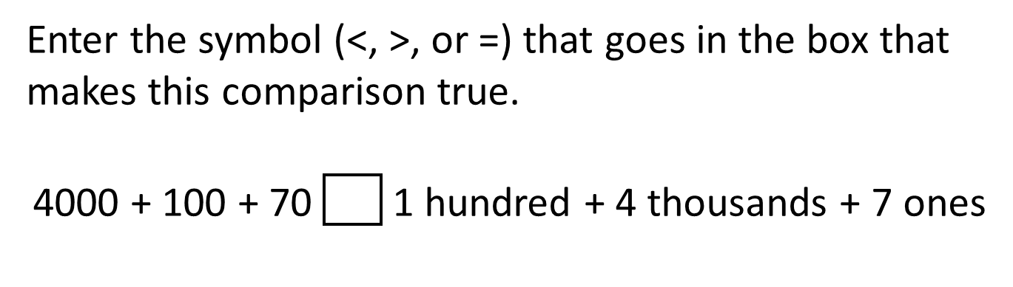
#9

Slide 19
#9 Answer
Rubric:
(1 point) The student enters the correct symbol to compare two numbers.
Answer: >

Slide 20
#10
Select the statement that explains how the values of the numbers 420 and 4200 are different.
A. 4200 is 1000 times as large as 420.
B. 4200 is 100 times as large as 420.
C. 4200 is 10 times as large as 420.
D. 4200 is 1 time as large as 420.

Slide 21
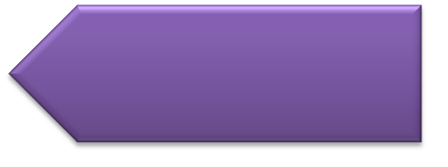
#10 Answer
Rubric:
(1 point) The student selects the correct statement.
Answer: C

Slide 22
#11
Jim and Tom collected empty soda cans to raise money. Jim collected 70 cans and Tom collected 700 cans.
The number of cans Tom collected is how many times greater than the number of cans Jim collected?
Enter your answer in the response box.

Slide 23
#11 Answer
Rubric:
(1 point) The student enters the correct value.
Answer: 10

