Slide 1

Claim 1
Smarter Balanced Sample Items
Grade 4 - Target C
Generate and analyze patterns.
Questions courtesy of the Smarter Balanced Assessment Consortium Item Specifications – Version 3.0
Slideshow organized by SMc Curriculum – www.ccssmathactivities.com
Notes:
‹#›

Slide 2

#1
A pattern is generated using this rule: Start with the number 7 as the first term and add 5. Enter numbers into the boxes to complete the table.
Term | Number
First | 7
Second
Third
Fourth
Fifth

Slide 3

#1 Answer
Rubric:
(1 point) The student enters the correct numbers.
Answer: 12, 17, 22, 27
Notes:
‹#›

Slide 4
#2
A shape pattern is generated by repeating the pattern of “Star, Circle, Circle.” Click in the table to show the first six terms of the pattern, starting with Star.
 | Star | Circle
First Term
Second Term
Third Term
Fourth Term
Fifth Term
Sixth Term
Notes:
‹#›

Slide 5
#2 Answer
Rubric:
(1 point) The student correctly identifies the first six terms of the pattern.
Answer: Star, Circle, Circle, Star, Circle, Circle
Notes:
‹#›

Slide 6
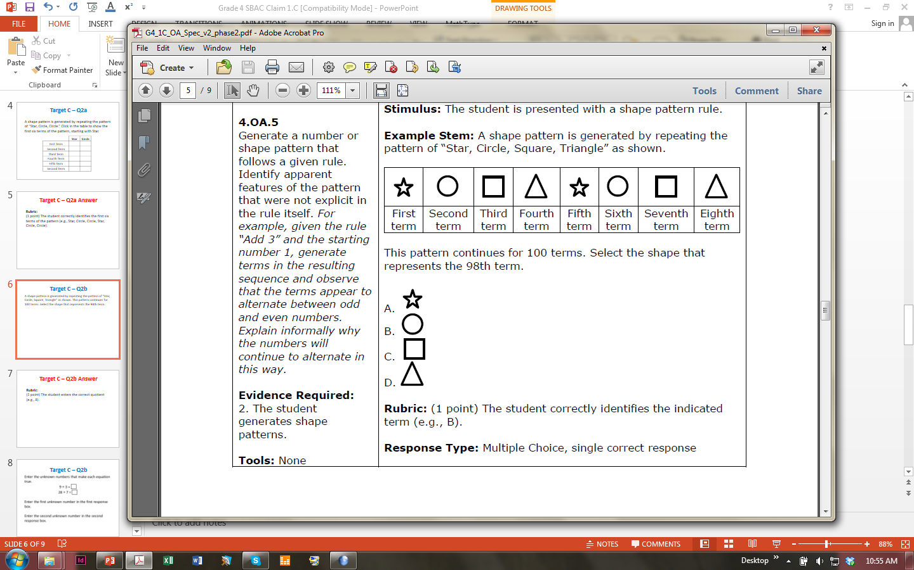
#3
A shape pattern is generated by repeating the pattern of “Star, Circle, Square, Triangle” as shown. This pattern continues for 100 terms. Select the shape that represents the 98th term.

Slide 7
#3 Answer
Rubric:
(1 point) The student correctly identifies the indicated term.
Answer: B

Slide 8
#4
A pattern is generated using this rule: Start with the number 5 as the first term and add 2. Select True or False for each statement about the pattern.
 | True | False
The terms alternate between even and odd numbers.
Each term is greater than the term before it.
All possible multiples of 5 are terms in the pattern.
Notes:
‹#›

Slide 9
#4 Answer
Rubric:
(1 point) The student correctly identifies all three statements as True or False.
Answer: F, T, F
Notes:
‹#›

Slide 10
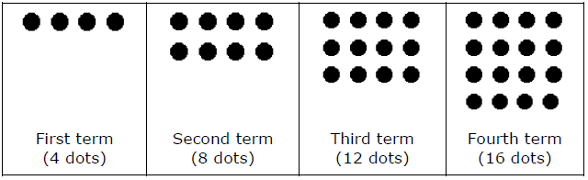
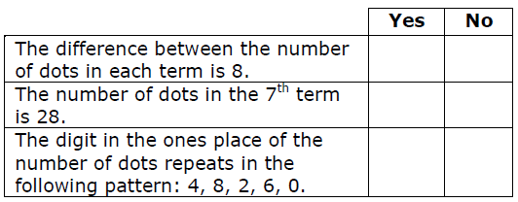
#5
The first four terms of a shape pattern are shown. Each term is generated by following the same rule. Decide whether each statement can be used to describe the dot pattern shown. Select Yes or No for each statement.

Slide 11
#5 Answer
Rubric:
(1 point) The student correctly selects yes or no for each method.
Answer: N, Y, Y

Slide 12
#6
A pattern is generated using this rule: Start with 42 and add 5. Enter one number in each response box that makes this sentence correct: The ones digit for every term in the pattern is either ___ or ___.

Slide 13
#6 Answer
Rubric:
(1 point) The student correctly names the values between which the identified place’s digits alternate.
Answer: 2, 7

Slide 14
#7
A pattern is generated using this rule: Start with the number 7 as the first term and add 5.
Part A: Drag numbers into the boxes to show the next six terms of this pattern.
Part B: Based on what you observe about the first seven terms, which numbers below are also in the pattern? Select all of the numbers that are in the pattern.
377 955 1022 9992
7
First term | Second term | Third term | Fourth term | Fifth term | Sixth term | Seventh term

Slide 15
#7 Answer
Rubric:
Part A: (1 point) The student correctly names the next six terms of the pattern.
Answer: 12, 17, 22, 27, 32, 37
Part B: (1 point) The student correctly identifies other terms from the pattern.
Answer: 377, 1022, 9992

