Slide 1

Claim 1
Smarter Balanced Sample Items
Grade 4 - Target B
Gain familiarity with factors and multiples.
Questions courtesy of the Smarter Balanced Assessment Consortium Item Specifications – Version 3.0
Slideshow organized by SMc Curriculum – www.ccssmathactivities.com

Slide 2

#1
Which list has all of the factors of 36?
A. 1, 2, 3, 4, 6, 9, 12, 18, 36
B. 1, 2, 3, 6, 8, 9, 12, 16, 36
C. 1, 2, 4, 6, 8, 9, 16, 18, 36
D. 1, 2, 3, 5, 6, 9, 12, 18, 36

Slide 3

#1 Answer
Rubric:
(1 point) The student identifies the correct list.
Answer: A

Slide 4
#2
Which list has all of the factor pairs of 36?
A. 1 × 36, 2 × 18, 3 × 12, 4 × 9, 6 × 6
B. 1 × 36, 2 × 16, 3 × 12, 4 × 9, 6 × 8
C. 1 × 36, 2 × 18, 3 × 6, 4 × 8, 6 × 12
D. 1 × 36, 2 × 12, 3 × 9, 4 × 8, 6 × 6

Slide 5
#2 Answer
Rubric:
(1 point) The student identifies the correct list.
Answer: A

Slide 6
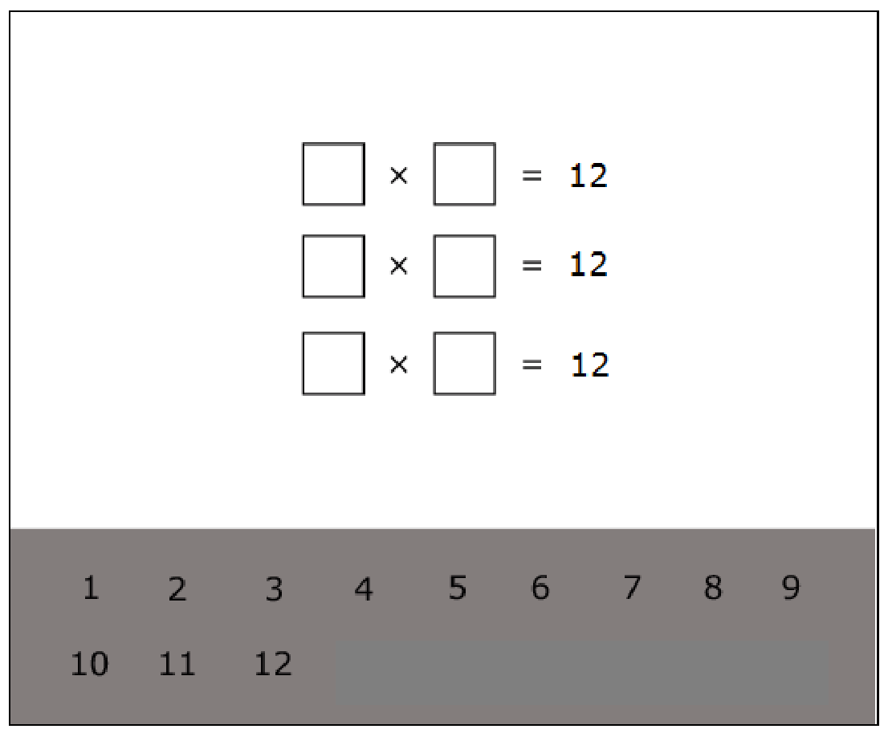
#3
Drag numbers into the boxes to make factor pairs of 12.
2 3 4 5 6 7 8 9
10 11 12

Slide 7
#3 Answer
Rubric:
(1 point) The student identifies all of the correct factor pairs.
Answer: 1 × 12, 2 × 6, 3 × 4

Slide 8
#4
Which number is a factor of both 16 and 20?
A. 3
B. 4
C. 5
D. 8

Slide 9
#4 Answer
Rubric:
(1 point) The student identifies a common factor.
Answer: B

Slide 10
#5
Which numbers are factors of both 18 and 45?
A. 1, 2, 8
B. 1, 3, 9
C. 1, 4, 8
D. 1, 5, 9

Slide 11
#5 Answer
Rubric:
(1 point) The student identifies common factors of two whole numbers.
Answer: B

Slide 12
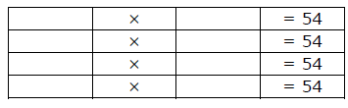
#6
Enter numbers into the boxes to make four different factor pairs of 54.

Slide 13
#6 Answer
Rubric:
(1 point) The student identifies four different factor pairs of the number.
Note: Numbers may be in either order (e.g., 1 and 54 or 54 and 1).
Answer: 1 and 54, 2 and 27, 3 and 18, 6 and 9

Slide 14
#7
Which factor of 12 is missing in this list of numbers?
1, 2, 3, 4, __, 12
5
6
8
10

Slide 15
#7 Answer
Rubric:
(1 point) The student identifies the correct missing factor
Answer: B

Slide 16
#8
Which factor of 24 is missing in this list of numbers?
1, 2, 3, 4, 6, __, 12, 24

Slide 17
#8 Answer
Rubric:
(1 point) The student identifies the correct missing factor
Answer: 8

Slide 18
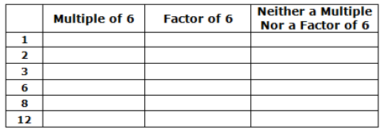
#9
Decide whether each number is a multiple of 6, a factor of 6, or neither. Each number may be matched to more than one description. Click in the table to respond.

Slide 19
#9 Answer
Rubric:
(3 points) The student correctly fills in all three columns (e.g., Multiple column: 6, 12; Factor column: 1, 2, 3, 6; Neither column: 8), with no incorrect fill-ins.
(2 points) Partial credit is possible for correctly filling in two of the three columns (e.g., Multiple column and Neither column filled in correctly, but Factor column not filled in correctly), with no incorrect fill-ins on the two columns
(e.g., Multiple and Neither).
(1 point) Partial credit is possible for correctly filling in one of the three columns (e.g., Multiple column filled in correctly but Factor and Neither column not filled in correctly), with no incorrect fill-ins on the one column (e.g., Multiple).

Slide 20
#10
Select the list of numbers that are all multiples of 8.
A. 8, 18, 24, 44
B. 8, 26, 44, 62
C. 16, 32, 48, 64
D. 40, 48, 54, 76

Slide 21

#10 Answer
Rubric:
(1 point) The student correctly identifies the multiples of a one-digit number.
Answer: C

Slide 22
#11
Which number is a multiple of both 2 and 5?
A. 7
B. 14
C. 40
D. 52

Slide 23
#11 Answer
Rubric:
(1 point) The student correctly identifies the multiple of two one-digit numbers.
Answer: C

Slide 24
#12
Decide whether each number is prime or composite. Click in the table to respond.
 | Prime | Composite
17
52
87

Slide 25
#12 Answer
Rubric:
(1 point) The student identifies all numbers as prime or composite,
Answer: P, C, C

