Slide 1

Claim 4
Smarter Balanced Sample Items
Grade 3
Modeling and Data Analysis
Questions courtesy of the Smarter Balanced Assessment Consortium Item Specifications – Version 3.0
Slideshow organized by SMc Curriculum – www.ccssmathactivities.com

Slide 2
#1
Eva gets home from school at 4:50 p.m. She eats dinner at 6:00 p.m. She spends the time between getting home and eating dinner on some of the activities in this table. Eva completes as many of these activities as she can before dinner. Click in the chart to show a set of activities that Eva could complete.
Eva’s Favorite Activities
Activity | Minutes
Bike | 20
Watch TV | 30
Play games | 30
Read | 20
Play outside | 40
Play with her dog | 10
Color | 10

Slide 3
#1 Answer
Rubric:
(1 point) The student is able to identify four activities within the specified time period of 70 minutes or less
Answer: Color, Play with her dog, Read, Bike; or Color, Play with her dog, Read, Watch TV; or Color, Play with her dog, Read, Play games; or Color, Play with her dog, Bike, Play games; or Color, Play with her dog, Bike, Watch TV

Slide 4
#2
There are 3 bookcases in a classroom.
Each bookcase has 2 shelves.
Each shelf has the same number of books (n).
There are 54 books in all.
Which equation can be solved to find the total number of books (n) on each shelf?
A. 3 × 2 + n = 54
B. 3 + 2 + n = 54
C. 3 + 2 × n = 54
D. 3 × 2 × n = 54

Slide 5
#2 Answer
Rubric:
(1 point) The student selects the correct equation.
Answer: D

Slide 6
#3
There are 123 girls and 135 boys in the third grade at a school. Today there are a total of 9 third grade students absent. Which equation can be used to find the total number of third grade students (s) in school today?
A. 123 + 135 = s
B. 135 – 9 = s
C. 123 + 135 + 9 = s
D. 123 + 135 – 9 = s

Slide 7
#3 Answer
Rubric:
(1 point) The student selects the correct equation.
Answer: D

Slide 8
#4
The table shows the start and end times for runners in a race.
What is the difference, in minutes, between Patty’s start time and Mike’s start time?
Racing Times
Runner | Start Time | End Time
Mike | 12:03 p.m. | 12:26 p.m.
Ann | 12:10 p.m. | 12:17 p.m.
John | 12:13 p.m. | 12:19 p.m.
Patty | 12:16 p.m. | 12:25 p.m.

Slide 9
#4 Answer
Rubric:
(1 point) The student enters the correct difference.
Answer: 13

Slide 10
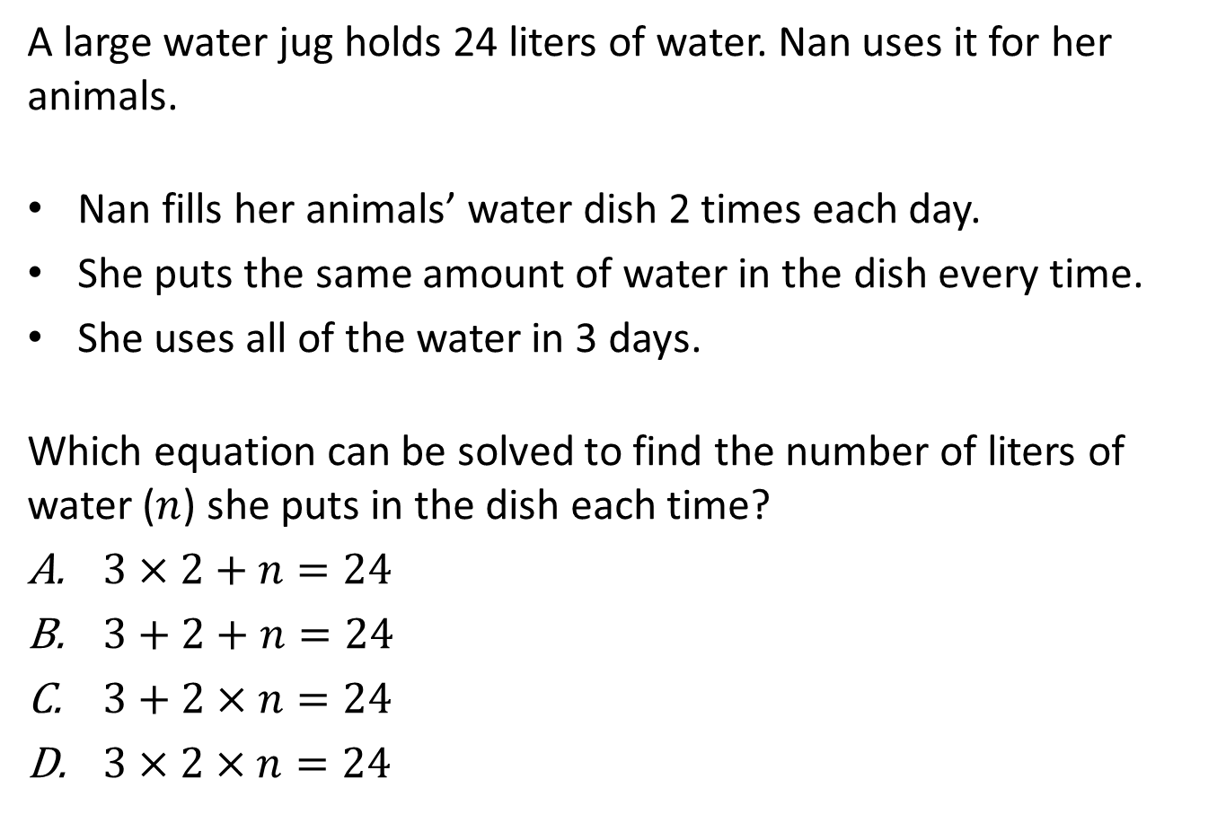
#5

Slide 11
#5 Answer
Rubric:
(1 point) The student selects the correct equation.
Answer: D

Slide 12
#6
Tina has 4 packs of gum. Each pack has the same number of pieces of gum. Altogether there are 60 pieces of gum.
Part A
Make an equation to find the number of pieces of gum in each pack. Use n for the number of pieces in each pack.
Part B
How many pieces of gum are in each pack?

Slide 13
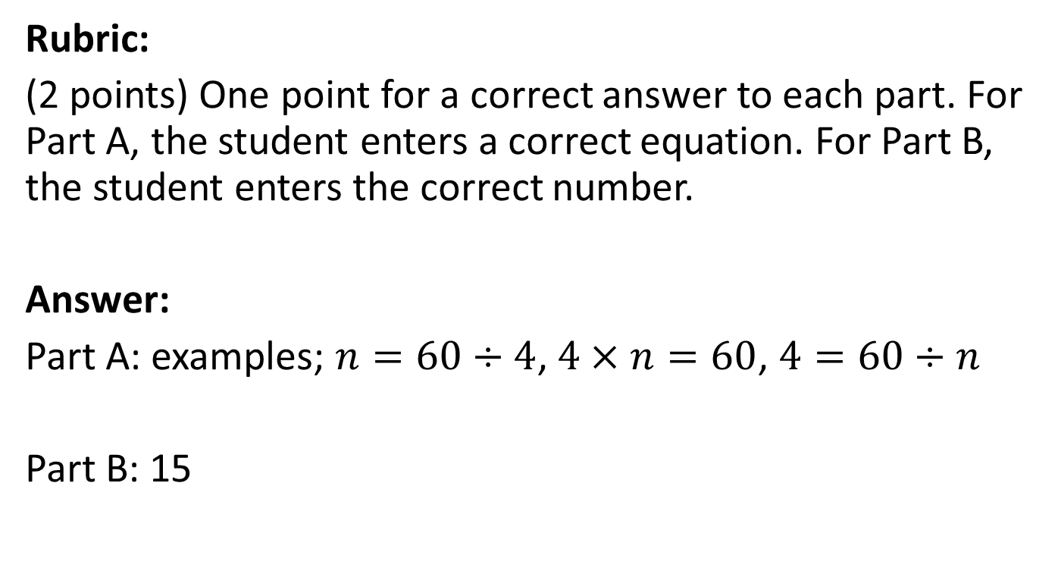
#6 Answer

Slide 14

#7
Part A
Estimate the length of an unsharpened pencil in centimeters.
Part B
The length of the pencil is about 19 cm.
How much longer or shorter is your estimate than the real length?

Slide 15
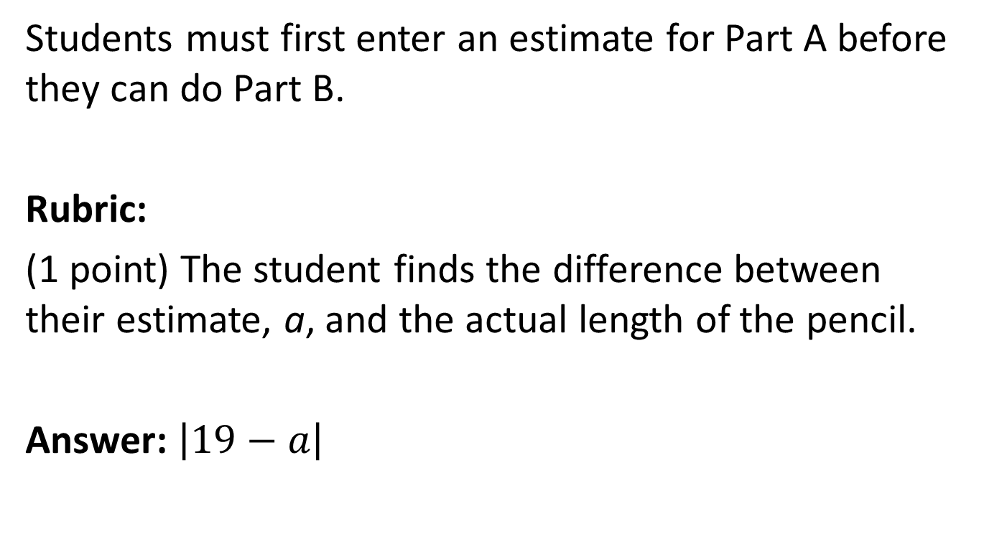
#7 Answer

Slide 16
#8
Jenny went to the store to buy 15 bottles of water.
The bags at the store can each hold 6 kilograms.
The bottles of water each weigh 2 kilograms.
Jenny bought 15 bottles of water.
What is the fewest number of bags that Jenny needs to hold all 15 water bottles?

Slide 17
#8 Answer
Rubric:
(1 point) The student enters the smallest number of bags needed.
Answer: 5

Slide 18
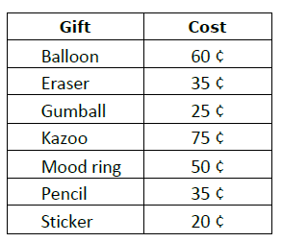
#9
Eva has 2 quarters, 4 dimes, and 6 nickels. She wants to buy a different gift for each of her 3 friends.
Click on the gifts in the table to show 3 gifts that Eva could buy.

Slide 19
#9 Answer
Rubric:
(1 point) The student is able to identify three items whose total cost is less than $1 and 20¢.
Answer: Examples: mood ring, pencil, and sticker.

