Slide 1

Claim 3
Smarter Balanced Sample Items
Grade 3
Communicating Reasoning
Questions courtesy of the Smarter Balanced Assessment Consortium Item Specifications – Version 3.0
Slideshow organized by SMc Curriculum – www.ccssmathactivities.com

Slide 2
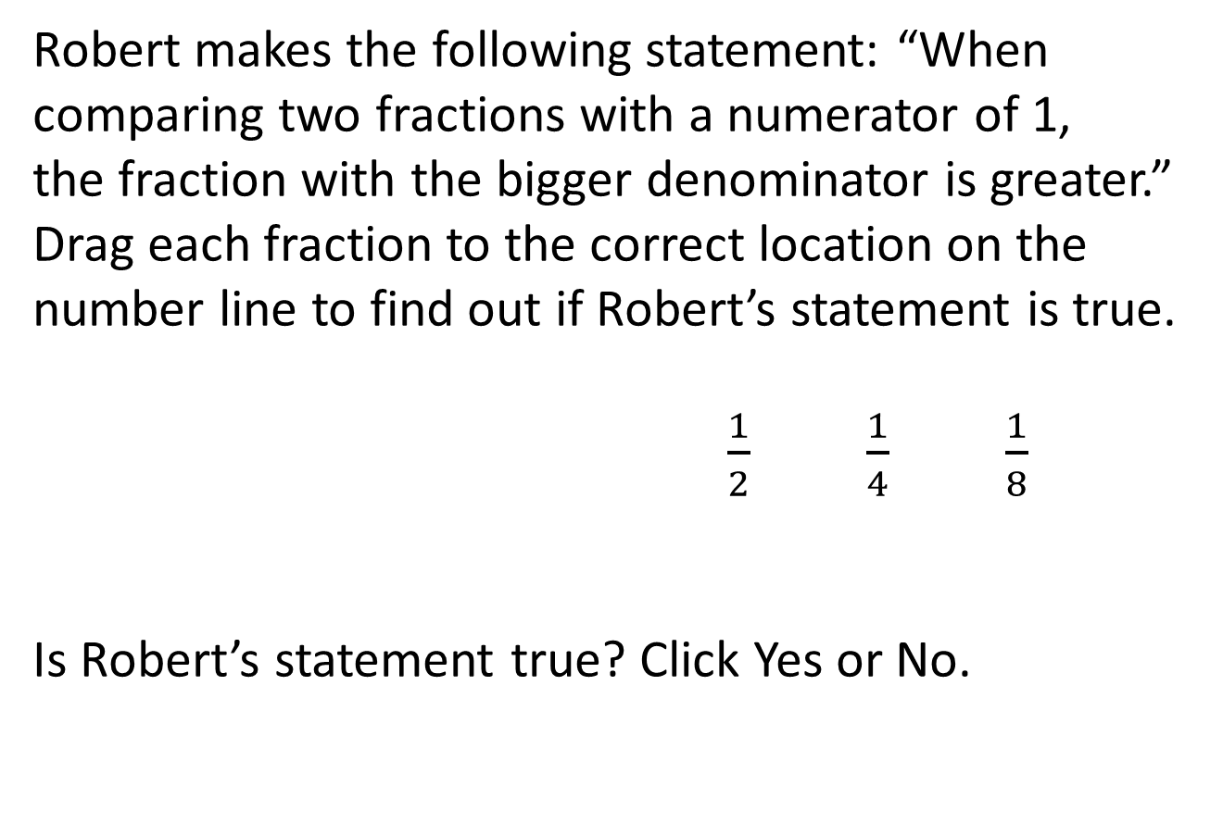
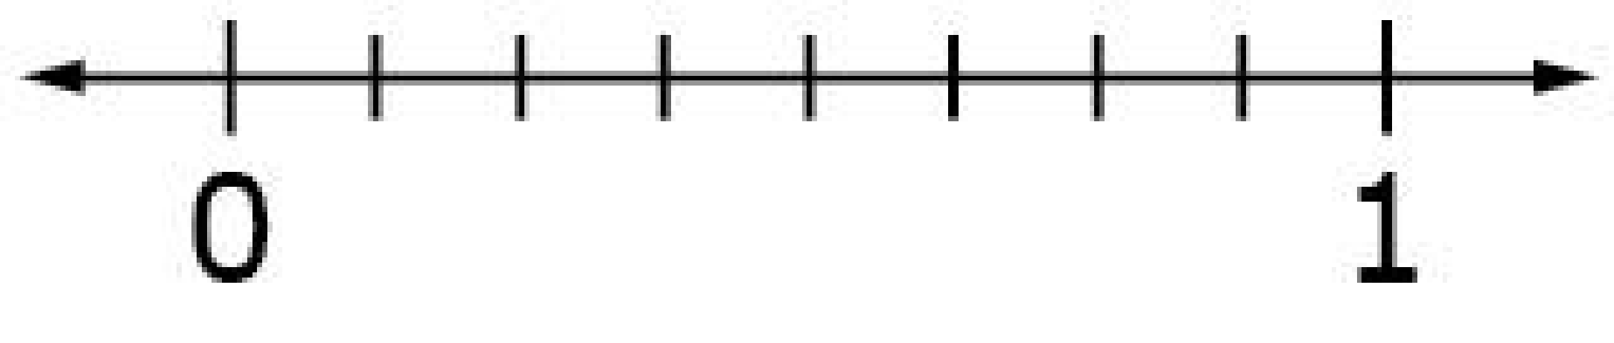
#1
Yes
No

Slide 3
#1 Answer
Rubric:
(2 points) The student places all three fractions in the correct locations and answers “No.”
(1 point) The student either places all the fractions in the correct locations and answers “Yes”; or places all fractions in the correct order but misses the correct location for one or more fractions and answers “No.”

Slide 4
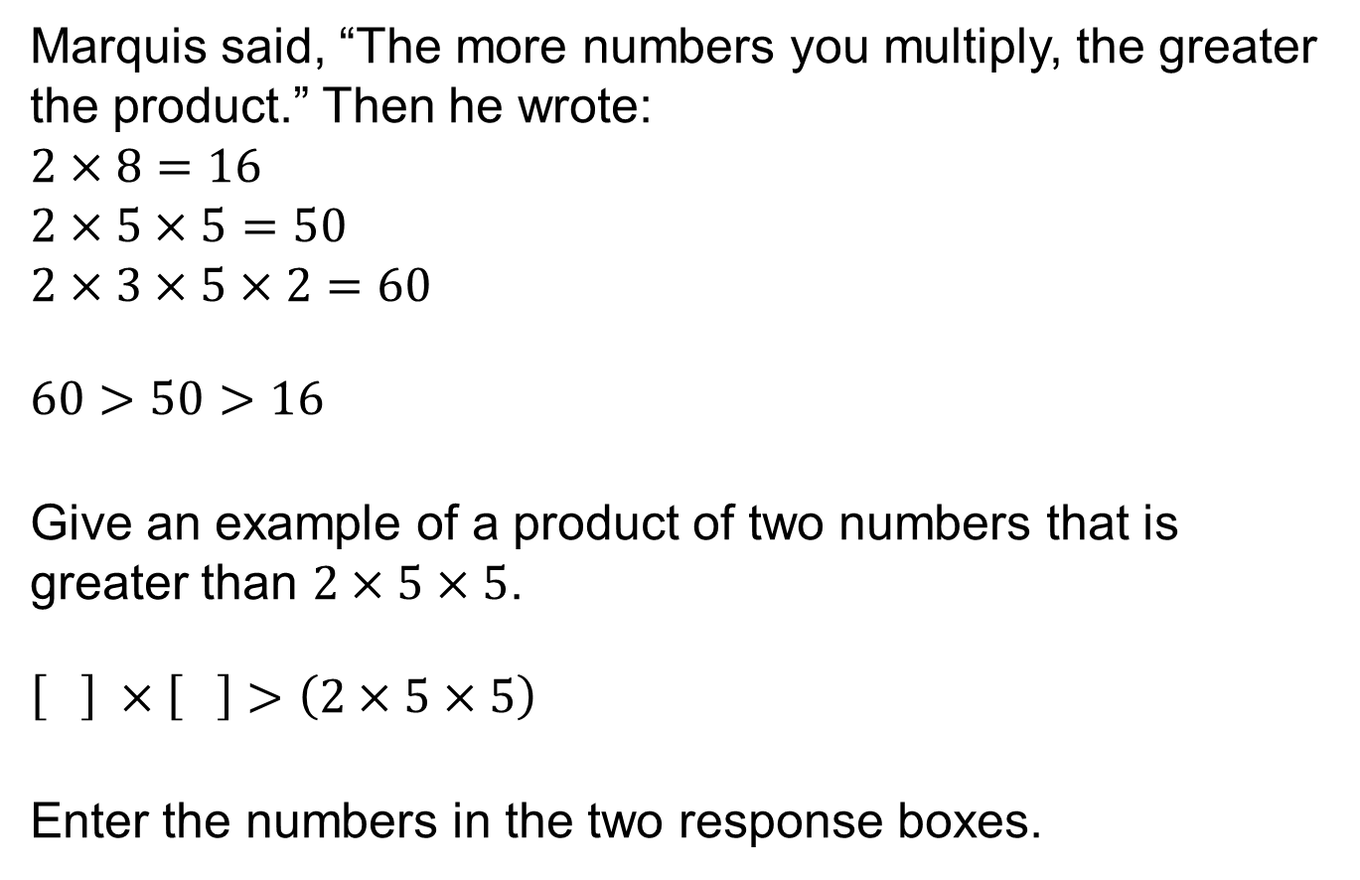
#2

Slide 5
#2 Answer
Rubric:
(1 point) The student enters two numbers in the response boxes whose product is greater than 50.
Answer: e.g., 7 and 8

Slide 6
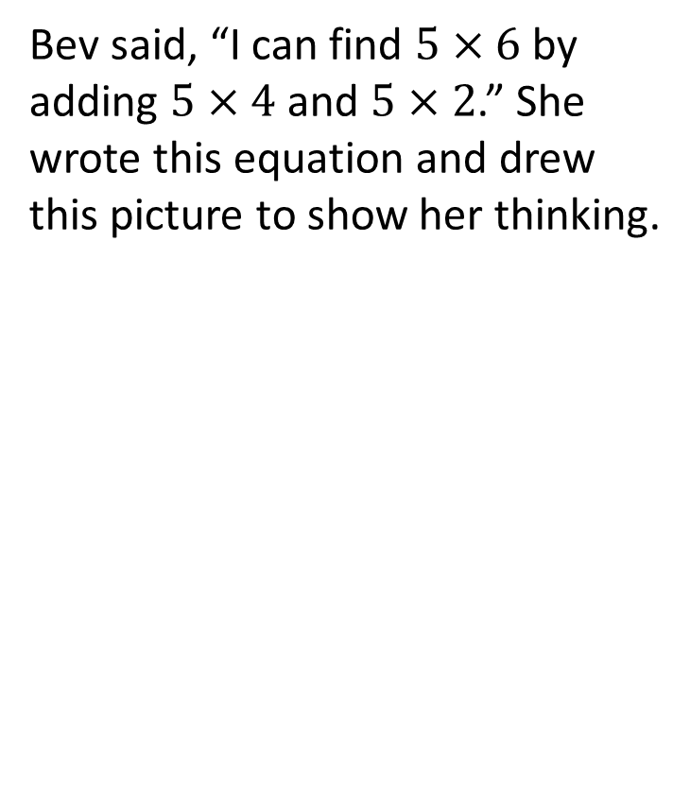
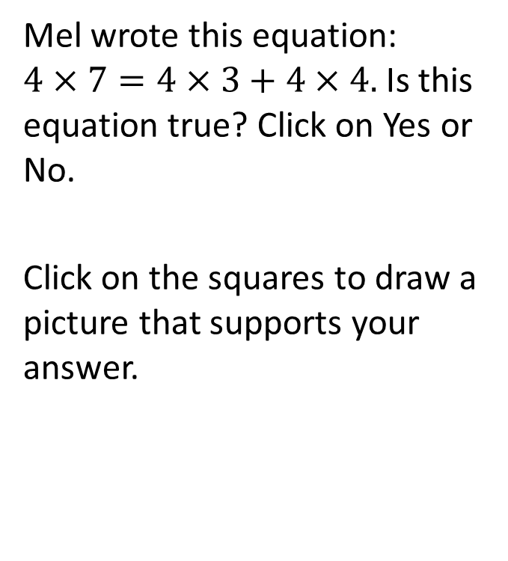
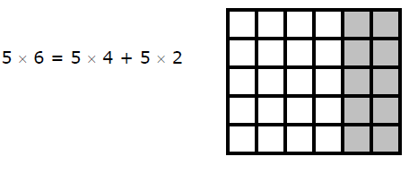

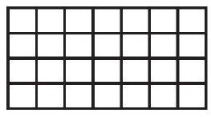
#3

Slide 7
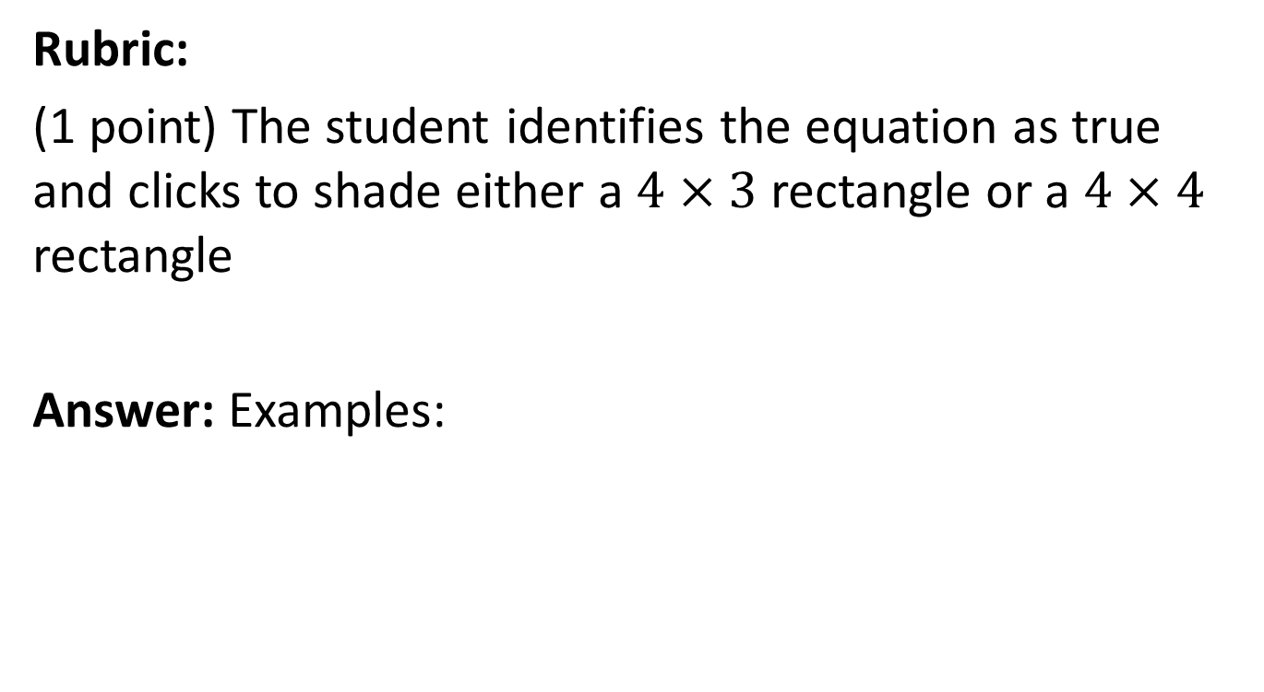
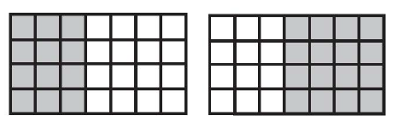
#3 Answer

Slide 8
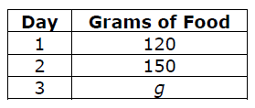
#4
A bird ate 400 grams of food in 3 days. The bird ate 120 grams of food on Day 1, 150 grams of food on Day 2, and g grams of food on Day 3.
How many grams of food did the bird eat on Day 3? Enter your answer in the first response box.
In the second response box, enter an equation that you could solve to find the amount of food the gird ate on Day 3.

Slide 9
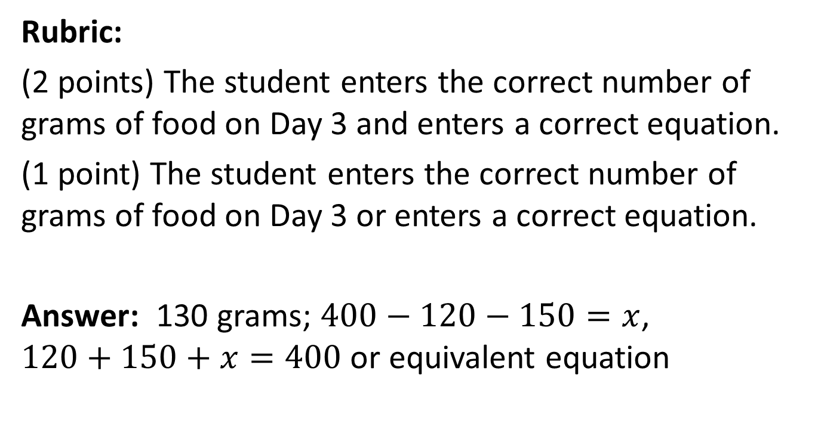
#4 Answer

Slide 10
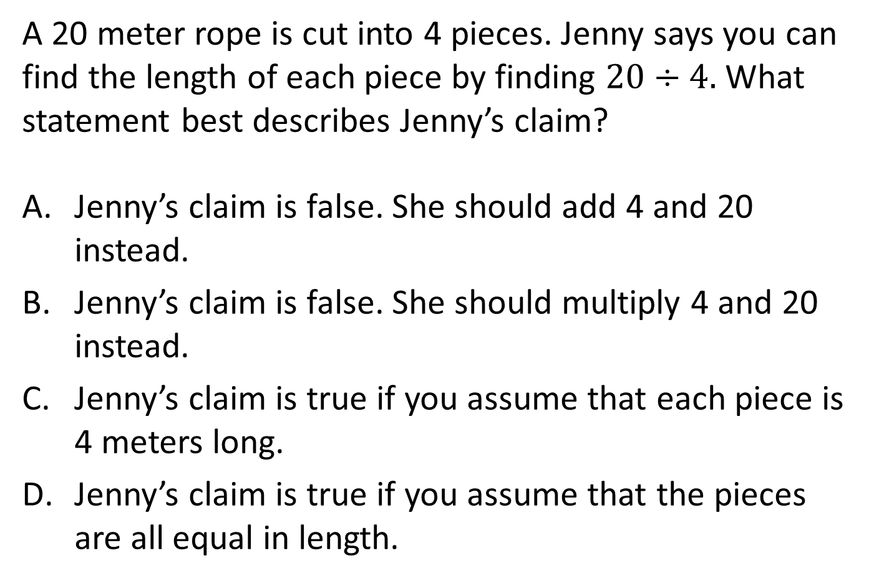
#5

Slide 11
#5 Answer
Rubric:
(1 point) The student selects the correct statement.
Answer: D

Slide 12
#6
Select all the ways you can divide 15 children into equal groups with none left over.
2 groups
3 groups
4 groups
5 groups

Slide 13
#6 Answer
Rubric:
(1 point) The student selects the possible number of groups.
Answer: B and D

Slide 14
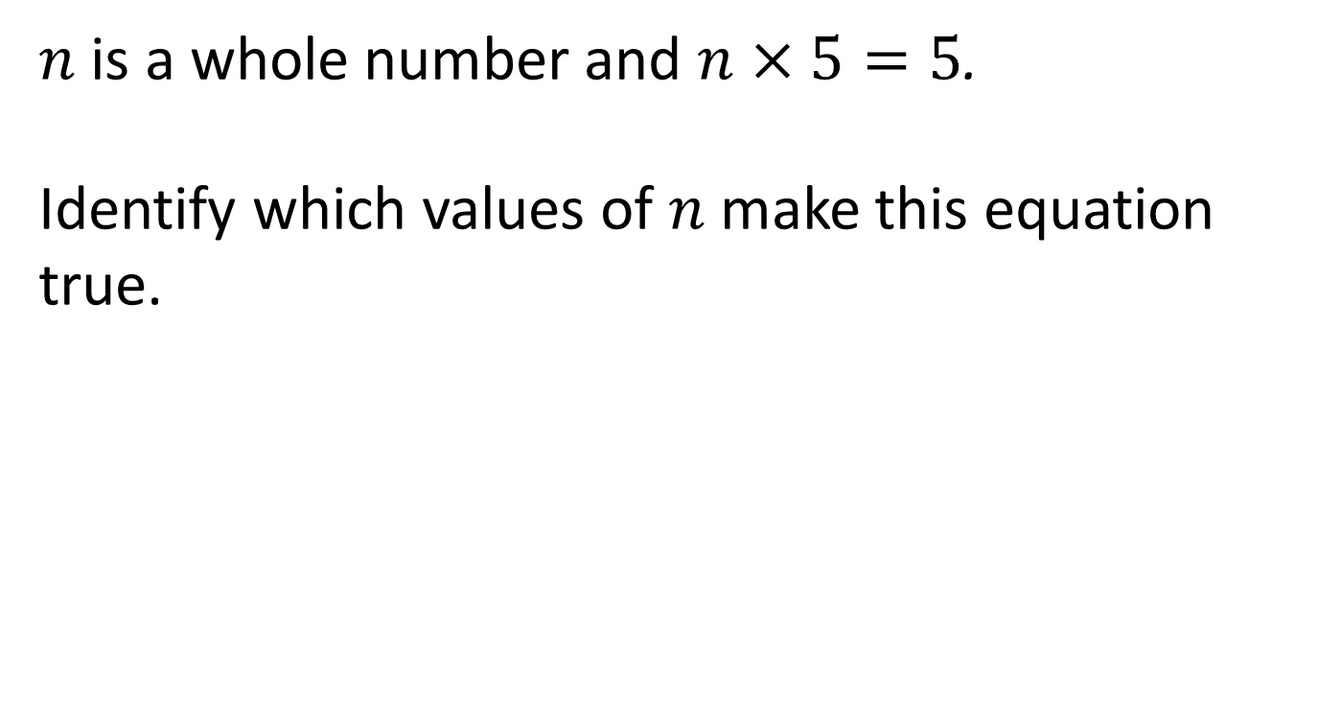
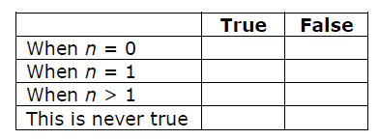
#7

Slide 15
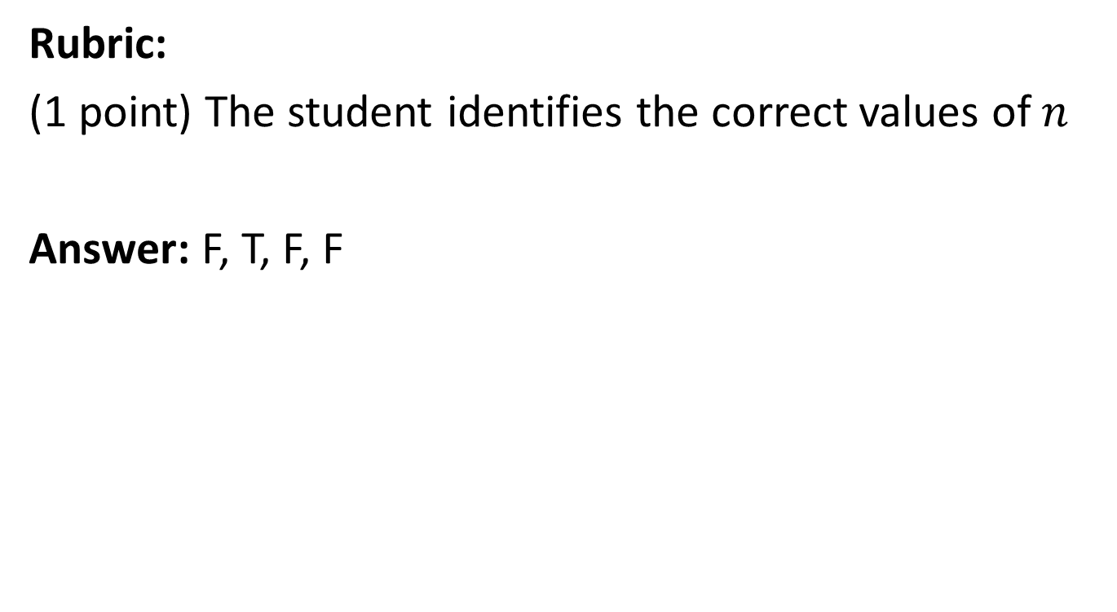
#7 Answer

Slide 16
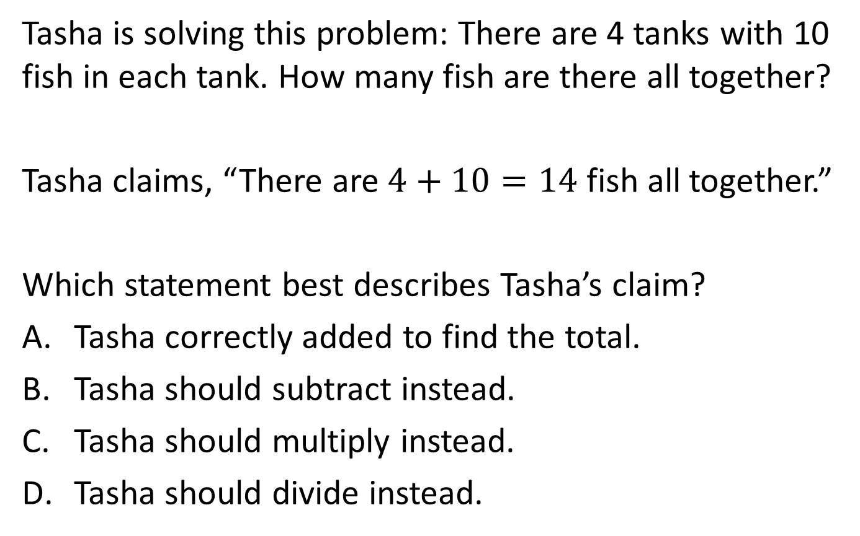
#8

Slide 17
#8 Answer
Rubric:
(1 point) The student selects the correct statement.
Answer: C

Slide 18
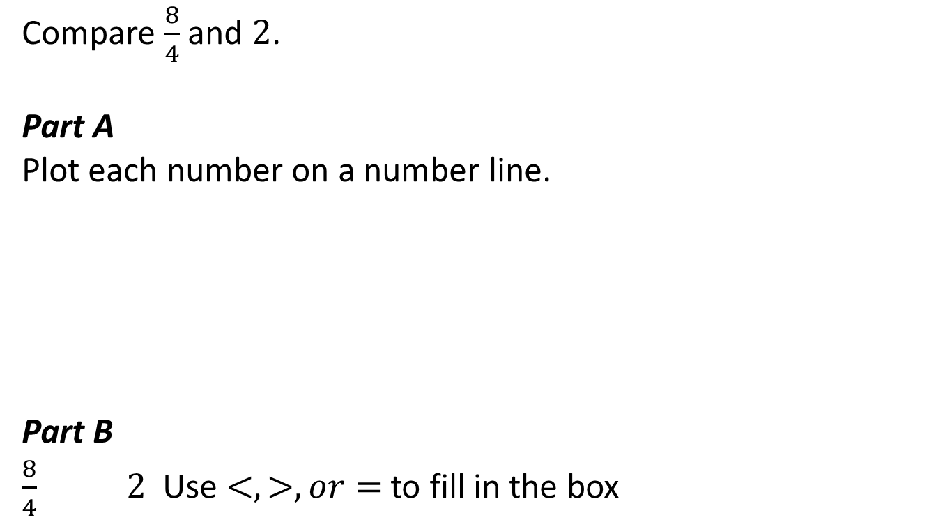
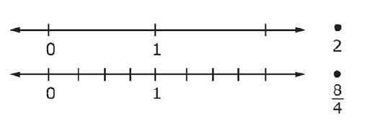
#9

Slide 19
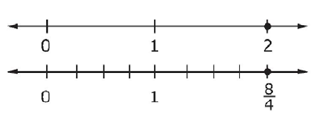
#9 Answer
Rubric:
(1 point) The student plots the points correctly and selects the correct comparison.
Answer: , and =

Slide 20
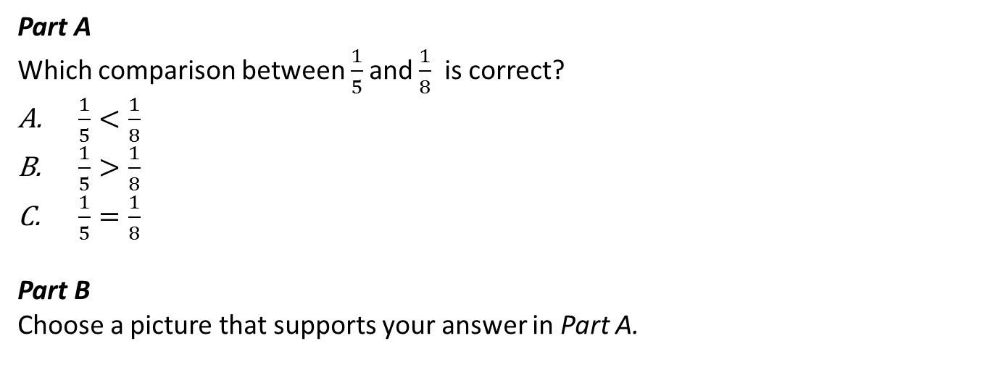
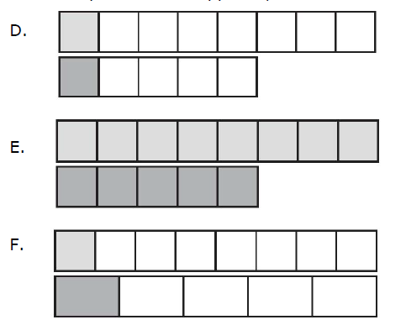
#10

Slide 21
#10 Answer
Rubric:
(1 point) The student selects the correct comparison and the correct picture.
Answer: B, F

