Slide 1

Claim 2
Smarter Balanced Sample Items
Grade 3
Problem Solving
Questions courtesy of the Smarter Balanced Assessment Consortium Item Specifications – Version 3.0
Slideshow organized by SMc Curriculum – www.ccssmathactivities.com

Slide 2
#1
James gets home from school at 3:30 p.m. He completes 2 chores. Then he plays his computer game until 5:00 p.m. Enter the greatest number of minutes that James can play his computer game.
Tasks | Time to Complete
Walk dog | 20 minutes
Clean room | 40 minutes

Slide 3
#1 Answer
Rubric:
(1 point) The student enters the correct number of minutes.
Answer: 30

Slide 4
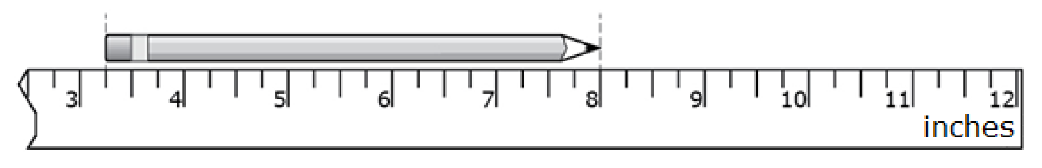
#2
What is the length, in inches, of the pencil shown?
Enter your answer in the response box.

Slide 5
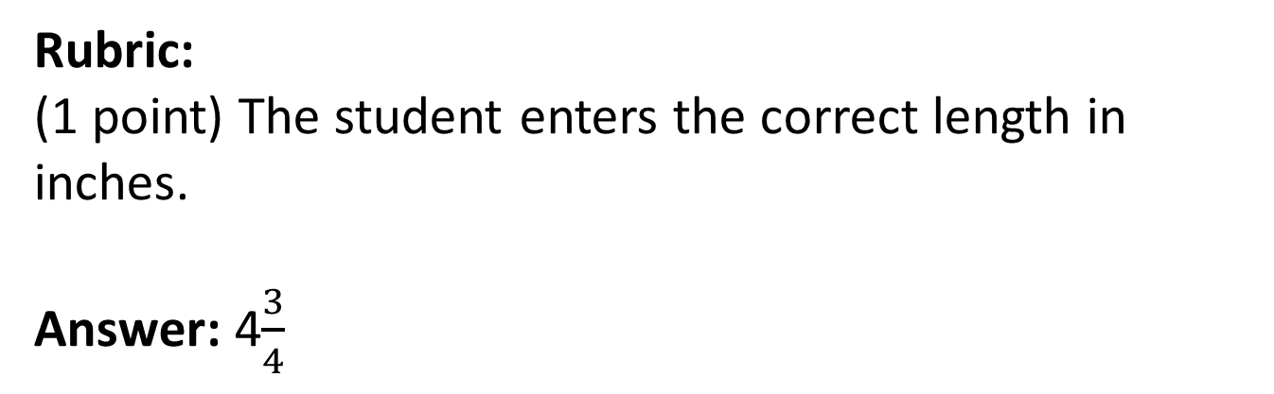
#2 Answer

Slide 6
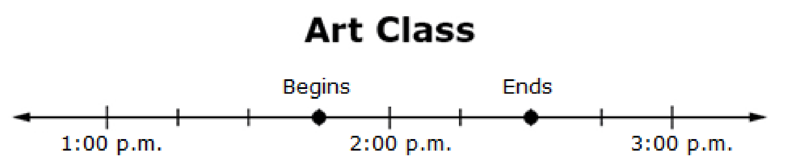
#3
The number line shows when art class begins and ends. How many minutes long is art class? Enter your answer in the response box.

Slide 7
#3 Answer
Rubric:
(1 point) Student correctly enters the time interval.
Answer: 45

Slide 8
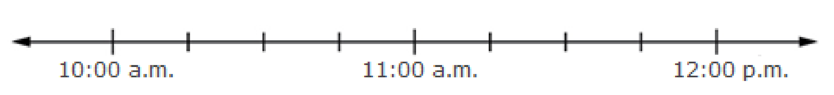
#4
Math class begins at 10:45 a.m. and is 45 minutes long. Use the Add Point tool to put a point on the number line that shows when math class ends.

Slide 9
#4 Answer
Rubric:
(1 point) Student places a point on the number line at the correct location.
Answer: 11:30 a.m.

Slide 10

#5
Mary started her homework 25 minutes before the time shown on the clock. What time was it when Mary started her homework ?

Slide 11
#5 Answer
Rubric:
(1 point) The student shows the correct time.
Answer: 4:25

Slide 12
#6
Steven is baking cookies. On one tray, he makes 5 rows with 4 cookies in each row. He cannot fit any more cookies on the tray. He puts some more cookies on another tray the same size as the first tray. Which number is a reasonable choice for the total number of cookies on the 2 trays?
9 C. 34
B. 20 D. 60

Slide 13
#6 Answer
Rubric:
(1 point) The student enters the most reasonable choice.
Answer: C

Slide 14
#7
Sabina has a jar full of dimes. A pack of cards costs 76 cents. How many dimes would she need to buy the cards if she uses no other coins?
Enter your answer in the response box.

Slide 15
#7 Answer
Rubric:
(1 point) The student enters the correct number of dimes.
Answer: 8

Slide 16
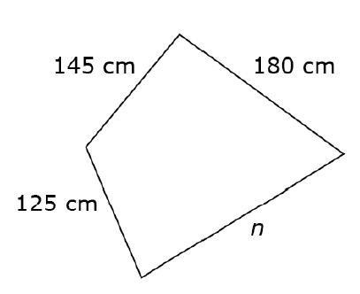
#8
This quadrilateral has a perimeter of 680 centimeters.
Enter the length, in centimeters, of side n.

Slide 17
#8 Answer
Rubric:
(1 point) The student correctly enters the length of the unknown side.
Answer: 230 or 230 cm.

Slide 18
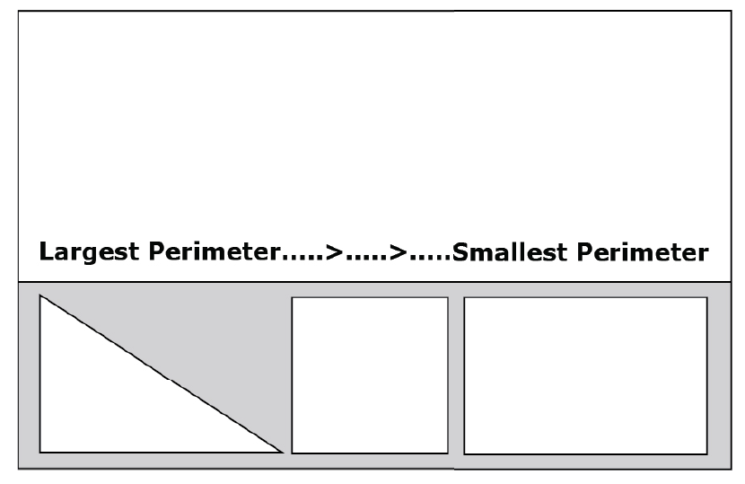
#9
Order all three figures so
that the one on the left
has the largest perimeter
and the one on the right
has the smallest perimeter.
Drag each figure into
the space in order of its perimeter.

Slide 19
#9 Answer
Rubric:
(1 point) The student correctly order the figures.
Answer: rectangle first, the triangle second, and the square third.

Slide 20
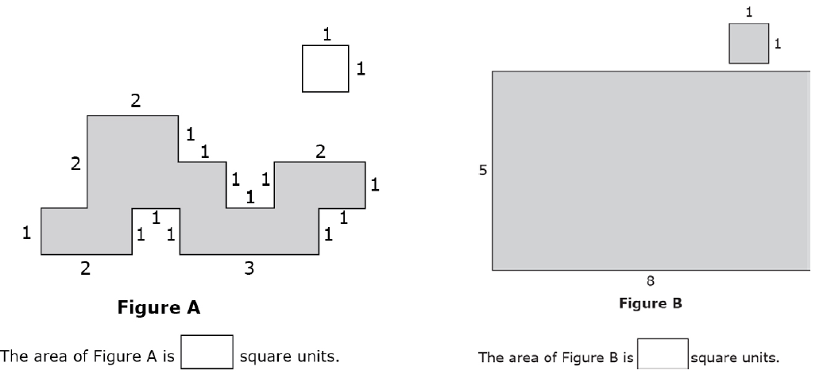
#10
What is the area of each figure?

Slide 21
#10 Answer
Rubric:
(2 points) The student enters the correct area for each figure, 1 point for each.
Answer: Figure A is 12 and Figure B is 40

Slide 22
#11
Vera is making 6 picture frames. Each picture frame requires 8 craft sticks. Craft sticks are sold in packs of 10.
What is the fewest number of packs of craft sticks Vera can buy to get the total she needs?
Enter your answer in the response box.

Slide 23
#11 Answer
Rubric:
(1 point) The student enters the correct number of packs
Answer: 5

Slide 24
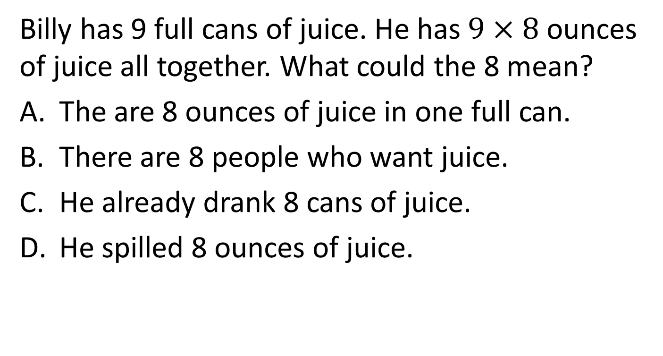
#12

Slide 25
#12 Answer
Rubric:
(1 point) The student selects the correct option.
Answer: A

Slide 26
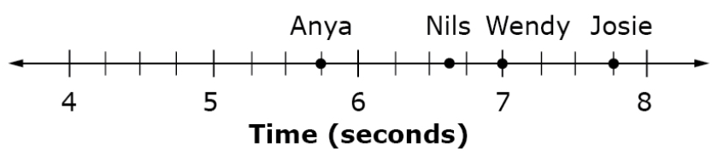
#13
Three friends ran a race. The points on the number line represent the race times, in seconds, for each friend.
Who had the shortest time?
Anya
Nils
Wendy
Josie

Slide 27
#13 Answer
Rubric:
(1 point) The student selects the correct option.
Answer: A

Slide 28
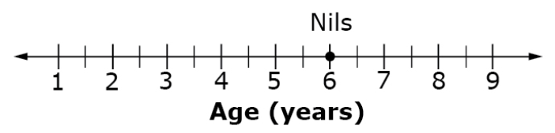
#14
Hank is 8.5 years old. Nils’ age in years is plotted on the number line shown.
How many years older is Hank than Nils?
Enter the number of years in the response box.

Slide 29
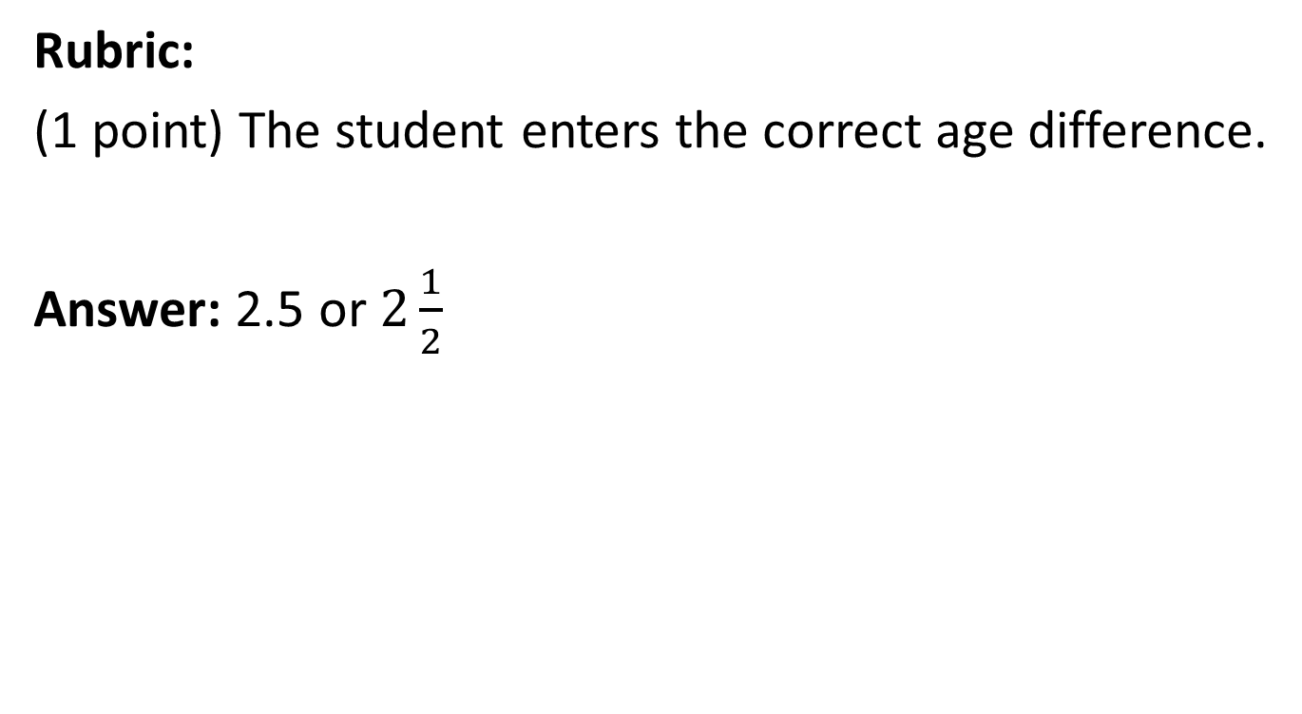
#14 Answer

