Slide 1

Claim 1
Smarter Balanced Sample Items
Grade 3 - Target K
Reason with shapes and their attributes.
Questions courtesy of the Smarter Balanced Assessment Consortium Item Specifications – Version 3.0
Slideshow organized by SMc Curriculum – www.ccssmathactivities.com
Notes:
‹#›

Slide 2
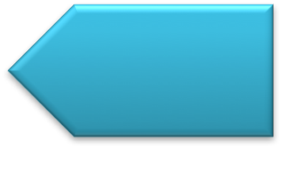
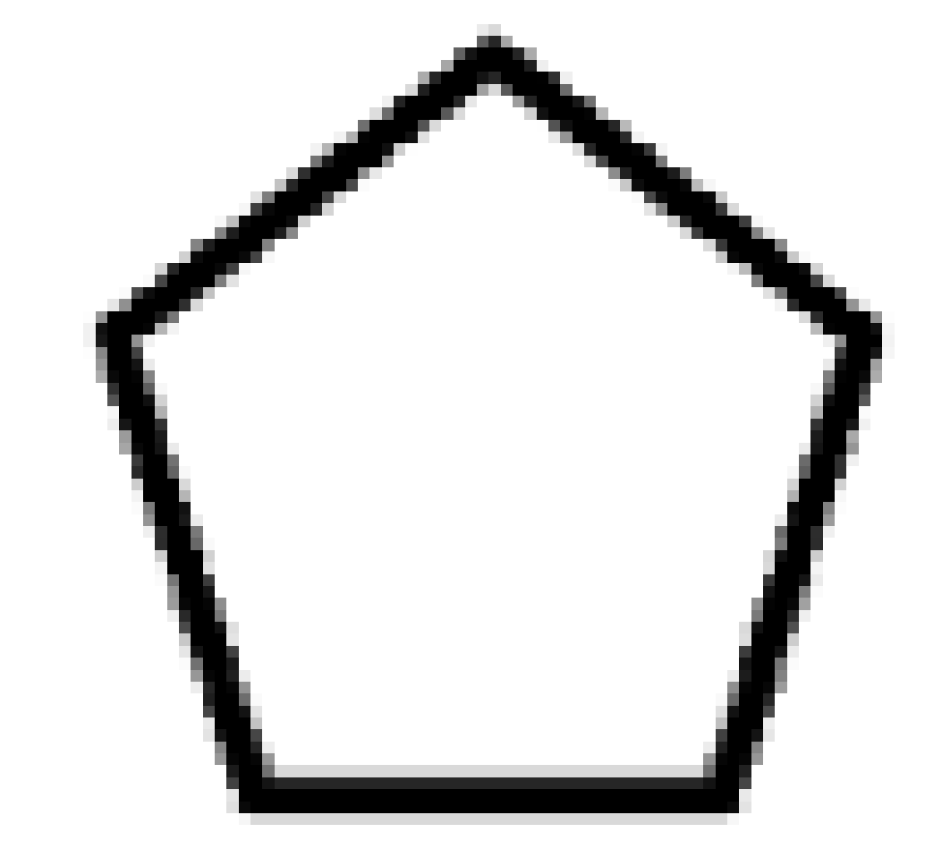

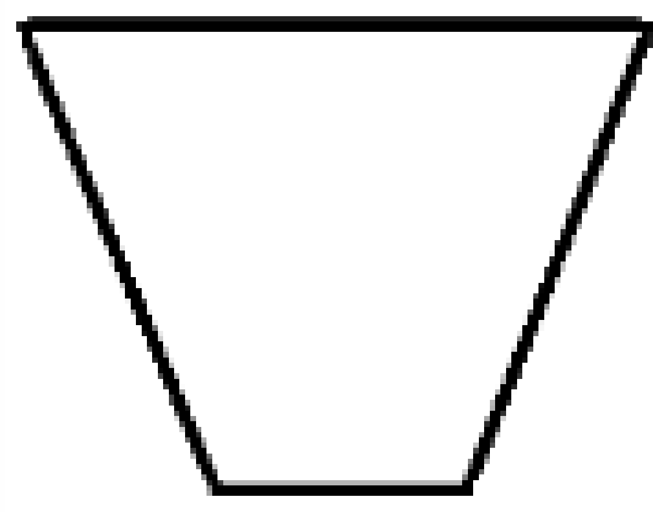
#1
Decide whether each shape is a quadrilateral. Click Yes or No for each shape.
 | Yes | No

Slide 3

#1 Answer
Rubric:
(1 point) The student correctly identifies each shape as Yes or No.
Answer: N, Y, Y
Notes:
‹#›

Slide 4
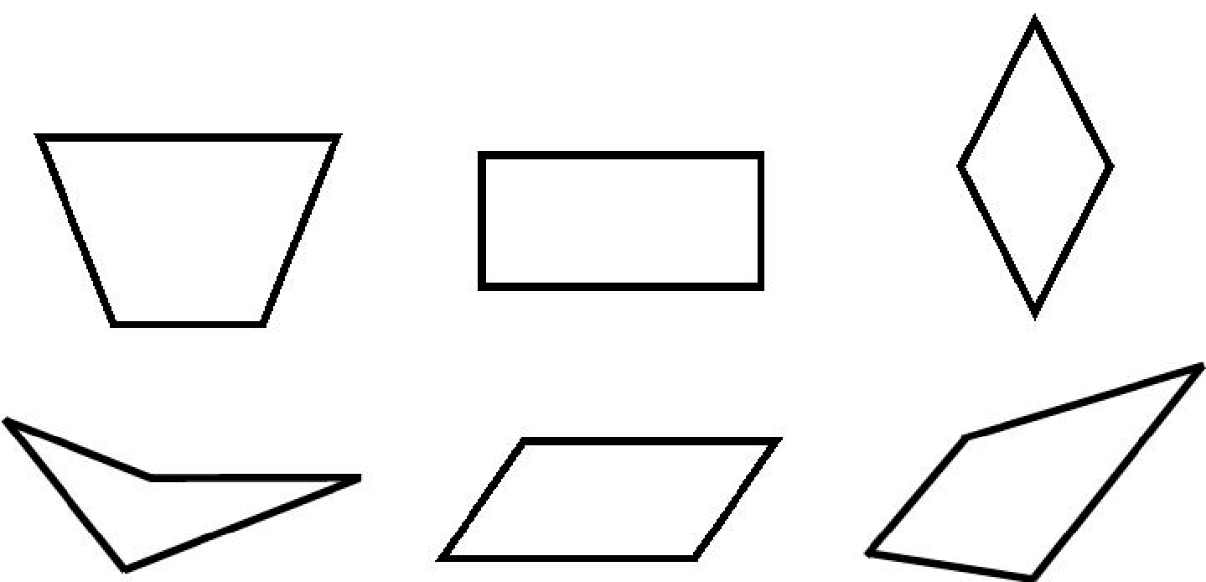
#2
Click all of the shapes that appear to be parallelograms.
Notes:
‹#›

Slide 5
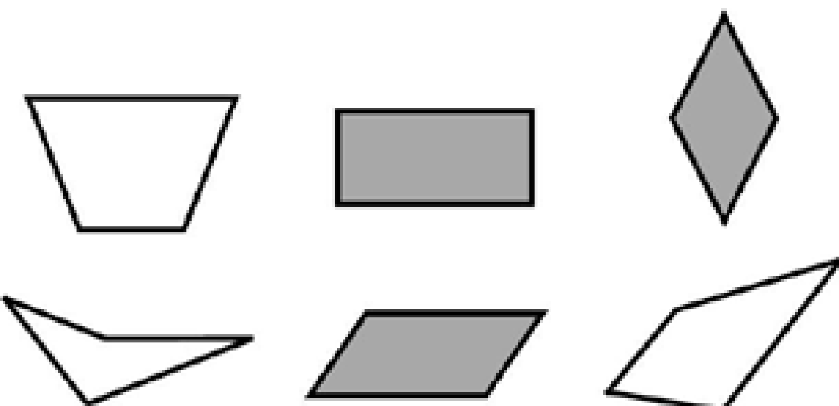
#2 Answer
Rubric:
(1 point) The student correctly selects all of the parallelograms.
Answer:
Notes:
‹#›

Slide 6
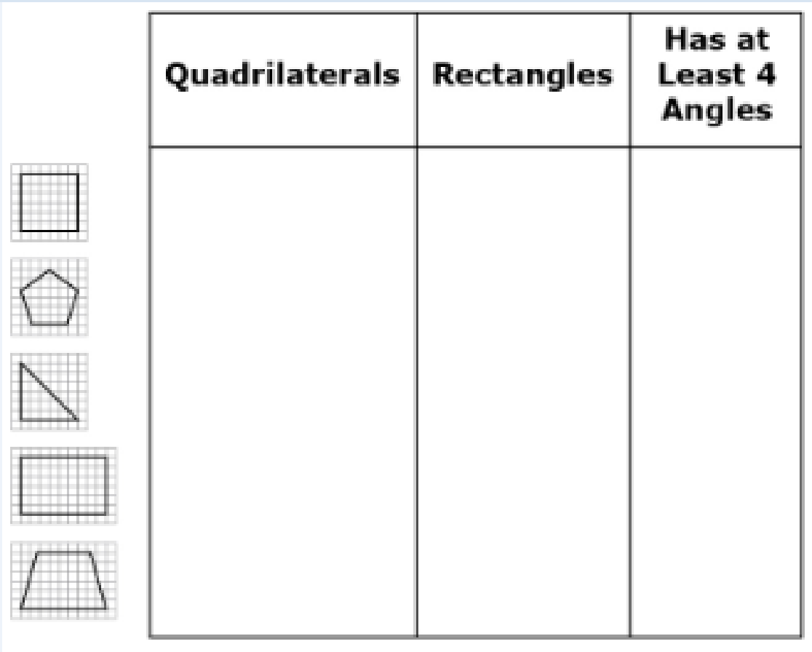
#3
Drag the figures to each box or boxes where they belong. A figure may belong to more than one category or to none of these categories.

Slide 7
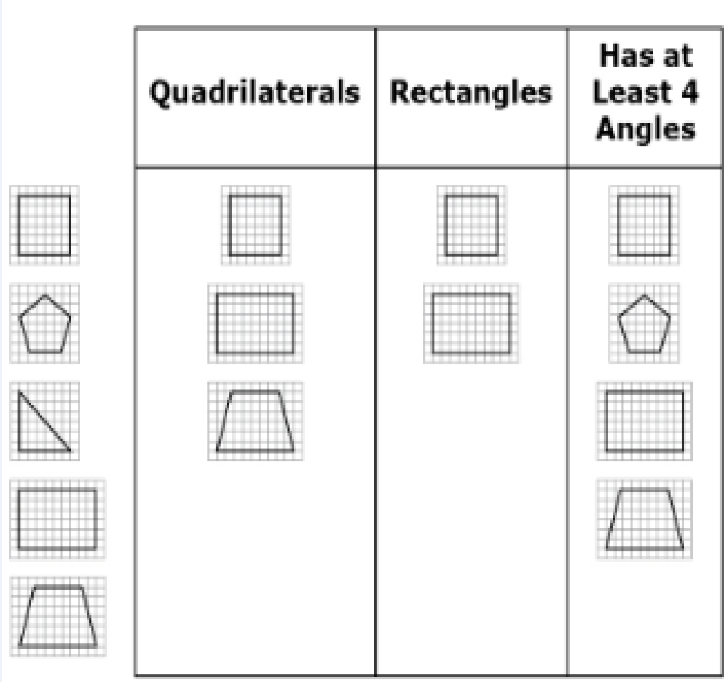
#3 Answer
Rubric:
(1 point) The student correctly classifies each shape.
Answer:

Slide 8
#4
Example 1: Use the Connect Line tool to draw a quadrilateral where every side is the same length.
Example 2: Use the Connect Line tool to draw a quadrilateral where every side is a different length.
Example 3: Use the Connect Line tool to draw a quadrilateral that is not a rhombus or a rectangle.

Slide 9

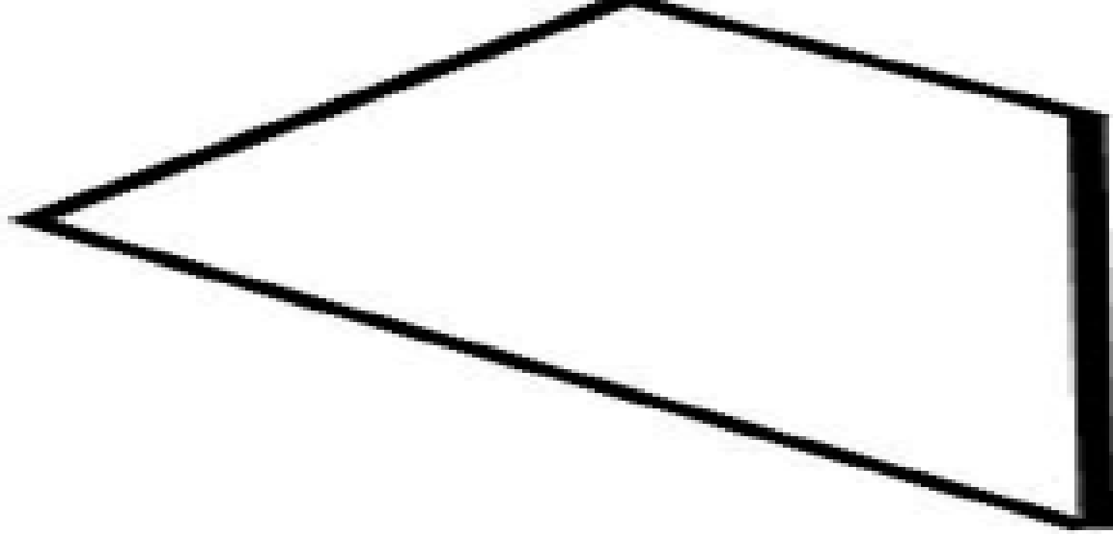
#4 Answer
Rubric:
(1 point each) The student correctly draws a quadrilateral that meets the given attributes.
Possible Answers:
Example 1:
Example 2:
Example 3:

Slide 10
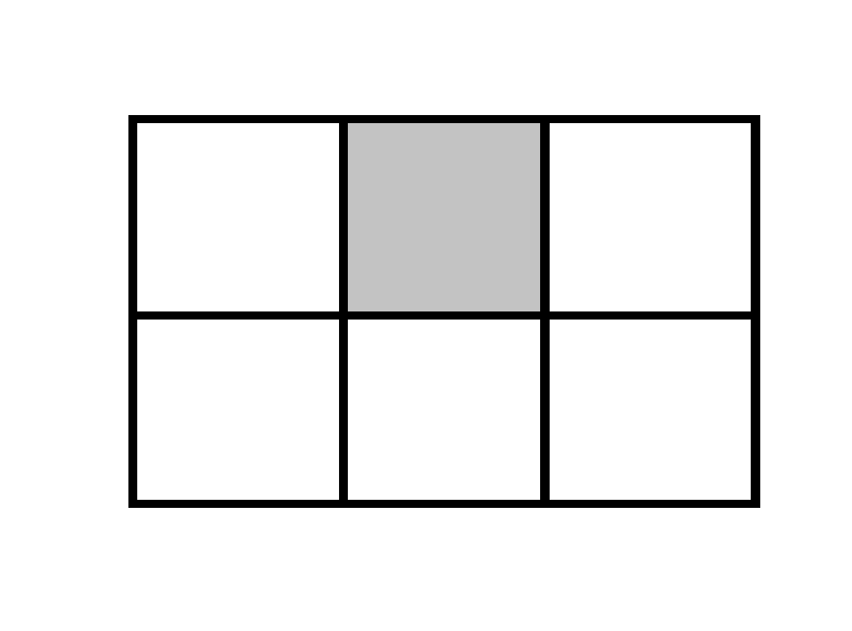
#5
Figure A is divided into equal squares. One square is shaded.
Figure A
Enter a fraction that is equal to the shaded area of Figure A.

Slide 11

#5 Answer
Rubric:
(1 point) The student enters the fraction equal to the shaded portion of the shape.
Answer:

Slide 12
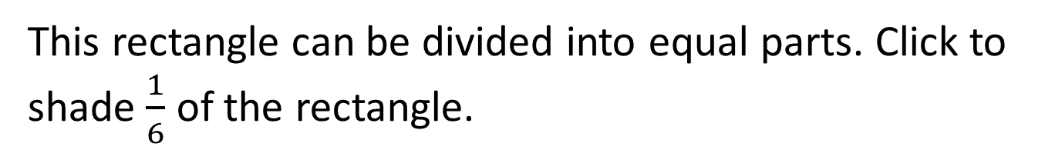
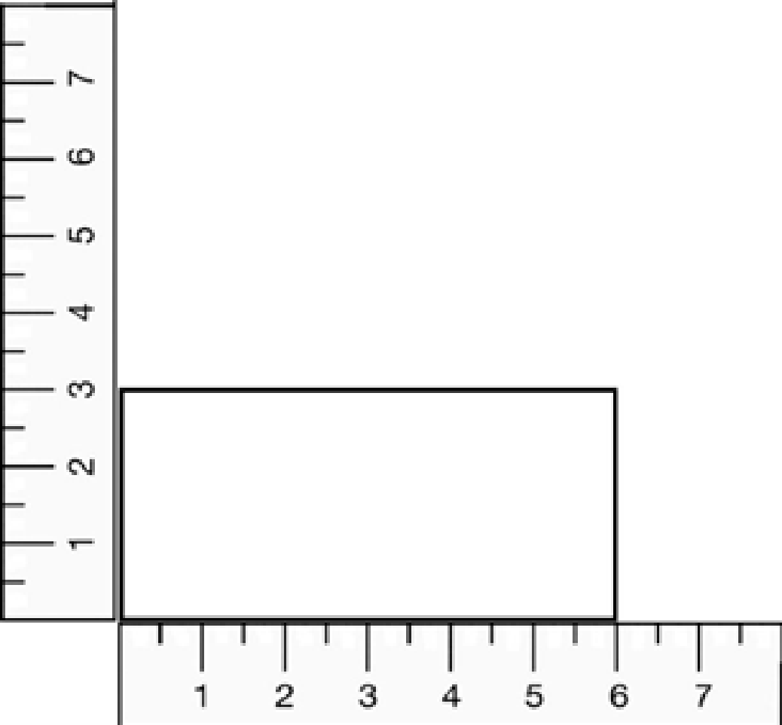
#6

Slide 13
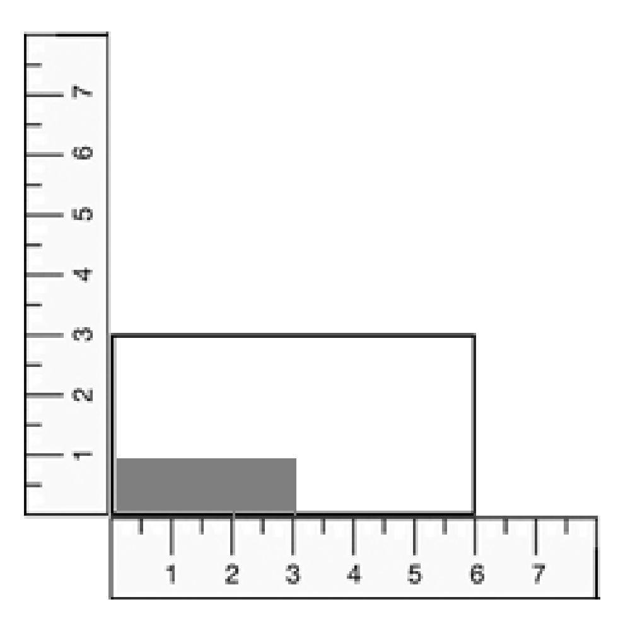
#6 Answer
Rubric:
(1 point) The student clicks on the Hot Spots in the background to represent the unit fraction provided.
Answer: see below, or any 3 squares shaded

