Slide 1

Claim 1
Smarter Balanced Sample Items
Grade 3 - Target J
Geometric measurement: recognize perimeter as an attribute of plane figures and distinguish between linear and area measures.
Questions courtesy of the Smarter Balanced Assessment Consortium Item Specifications – Version 3.0
Slideshow organized by SMc Curriculum – www.ccssmathactivities.com
Notes:
‹#›

Slide 2

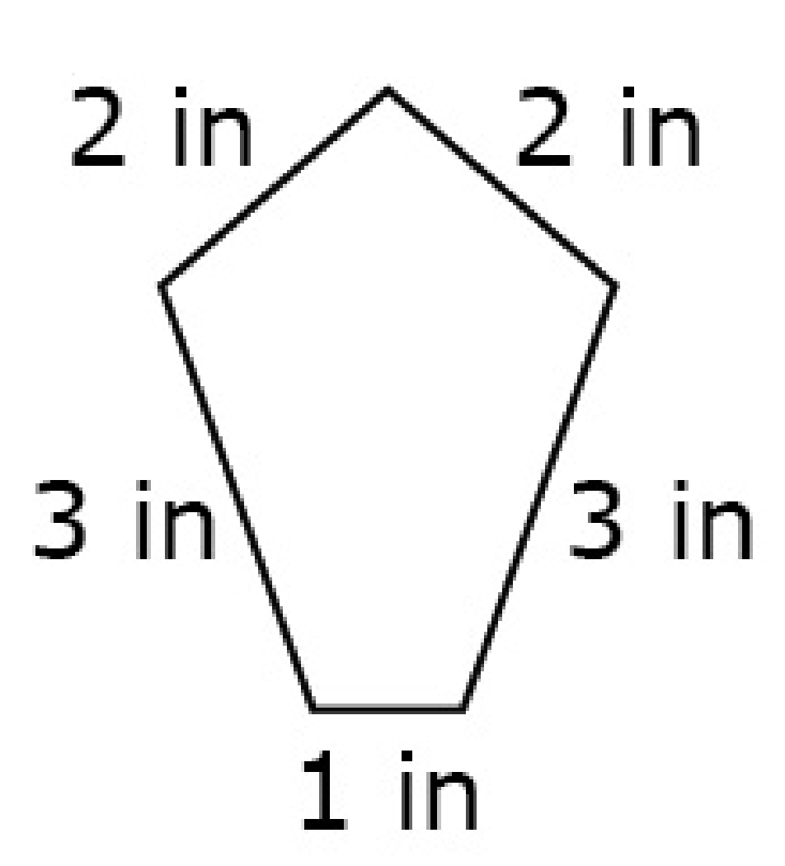
#1
The length of each side of the polygon is shown. Enter the perimeter, in inches, of the polygon.

Slide 3

#1 Answer
Rubric:
(1 point) The student correctly enters the perimeter of the shape.
Answer: 11
Notes:
‹#›

Slide 4
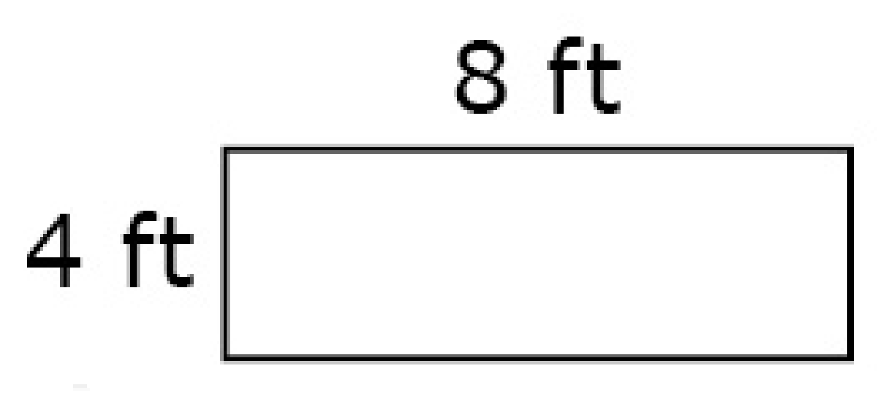
#2
Ms. Smith needs to find the perimeter of her rectangular garden. She wants to put a fence around her entire garden. Her garden measures 8 feet by 4 feet as shown. Enter the perimeter, in feet, of the garden.
Notes:
‹#›

Slide 5
#2 Answer
Rubric:
(1 point) The student correctly enters the perimeter of the shape.
Answer: 24
Notes:
‹#›

Slide 6
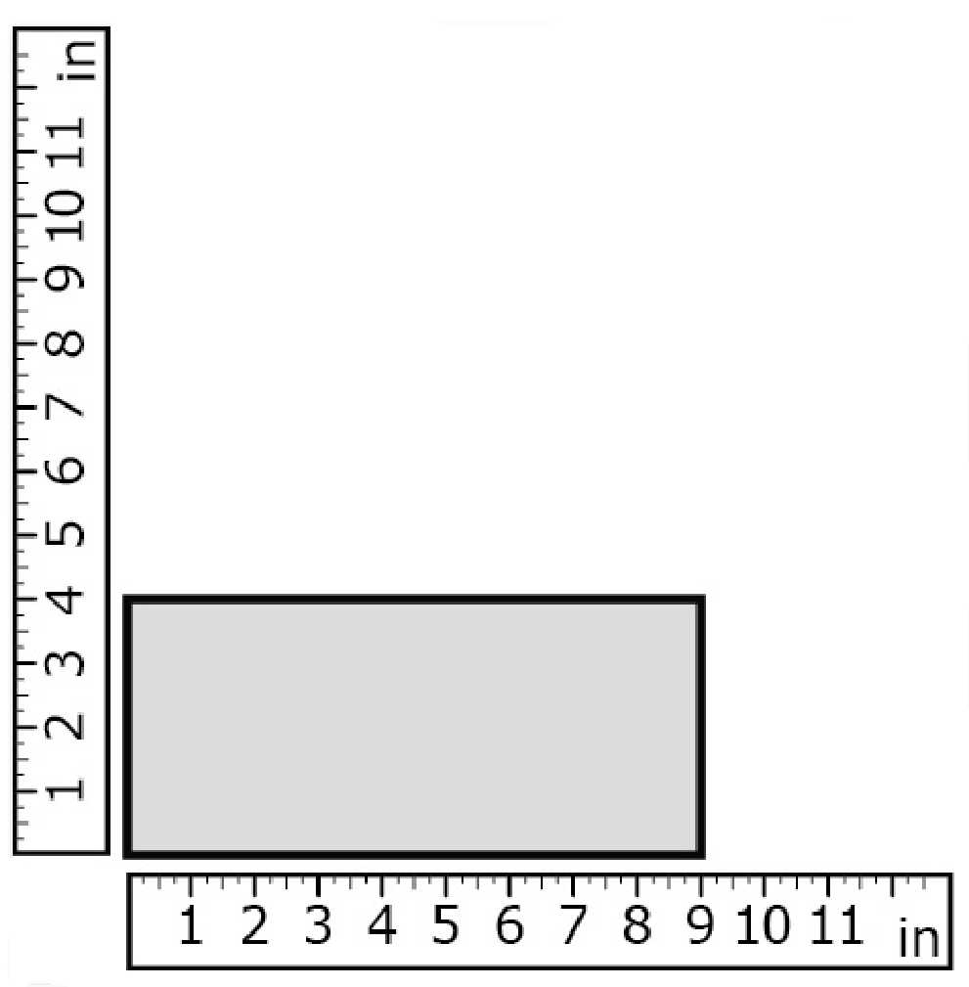
#3
The rulers give the measurement for two sides of the rectangle. Enter the perimeter, in inches, of the rectangle.

Slide 7
#3 Answer
Rubric:
(1 point) The student correctly enters the perimeter of the shape.
Answer: 26

Slide 8
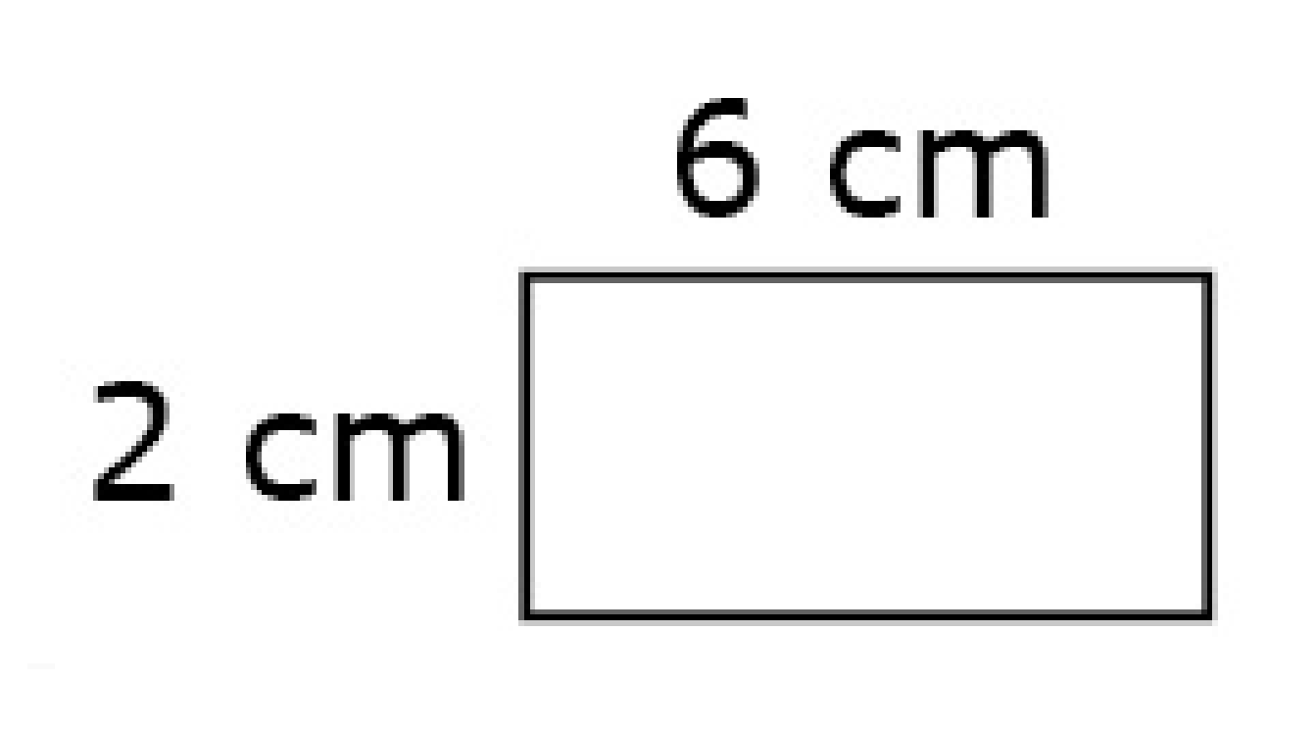
#4
The rectangle shown has side lengths 6 centimeters and 2 centimeters. Enter the perimeter, in centimeters, of the rectangle.

Slide 9
#4 Answer
Rubric:
(1 point) The student correctly enters the perimeter of the shape.
Answer: 16

Slide 10
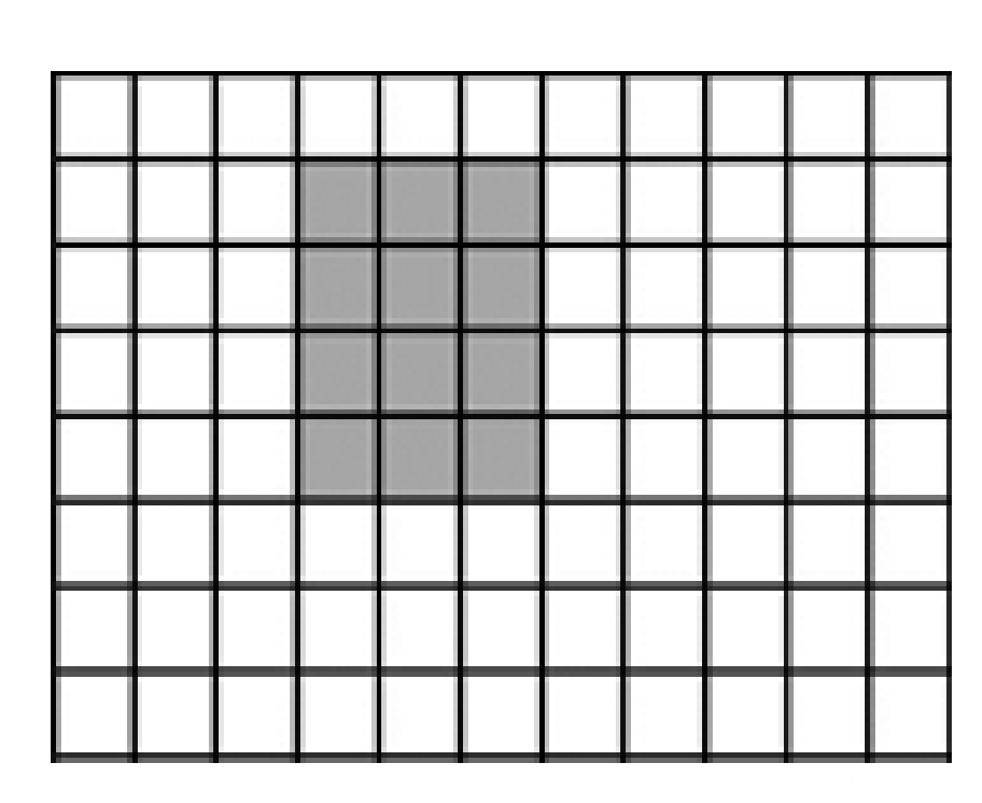
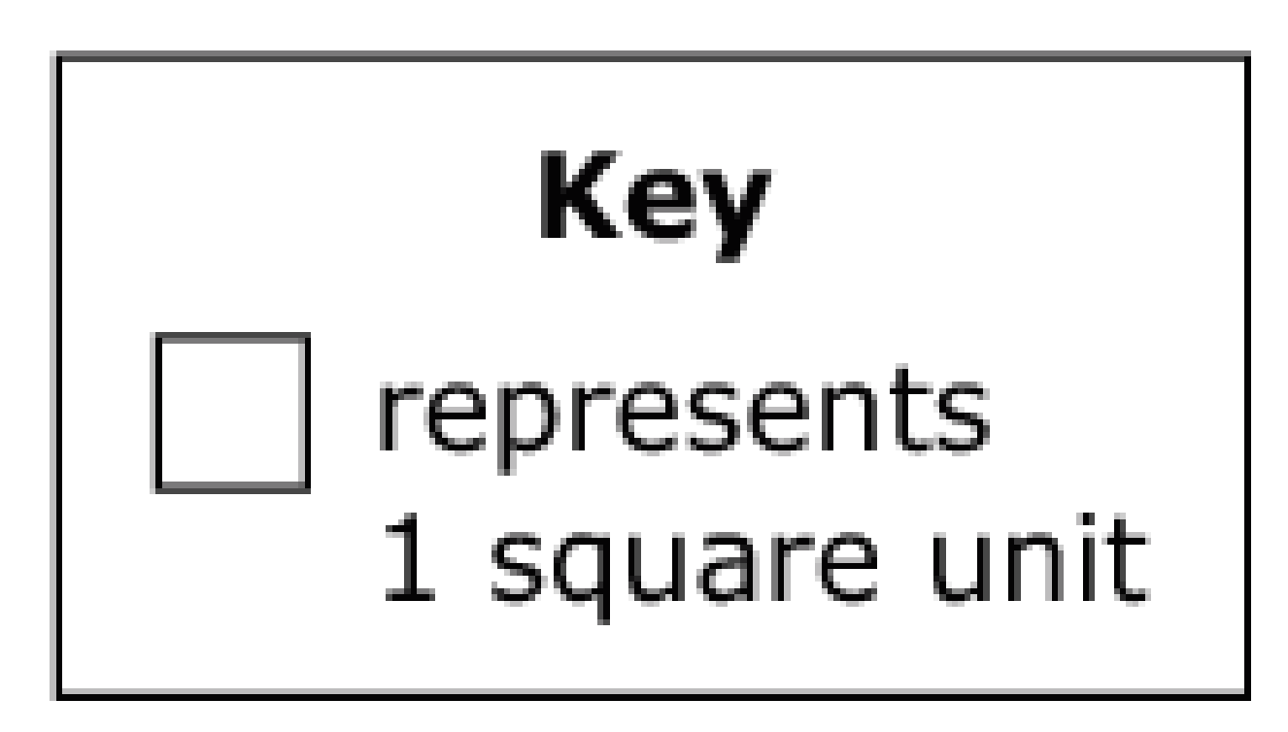
#5
A shaded rectangle is shown on the grid.
Part A: What is the perimeter, in units, of the rectangle? Enter your answer in the first response box.
Part B: What is the area, in square units, of the rectangle? Enter your answer in the second response box.

Slide 11
#5 Answer
Rubric:
(2 points) The student correctly enters the perimeter and area of the rectangle.
(1 point) The student correctly enters either the perimeter or area of the rectangle.
Answers:
Part A: 14
Part B: 12

