Slide 1

Claim 1
Smarter Balanced Sample Items
Grade 3 - Target I
Geometric measurement: understand concepts of area and relate area to multiplication and to addition.
Questions courtesy of the Smarter Balanced Assessment Consortium Item Specifications – Version 3.0
Slideshow organized by SMc Curriculum – www.ccssmathactivities.com
Notes:
‹#›

Slide 2
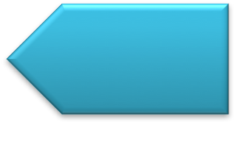
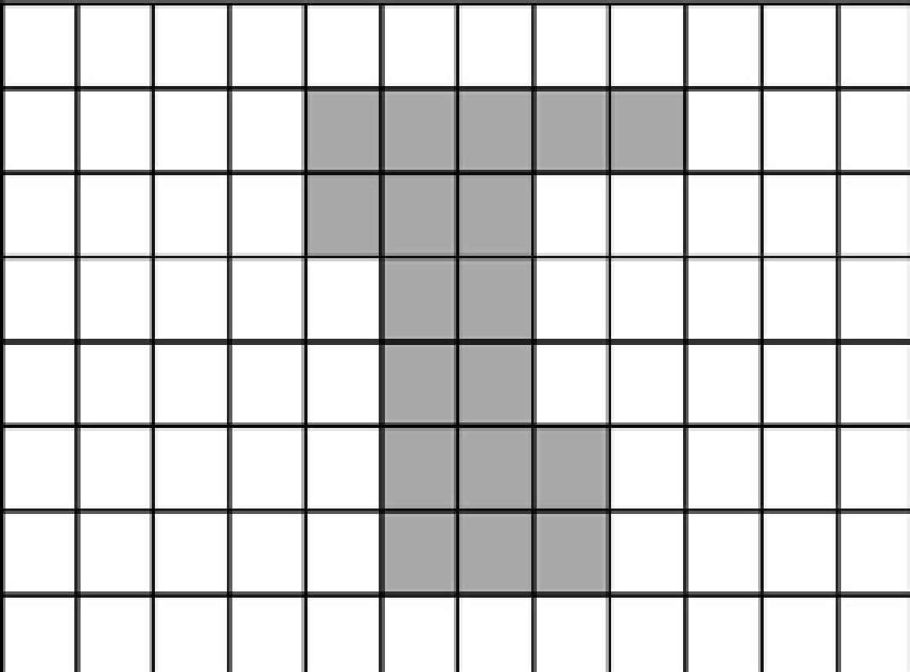
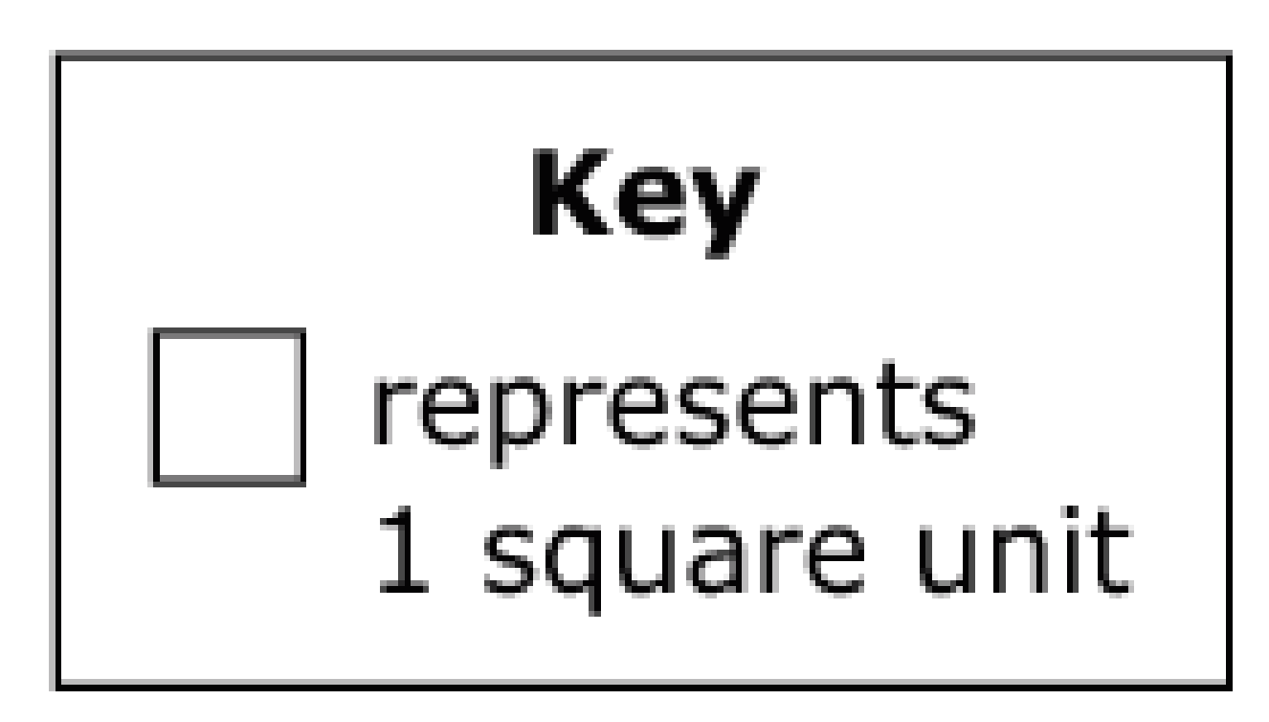
#1
Use this diagram to solve the problem. Enter the area, in square units, of the shaded figure.

Slide 3
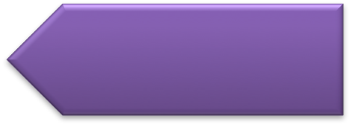
#1 Answer
Rubric:
(1 point) The student correctly enters the area, in square units, of the shaded figure.
Answer: 18
Notes:
‹#›

Slide 4
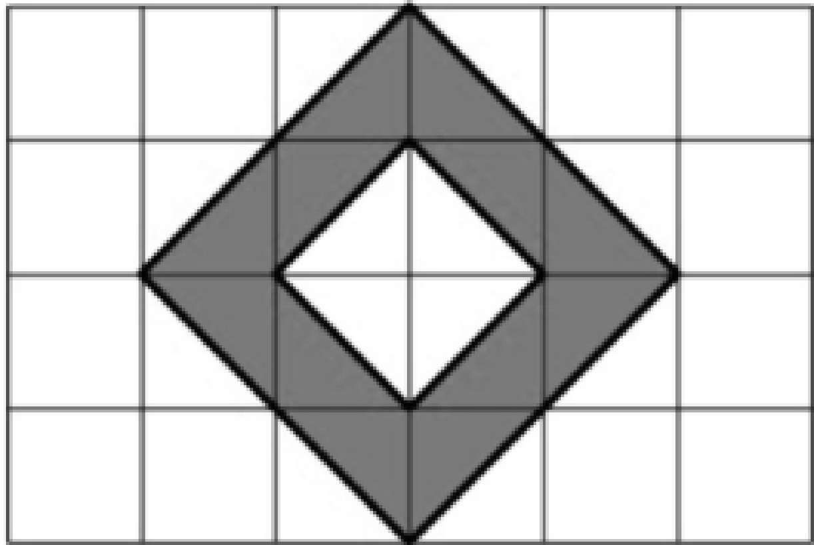
#2
Use this diagram to solve the problem. Enter the area, in square units, of the shaded figure.
Notes:
‹#›

Slide 5
#2 Answer
Rubric:
(1 point) The student correctly enters the area, in square units, of the shaded figure.
Answer: 6
Notes:
‹#›

Slide 6
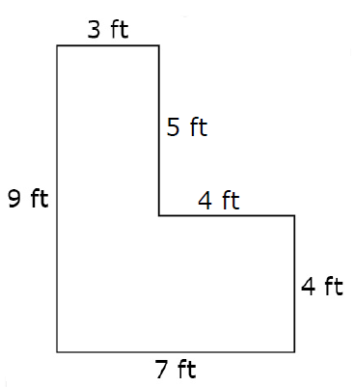
#3
This figure is made by joining two rectangles. Enter the total area, in square feet, of the figure.

Slide 7
#3 Answer
Rubric:
(1 point) The student enters the correct value.
Answer: 43

Slide 8
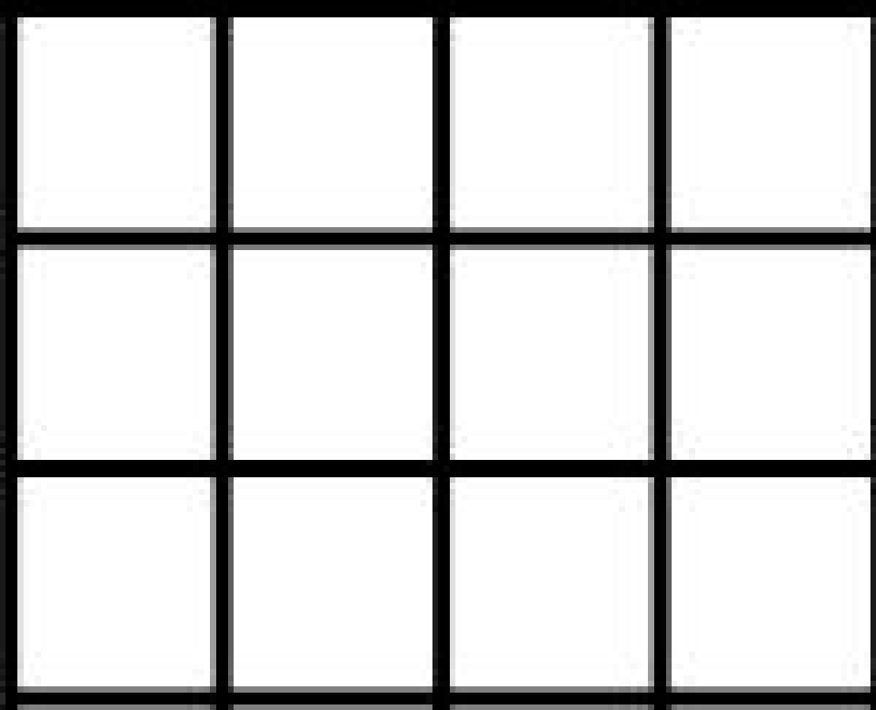
#4
This figure is tiled with square units. Which expression could be used to find the area of this figure in square units?
A. 3 + 4
B. 3 × 4
C. 3 + 3 + 4 + 4
D. 3 × 3 × 4 × 4

Slide 9
#4 Answer
Rubric:
(1 point) The student chooses the correct expression.
Answer: B

