Slide 1

Claim 1
Smarter Balanced Sample Items
Grade 3 - Target H
Represent and interpret data.
Questions courtesy of the Smarter Balanced Assessment Consortium Item Specifications – Version 3.0
Slideshow organized by SMc Curriculum – www.ccssmathactivities.com
Notes:
‹#›

Slide 2

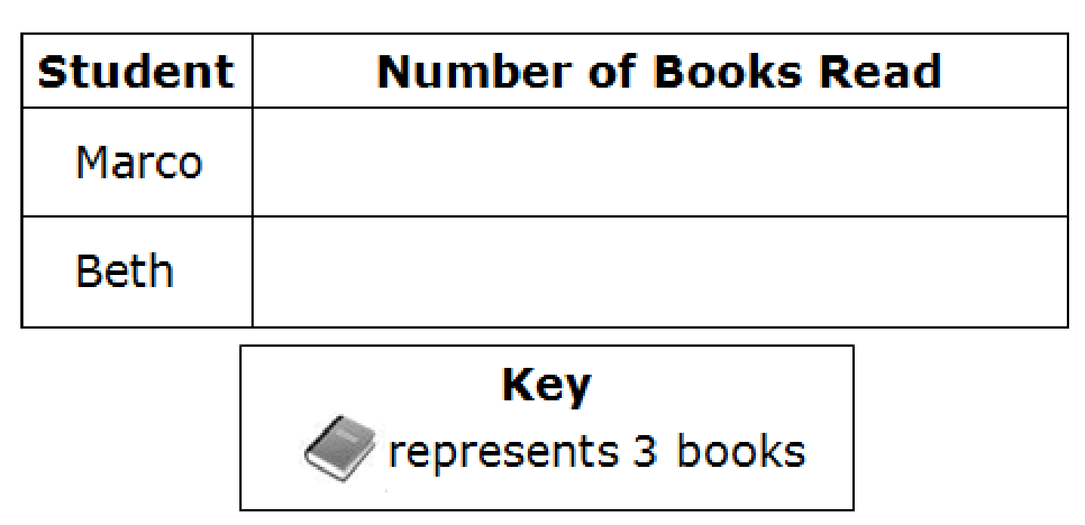
#1
Marco and Beth each read the number of books shown.
Click in each row to create a picture graph that shows the number of books each student reads.
Student | Number of Books Read
Marco | 12
Beth | 21

Slide 3

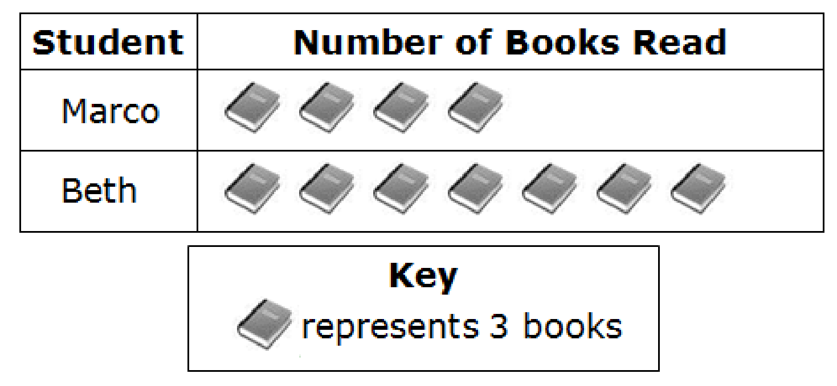
#1 Answer
Rubric:
(1 point) The student creates a picture or a bar graph to show the correct number for each category of data.
Answer:
Notes:
‹#›

Slide 4
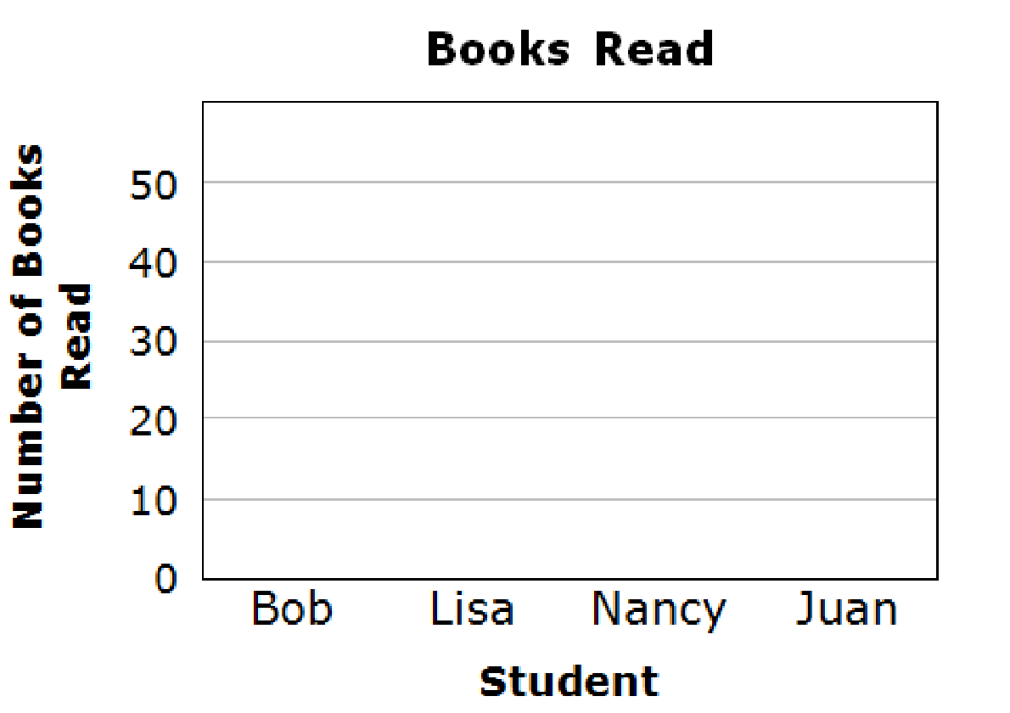
#2
Four students read the number of books shown.
Click in each column to create a bar graph that shows the number of books that each student reads.
Student | Number of Books Read
Bob | 15
Lisa | 50
Nancy | 25
Juan | 40
Notes:
‹#›

Slide 5
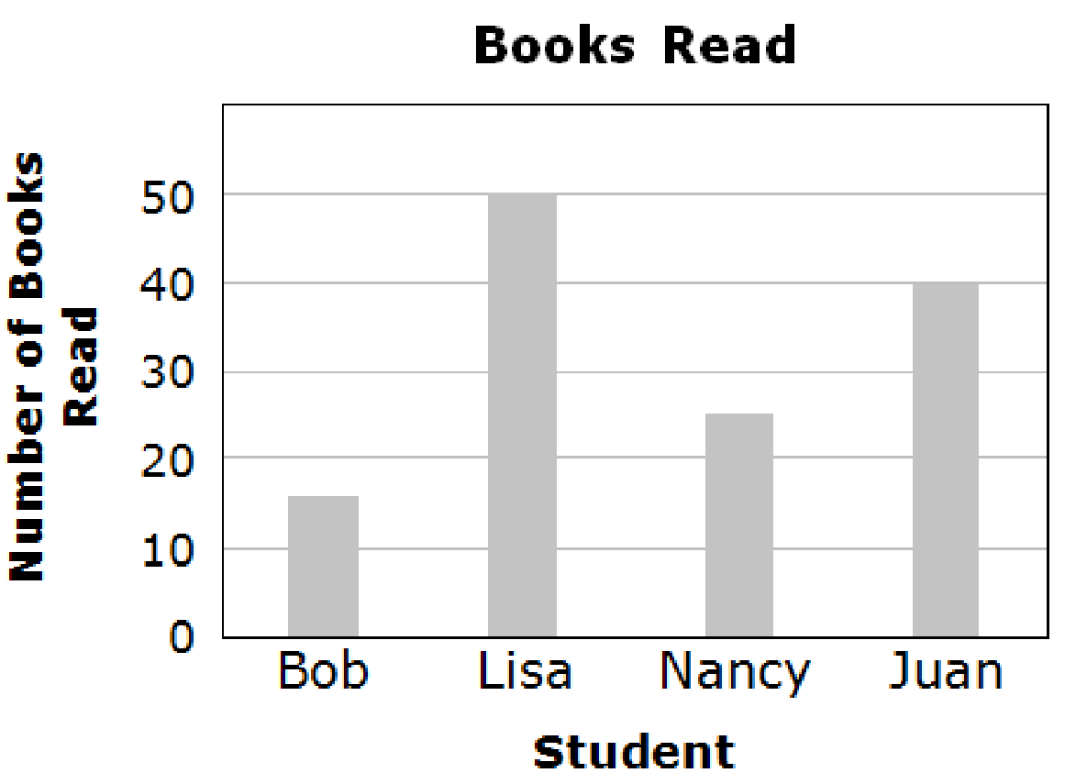
#2 Answer
Rubric:
(2 points) The student creates a picture or a bar graph to show the correct number for each category of data.
(1 point) The student creates a picture or bar graph to show the correct number for two out of three categories or three out of four categories and the incorrect symbol(s) is within one scaled interval of the graph. In other words, the student made an error in the level of precision, not in understanding.
Answer:
Notes:
‹#›

Slide 6
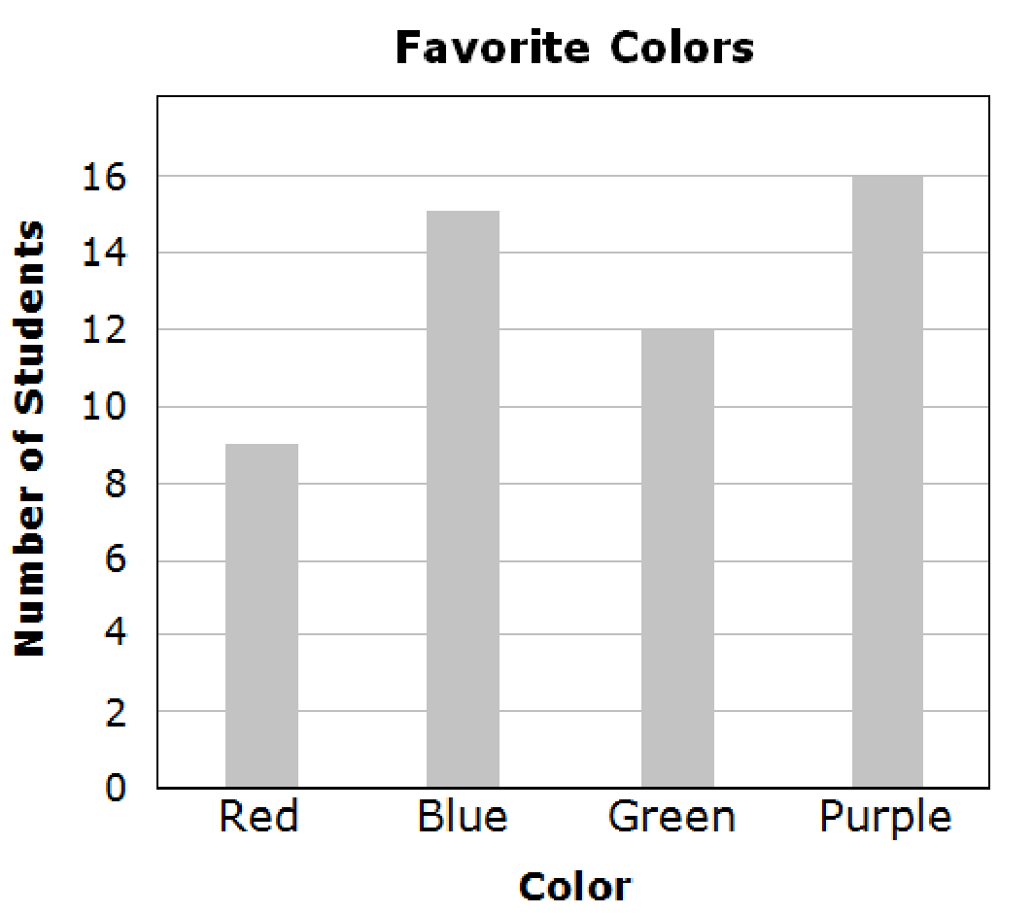
#3
Students vote for their favorite colors. Use the bar graph to answer the question.
How many more students voted for purple than red?

Slide 7
#3 Answer
Rubric:
(1 point) Student enters correct answer for the graph.
Answer: 7

Slide 8
#4
Example 1: Students vote for their favorite colors. Use the bar graph to answer the question. How many fewer students voted for red than purple?
Example 2: Students vote for their favorite colors. Use the bar graph to answer the question. How many more students voted for purple and blue than green?
Example 3: Students vote for their favorite colors. Use the bar graph to answer the question. How many fewer students voted for red than purple and blue?

Slide 9
#4 Answer
Rubric:
(1 point each) Student enters correct answer for the graph.
Answers:
Example 1: 7
Example 2: 19
Example 3: 22

Slide 10
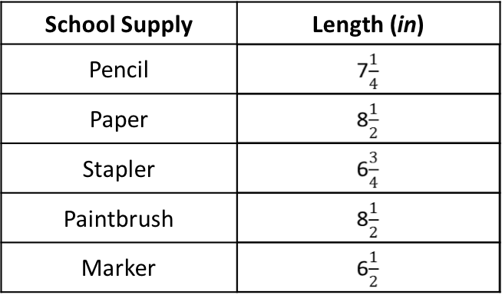
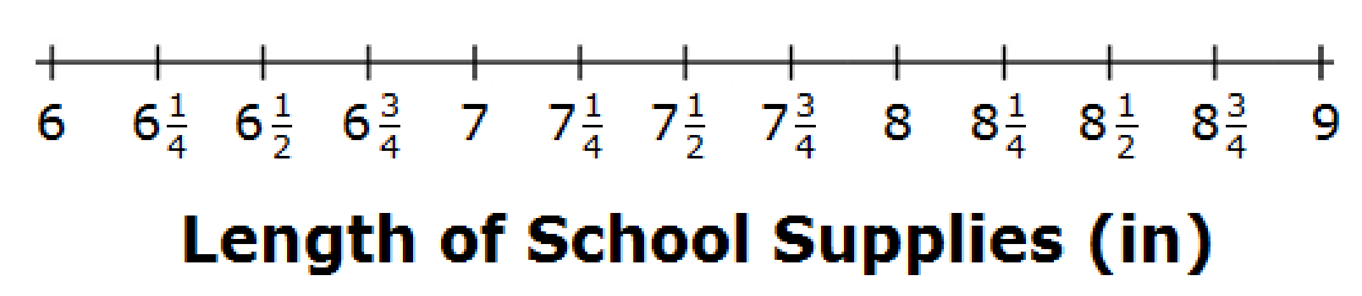
#5
A boy measures the length of some items in his desk. This chart shows the length, in inches, of each item.
Click above a tick mark to complete the line plot that displays the data.

Slide 11
#5 Answer
Rubric:
(1 point) The student correctly marks all 5 points to create the line plot.

