Slide 1

Claim 1
Smarter Balanced Sample Items
Grade 3 - Target F
Develop understanding of fractions as numbers.
Questions courtesy of the Smarter Balanced Assessment Consortium Item Specifications – Version 3.0
Slideshow organized by SMc Curriculum – www.ccssmathactivities.com
Notes:
‹#›

Slide 2

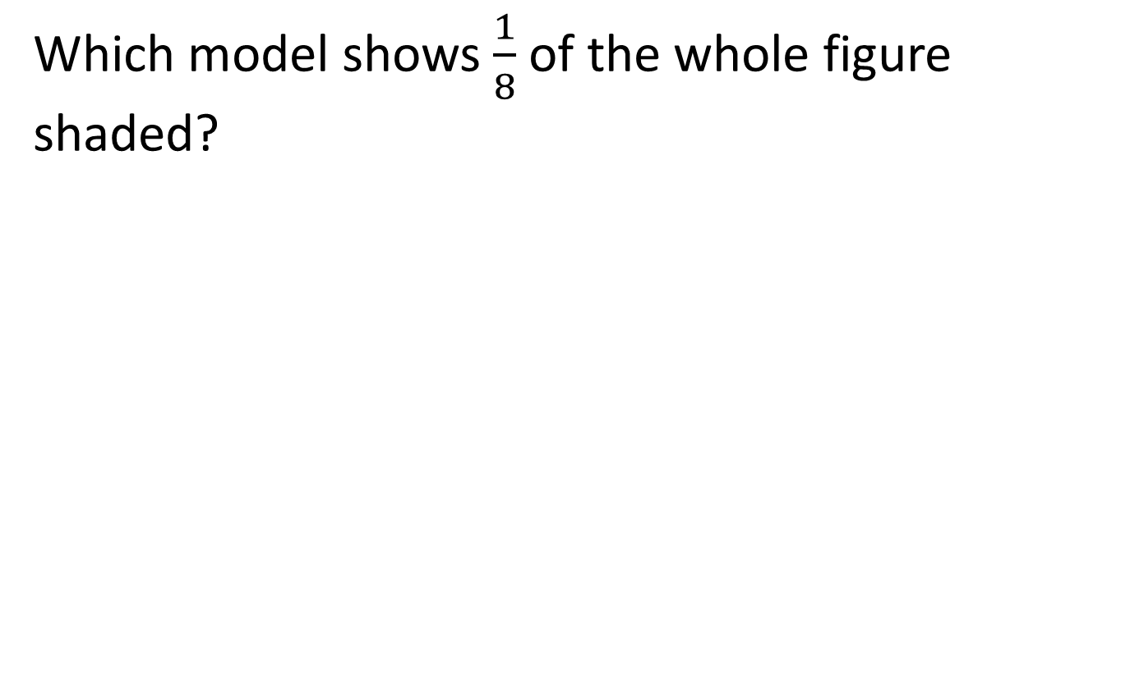

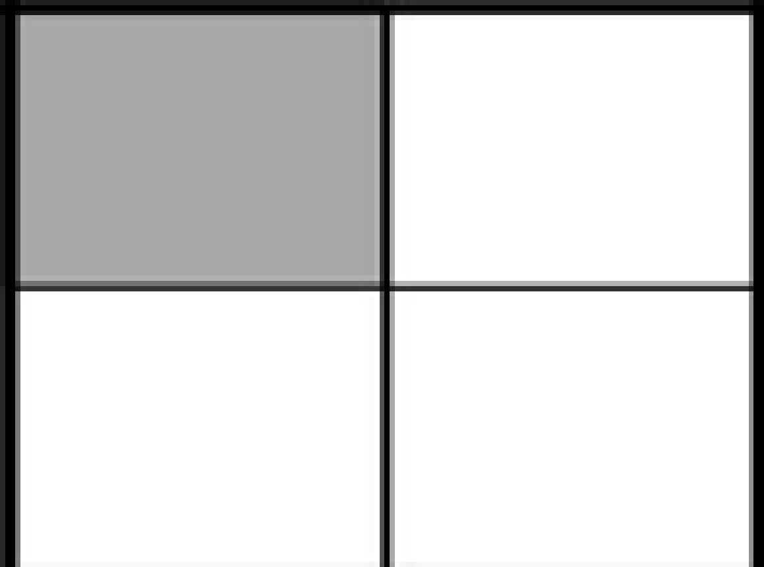


#1

Slide 3

#1 Answer
Rubric:
(1 point) The student selects the correct model.
Answer: A
Notes:
‹#›

Slide 4
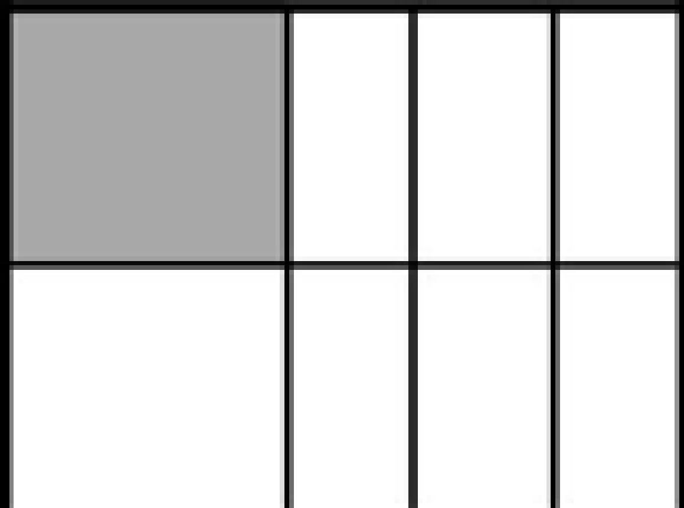
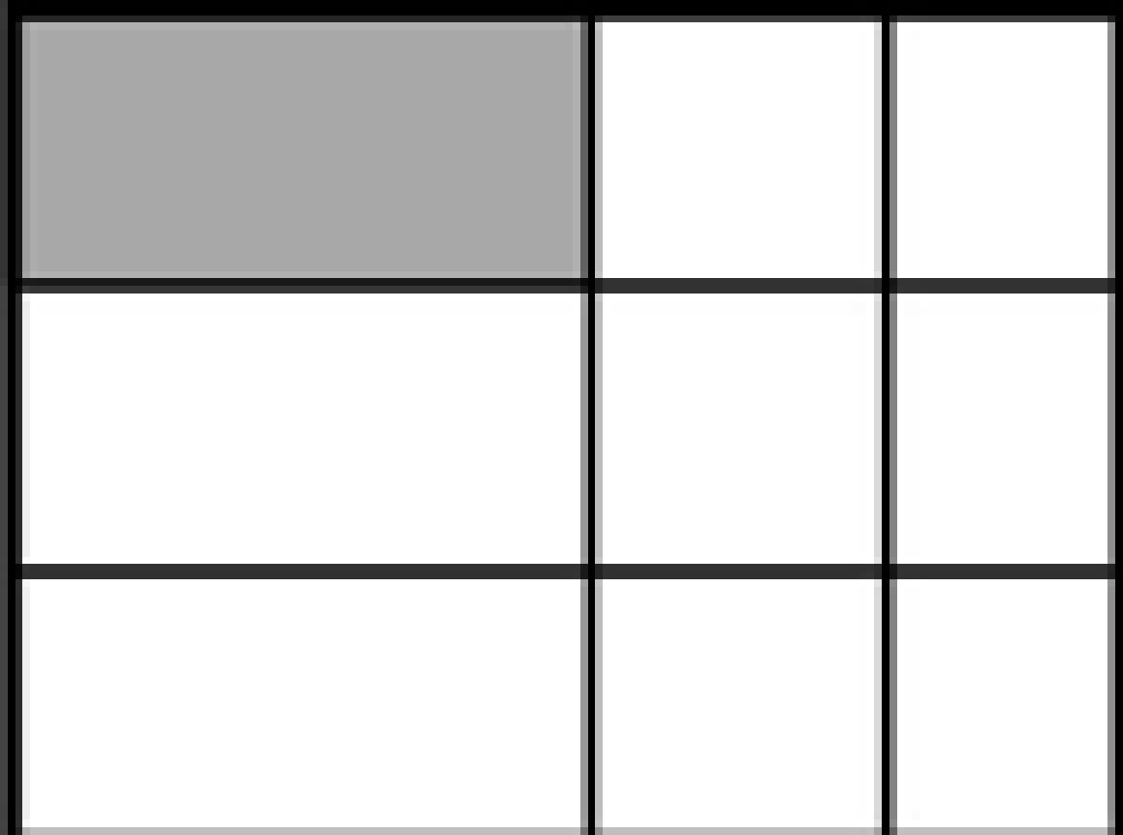
#2
Notes:
‹#›

Slide 5
#2 Answer
Rubric:
(1 point) The student selects the correct model.
Answer: B
Notes:
‹#›

Slide 6
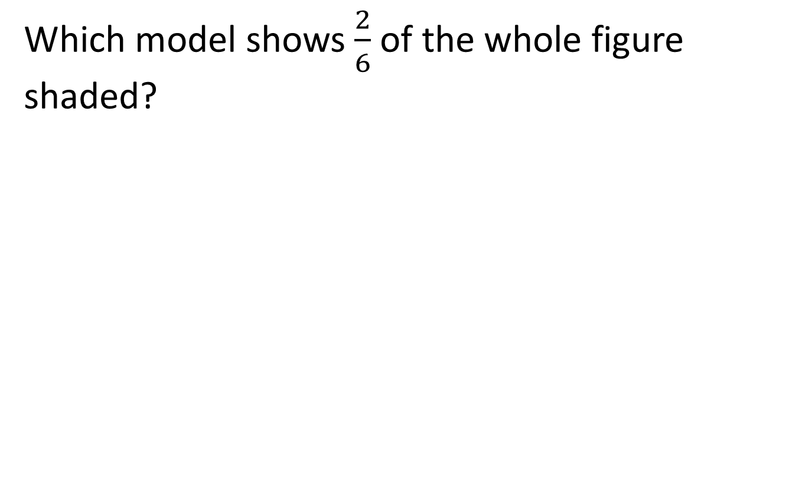

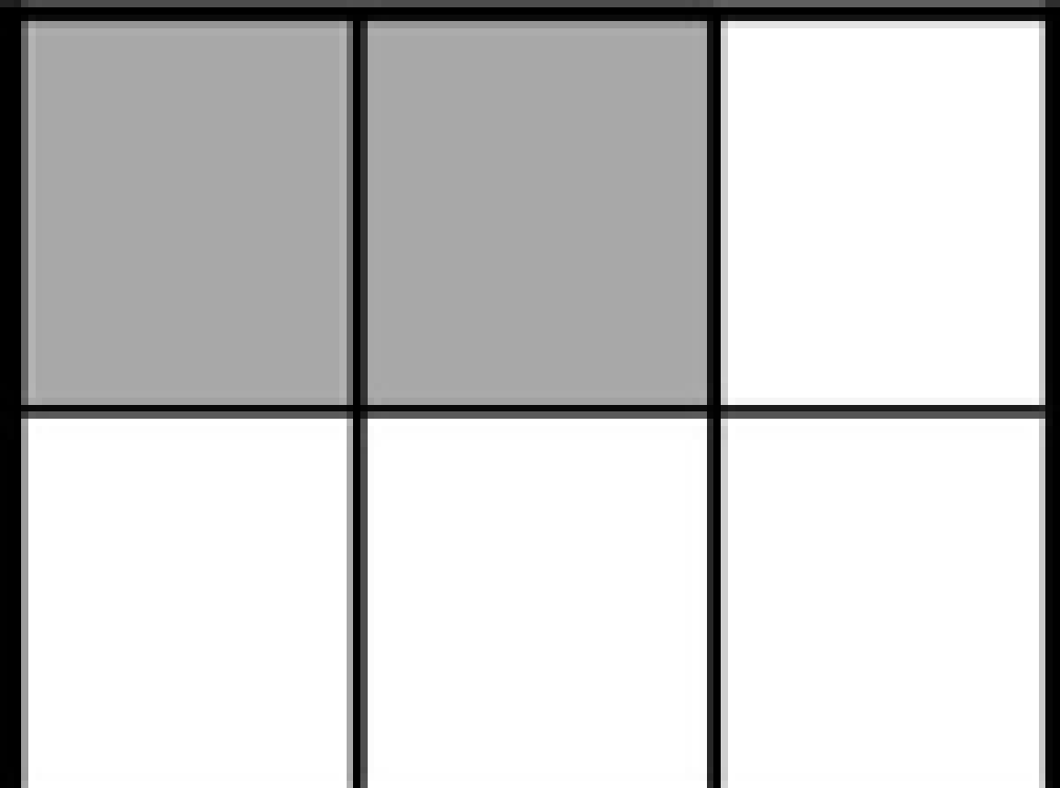
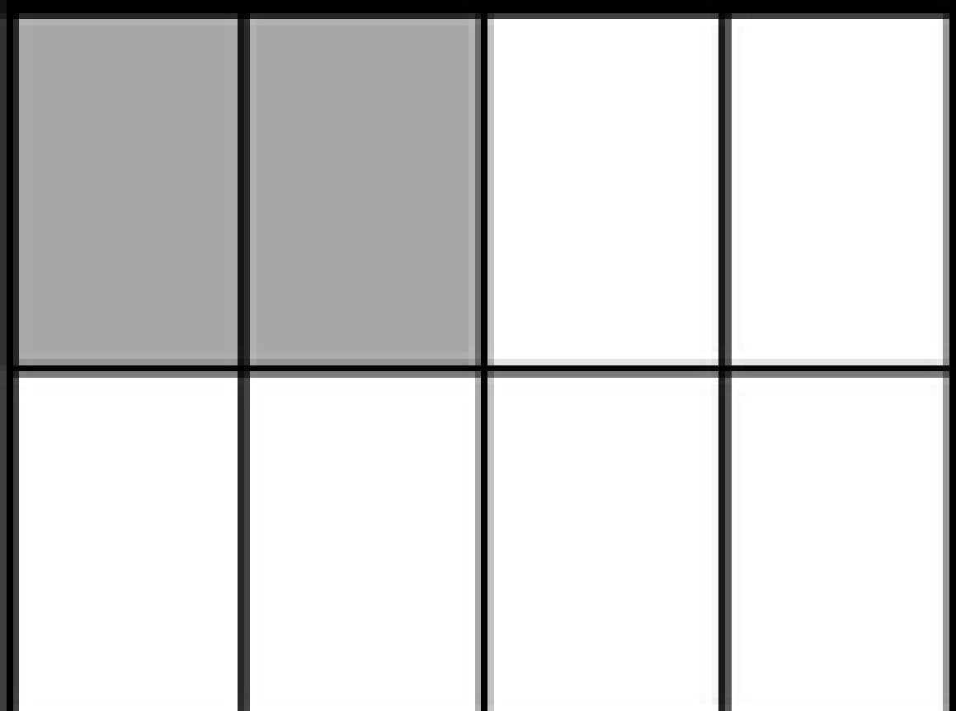

#3

Slide 7
#3 Answer
Rubric:
(1 point) The student selects the correct model.
Answer: B

Slide 8
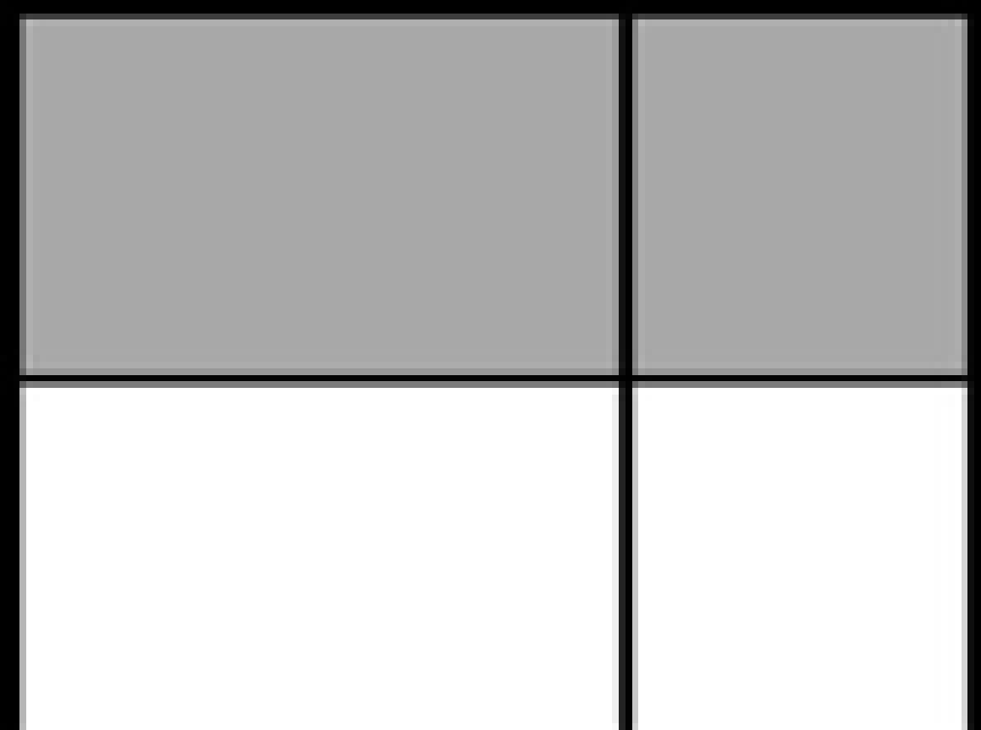
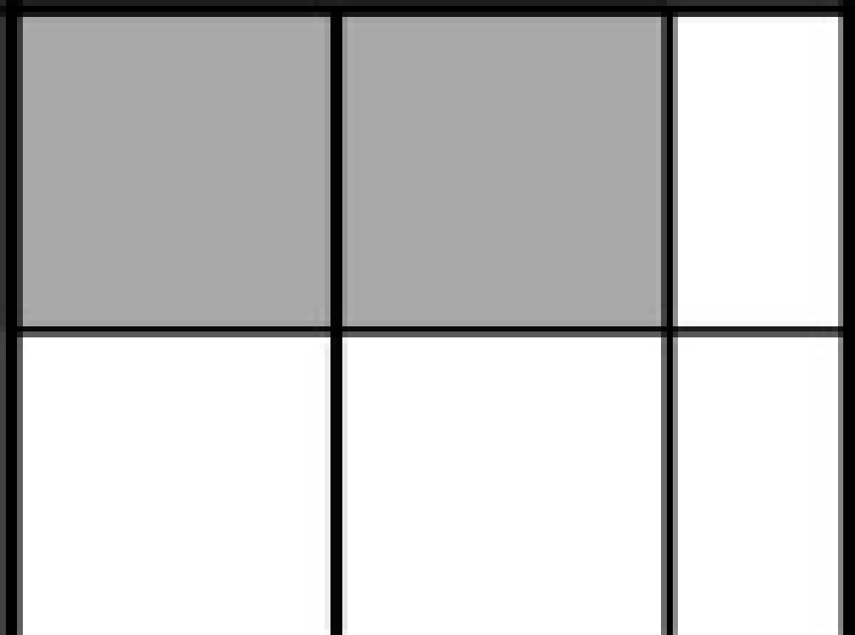
#4
Notes:
‹#›

Slide 9
#4 Answer
Rubric:
(1 point) The student selects the correct model.
Answer: C
Notes:
‹#›

Slide 10
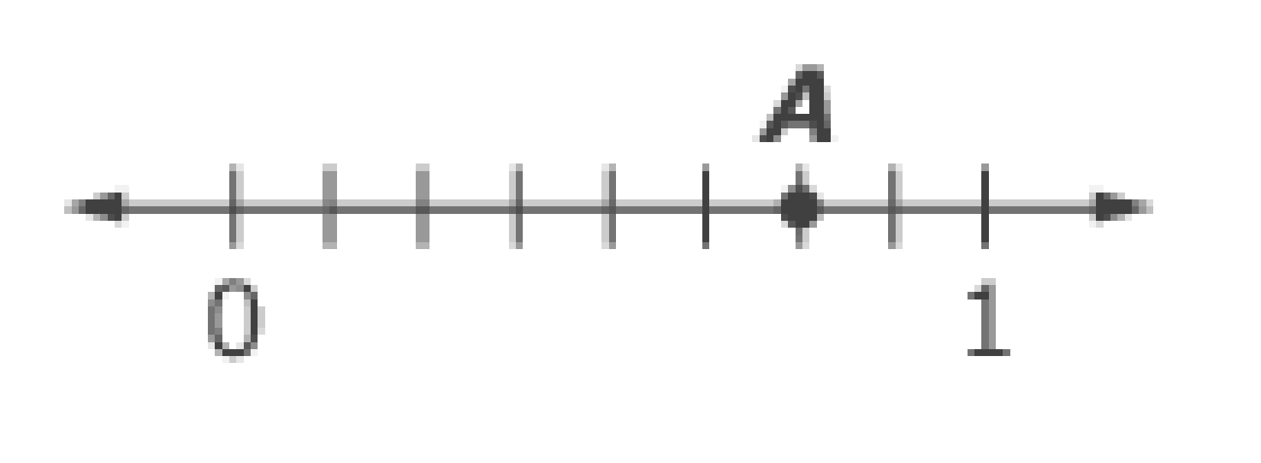
#5
Enter the fraction located at point A on the number line.

Slide 11
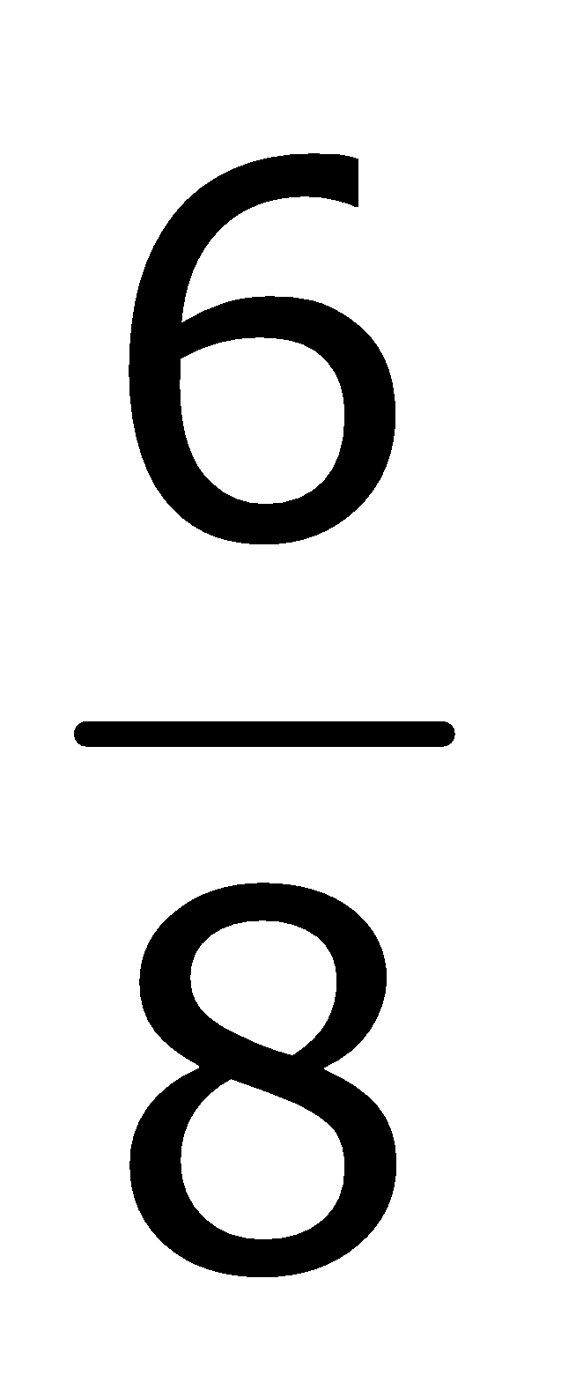
#5 Answer
Rubric:
(1 point) The student enters the fraction that is located at the point on the number line.
Answer:

Slide 12

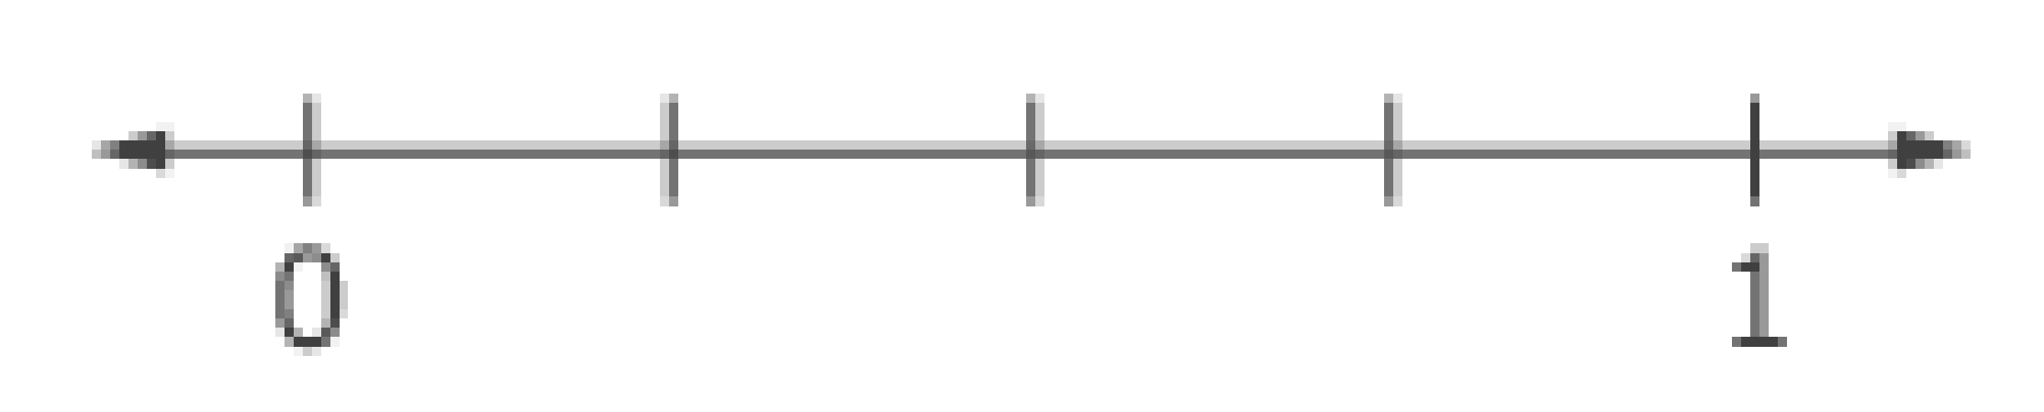
#6
Use the Add Point tool to place a point on the
number line where should be located.

Slide 13

#6 Answer
Rubric:
(1 point) The student places a point at the correct location on the number line.
Answer: is placed halfway between 0 and 1.

Slide 14
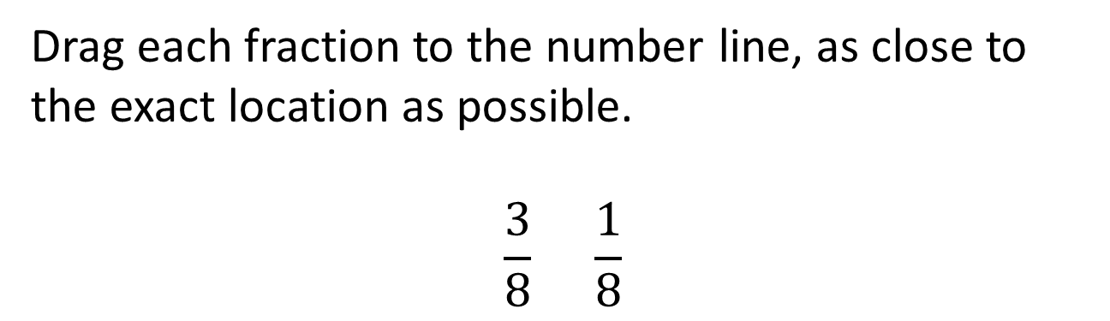
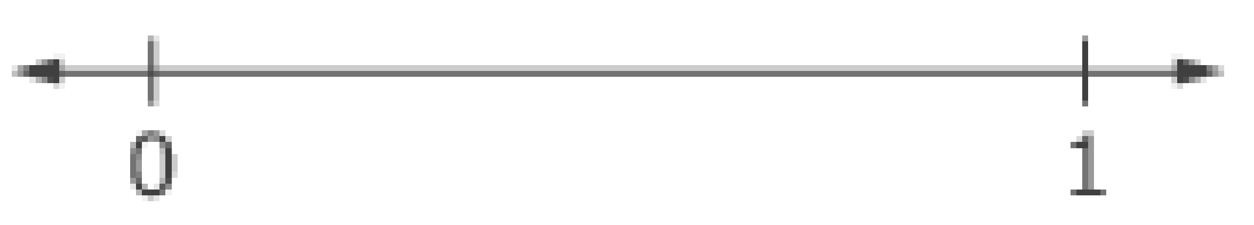
#7

Slide 15
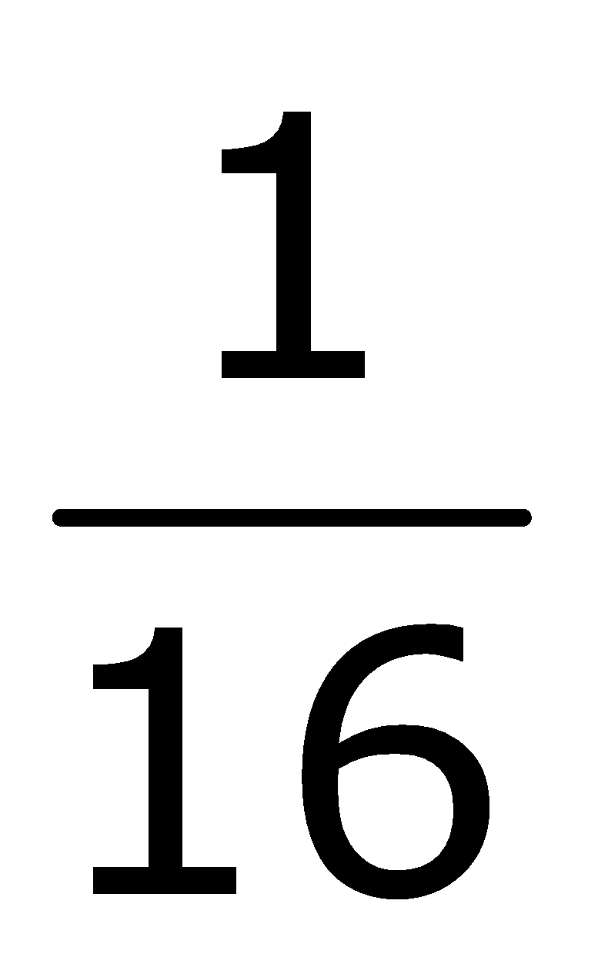


#7 Answer
Rubric:
(2 points) The student places both fractions at the correct location on the number line.
(1 point) The student places one fraction within the interval of tolerance for its correct location AND places the other fraction on the correct side (less than or greater than) of the correctly placed fraction.
A tolerance of ± half of the unit fraction is acceptable for scoring (± because is the unit).
Answer:
and are placed at their approximate location

Slide 16

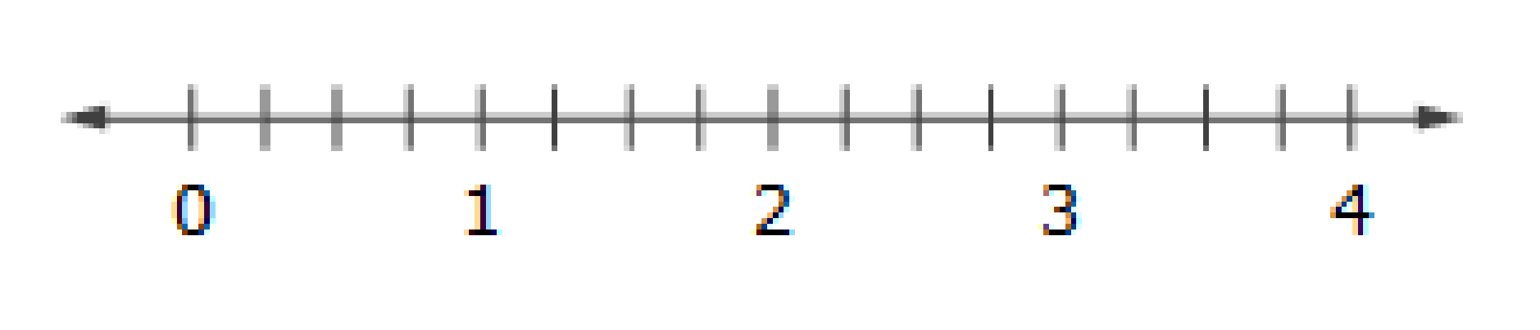
#8
Place each fraction on the number line, as close to its exact location as possible.

Slide 17



#8 Answer
Rubric:
(2 points) The student places all fractions at the correct location on the number line.
(1 point) The student places three out of four fractions at the correct location, within the interval of tolerance AND places the other fraction on the correct side (less than or greater than) of the correctly placed fractions.
A tolerance of ± half of the unit fraction is acceptable for scoring.
Answer:
, , and are placed at their approximate location

Slide 18
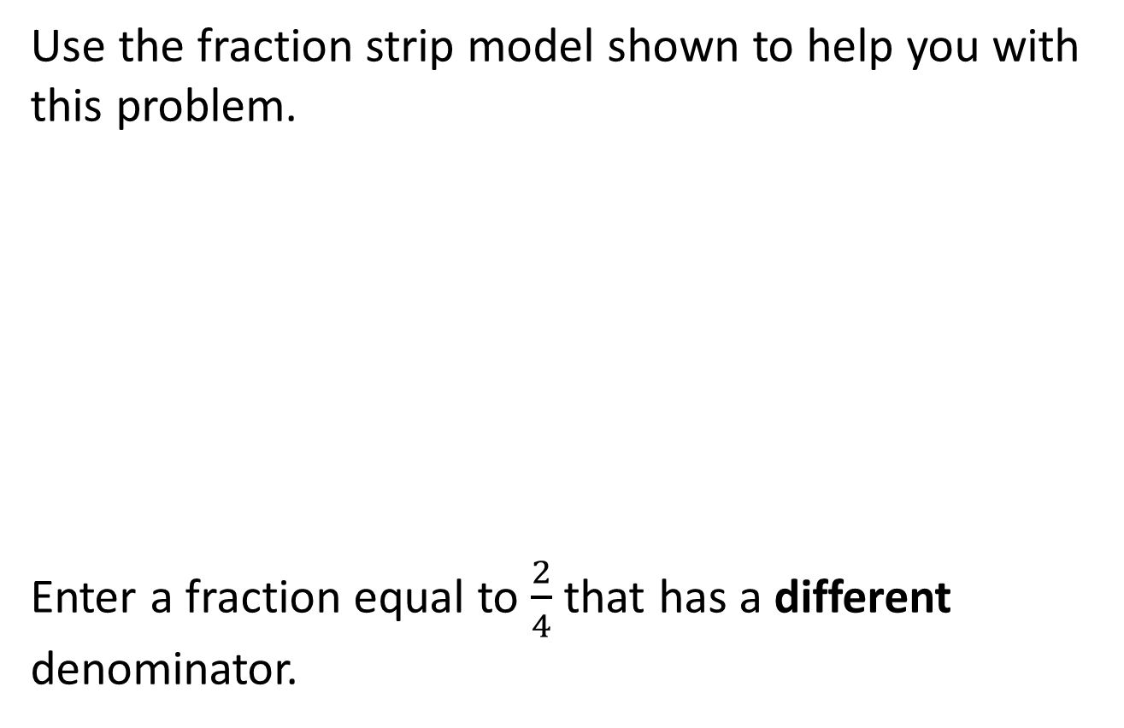
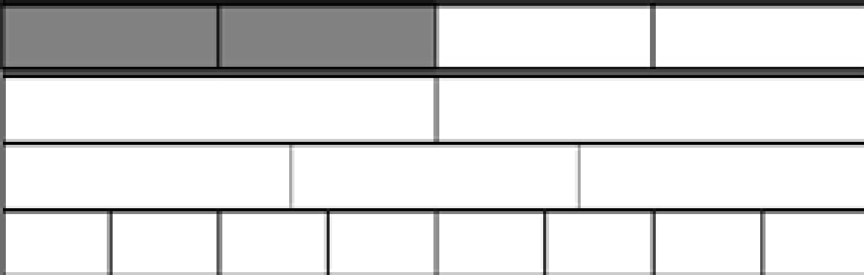
#9

Slide 19


#9 Answer
Rubric:
(1 point) The student enters an equivalent fraction.
Answer: or

Slide 20
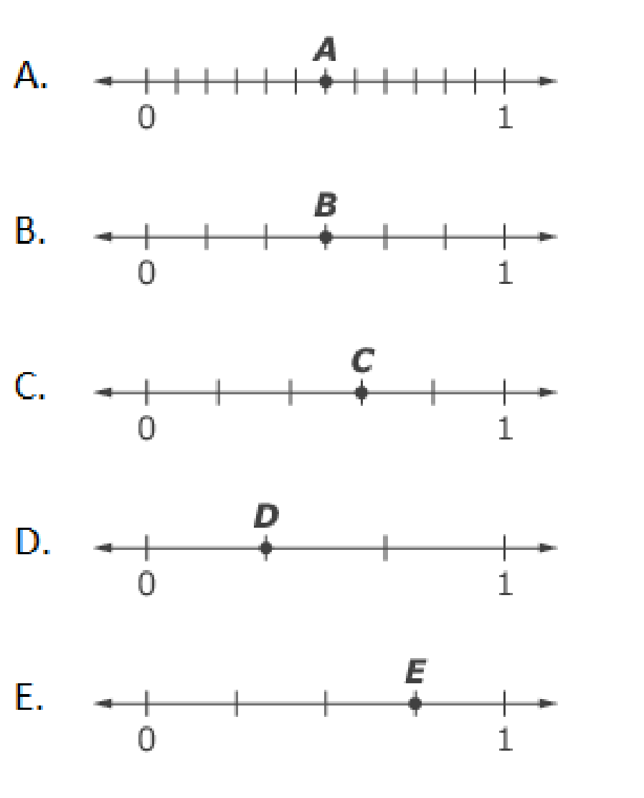
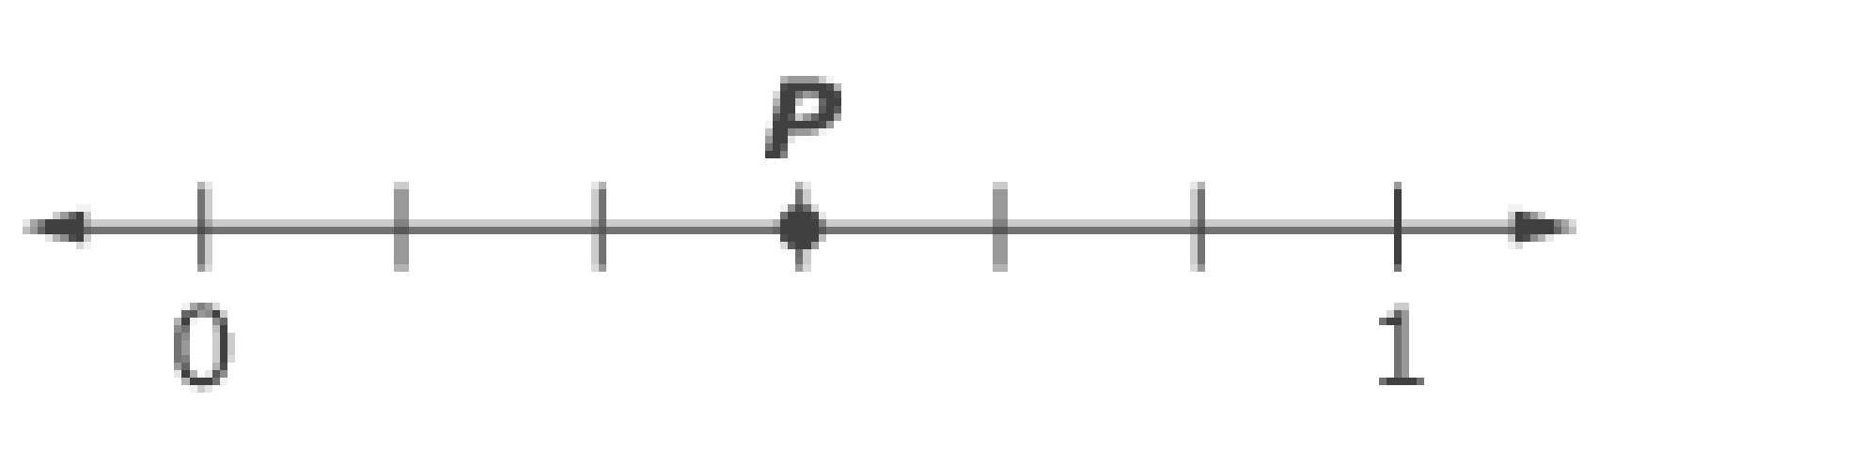
#10
Use this number line to answer the question that follows.
Choose all the number lines that show a fraction equal to the fraction shown by point P.

Slide 21


#10 Answer
Rubric:
(1 point) The student selects all number lines that show .
Answer: A, B

Slide 22
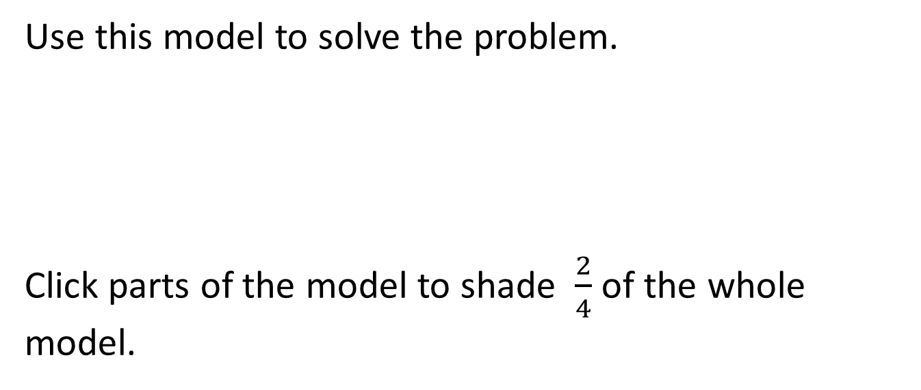
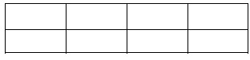
#11

Slide 23
#11 Answer
Rubric:
(1 point) The student creates a fraction model equal to the given fraction.
Answer:

Slide 24
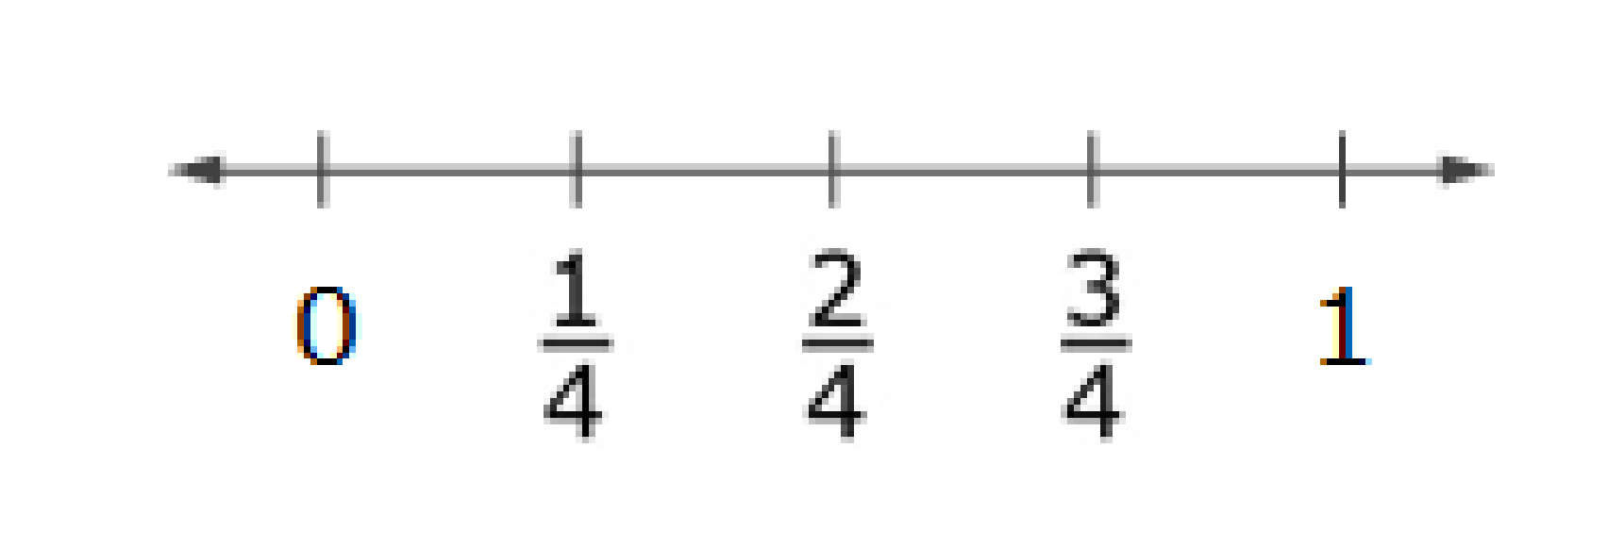

#12
Use the number line to help you complete the equation.
What numerator makes the equation true?

Slide 25
#12 Answer
Rubric:
(1 point) The student enters the correct value.
Answer: 4

Slide 26
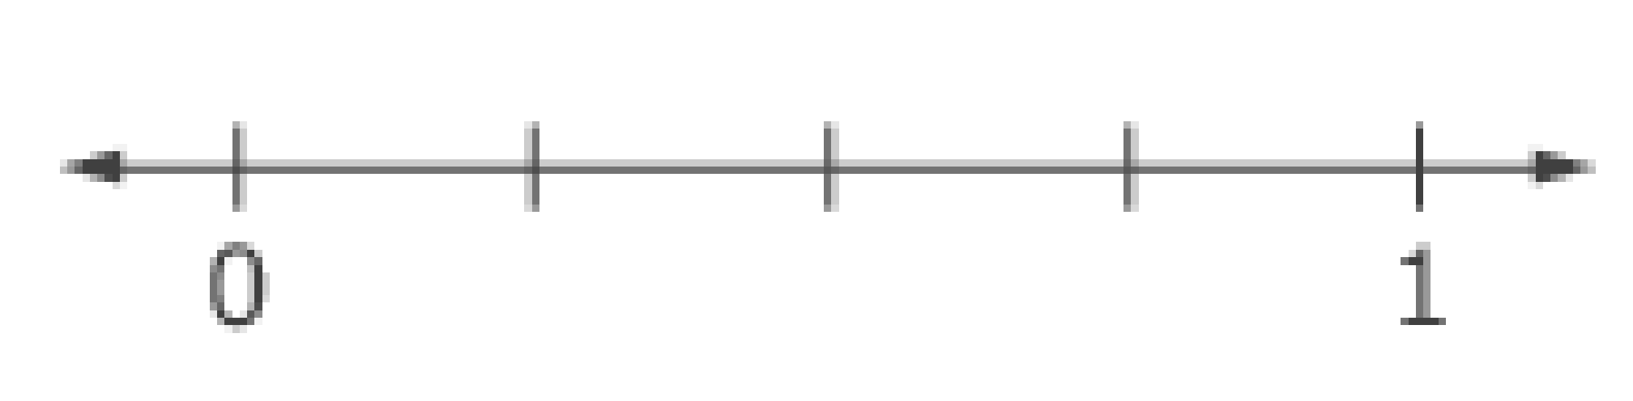
#13
Use the number line to help you complete the equation.
What numerator makes the equation true?

Slide 27
#13 Answer
Rubric:
(1 point) The student enters the correct value.
Answer: 4

Slide 28
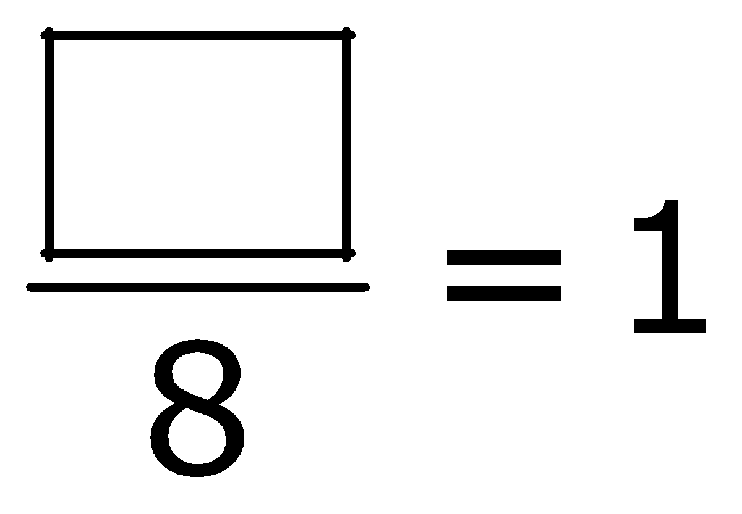
#14
The fraction model shows of the whole figure shaded.
Enter a numerator in the box to make the equation true.

Slide 29
#14 Answer
Rubric:
(1 point) The student enters the correct value.
Answer: 8

Slide 30


#15
Example 1: What denominator goes in the box to make the equation true?
Example 2: What numerator goes in the box to make the equation true?

Slide 31
#15 Answer
Rubric:
(1 point) The student enters the correct value.
Answers:
Example 1: 1
Example 2: 2

Slide 32


#16
Example 1: What numerator goes in the box to make the equation true?
Example 2: What denominator goes in the box to make the equation true?

Slide 33
#16 Answer
Rubric:
(1 point) The student enters the correct value.
Answers:
Example 1: 2
Example 2: 2

Slide 34
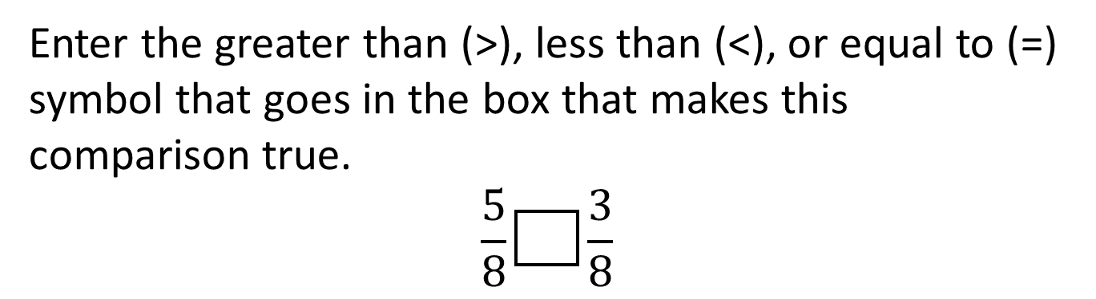
#17

Slide 35
#17 Answer
Rubric:
(1 point) The student enters the correct symbol.
Answer: 

Slide 36
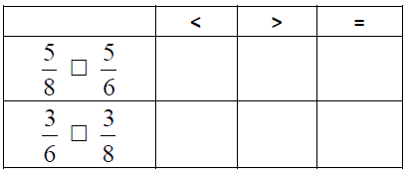
#18
Select the symbol (<, >, or = ) that correctly compares each pair of numbers.

Slide 37
#18 Answer
Rubric:
(1 point) The student identifies the correct symbol to compare pairs of fractions.
Answer: <; >

Slide 38
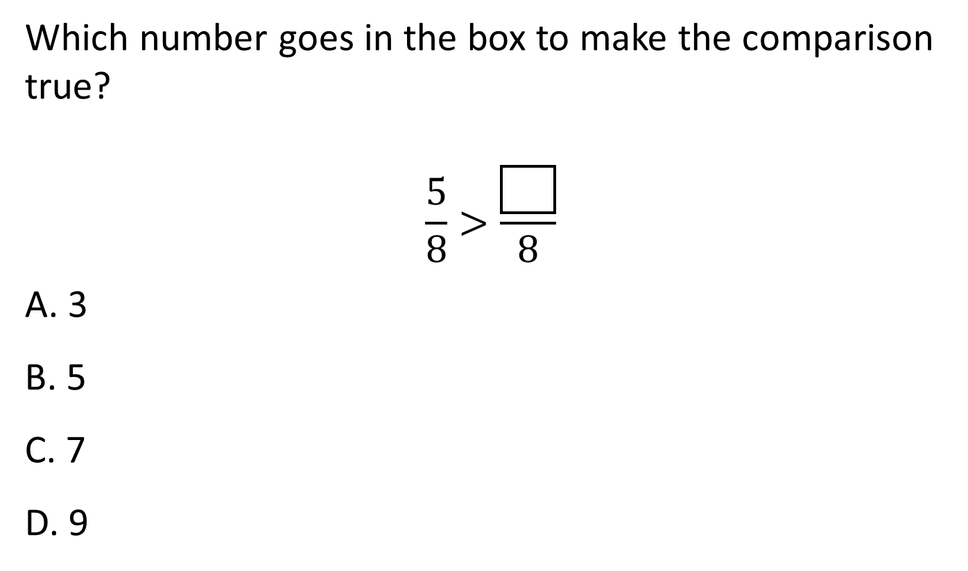
#19
Notes:
‹#›

Slide 39
#19 Answer
Rubric:
(1 point) The student selects the correct number.
Answer: A
Notes:
‹#›

Slide 40
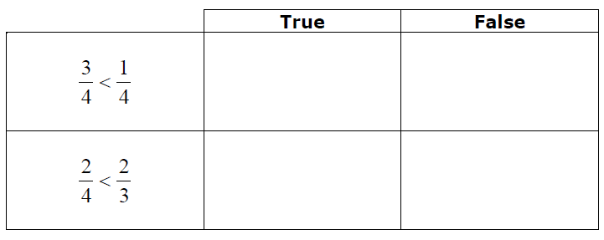
#20
Decide whether each comparison is true or false. Click True or False for each comparison.
Notes:
‹#›

Slide 41
#20 Answer
Rubric:
(1 point) The student answers correctly identifying each as True or False.
Answers: F; T
Notes:
‹#›

